Slide 1
Education for Life
Away Day
School of Maths, Stats and Physics
12/4/2018
Wifi: Exhibitors
Password: Expo2017

Slide 2
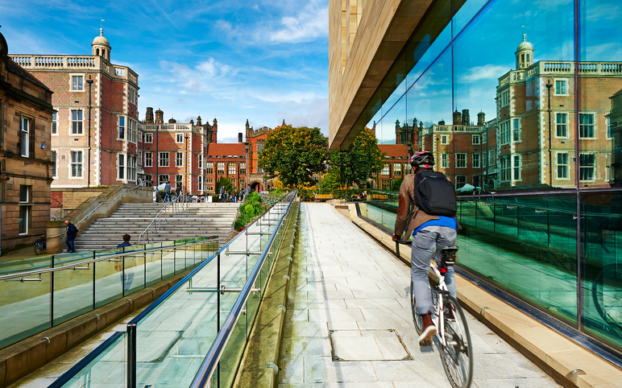

Slide 3
Agenda
11.00-11.10: Welcome and introductions
11.10-12.00: UG Strategy and Implementation Plan
12.00-13.00: Lunch (Staff Survey)
13.00-13.45: Review of Curriculum
13.45-14.30: E-Learning Developments
14.30-14.45: Break
14.45-15.30 PG Strategy and Implementation Plan
15.30: Close

Slide 4
Updates
School Learning and Teaching Review
  Maths, Stats and Physics (Semester 2)
  Suggestions for external panel members (Maths and Physics)
DELT funds for education activities (including outreach, recruitment)
  Small amounts available (up to £500 and must be spent by the end of the academic year)
  Suitable activities might include events, seminars, etc
  Please send suggestions to me by c/b 30th April

Slide 5

UG/PG strategies (wider context)
New University Vision and Strategy
Faculty Restructure
Formation of School of Maths, Stats and Physics
HE Landscape
  Office for Students
  Tuition Fee Review
  TEF (institutional and subject)
  Graduate Outcomes (replacing DLHE)

Slide 6

School Strategy
School Strategy
Research
Education
Engagement
Equality and Diversity
UG
Physics
Research
PG

Slide 7
UG Education for Life Strategy
Draft sent out with today’s agenda
Unpack some of the ideas
Opportunity for discussion and feedback
Gather initial thoughts on an implementation plan

Slide 8
Summary
Outreach and Recruitment
Degree Programmes
Service Teaching
Student Experience
Accreditation
Careers and Employability

Slide 9
Context (student population)
Programme | Physics | Single Honours | Major-Minor | Joint Honours | Total
Total | 49 | 179 | 22 | 31 | 281
Female | 23% (11) | 31% (55) | 32% (7) | 46% (14) | 31% (87)
WP (inc Partners) | 18% (9) | 23% (41) | 5% (1) | 19% (6) | 23% (66)
Maths A-level (A/A*) | 51% (25) | 84% (151) | 64% (14) | 84% (26) | 77% (216)
8 students are classed as international

Slide 10
Context (service teaching)
 | Biomed/ Medicine | Business | Computing | Engineering | Natural and Environmental Sciences
Total number of students on service modules delivered by MSP (2017/18) | 607 | 584 | 52 | 1450 | 408
In total MSP staff are responsible for the teaching of nearly 1000 FTE each year for the Schools of Biomedical Sciences, Business, Computing, Engineering, Natural and Environmental Sciences and Medicine

Slide 11
UG Education for Life Strategy
Vision
A thriving and diverse UG portfolio across mathematics, statistics and physics, providing an outstanding UG experience for all
Strategic Objectives
1. Develop an outreach and recruitment programme that addresses the needs of local, national and international populations
2. Provide a portfolio of degree programmes to enable an overall growth in student numbers, alongside improving entry grades
3. Ensure an inclusive and excellent student experience for all
4. Enhance degree programmes across the Faculty and University through the provision of high quality service teaching
5. Provide all students with the opportunity to develop their skills to enable them to fulfil their potential.

Slide 12
Strategic Objective 1.
Develop an outreach and recruitment programme that addresses the needs of local, national and international populations
Deliver and evaluate a North-East outreach programme aligned with the requirements of all local state-schools and colleges and MSP
Support the Further Maths Centre and develop resources that will enable the delivery of the experimental elements of Physics A-level
Develop a range of online resources aimed at raising the national and international profile of MSP degree programmes. In particular, to address areas not covered by the central University resources
Engage in the delivery of targeted in-country outreach and recruitment activities
Ensure that all UCAS applications are dealt with efficiently and that prospective students are provided with timely and appropriate communications
Provide an outstanding and inclusive experience for prospective students at University Open Days, Post-Application Visit Days and other events

Slide 13
Strategic Objective 2.
Provide a portfolio of degree programmes to enable an overall growth in student numbers, alongside improving entry grades
Regularly review our portfolio of degree programmes and entry requirements to ensure they remain competitive
Investigate the potential to develop new joint and combined honours programmes that would increase the number of applications received by the school
Ensure that all degree programmes, where appropriate, are accredited by an appropriate professional body

Slide 14
Strategic Objective 3.
Ensure an inclusive and excellent educational experience for all.
Deliver appropriate transition and induction activities for all stages of MSP degree programmes.
Provide appropriate and dedicated pastoral support for all students.
Ensure that students have timely and appropriate access to degree programme documentation.
Deliver a relevant and challenging curriculum.
Provide all students with a range of assessment and feedback opportunities to enable them to reach their full potential.
Where possible, encourage the use of technology-enhanced-learning in all aspects of the curriculum.
Ensure that the student voice is heard and responded to appropriately.

Slide 15
Strategic Objective 4.
Enhance degree programmes across the Faculty and University through the provision of high quality service teaching
Ensure that module leaders assigned to service courses have an understanding of the practical applications of mathematics, statistics and physics relevant to the programme being taught
Develop engaging and relevant teaching materials incorporating the use of technology-enhanced-learning
Contribute, where appropriate, to the governance of the degree programmes being taught

Slide 16
Strategic Objective 5.
Provide all students with the opportunity to develop their skills to enable them to fulfil their potential.
Provide relevant, timely, and, where appropriate, embedded employability and enterprise advice for all students in MSP.
Engage with employers to provide summer placements, internships and year-long placements.
Work with the University Careers Service to ensure that opportunities beyond the subject specific ones delivered by MSP are visible to all students.
Encourage our alumni to engage with the school, through careers events, profiles and other activities delivered by MSP.

Slide 17
Table activity
Question: does the UG strategy cover everything it should? Is there anything missing? Should anything be removed?
Question: What should be the key priorities for the next 12-18 months?
Feel free to discuss any aspects but I’d be particularly interested in:
how to build our outreach programme
ideas of how to increase overseas UG recruitment
potential joint/with degree programmes to investigate
ideas for engaging students on service modules
ways in which we can develop students transferrable skills outside of the curriculum
how we engage more fully with our alumni
Feedback in 15-20 minutes

Slide 18
Agenda
11.00-11.10: Welcome and introductions
11.10-12.00: UG Strategy and Implementation Plan
12.00-13.00: Lunch (Staff Survey)
13.00-13.45: Review of Curriculum
13.45-14.30: E-Learning Developments
14.30-14.45: Break
14.45-15.30 PG Strategy and Implementation Plan
15.30: Close

Slide 19

Staff Survey
The Athena SWAN self-assessment team (SAT) are launching a staff survey to gauge the culture in the School, particularly for women
In addition to the more targeted questions, we would like to invite staff in the School to help design the survey by suggesting topics or potential issues that should be included

Slide 20
Staff Survey
Process (today):
Please complete two suggestion cards anonymously and submit into the suggestion boxes available.
The idea is to have some discussion with colleagues over this topic during the breaks and to submit the suggestions by the end of the day.
The ideas submitted to the suggestion boxes will be used to design the new survey (framing issues into appropriate questions) by members of the SAT team.
The survey will be opened end April/early May and the results shared at the next all staff meeting in July.

Slide 21
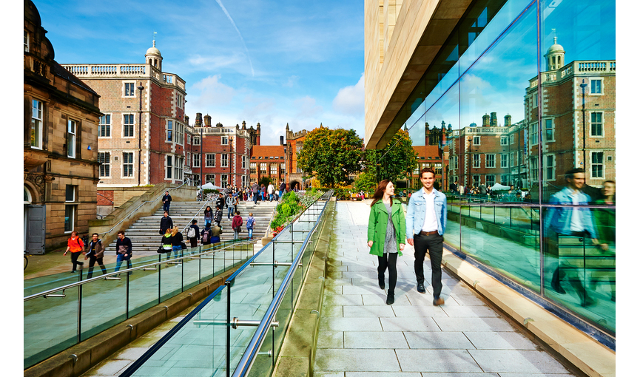

Slide 23
Agenda
11.00-11.10: Welcome and introductions
11.10-12.00: UG Strategy and Implementation Plan
12.00-13.00: Lunch (Staff Survey)
13.00-13.45: Review of Curriculum
13.45-14.30: E-Learning Developments
14.30-14.45: Break
14.45-15.30 PG Strategy and Implementation Plan
15.30: Close

Slide 24
Review of Curriculum
Physics: first cohort of third year students
Maths and Stats: first cohort of third students (following the curriculum review)
Service Teaching: new and existing modules
SO3. Ensure an inclusive and excellent educational experience for all
Deliver appropriate transition and induction activities for all stages of MSP degree programmes.
Provide appropriate and dedicated pastoral support for all students.
Ensure that students have timely and appropriate access to degree programme documentation.
Deliver a relevant and challenging curriculum.
Provide all students with a range of assessment and feedback opportunities to enable them to reach their full potential.
Where possible, encourage the use of technology-enhanced-learning in all aspects of the curriculum.
Ensure that the student voice is heard and responded to appropriately.

Slide 25
Aim of this session
Not a curriculum review!
Identify a number of pressing issues that SSC, MLTSEC, PLTSEC and BoS can investigate and potentially implement solutions for over the next 9-12 months
If I were to be asked to do this exercise, I would start with:
  computing
  problem solving
  exam marking load

Slide 26
Table activity
Part 1 (individually, 5 minutes)
- what aspects of how we teach, assess or support our students need a fresh look?
Part 2 (as a table, 20 minutes)
- discuss and produce a ‘top 3 list’ and some potential solutions
Part 3 (feedback to all, 10 minutes)
- identify common issues to take forward

Slide 27
Agenda
11.00-11.10: Welcome and introductions
11.10-12.00: UG Strategy and Implementation Plan
12.00-13.00: Lunch (Staff Survey)
13.00-13.45: Review of Curriculum
13.45-14.30: E-Learning Developments
14.30-14.45: Break
14.45-15.30 PG Strategy and Implementation Plan
15.30: Close

Slide 30
Agenda
11.00-11.10: Welcome and introductions
11.10-12.00: UG Strategy and Implementation Plan
12.00-13.00: Lunch (Staff Survey)
13.00-13.45: Review of Curriculum
13.45-14.30: E-Learning Developments
14.30-14.45: Break
14.45-15.30 PG Strategy and Implementation Plan
15.30: Close

Slide 33
Agenda
11.00-11.10: Welcome and introductions
11.10-12.00: UG Strategy and Implementation Plan
12.00-13.00: Lunch (Staff Survey)
13.00-13.45: Review of Curriculum
13.45-14.30: E-Learning Developments
14.30-14.45: Break
14.45-15.30 PG Strategy and Implementation Plan
15.30: Close

Slide 34
PG Strategy
Draft sent out with today’s agenda
Unpack some of the ideas
Opportunity for discussion and feedback
Gather initial thoughts on an implementation plan

Slide 35
Current Position
We offer PhD programmes in Mathematics, Statistics and Physics
Current cohort:
  65 PhD students, 3 MPhil students
  25% female, 25% non-EU
From AY1819 we will:
  run an MRes in Physics
  contribute to MSc in Data Science (led by Computing)

Slide 36
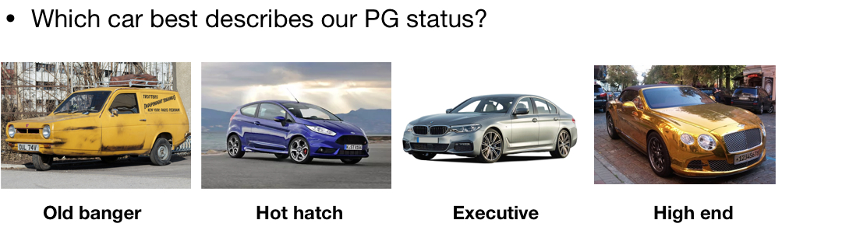
Poll

Slide 37
Poll

Slide 38
PG Strategy
Vision
A thriving and diverse PG portfolio across mathematics, statistics and physics, providing an outstanding PG experience for all
Strategic Objectives
Grow PGR numbers across all disciplines, while maintaining high standards
Develop and contribute to a portfolio of Masters programmes
Continue to provide an outstanding PG research training and environment
Continue to promote a supportive and inclusive community with extra-curricular opportunities
Develop targeted recruitment to national and international markets

Slide 39
Strategic Objective 1.
Grow PGR numbers across all disciplines, while maintaining high standards
Context:
Supervisors want more (good) students and PGR numbers are important for REF.
PGR numbers have grown from 7 in 13/14 to 18 in 17/18.
We rank 22/24 in the Russell Group for number of PGRs per T&R FTE.
The growth of physics requires rapid growth in PGRs.
We will:
Leverage strategic support for the growth of physics PGRs.
Continue to invest school studentships for strategic cases, e.g. new staff, large grants.
Consider offering flexible partial school studentships.
Consider offering scholarships for self-funders, particularly focussed on E&D
Investigate future CDT/DTP opportunities, including with other schools.
Provide suitable incentives for supervision of international sponsored PGRs.
Maintain high standards of admissions and annual progression.

Slide 40
Strategic Objective 2.
Develop and contribute to a portfolio of Masters programmes
Context:
Introduction of PG loans for home students increases the market for the 3+1 route.
Our 10 closest competitors in REF UoA 10 all offer Masters programmes.
Some of our best undergraduates are already choosing this option.
Potential to attract students from other institutions.
We will:
Consider the introduction of an MRes programme in Mathematical Sciences.
Consider the introduction of broad MSc programmes, based on our MMath/MPhys.
Manage staff resources and risk to our MMath/MPhys programmes through quotas & pricing.
Ensure project supervision is voluntary and receives appropriate credit/incentives.
Investigate opportunities to offer specific MSc courses.
Actively pursue collaboration with Masters programmes across campus.
Direct Masters programmes towards providing high-quality potential PhD students.

Slide 41
Strategic Objective 3.
3. Continue to provide an outstanding PG training and research environment
Context:
We provide an outstanding research experience (PRES survey, focus groups) and a strong research culture.
Grumbles about often irrelevant faculty training, inconsistent school training and insufficient travel funds.
We will:
Review school PGR training to ensure it remains fit-for-purpose within each section and coherent across the school, and incorporates physics training needs.
Continue to provide state-of-the-art facilities and technical support.
Ensure students from atypical backgrounds have the necessary support and training.
Investigate the possibility to offer MRes “research skills” modules as faculty training.
Do more to celebrate and publicise the successes of our PGRs.
Make available additional travel funds for meritable cases.

Slide 42
Strategic Objective 4.
4. Continue to promote a supportive and inclusive community with extra-curricular opportunities
Context:
We are responsible for providing PGRs with pastoral support, a social community, professional development and transferrable skills.
Our PGRs aspire to careers in academia (largest), teaching and industry.
Our PGRs lament the absence of a social space and advanced teaching opportunities.
We will:
Continue to provide strong pastoral care.
Continue to facilitate the PG student voice
Consider incorporating PG social space into our estates plan.
Encourage opportunities for professional development across teaching, outreach and entrepreneurship.
Investigate the possibility to offer advanced teaching opportunities.

Slide 43
Strategic Objective 5.
5. Develop targeted recruitment to national and international markets
PGR recruitment relies on website and academic contacts, plus targeted advertising for specific studentships.
We have 10 externally-funded PGRs without systematic efforts.
Our 25% of female PGRs is well below the national average (38%).
We will:
Improve the external visibility of our PG programmes and PG environment.
Review our package for PGRs to ensure it remains competitive.
Identify our key national and international PG markets, and develop approaches to tap into these markets.
Promote equality and diversity in our PG recruitment.
Continue to advertise studentships early to attract the best candidates.

Slide 44
Table activity
Question: Does the PG strategy cover everything it should? Is there anything missing? Should anything be removed?
Feel free to discuss any aspects but I’d be particularly interested in:
How can we increase our PGR numbers? (Doc. PG1)
Assume MMath/MPhys are dead. What do we offer instead? (Doc. PG2)
How can we improve our school PhD training? (Doc. PG3)
How can we offer our PhD students more teaching?
How can we improve our PG recruitment? (Doc. PG4)
Feedback in 15-20 minutes

