Slide 1
Why choose a Mathematics, Statistics or Physics degree?
School of Mathematics, Statistics & Physics
Newcastle University
Summer 2018

Slide 2
Outline
Introductions
Student Profiles
Maths and Physics degree programmes
Course content
Job opportunities
Admission process
Personal statements

Slide 3
Charlie Cockburn –
Stage 2
A-levels: Maths, English Language, Sociology
G100 Mathematics
I want to be a Retail Merchandiser in a high-end fashion company
I like maths because it is so satisfying to get the right answer at the end of a difficult sum
I also like doing a maths degree because it is so adaptable and useful in many career areas

Slide 4
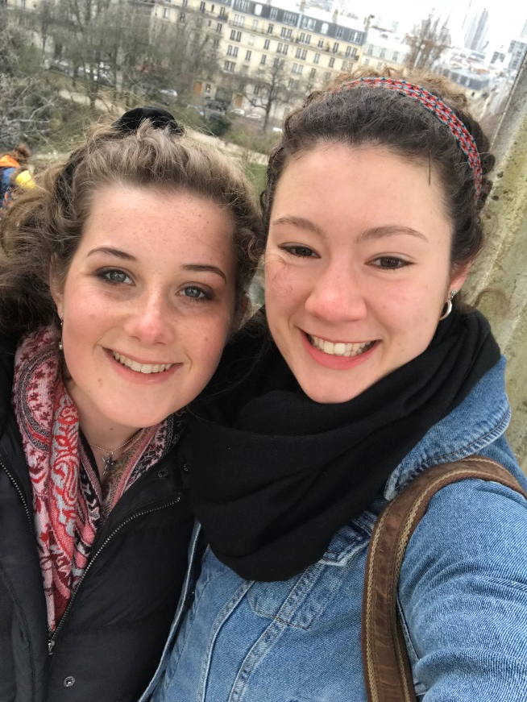
Olivia Savage – Stage 2
A-levels: Maths, Further Maths, Physics, Art.
G100 3 Year BSc Mathematics and Statistics degree, just finished Stage 2.
Considering changing to 4 year MMath course.
Not entirely sure what I want to do after university, but know I want to do something using statistics.
I love playing lacrosse and have been captain of the team this past year.

Slide 5
Olivia Savage – Stage 2
Maths has always been one of my strongest subjects and is something have always enjoyed doing.
Having a maths degree on my CV will give me lots of career possibilities as I can apply all the skills I have learnt many different careers.
I like the satisfaction of getting the right answer on a particularly difficult problem.

Slide 6
Christy Wharton – Stage 3
A-levels: Maths, Further Maths and Geography
GGC3 – Mmath Hons Maths and Stats, 4 years
I’m doing a summer internship in Assurance with EY – hoping for a grad job offer!
I decided to do maths as I find solving problems with certain answers extremely satisfying and it is such a broad subject that is relevant to almost any future career I choose.
Notes:
ME!

Slide 7
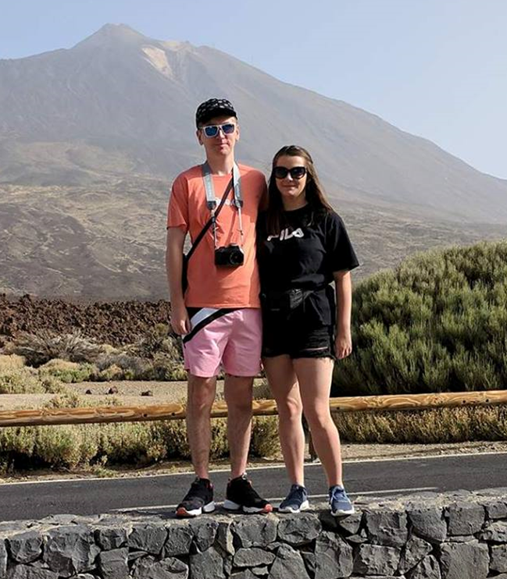
Christy Wharton – Stage 3
I knew I wanted to do maths from a very young age as I had an encouraging maths teacher in middle school who made me realise my potential and made maths a fun subject.
There is a social side to maths too! Mathsoc is one of the most popular societies at Newcastle University, organising weekly socials, a yearly holiday and a Winter and Summer Ball every year.

Slide 8
Charlie Livingstone Stage 2
A-levels: Maths, Further Maths, Physics and Engineering.
GGC3 – MMath Hons Maths and Stats, 4 year course.
Just recently changed to the 4 years masters course as I’ve decided I wanted to do more maths.
I have no idea what I want to do after university but definitely leaning more towards statistics.

Slide 9
Charlie Livingstone Stage 2
Always been good at maths and its something I enjoy so I knew from a young age it was something I wanted to study further.
Such a broad subject and really opens doors to lots of different jobs.
Next year I’m studying for a semester at a Canadian university – opportunity to work and study abroad with the degree

Slide 10
Amy Neild-Stage 3
A-levels: Maths, Physics and Biology
F303-Physics MPhys Honours, 4 year course
Physics at Newcastle University is a small course, lectures are small sizes. Lecturers know me personally, I feel valued as a student at Newcastle University

Slide 11
Amy Neild-Stage 3
The lecturers on my course are all experts in their field. They explain the material extremely well and if I don’t understand anything they are happy to go through it until I do.
Laboratory physics is my favourite module. I have the opportunity to work with high tech equipment, making labs much more exciting than they were during A Levels.

Slide 12
Key message!
Graduates from the School of Mathematics, Statistics and Physics are:
highly sought after by employers;
have high starting salaries on average;
can go into a wide variety of graduate jobs

Slide 13
What are your options?
Many Universities offer:
Mathematics
Mathematics and Statistics
Statistics
Physics
Lots of Universities offer:
MMath
MMathStat
MPhys

Slide 14
What are your options?
Also available are “with” degrees, e.g.
Mathematics with Management
Mathematics with Finance
Joint Honours in Mathematics and X, e.g.
Accounting, Computing, Economics, Psychology etc....
Other possibilities include e.g.
Theoretical Physics
Natural Sciences
Combined Honours/Studies

Slide 15
Some University degrees where A-level Mathematics is important
Accountancy | Actuarial Studies | Aeronautical Engineering | Architecture | Biochemistry
Biology | Business | Chemical Engineering | Chemistry | Computing
Dentistry | Dietetics | Economics | Electronic Engineering | Environmental Science
Geography | Geology and Earth Sciences | Management | Materials Science | Mathematics and Statistics
Mechanical Engineering | Medicine | Optometry | Pharmacy | Physics
Physiotherapy | Psychology | Sports Science | Surveying | Veterinary Science
Red: Almost always necessary
Orange: Sometimes necessary
Green: Useful

Slide 16
What will you study in a Maths degree?
Most Mathematics and Statistics degree programmes contain:
Mathematical Methods
Pure Mathematics
Applied Mathematics
Statistics
“with”, Joint Honours and Combined degrees take the same modules but fewer of them!

Slide 17
1st Year
An overview of the first year modules (the ones in BOLD are compulsory):
Semester One
Semester Two
Introduction to Calculus (15)
Linear Algebra: Vectors and Matrices (15)
Logic, Sets and Counting (10)
Problem Solving and Computing I (10)
Optimisation with Constraints* (10)
Multivariable Calculus and Differential Equations (15)
Introduction to Probability (15)
Number Systems (10)
Problem Solving and Computing II (10)
Dynamics* (10)
* Can be replaced by modules from other Schools (subject to timetable):
e.g. Accounting, Computing, Languages, Psychology, Economics,
Biology, Business Management, Geography, Music, History, ...

Slide 18
2nd Year
An overview of the second year modules (the ones in BOLD are compulsory):
Semester One
Semester Two
Linear Algebra (10)
Complex Analysis (10)
Vector Calculus (10)
Introduction to Statistical Inference (10)
Computing for Mathematics and Statistics (10)
Key Skills and Career Development* (10)
Algebra (10)
Differential Equations, Transforms and Waves (10)
Fluid Dynamics (10)
Stochastic Modelling (10)
An Introduction to Bayesian Methods (10)
Group Project* (10)
* Can be replaced by modules from other Schools (subject to timetable and appropriate skills being developed):
e.g. Accounting, Computing, Languages, Psychology, Economics,
Biology, Business Management, Geography, Music, History, ...

Slide 19
3rd Year
Numerical and Computational Modelling
Partial Differential Equations with Applications
Introductory Fluids
Relativity and Cosmology
Instabilities and Turbulence
Differential Equations, Transform Methods & Fields
Electromagnetism
Foundations of Group Theory
Linear Analysis
Topology
Geometries and Designs
Number Theory and Cryptography
Stochastic Calculus and Applications
Coding Theory
Geometric Group Theory
Applied Probability
Statistical Modelling
Stochastic Financial Modelling
Time Series and Forecasting
Multivariate Data Analysis
Bayesian Statistics
Survival Analysis
Randomized Clinical Trials
Discrete Stochastic Modelling

Slide 20
Degree Structure
4 year degree (MMath/MMathStat)
1st, 2nd and 3rd years are very similar to 3 year BSc
4th year includes:
Advanced Modules
Project (Dissertation, Poster and Presentation)
Possibility to interact with world-leading researchers in hot research topics!
Examples of recent projects:
Modelling Magnetic Activity in the Sun
Bayesian inference for ranking models applied to Formula One data
The Riemann Mapping Theorem
Notes:
20
Style sheet – extra type features

Slide 21
BSc Physics programme
Year One
Year Two
Dynamics
Introductory Astrophysics
Vibrations, Waves, AC Theory
Introductory Electromagnetism and Materials
Introductory Quantum Mechanics
Multivariate Calculus and Differential Equations
Laboratory Physics 1
Introductory Calculus
Introductory Algebra: Complex Numbers, Vectors and Matrices
Principles of Quantum Mechanics
Principles of Electromagnetism
Thermodynamics
Statistical Mechanics
Principles of Materials and Solid State Physics
Vector Calculus
Semiconductor Devices
Laboratory Physics 2
Physics in the Modern World
Differential Equations, Transforms and Waves
Optics

Slide 22
BSc Physics programme: 3rd year
Compulsory
Optional
Advanced Quantum Mechanics
Relativity and Cosmology
Advanced Materials and Solid-State Physics
Atoms, Molecules, Nuclei, Particles
Group Project
Electronic Devices
Project
Numerical and Computational Modelling
3 from:
Fluid Dynamics
Variational Methods
Advanced Electromagnetism
Advanced Astrophysics
Partial Differential Equations
Photonics
Biophysics

Slide 23
Other Physics programmes
MPhys:4 year degree
1st, 2nd and 3rd years are very similar to 3 year BSc
4th year includes:
Advanced Modules
Extended project
Possibility to interact with world-leading researchers in hot research topics!
Theoretical Physics: 3 or 4 year degrees
Only laboratories in the first year
Advanced mathematical & theoretical techniques
Theory project

Slide 24
Where are Maths, Stats & Physics used?
Business and Management
Finance and Economics
Aerodynamics
Pharmaceuticals
Medicine
Logistics, Communication and Security
Energy production (wave and wind power)
Extreme weather events

Slide 25
Job Opportunities
Accountant
Air Traffic Controller
Crime Analysis
Software Developer
Computer Game Designer
Consultant
Government Statistics
Lecturer
Aircraft Designer
Risk Management
Actuary
Cryptographer
Teacher
Further Study
Sports Betting Analyst

Slide 26
But more importantly.....
What you gain from a Maths & Stats/Physics degree:
Numerical Skills
Problem Solving Skills
Presentation Skills
Experience of Team Work
Experience of Report Writing
Analytical Skills
Statistical Skills
...

Slide 27
Maths Admissions at Newcastle
The standard offer is
AAA or A*AB including at least grade A in Maths and exc. General Studies
AAB or A*BB including at least grade A in Maths and exc. General Studies AND including one A level from:
Further Maths, Biology, Chemistry, English Literature, Geography, History, Physics and Modern/Classical Languages
OR grade 2 in any STEP paper.
Further mathematics is not required, but of course is helpful! (less than 50% of our students have this)
PARTNERS students may be given a lower offer (by 2 grades) with an additional requirement of completing the PARTNERS Summer School
Offers for Joint Honours combinations are typically AAB

Slide 28
Physics Admissions at Newcastle
The standard offer is
Physics/Theoretical Physics BSc Honours
- AAB including Mathematics and Physics and exc. General Studies.
- ABB including Mathematics and Physics and exc. General Studies AND and including one A level from:
Further Maths, Biology, Chemistry, English Literature, Geography, History and Modern/Classical Languages or grade 2 in any STEP paper.
Physics/Theoretical Physics MPhys Honours
- AAA including Mathematics and Physics and exc. General Studies.
- AAB including Mathematics and Physics and exc. General Studies AND including one A level from:
Further Maths, Biology, Chemistry, English Literature, Geography, History and Modern/Classical Languages or grade 2 in any STEP paper.
Biology, Chemistry and Physics A levels require a pass in the practical element.

Slide 29
Admissions at Newcastle University
Once you have your offer, we will invite you to a School Open Day.
This includes opportunities to:
find out more details about the degree programmes that we offer
talk to current students and staff
tour the University
tour the accommodation
ask any questions you might have
Parents are very welcome and have some separate sessions

Slide 30
Personal statements
When are they used?
When making an offer or inviting for interview
As the basis for an interview or chat with academic member of staff
After the A-level results have come out

Slide 31
Personal statements (Maths & Stats)
Newcastle University:
Personal statements help the discussion when students meet staff at Post-application Open Day
Personal statement used after results have been published to help choose between “near-miss” candidates

Slide 32
Making a good impression
The personal statement is an opportunity for you to demonstrate:
Why you would be a good student for the programme you are applying to
Why the university should select your application over those of other candidates
A chance for you to sell yourself!
Notes:
UCAS personal statements can be a maximum of 4000 characters long (inc. Spaces) OR 47 lines long, depending on which limit you meet first when writing. Remember you are trying to convince the admissions tutor that you are worth offering a place at university to– they get thousands of applications so you have to persuade them that they will be missing out if they don’t get a student like you at their university. Its just like applying for a job in this sense.

Slide 33
Things to consider
Structure
Choice of course
School/college experience
Work experience
Outside school/college experience
Concluding statement
Notes:
UCAS suggest that the Personal Statement should cover all of the issues over the next five slides, which I have grouped into the following sections. (Go through points on slide).
However, it is important to remember that the Personal Statement has to be personal and has to be about YOU – the Admissions Tutors don’t want to read the same statement again and again. Try to be exciting and different from the rest (to an extent…)

Slide 34
Summary
Mathematics/Physics and related degrees are excellent choice of degree programme
Good career opportunities
Variety of degrees available – research the options and entry requirements
Take care over your personal statement
Good luck!!

