Slide 1
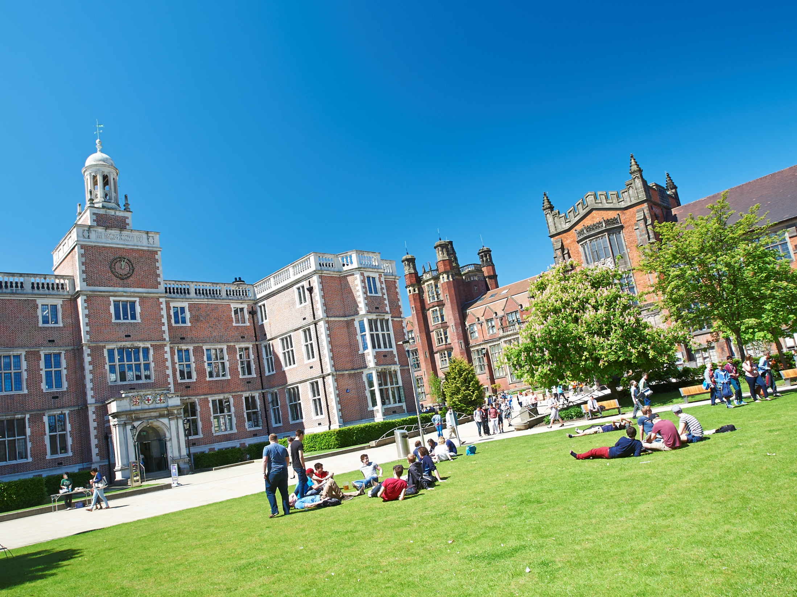
Careers
Ryan Marr

Slide 2
Facts and Figures
We are one of the
Top 20 ‘Most
Targeted’
universities by the UK’s
leading employers
(The Graduate Market Report 2012–13)
3rd in the UK for quality of staff and lecturers
Times Higher Education Student Experience Survey
6th in the UK for Student Satisfaction
Lloyds Bank Survey 2014
1st in the UK for Quality of Social Life
Lloyds Bank Survey 2014
4th in the UK for Quality of Student Life
Lloyds Bank Survey 2014
Top 1% of world universities
QS World University Rankings 2014/2015
95% of NCL students go into graduate employment or future study within first six months
13th in the world for our careers advice
out of 163 institutions.
(International Student Barometer 2012)

Slide 3
Careers Service
Career Advice
Drop in CV checks
Mock Assessments
Recruitment Fairs
Support after Graduation
Careers Workshop
Multi-Award Winning Careers Service
Rise-up
Vacancies Online
Further Advice
Time Out Advice
Great Employer Links
Newcastle Work Experience

Slide 4
NCL+ Award
Represent the University
Clubs, Societies and Events
Earn and Learn
World and Media
Volunteering
Course Rep
Societies Officer
CV Advisor
Careering Ahead Blogger
Go Play Coach
Hall Rep
Events Crew
Jobs OC
Language Learning
Passport to Work
Student Mentor
Rise up
Part-time Jobs
Journalism
Sports Volunteer
Student Ambassador
Student Society
Holiday Work
Broadcaster
Student Advice Centre
Union Officer
Student Ambassador
Student Exchange
Sustainability Volunteer
Sports Centre Jobs

Slide 5
Maths & Stats Specific Advice
Maths & Stats Related Skills
Group work Experience
Presentation Skills
Report Writing Experience
Mathematical Skills and Career Development module
Maths & Stats Careers Help
Careers Fairs

Slide 6
What Next?
Further Study
Crime Analyst
Software Developer
Investment Banker
Time Out
Statistician
Computer Game Designer
Actuary
Teacher
Sports Betting
Engineer
Accountant
Cryptographer
Air Traffic Controller
Data Analyst
Consultant

Slide 7
Further Study
MSc or PhD
Expertise in Interesting Subject
4 Year PhD Programme – Systems Neuroscience
4 Year Doctoral Training in Carbon Capture and Storage, and Cleaner Fossil Energy
Funding
Boost Career Prospects

Slide 8
Example Students
Joe
Jack
EPSRC Centre for Doctoral Training in Cloud Computing for Big Data
Joint PhD in M&S and
Civil Engineering
Statistical analysis of road safety
Only 12% of data recorded is used
Working with a large, multinational German company
Sites like Facebook and Amazon use data to recommend to users

Slide 9
Employment Routes
Summer Internship
Graduate Scheme or Job
4-10 week summer vacation work placement
Full-time work beginning September after graduation
May lead to conditional offer of employment subject to graduation
Employment

Slide 10
My Advice
Start looking in good time
Consider preferred division of employment
Start applying
Take your time and make each one count!
Practice and prepare for next stages
Careers service – mock interviews and psychometric tests

Slide 11
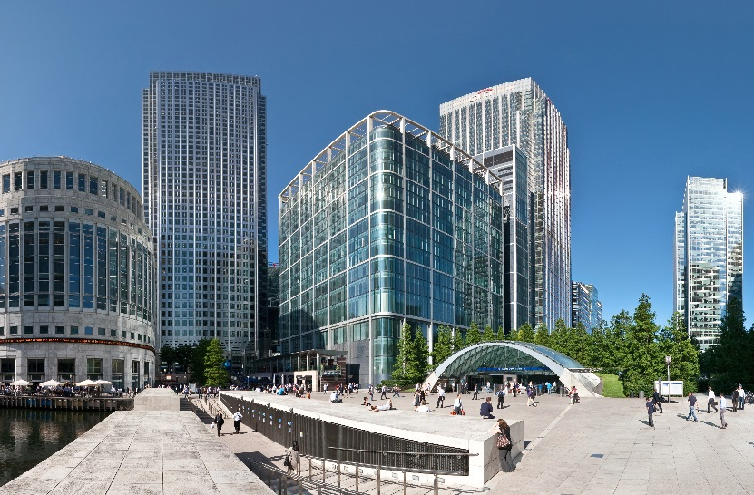
Think Outside The Box
Lloyds Banking Group
Mid-markets Banking
Summer Placement
KPMG
Transaction Services
Summer Placement
MagTec Ltd.
Data analysis
8-week Intern
Went to careers fairs
Took business cards
Expanded my network

Slide 12
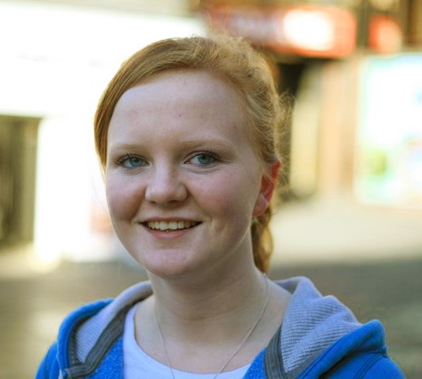
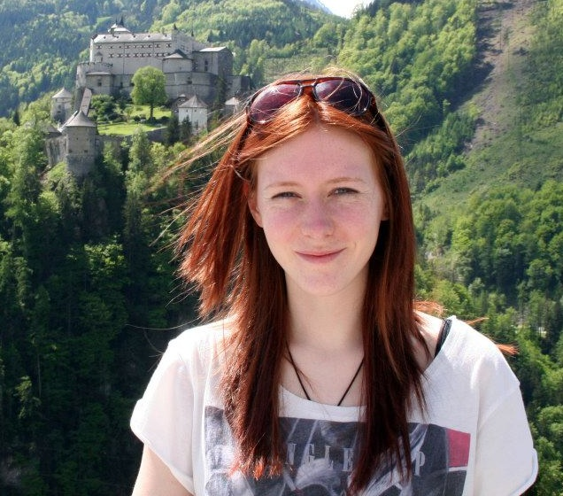
Graduate Profiles
Jess
Kathryn
Graduated in 2013, BSc
Technology Graduate at Sky
Graduated in 2012, MMath
Atomic Weapons Establishment

Slide 13
Graduate Profiles
Will
Gary
Graduated in 2015, BSc
Statistical Analyst, Servelec
Graduated in 2011, MMath
Sports Trader, Bodog Europe

Slide 14
Summary
Maths & Stats opens many doors!
NCL ensures the best chance for future employment
@NCLMathsStats

