Slide 1
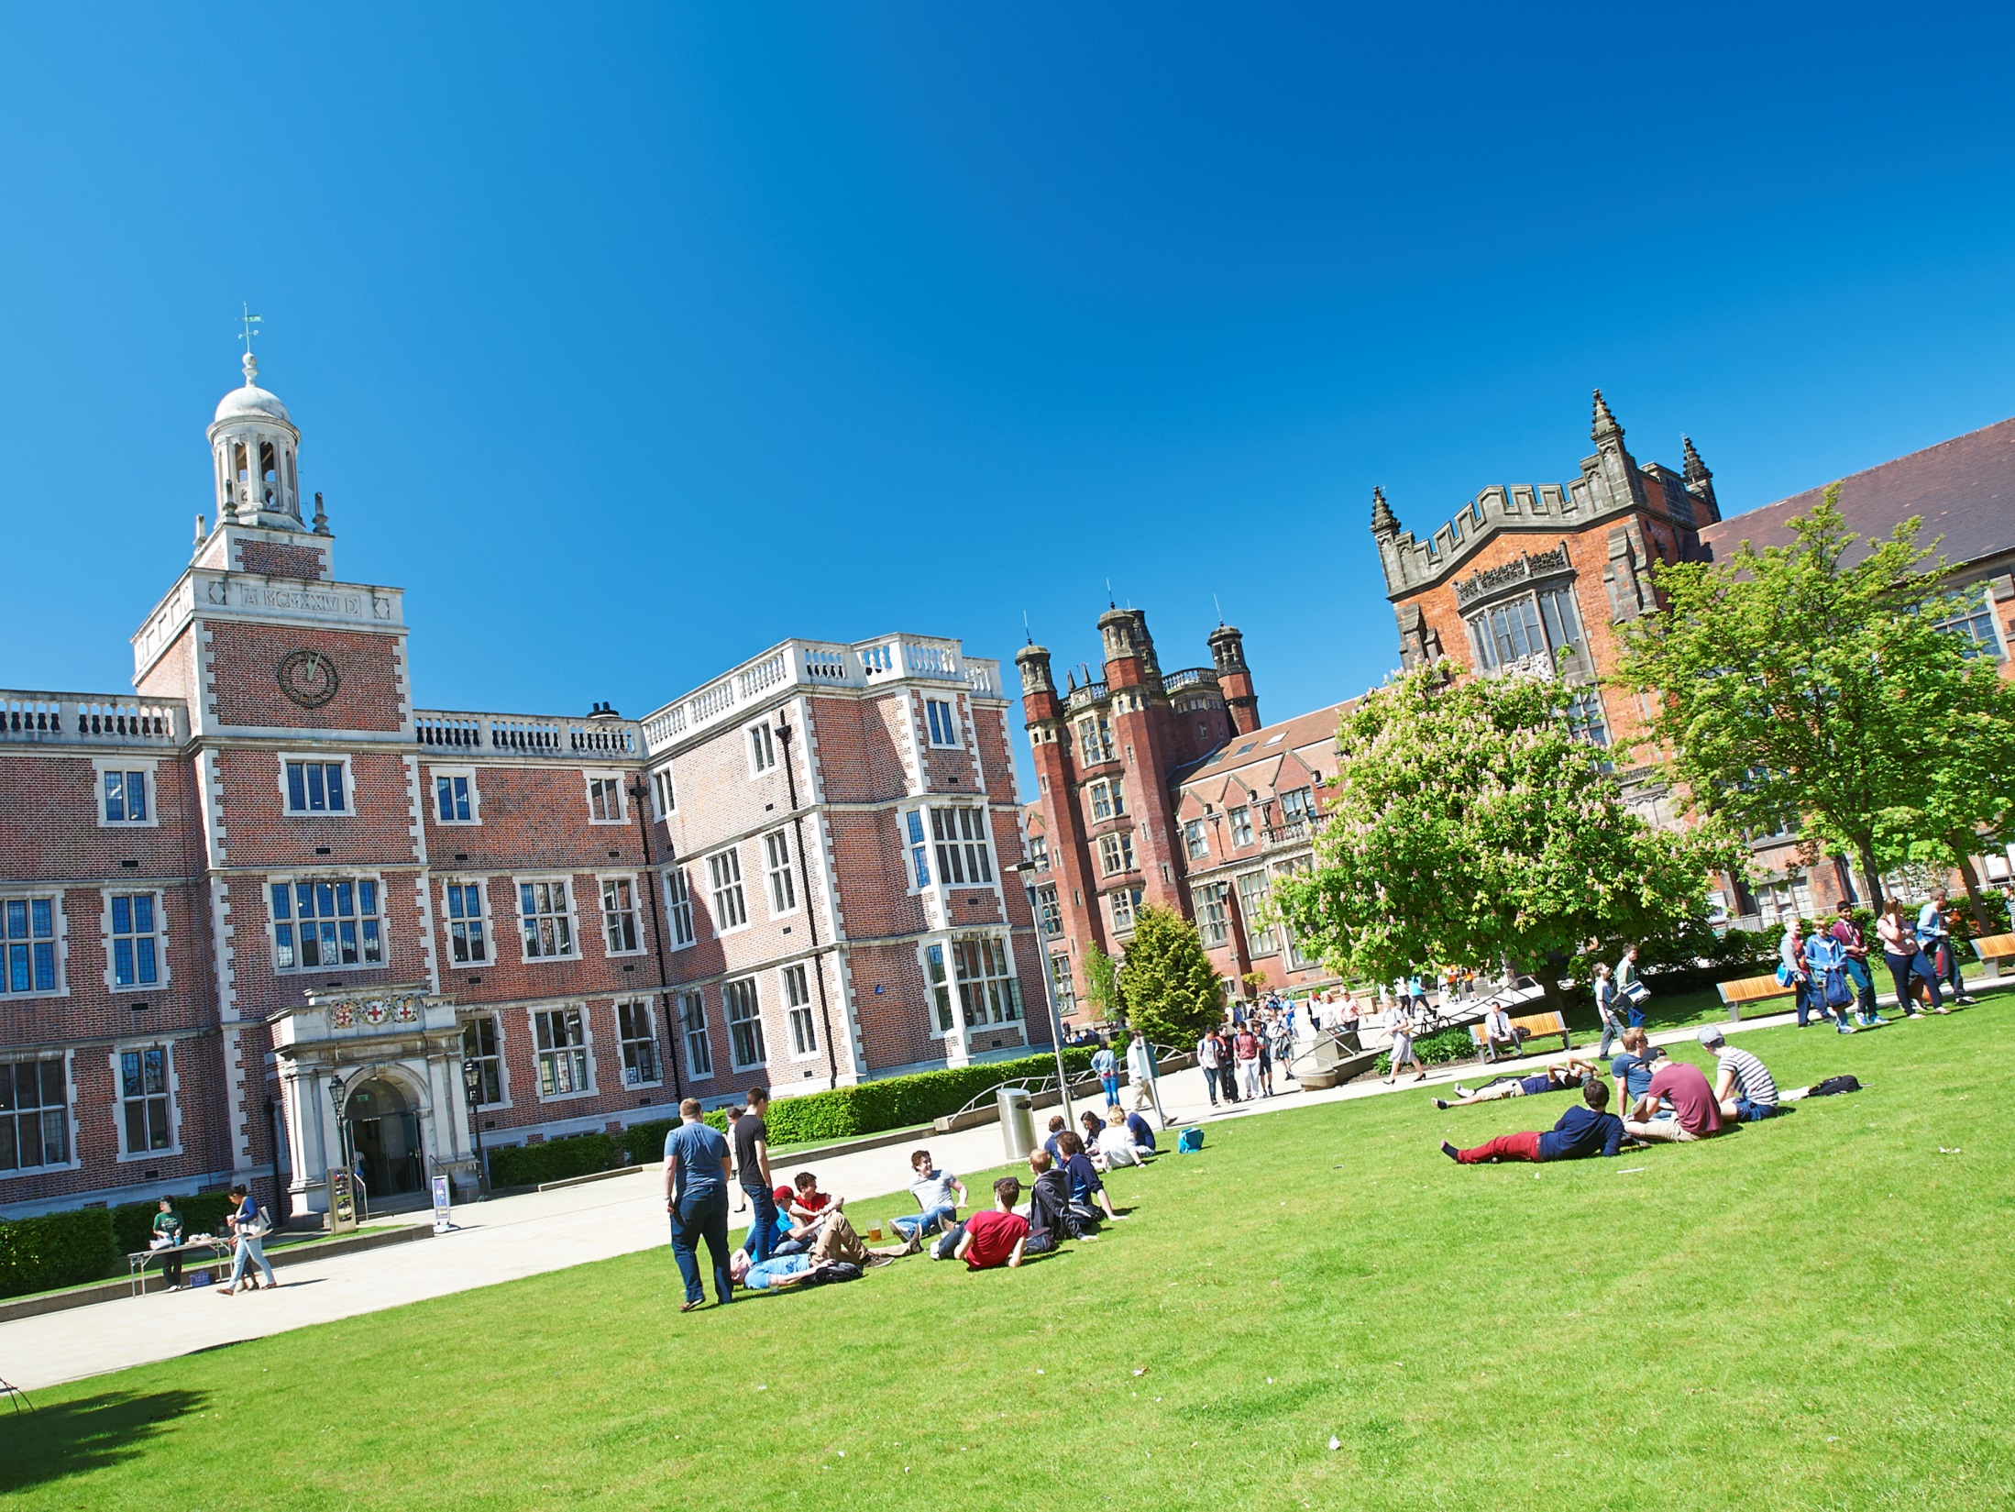
Accommodation
Emma Bradley
Amy Green

Slide 2
Accommodation Guarantee
Choose Newcastle as your first choice before 30th June 2016
You complete the online application form before 30th June 2016
Guaranteed a place in a halls, regardless of where you currently live

Slide 3
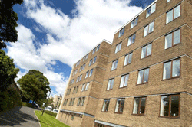
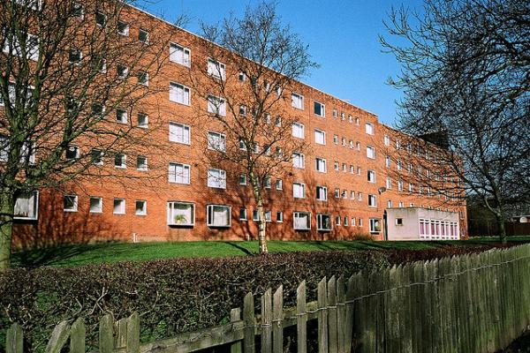
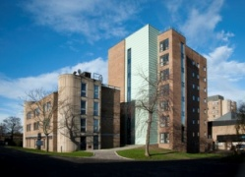
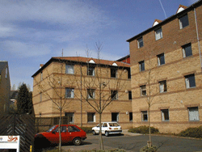
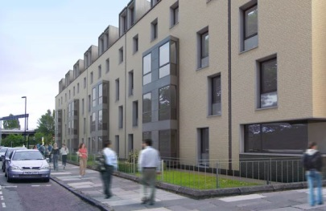
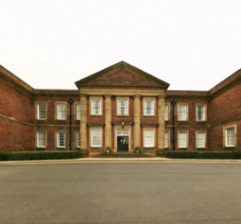
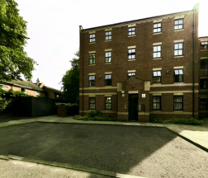
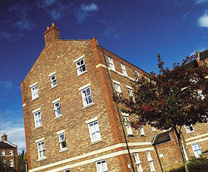
Castle Leazes
Henderson Hall
Castle Court
The Halls
Bowsden Court
The Halls
The Halls
Park Terrace
St Mary’s
Windsor Terrace
Marris House

Slide 4
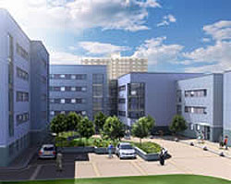
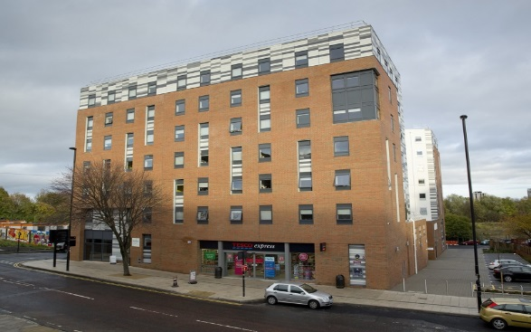
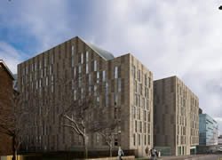
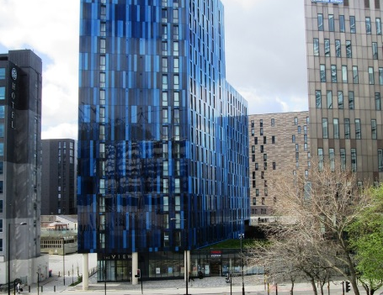
Victoria Hall
Turner Court
Managed Partnership Accommodation
Liberty Plaza
The View
More managed partnership sites to be released soon for 2016/17…

Slide 5
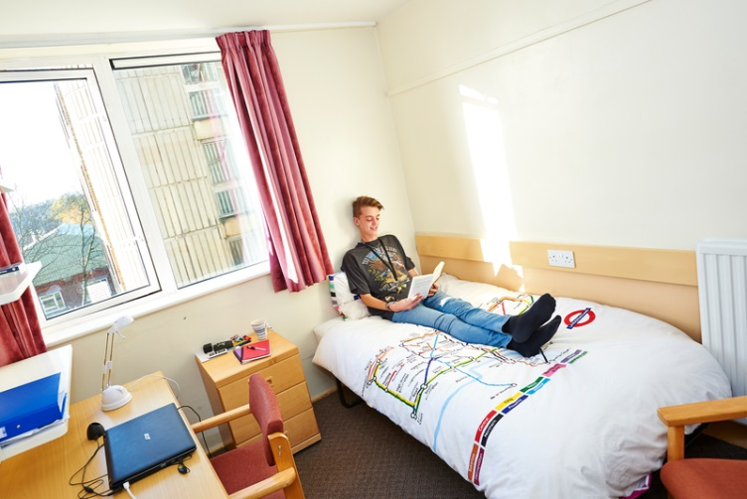
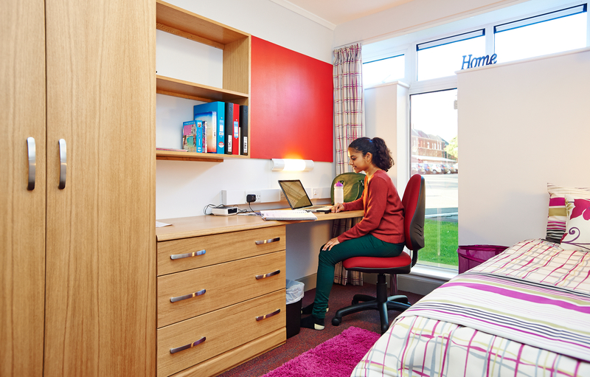
Typical Rooms
To find out more detailed information and view our virtual tours for each of our halls of residence visit:
www.ncl.ac.uk/accommodation

Slide 6
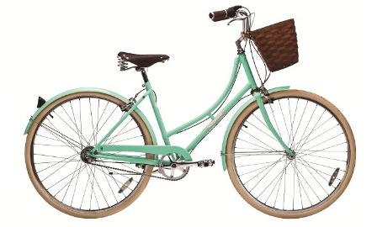
Included In All Halls
Free internet connection
Launderette
Holidays included
Bicycle Storage
24 hour security
Bills

Slide 7
Things To Consider
Self Catered/Catered
Affordability
Location
Mixed/Single Gender
Flat/Corridor Layout
Deluxe Room
Standard Washbasin Room
Smaller/Larger Community
Ensuite Room

Slide 8
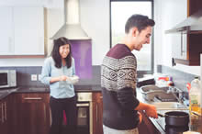
Why Catered Is Best
Get your meals cooked
Cleaner for kitchen & bedroom
Small kitchen provided
Saves time and effort

Slide 9
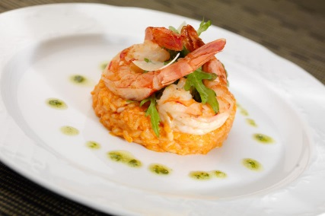
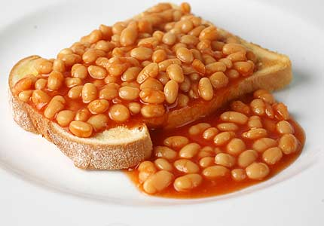
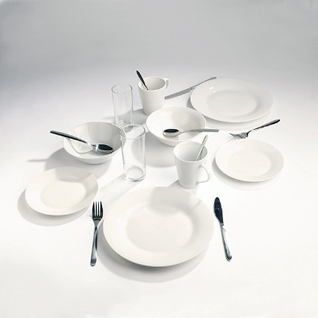
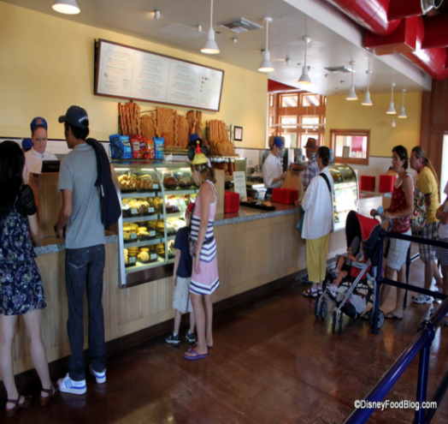
Why Self-Catered Is Best
More freedom to choose what/when you eat
Can still buy catered meals
Larger kitchen & free crockery pack

Slide 10
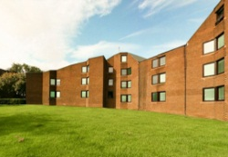
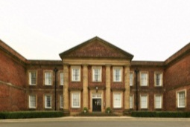
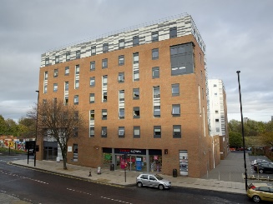
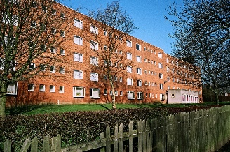
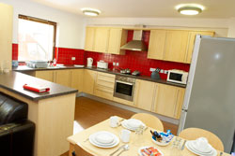
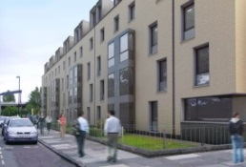
Comparing Price
Least Expensive- £79 p/w
Most Expensive- £128 p/w
Windsor Terrace
Victoria Halls
Richardson Rd
Victoria Halls
The View
St Marys College
St Marys College
Marris House
Castle Court
Marris House
Castle Leazes
Marris House
Castle Court
Turner Court
Castle Leazes
Bowsden Court
Park Terrace
Henderson Hall
Bowsden Court
Park Terrace
Central Link

Slide 11
Comparing Size
Smallest - 50 rooms
Largest - 1100 rooms
Castle Court
Bowsden Court
Windsor Terrace
Marris House
Castle Court
Marris House
Turner Court
Marris House
Bowsden Court
Victoria Halls
Castle Leazes
Bowsden Court
Victoria Halls
Central Link
Castle Leazes
Park Terrace
St Marys College
Richardson Rd
Park Terrace
Henderson Hall
The View
Park Terrace
St Marys College

Slide 12
Routes from further away.
Bowsden Court
Henderson Hall
St Mary’s College
Windsor Terrace
Marris House
Newcastle University
Castle Leazes and Castle Court
Park Terrace
Victoria Hall
Central Link and The View
Turner Court

Slide 13
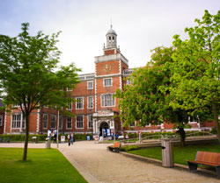
After Halls
Lots of student properties
Remember extra costs
Support available
Typically 12 month contracts

Slide 14
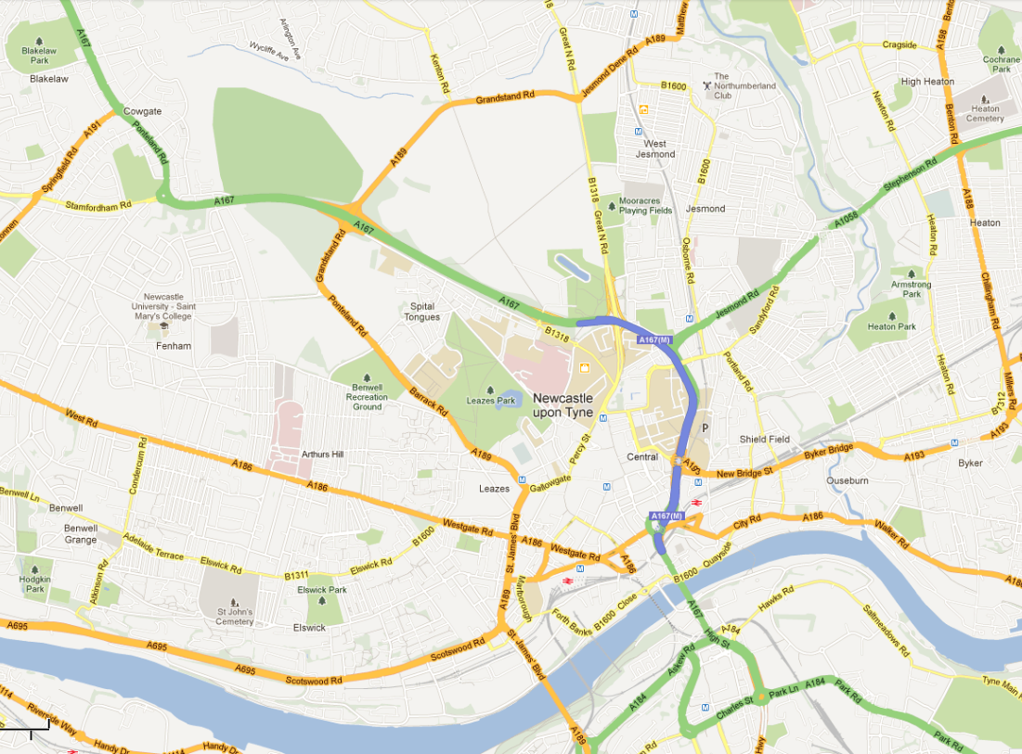
Jesmond
Newcastle University
Spital Tongues
Heaton
Fenham
Sandyford

Slide 15
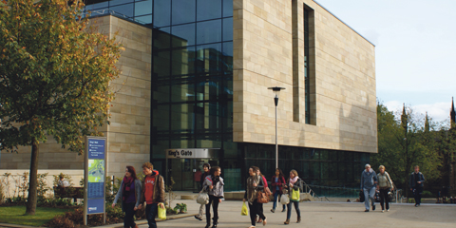
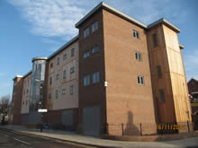
University Properties
Accommodation service - Level 1, Kings Gate
NUStudentHomes
University owned/managed accommodation
Barker House and Albion House; available to all students (Stage 2+)

Slide 16
Overview
Find brief facts and figures for each accommodation on:
http://www.ncl.ac.uk/accommodation/assets/documents/AccommodationOverview.pdf

Slide 17
Overview
“There was only 3 of us in our flat so it’s not the most social accommodation but we made friends with the rest of our block. The flat was lovely, especially the kitchen.”
Tom, Victoria Halls
““The facilities were really nice and my room was huge, there was a really big common room with a pool table and tv’s. It was a bit quiet but I enjoyed that.”
Jenny, St Mary’s College
“Great atmosphere, lovely mix. Great location for going to town and only a 15 minute walk to uni.”
Anna, Central Link
“Being catered was good, even though it would probably have worked out cheaper cooking for myself, I enjoyed the social aspect of going to the dining hall.”
Georgia, Castle Leazes
“It was a nice local area and good to have an en-suite without breaking the bank.”
Theo, Bowsden Court
If you have any further questions, feel free to contact us on Twitter: @NCLMathsStats

