Slide 1
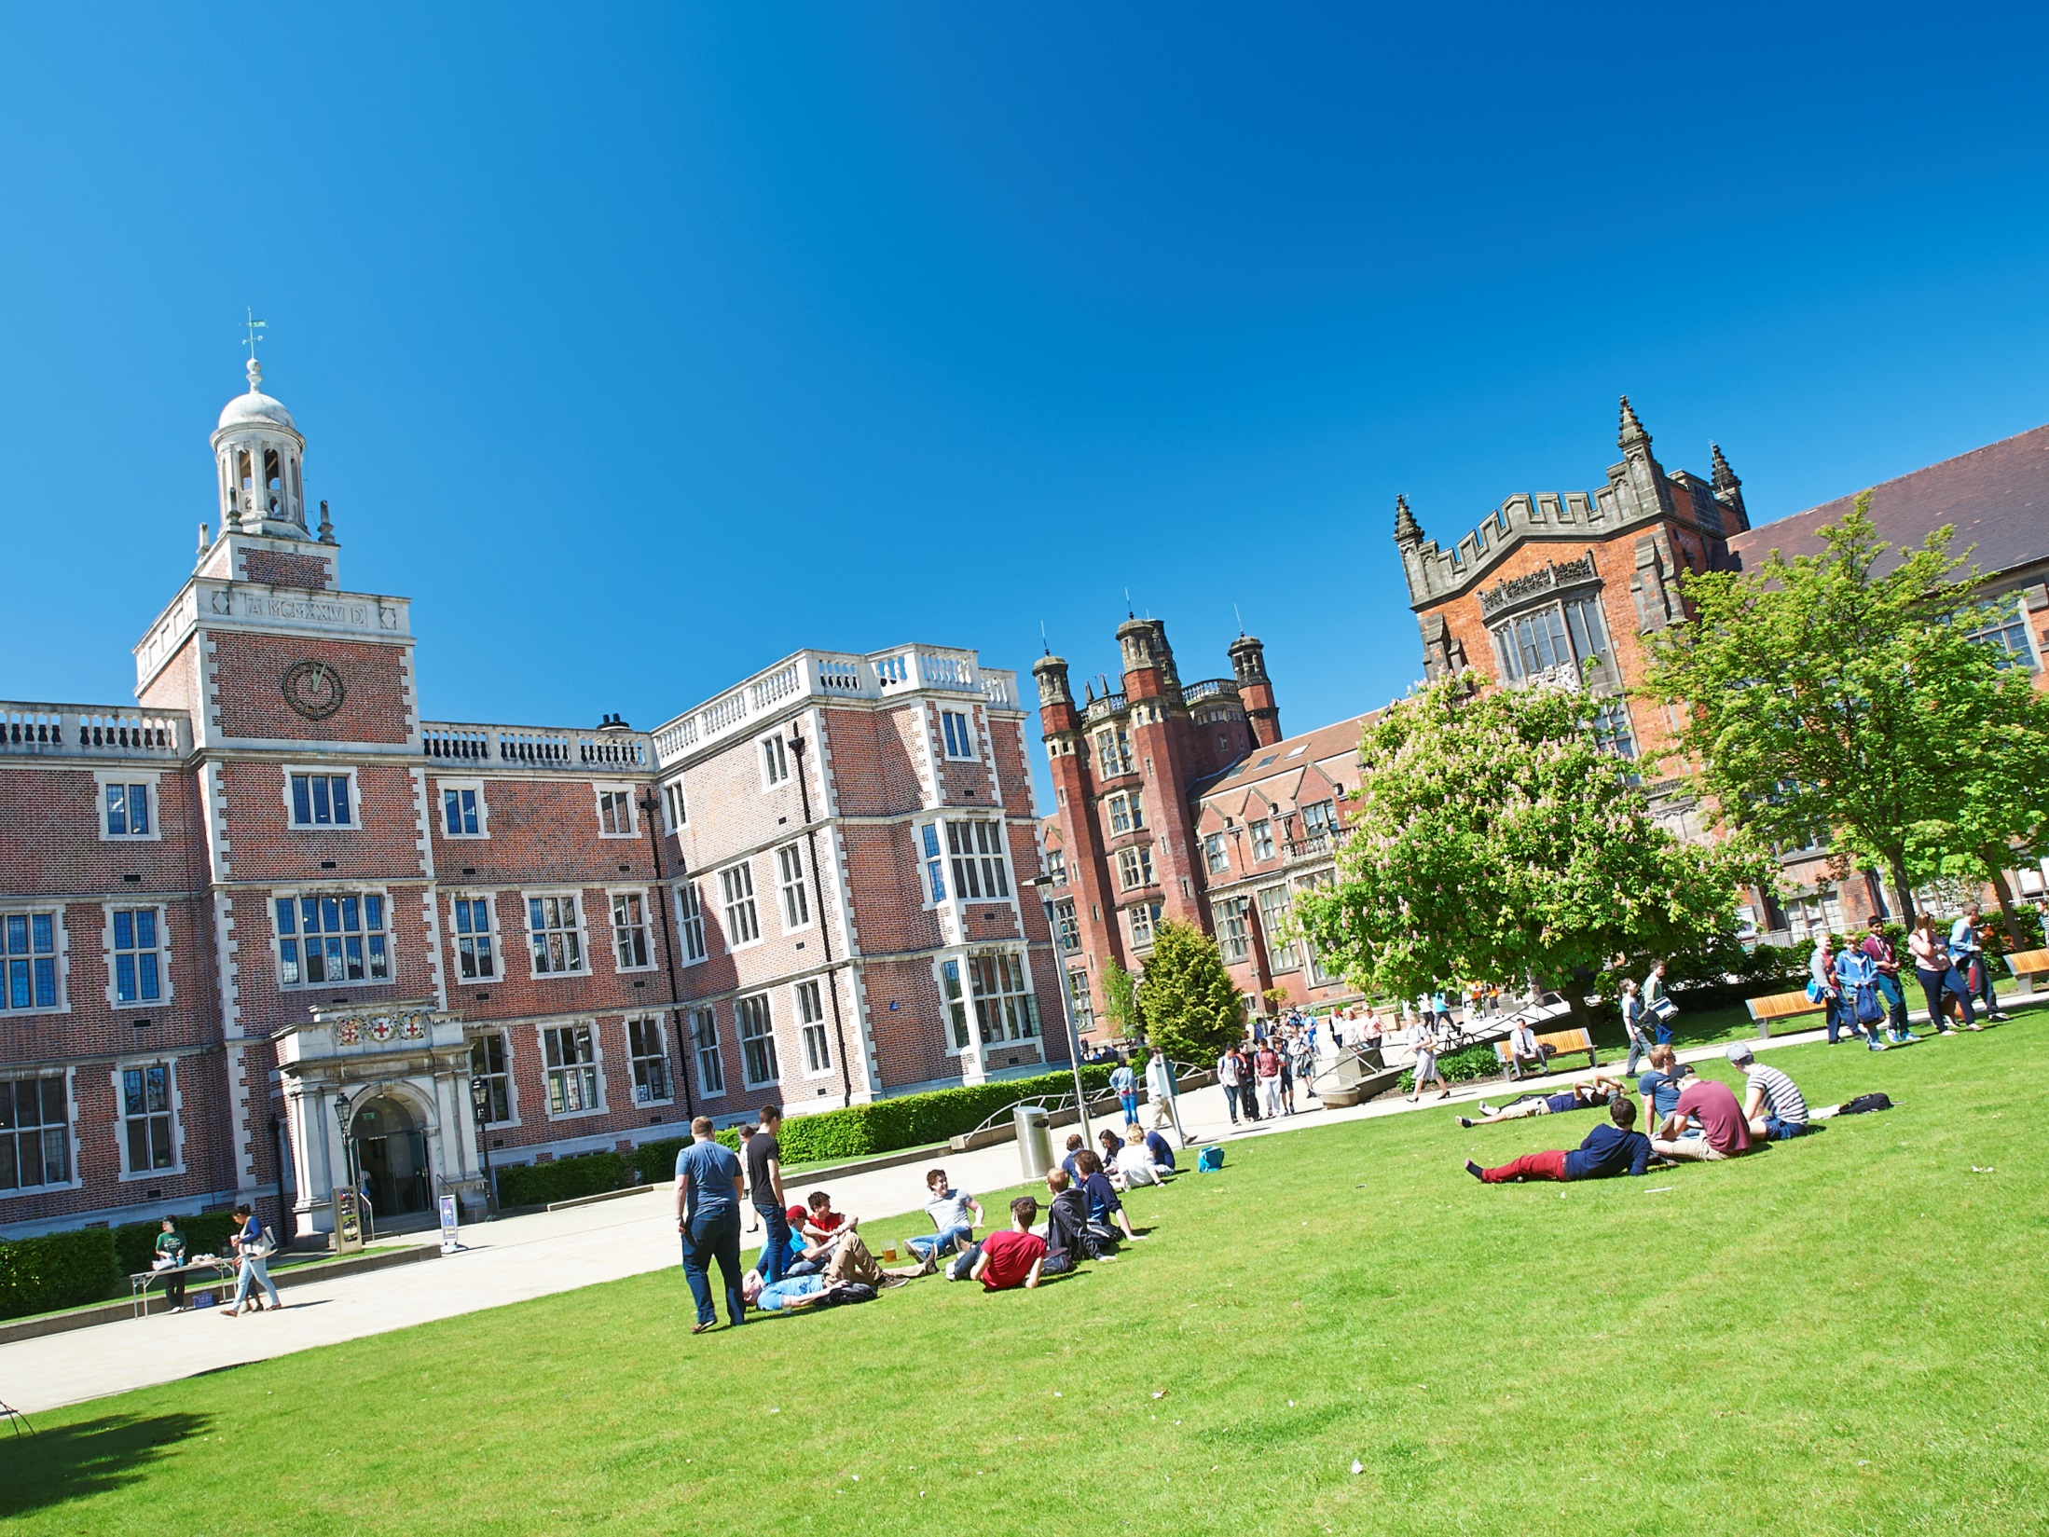
Studying At Newcastle
Chloe Johnston
Tom Lowe

Slide 2
This Talk
Degree Types
Single Honours
Other Types
Physics
Structure
1st Year
2nd Year
Important Projects
Learning & Assessment
Teaching Methods
Assessment Methods
Grades & Weighting
Resources
The Herschel Building
Internet Resources
Support
Timetabling
Typical Week
Semester Calendars
Important Dates

Slide 3
Single Honours Degrees
Single Honours
3 Year Degree
4 Year Degree
BSc Maths & Stats Hons
BSc Maths Hons
MMathStat Hons
BSc Statistics Hons
MMath Hons

Slide 4
Other Types of Degree
Major/Minor
Maths with Finance
Maths with Management
Physics
Maths and Psychology
Economics and Maths
Accounting and Maths
Joint Honours

Slide 5
This Talk
Degree Types
Single Honours
Other Types
Physics
Structure
1st Year
2nd Year
Important Projects
Learning & Assessment
Teaching Methods
Assessment Methods
Grades & Weighting
Resources
The Herschel Building
Internet Resources
Support
Timetabling
Typical Week
Semester Calendars
Important Dates

Slide 6
University Credits
120 Credits in Each Year
100 Hours per 10 Credits
Lectures
Revision and Exam
Term-time Assessments

Slide 7
Single Honours Structure
1st Year
2nd Year
3rd Year
4th Year
MAS
1601
MAS
1602
MAS
2701
MAS
2702
MAS
2703
MAS 8091
MAS
1701
MAS
1801
MAS
1901
MAS
2801
MAS
2802
MAS
2803
MAS
1603
MAS
1604
MAS
2901
MAS
2902
MAS
2903
MAS
1702
MAS
1802
MAS
1902
MAS
2601
MAS
2603
MAS
2602
Key:
Inner
Outer
Optional
Key:
Computing
Pure
Applied
Statistics
Optional

Slide 8
1st Year Structure
Semester 2
Semester 1
Multivariable Calculus and Differential Equations
Introduction to Calculus
Linear Algebra: Vectors and Matrices
Probability and Statistics
Sets and Counting
Problem Solving and Computing I
Dynamics
Number Systems
Problem Solving and Computing II
Optimisation with Constraints
Key:
Inner
Outer
Optional

Slide 9
2nd Year Structure
Semester 1
Linear Algebra
Complex Variable
Algebra
Vector Calculus
Differential Equations
Transforms, Waves and Fluid Dynamics
Introduction to Statistical Inference
Stochastic Modelling
An Introduction to Bayesian Methods
Semester 2

Slide 10
2nd Year Structure
Semester 1
Linear Algebra
Complex Variable
Algebra
Vector Calculus
Differential Equations
Transforms, Waves and Fluid Dynamics
Introduction to Statistical Inference
Stochastic Modelling
An Introduction to Bayesian Methods
Group Project
Careers Management and Mathematical Skills
Computing
Semester 2

Slide 11
3rd Year Modules
Stochastic Calculus & Applications
Foundations of Group Theory
Coding Theory
Linear Analysis
Topology
Geometries & Designs
Groups, Graphs & Symmetry
Number Theory & Cryptography
Survival Analysis
Statistical Modelling
Markov Processes
Bayesian Inference
Randomised Clinical Trials
Discrete Stochastic Modelling
Applied Probability
Multivariate Data Analysis
Stochastic Financial Modelling
Time Series & Forecasting
Partial Differential Equations with Applications
Instabilities, Turbulence & Scaling
Electromagnetism
Variational Methods
Introduction to Numerical & Computational Modelling
Quantum Mechanics
Introduction to Fluids
Differential Equations, Transform Methods & Fields

Slide 12
4th Year Project
Before 4th year
Introductory presentation
Given topic choices
Meetings with potential supervisors
Give list of choices
Summer
Given topic of study
Meeting with confirmed supervisor
Begin research/collect data
1st Semester
Regular meetings with supervisor
Project gets going
Give presentation on topic
2nd Semester
Finalise report and hand in
Report starting to take shape
Produce a poster summarising work

Slide 13
4th Year Project
C*-algebras
Quantum Ferrofluid Hedgehogs
Analysis of Sport Data
Galactic Winds
Convexity
Randomized Clinical Trials

Slide 14
This Talk
Degree Types
Single Honours
Other Types
Physics
Structure
1st Year
2nd Year
Important Projects
Learning & Assessment
Teaching Methods
Assessment Methods
Grades & Weighting
Resources
The Herschel Building
Internet Resources
Support
Timetabling
Typical Week
Semester Calendars
Important Dates

Slide 15
Learning and Assessment
Inner Core
Learning
Assessment
Lectures
Problems Classes
Assignments
CBAs (Numbas)
Seminars
Computing Practicals
Projects
Presentations
Office Hours
Drop Ins
Mid Semester Tests
Exams

Slide 16
Learning and Assessment
Numerical & Computational Modelling
Learning
Assessment
Lectures
Seminars
Assignments
CBAs (Numbas)
Office Hours
Problems Classes
Projects
Presentations
Computing Practicals
Drop Ins
Exams
Mid Semester Tests

Slide 17
Grades and Weighting

Slide 18
This Talk
Degree Types
Single Honours
Other Types
Physics
Structure
1st Year
2nd Year
Important Projects
Learning & Assessment
Teaching Methods
Assessment Methods
Grades & Weighting
Resources
The Herschel Building
Internet Resources
Support
Timetabling
Typical Week
Semester Calendars
Important Dates

Slide 19
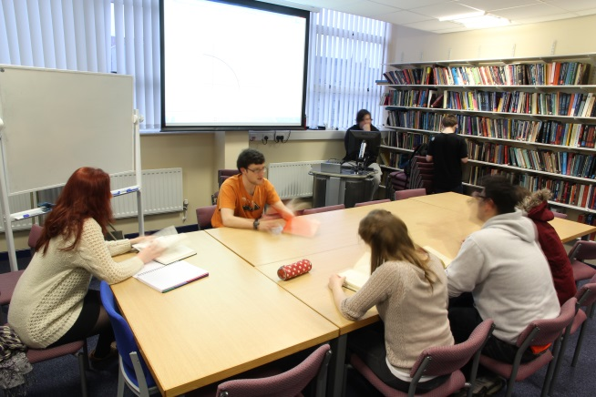
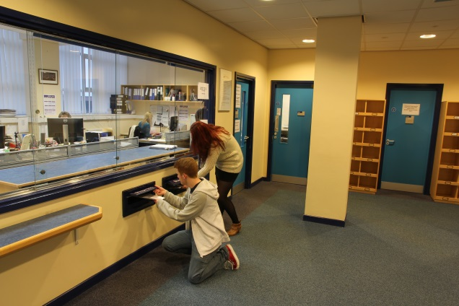
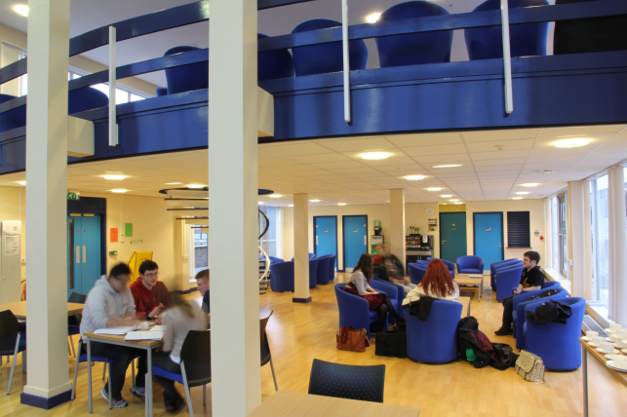
The Herschel Building
Herschel Library
Computer Cluster
School Office
Penthouse

Slide 20
Internet Resources
Blackboard
ReCap
RAS
Lecture Notes
Lecture Recordings
Remote Application Service
Assignments
Open Day ReCap
University Documents
Announcements
University Software
Smartphone App

Slide 21
Support
Current Maths & Stats Student
Regular contact through emails
Buddy
Module Selection & Registration
Academic & Personal issues
Personal Tutor
Undergraduate Secretary
Personal Issues
Exams & Assignments
Student Wellbeing
Financial Matters
Counselling

Slide 22
This Talk
Degree Types
Single Honours
Other Types
Physics
Structure
1st Year
2nd Year
Important Projects
Learning & Assessment
Teaching Methods
Assessment Methods
Grades & Weighting
Resources
The Herschel Building
Internet Resources
Support
Timetabling
Typical Week
Semester Calendars
Important Dates

Slide 23
Typical Week
 | 9-10 | 10-11 | 11-12 | 12-1 | 1-2 | 2-3 | 3-4 | 4-5 | 5-6
Mon
Tues
Wed
Thurs
Fri
L
L
PC

Slide 24
Typical Week
 | 9-10 | 10-11 | 11-12 | 12-1 | 1-2 | 2-3 | 3-4 | 4-5 | 5-6
Mon
Tues
Wed
Thurs
Fri
L
L
DI

Slide 25
Typical Week
 | 9-10 | 10-11 | 11-12 | 12-1 | 1-2 | 2-3 | 3-4 | 4-5 | 5-6
Mon
Tues
Wed
Thurs
Fri
L
L
L
PC
L
L
PC
L
PC

Slide 26
Typical Week
 | 9-10 | 10-11 | 11-12 | 12-1 | 1-2 | 2-3 | 3-4 | 4-5 | 5-6
Mon
Tues
Wed
Thurs
Fri
L
L
L
DI
L
L
DI
L
DI

Slide 27
Typical Week
 | 9-10 | 10-11 | 11-12 | 12-1 | 1-2 | 2-3 | 3-4 | 4-5 | 5-6
Mon
Tues
Wed
Thurs
Fri
L
L
L
L
PC
L
L
PC
L
PC
S
L
Sports and Societies
L
L
PC
L
L
PC

Slide 28
Semester One
September 2016
October 2016
November 2016
Important Date:
Fresher’s Week 26th
December 2016
January 2017
Important Date:
Christmas Hols 16th
Important Date:
Exam Period 16th
Key: Teaching Weeks
Holidays
Exam Period
FRESHERS WEEK!

Slide 29
Semester Two
January 2017
February 2017
March 2017
Important Date:
Semester 2: 30th
Important Date:
Easter Hols 24th
April 2017
May 2017
June 2017
Important Date:
Back to Uni 24th
Important Date:
Exam Period 22nd
Important Date:
Summer 9th
Key: Teaching Weeks
Holidays
Exam Period
Resit Period:
21st August-1st September

Slide 30
Opportunities Abroad
Opportunities Abroad
Placement Year
Stage 3 Semester 1 Abroad
Year out between Stages 2 and 3
3 year single honours degree only
4 year degree only
Not Graded
Graded
Notes:
Placement Year has £1,000 tuition fees, you then continue your 3rd year as before, students arrange themselves
Stage 3 Semester 1 abroad pay full tuition fees, must have 60+ in Stage 2, students arrange themselves

Slide 31
Thanks For Listening
If you have any questions feel free to come and talk to us at any point throughout the day and we will be happy to help.
Thank You for Listening
If you have any further questions, feel free to contact us on Twitter: @NCLMathsStats

