Slide 1
Question 24
Victoria kent

Slide 2
24.P Let θ be the chance that a major earthquake will occur after a “degassing burst” has taken place (see previous question). Six of the last ten degassing bursts at locations along the edge of the Eurasian plate were followed by major earthquakes. Update the beliefs of the seismologist from the previous question with this information to form the posterior for θ, and compare prior and posterior means.

Slide 3
23.P A “degassing burst” is a seismic event that can occur just before a major earth-
quake. Let θ be the chance that a major earthquake will occur after a degassing
burst has taken place. From discussions with an seismologist, we are able to elicit
the following:
Pr(θ < 0.6) = 10−3.
The seismologist also tells us that she thinks the most likely value for θ will be
about 0.9. Use this information to justify using a Beta(22.6, 3.4) prior for θ, clearly
explaining your method. [Hint: You may use R to help you.]

Slide 4
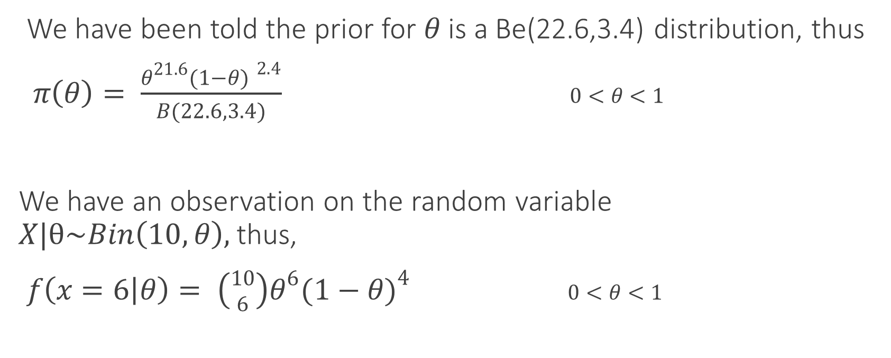
Finding Posterior Distribution
We have been told the prior for $θ$ is a Be(22.6,3.4) distribution, thus
$π\left(θ\right)= \frac{θ^{21.6}{(1−θ) }^{2.4}}{B(22.6,3.4)}$ $0<θ<1$
We have an observation on the random variable $X|θ\sim Bin\left(10,θ\right),$thus,
$f\left(x=6 | θ\right)= \left({10 \atop 6}\right)θ^{6}{(1−θ)}^{4}$ $0<θ<1$

Slide 5
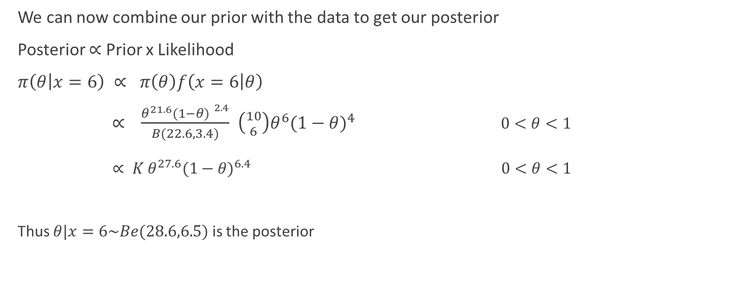
Finding Posterior Distribution
We can now combine our prior with the data to get our posterior
Posterior $∝$ Prior x Likelihood
$π\left(θ | x=6\right) ∝ π\left(θ\right)f\left(x=6 | θ\right)$
$∝$ $\frac{θ^{21.6}{(1−θ) }^{2.4}}{B(22.6,3.4)}$ $\left({10 \atop 6}\right)θ^{6}{(1−θ)}^{4}$ $0<θ<1$
$∝ K θ^{27.6}{(1−θ)}^{6.4}$ $0<θ<1$
Thus $θ|x=6\sim Be(28.6,6.5)$ is the posterior

Slide 6

Compare Prior and Posterior means
Now, Prior : Be(22.6,3.4)
Posterior : Be(28.6,6.5)
Mean of a Beta(a,b) distribution : $\frac{a}{a+b}$
Thus, Prior mean : $\frac{22.6}{22.6+3.4}=$0.86923
And Posterior mean: $\frac{28.6}{28.6+6.5}=0.81481$

