Slide 1
MAS2317- Introduction to Bayesian Statistics
Ryan Doran

Slide 2
Question 15)
Richard plays “flip to win” with a student
They flip a coin
If the coin lands heads up, the student gets £5
If the coin lands tails, the student must buy Richard a pint
Five students play this game with Richard and only one head is observed.

Slide 3
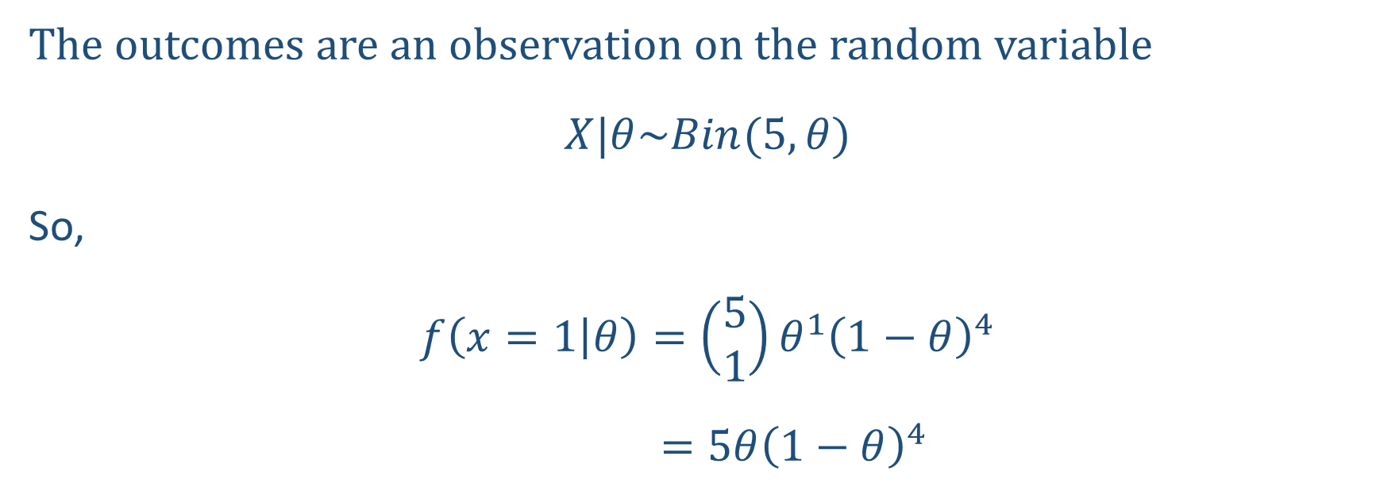
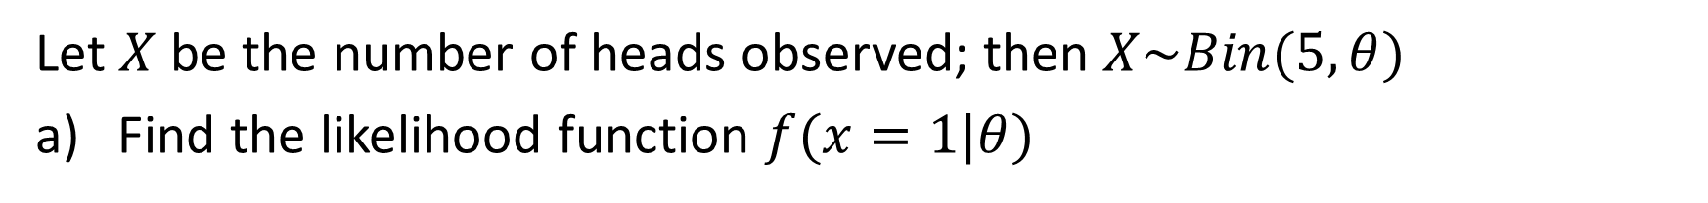
Let $X$ be the number of heads observed; then $X\sim Bin(5, θ)$
Find the likelihood function $f(x=1|θ)$
The outcomes are an observation on the random variable
$$X|θ\sim Bin(5, θ)$$
So,
$$f\left(x=1 | θ\right)=\left(\begin{matrix}5 \\ 1\end{matrix}\right)θ^{1}{\left(1−θ\right)}^{4}$$
$$=5θ{\left(1−θ\right)}^{4}$$

Slide 4
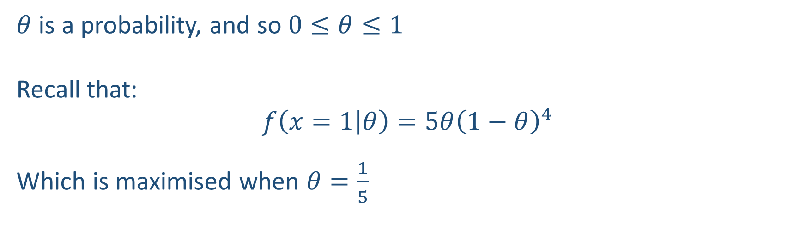
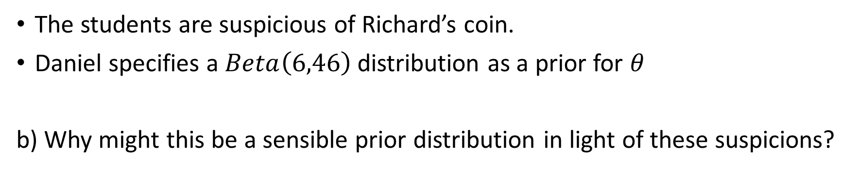
The students are suspicious of Richard’s coin.
Daniel specifies a $Beta\left(6,46\right)$ distribution as a prior for $θ$
b) Why might this be a sensible prior distribution in light of these suspicions?
$θ$ is a probability, and so $0≤θ≤1$
Recall that:
$$f\left(x=1 | θ\right)=5θ{\left(1−θ\right)}^{4}$$
Which is maximised when $θ=\frac{1}{5}$

Slide 5

We can work out the expectation of the $Beta\left(6,46\right)$ distribution
$$\frac{6}{6+46}=\frac{3}{23}=0.130434……..$$

Slide 6
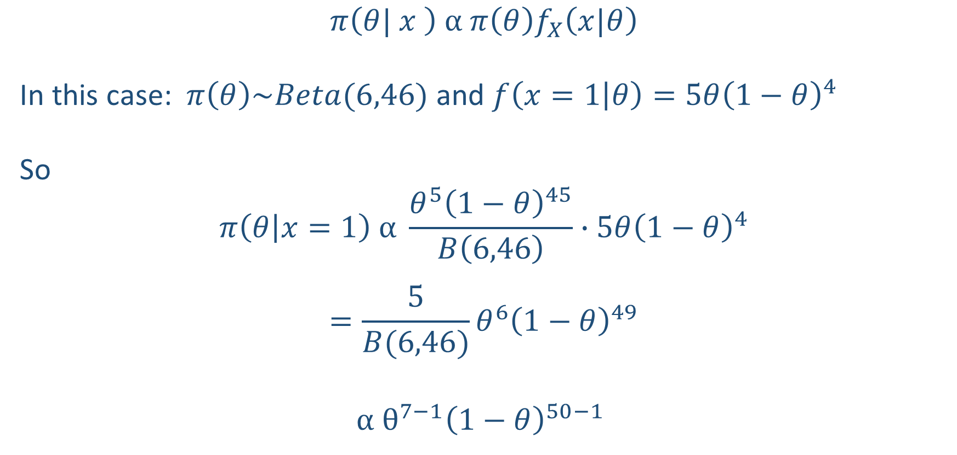
c) Obtain the posterior distribution for $θ$, $π\left(θ| x=1\right)$
$$π\left(θ| x \right) α π\left(θ\right)f_{X}\left(x|θ\right)$$
In this case: $π\left(θ\right)\sim Beta(6,46)$ and $f\left(x=1 | θ\right)=5θ{\left(1−θ\right)}^{4}$
So
$$π\left(θ | x=1\right) α \frac{θ^{5}{\left(1−θ\right)}^{45}}{B\left(6,46\right)}∙5θ{\left(1−θ\right)}^{4}$$
$$=\frac{5}{B(6,46)}θ^{6}{\left(1−θ\right)}^{49}$$
$$α θ^{7−1}{\left(1−θ\right)}^{50−1}$$

Slide 7

$$π\left(θ | x=1\right) α { θ}^{7−1}{\left(1−θ\right)}^{50−1}$$
So our posterior is
$$θ|(x=1) \sim Be(7, 50)$$
We can check:
$$E\left[θ|x=1\right]=\frac{7}{50+7}=0.1228……$$
Richard cheating?!

