Slide 1
MAS2317 Question 3 (12 in notes)
By Robert Gilbert

Slide 2
The time until a bicycle tyre gets punctured is exponentially distributed with mean $1/θ$ weeks. From a cyclist, we are able to elicit the following prior for θ:
$$π\left(θ\right)= \frac{{100}^{6}}{120}θ^{5}e^{−100θ}$$
a.) Identify fully the distribution of $π(θ)$.
b.) The cyclist records the times that two tyres last, and his readings (in weeks) are 33 and 41. Find how his beliefs about θ change in light of these data.

Slide 3
a.) Identify fully the distribution of $π(θ)$.
$π\left(θ\right)= \frac{{100}^{6}}{120}θ^{5}e^{−100θ}$
The pdf for Ga(α,β) is:
$\frac{β^{α}}{Γ(α)}x^{α−1}e^{−βx}$
From this we can clearly see that:
$π\left(θ\right)\sim Ga(6,100)$

Slide 4
As our prior is distributed Ga(6,100);
The mode of our prior is;
$\frac{6−1}{100}=0.05$
Also the mean is;
$\frac{6}{100}=0.06$
And the variance is;
$\frac{6}{{100}^{2}}=0.0006$

Slide 5
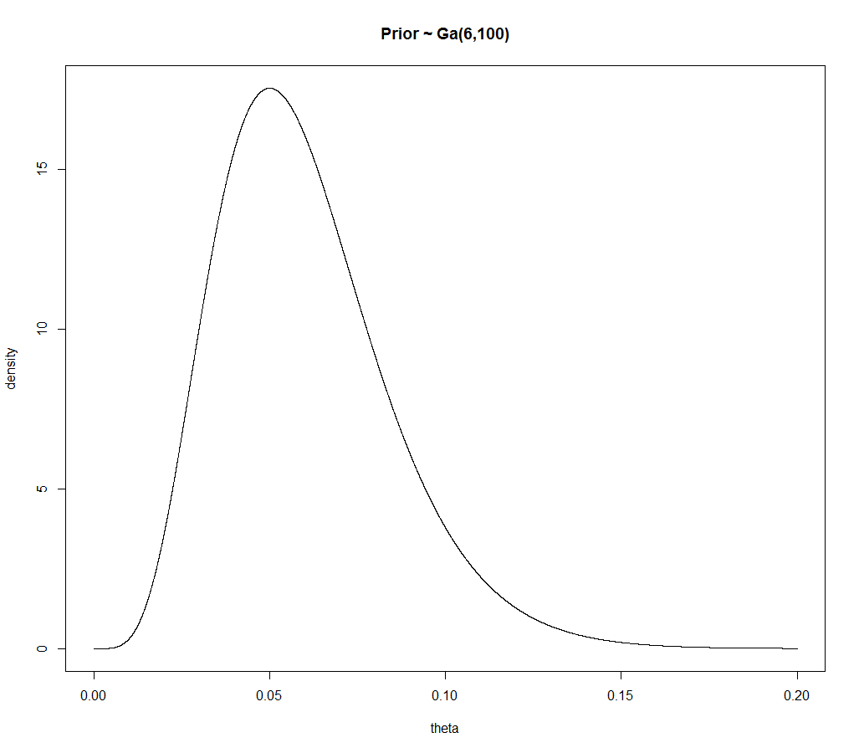

Slide 6
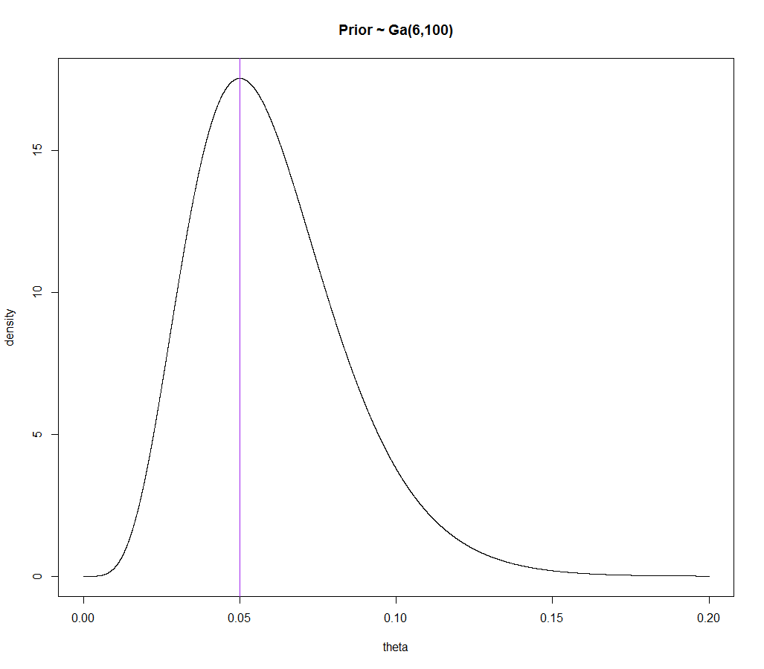
Mode

Slide 7
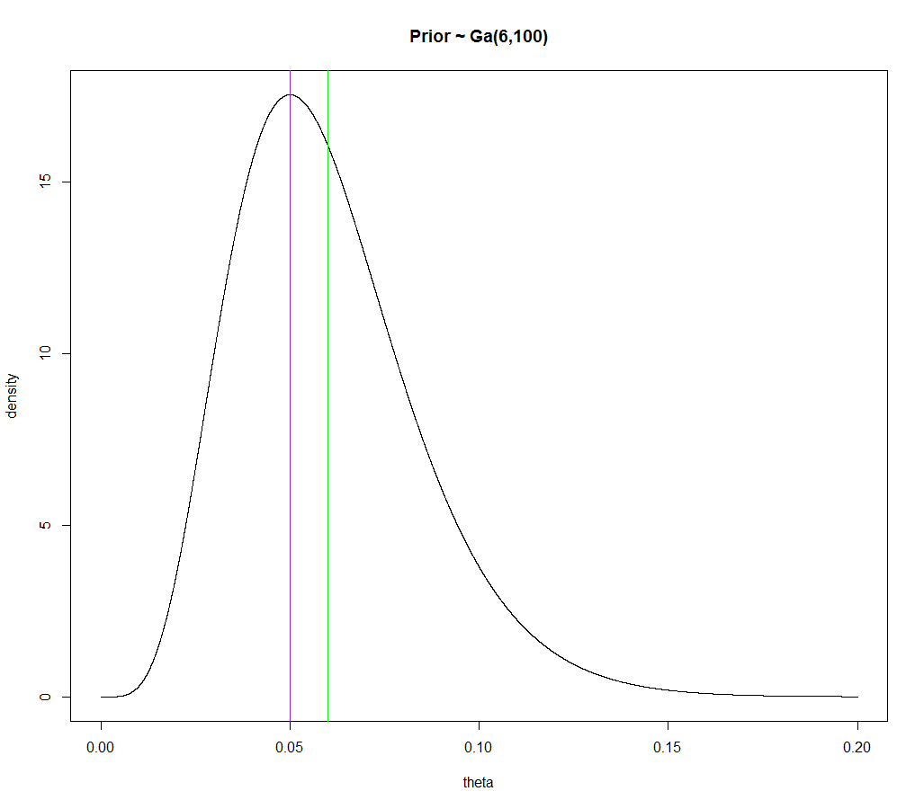
Mode
Mean

Slide 8
b.) The cyclist records the times that two tyres last, and his readings (in weeks) are 33 and 41. Find how his beliefs about θ change in light of these data.
$π(θ$|x$) α π\left(θ\right)f($x$|θ)$
Posterior α Prior x Likelihood
$π(θ$|x$) α \frac{{100}^{6}}{120}θ^{5}e^{−100θ} \text{x} 33e^{−33θ} \text{x} 41e^{−41θ}$
$α θ^{5}e^{−174θ}$
We can recognise this as coming from a gamma distribution:
$θ$|x $\sim Ga(6,174)$
Very important! Learn for exam! (We all know this).

Slide 9
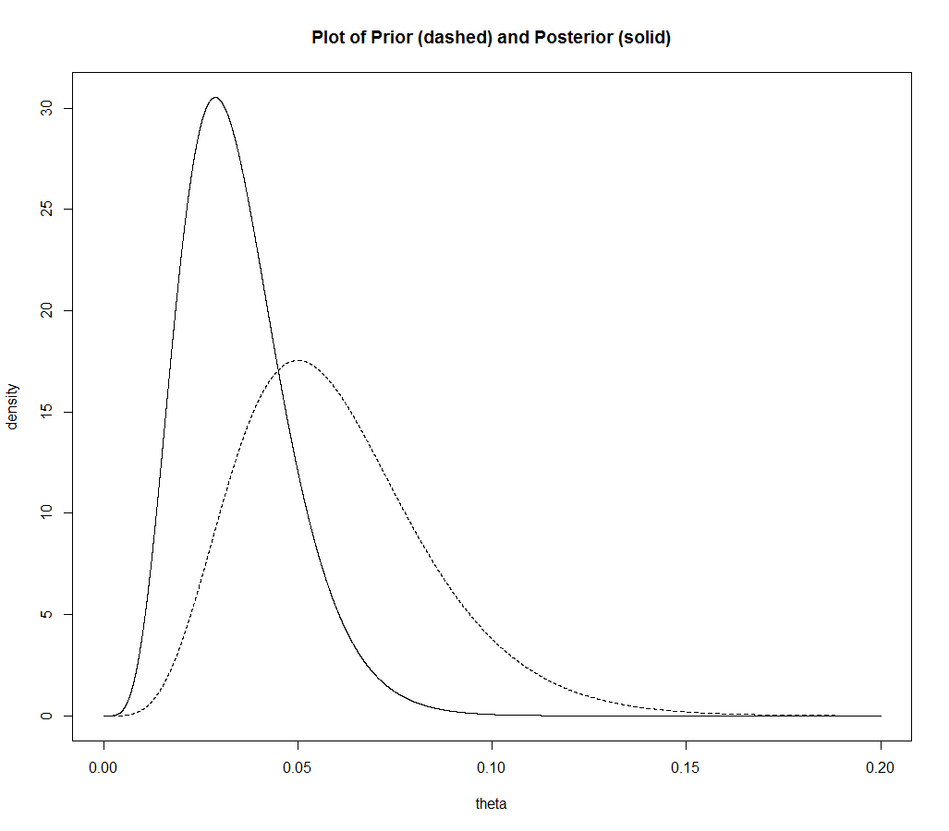

Slide 10
As we can see above the mode has moved down from 0.05 to 0.0287 and the mean has moved down from 0.06 to 0.0345.
This would represent a change in our belief where we now believe that the bike tyres last longer than we originally thought.
 | Prior ~ Ga(6,100) | Posterior ~ Ga(6,174)
Mode = $\frac{α−1}{β}$ | 0.05 | 0.0287
Mean = $\frac{α}{β}$ | 0.06 | 0.0345
Variance = $\frac{α}{β^{2}}$ | 0.0006 | 0.000198

