Slide 1
MAS2317 Presentation
Jake McGlen

Slide 2
Assuming vague prior knowledge, obtain the posterior distribution for µ and hence construct a 95% Bayesian conﬁdence interval for µ and comment on your results.
14. A sports scientist measures the rate of oxygen consumption of 10 randomly chosen athletes immediately after exercise. The sample mean is $\overline{x}$= 2.25 litres per minute and she assumes a Normal distribution for these measurements with a standard deviation of $\frac{1}{\sqrt{6}}$ litres per minute.

Slide 3
The Normal Distribution is given as µ$\sim N(\text{µ} \text{,} {\text{σ} }^{2})\text{.}$
µ in this case is known by using $\overline{x}$= 2.25 and $\text{σ}$ is told to us to be $\frac{1}{\sqrt{6}}$. Therefore the normal distribution is given by µ$\sim N(\text{2.25 }\text{,}\frac{1}{6} )\text{.}$If the prior is known to be µ$\sim N(\text{b} \text{,}\frac{1}{d} )\text{, }$then the posterior distribution is µ|x$\sim N(\text{B}\text{ ,}\frac{1}{D} )\text{;}$
Where $B=\frac{db+nτ\overline{x} }{d+nτ}$ ,$D=d+nτ ,n=10,τ=6 and$
$$\overline{x}=2.25.$$

Slide 4
If we now proceed to use vague prior knowledge about µ, we let the prior variance tend to ∞ (d→0).
This causes B→$\overline{x}$ and D→$nτ$as d→0, creating the posterior distribution of µ|x$\sim N(\overline{x}\text{,}\frac{1}{nτ} )$.
Using the information from the previous slide, the distribution is µ|x$\sim N\left(\text{2.25}\text{,}\frac{1}{60} \right).$

Slide 5
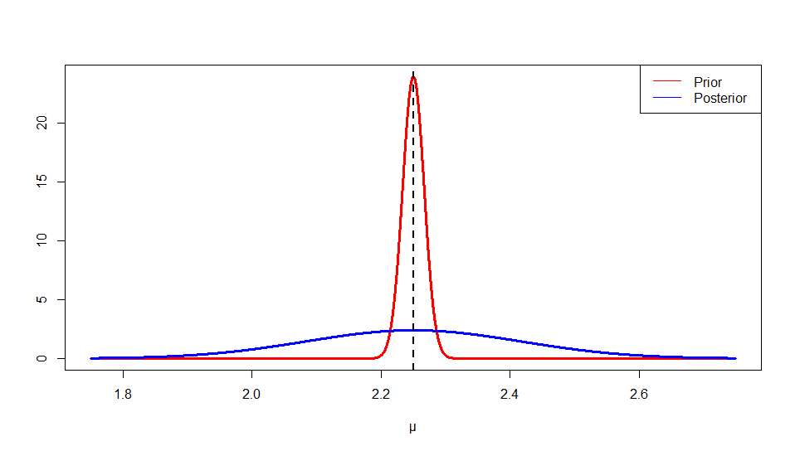
The mean does not change for a normal distribution. The posterior distributions shape is much more compact than the original prior distribution as the variance is ten times smaller This makes the distribution more precise.

Slide 6
For a 95% interval we use the formula 2.25 ±$\frac{1.96}{\sqrt{60}}$. This gives the answer (1.997, 2.503).
We now need to find the 95% Bayesian conﬁdence interval for µ and comment on the results.
This confidence interval shows the probability of capturing the true value of µ to be 0.95. A range of 0.506 is a precise region for µ. This is a smaller range than would have been given if we used the frequentist prior distribution.

