Slide 1
MAS2317 Question 12
Brandon Gourlay-Herring

Slide 2
Question 12
In viewing a section through the pancreas, doctors see what are called “islands”. The number of islands seen in 900 patients are summarised below.
Assuming that the numbers of islands are Poisson distributed with mean θ, obtain the posterior mean and standard deviation for θ from several gamma Ga(g,h) prior distributions (with g and h in the range 1-50 – choose around 5 values in this range). Why is the posterior distribution quite insensitive to variations in the prior distribution?
Number of Islands | 0 | 1 | 2 | 3 | 4 | 5 | 6 | ≥7
Frequency | 327 | 340 | 160 | 53 | 16 | 3 | 1 | 0

Slide 3
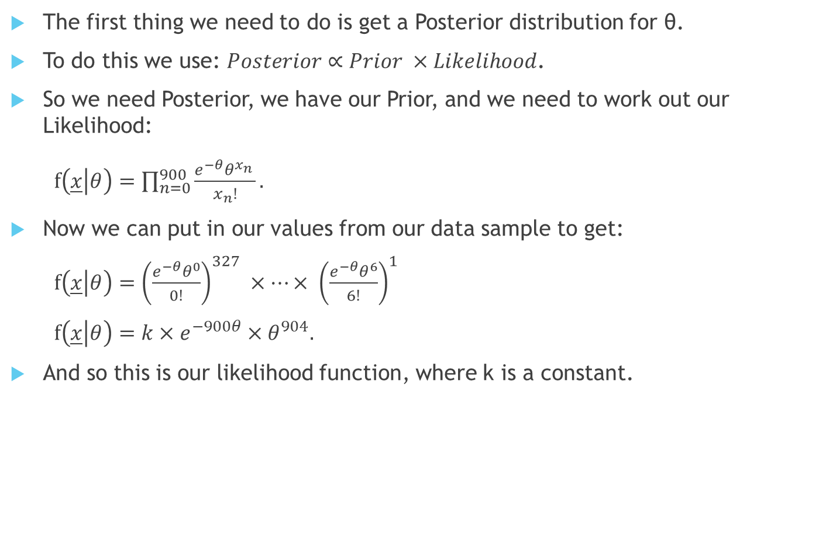
The first thing we need to do is get a Posterior distribution for θ.
To do this we use: $Posterior∝Prior ×Likelihood$.
So we need Posterior, we have our Prior, and we need to work out our Likelihood:
$f\left(\underline{x} | θ\right)=\prod_{n=0}^{900}{\frac{e^{−θ}θ^{x_{n}^{}}}{x_{n}!}}.$
Now we can put in our values from our data sample to get:
$f\left(\underline{x} | θ\right)={\left(\frac{e^{−θ}θ^{0}}{0!}\right)}^{327} ×…× {\left(\frac{e^{−θ}θ^{6}}{6!}\right)}^{1}$
$f\left(\underline{x} | θ\right)=k×e^{−900θ}×θ^{904}.$
And so this is our likelihood function, where k is a constant.

Slide 4
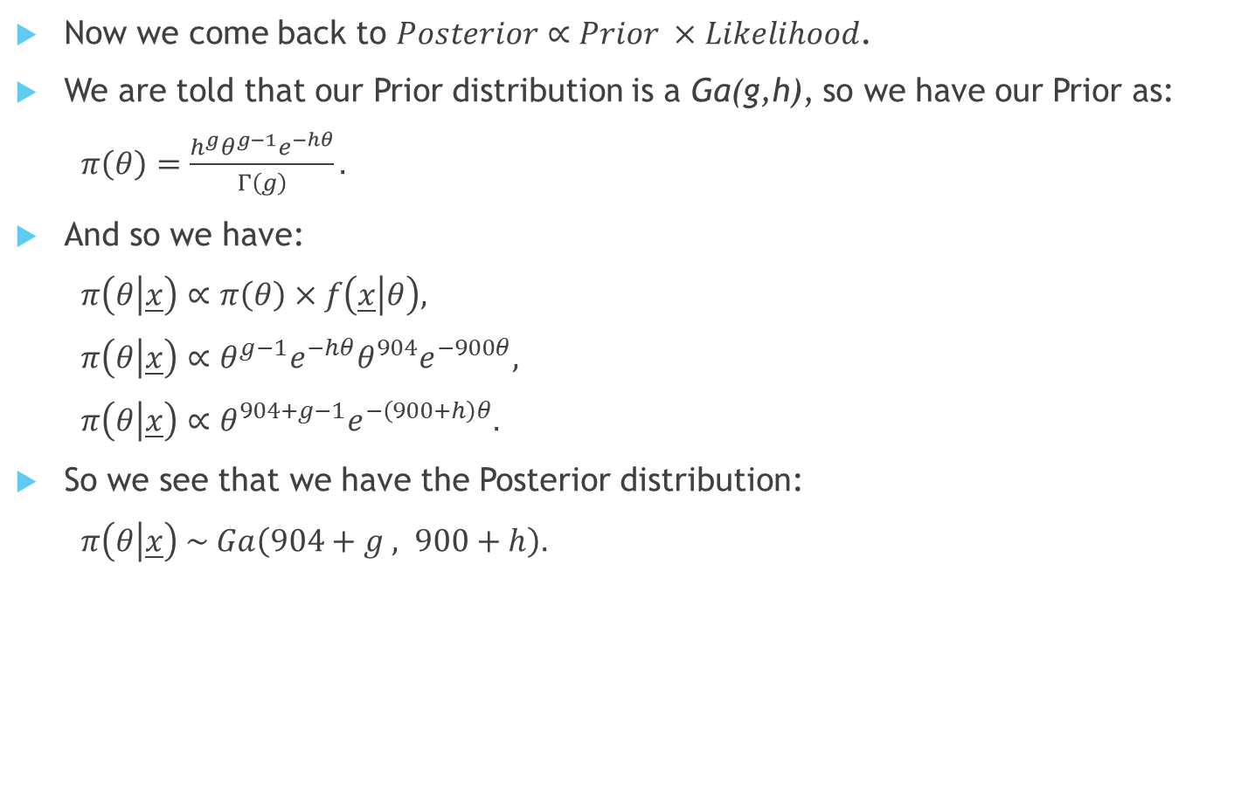
Now we come back to $Posterior∝Prior ×Likelihood$.
We are told that our Prior distribution is a Ga(g,h), so we have our Prior as:
$π\left(θ\right)=\frac{h^{g}θ^{g−1}e^{−hθ}}{Γ\left(g\right)}.$
And so we have:
$π\left(θ | \underline{x}\right)∝π\left(θ\right)×f\left(\underline{x} | θ\right),$
$π\left(θ | \underline{x}\right)∝θ^{g−1}e^{−hθ}θ^{904}e^{−900θ},$
$π\left(θ | \underline{x}\right)∝θ^{904+g−1}e^{−\left(900+h\right)θ}.$
So we see that we have the Posterior distribution:
$π\left(θ | \underline{x}\right) \sim Ga\left(904+g , 900+h\right).$

Slide 5
Now we are asked for the mean and standard deviation from our Posterior distribution with several different values of g and h between 1 and 50.
Here is a table showing the means and standard deviations of 5 different g,h combinations:
g,h | Distribution | Mean (5 d.p.) | S.D. (5 d.p.)
1,1 | Ga(905,901) | 1.00444 | 0.03339
50,50 | Ga(954,950) | 1.00421 | 0.03251
1,50 | Ga(905,950) | 0.95263 | 0.03167
50,1 | Ga(954,901) | 1.05882 | 0.03428
25,25 | Ga(929,925) | 1.00432 | 0.03295

Slide 6
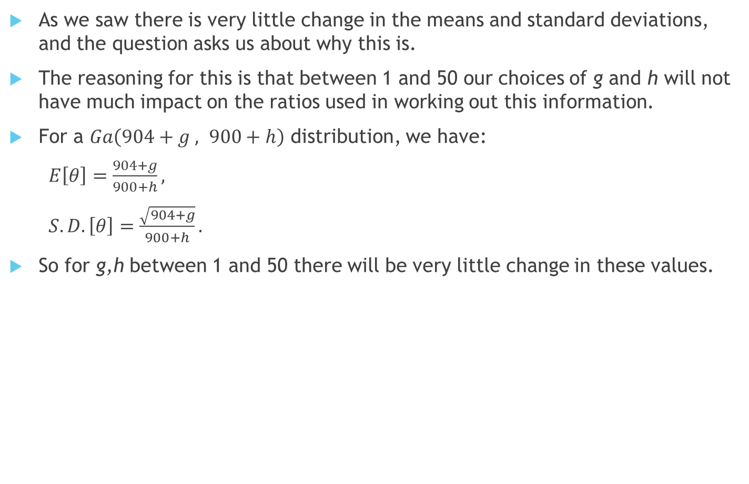
As we saw there is very little change in the means and standard deviations, and the question asks us about why this is.
The reasoning for this is that between 1 and 50 our choices of g and h will not have much impact on the ratios used in working out this information.
For a $Ga\left(904+g , 900+h\right)$ distribution, we have:
$E\left[θ\right]=\frac{904+g}{900+h},$
$S.D.\left[θ\right]=\frac{\sqrt{904+g}}{900+h}.$
So for g,h between 1 and 50 there will be very little change in these values.

Slide 7
The End
Thank you for listening

