Slide 1
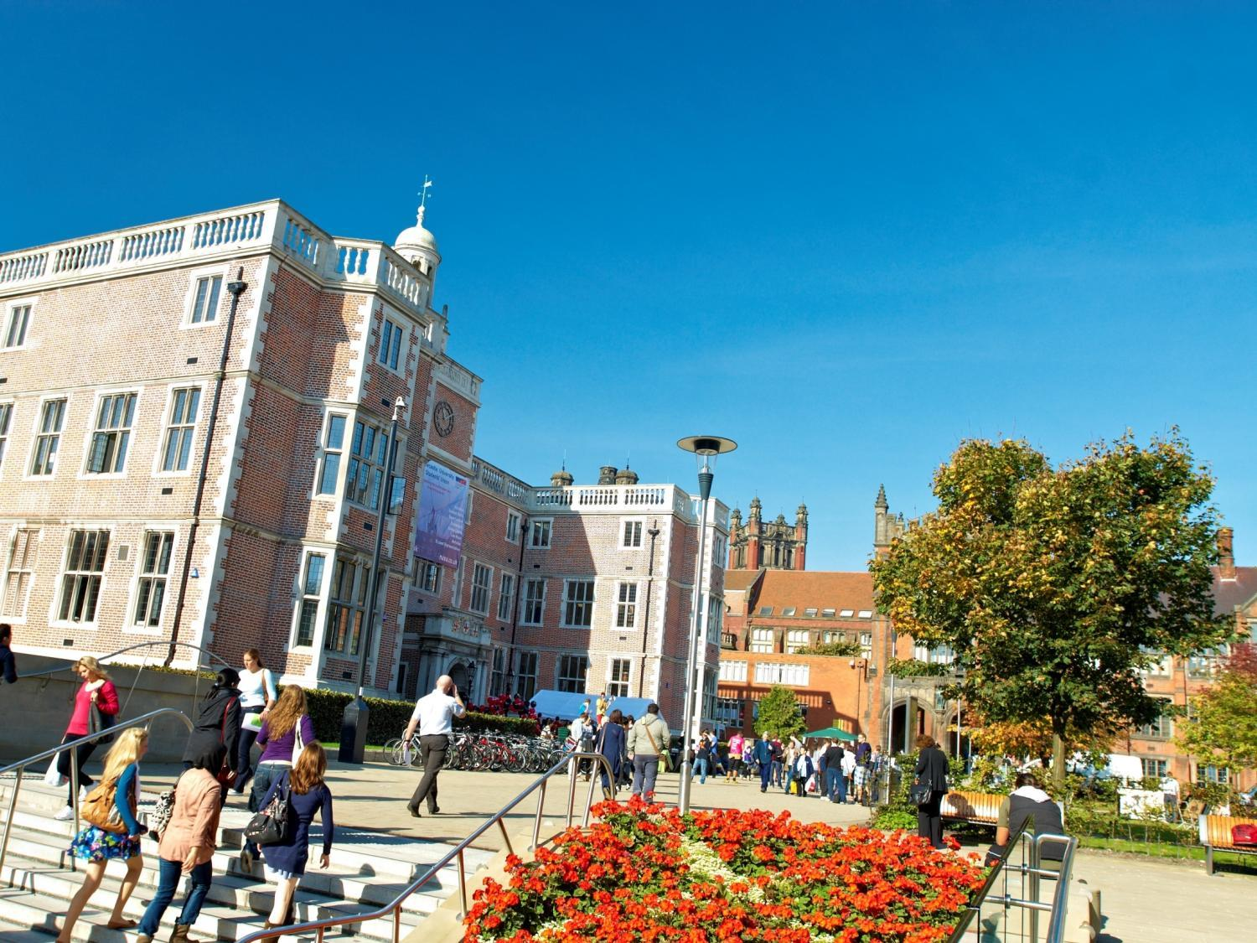


Dr. Lee Fawcett
School of Maths, Statistics & Physics
Newcastle University, UK
A Future in Mathematics (II)
@NCLMathsStats
www.ncl.ac.uk/maths

Slide 2
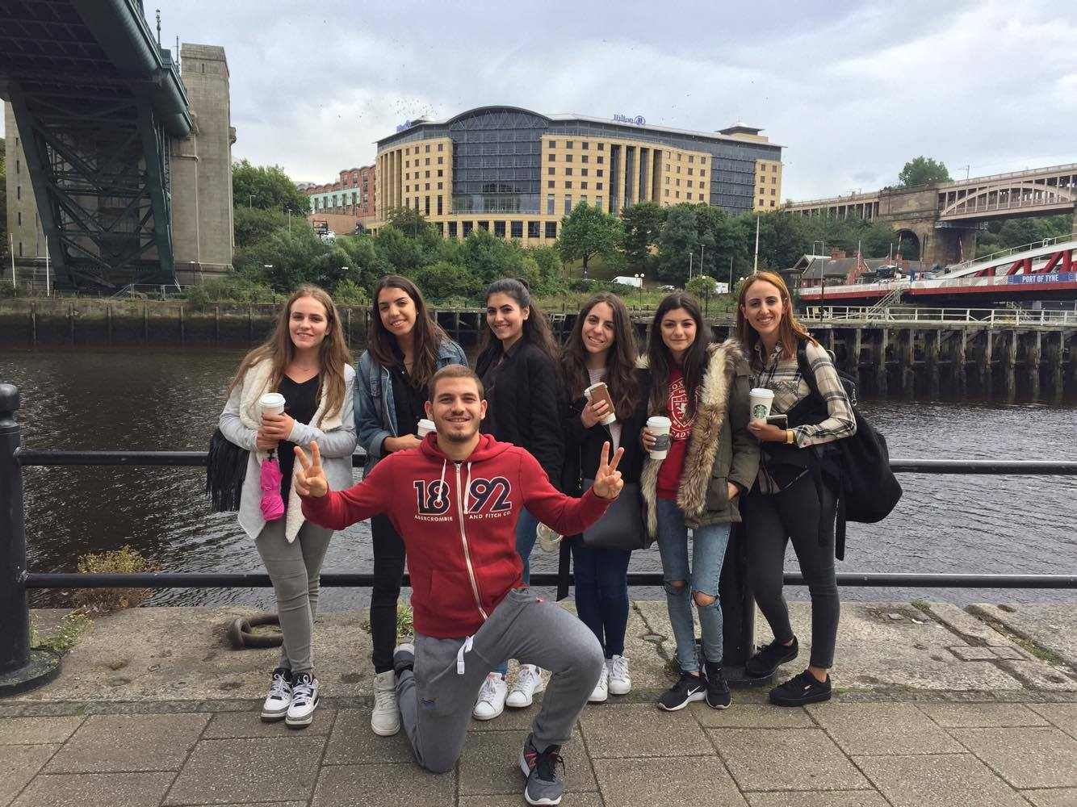
Recent students…

Slide 3
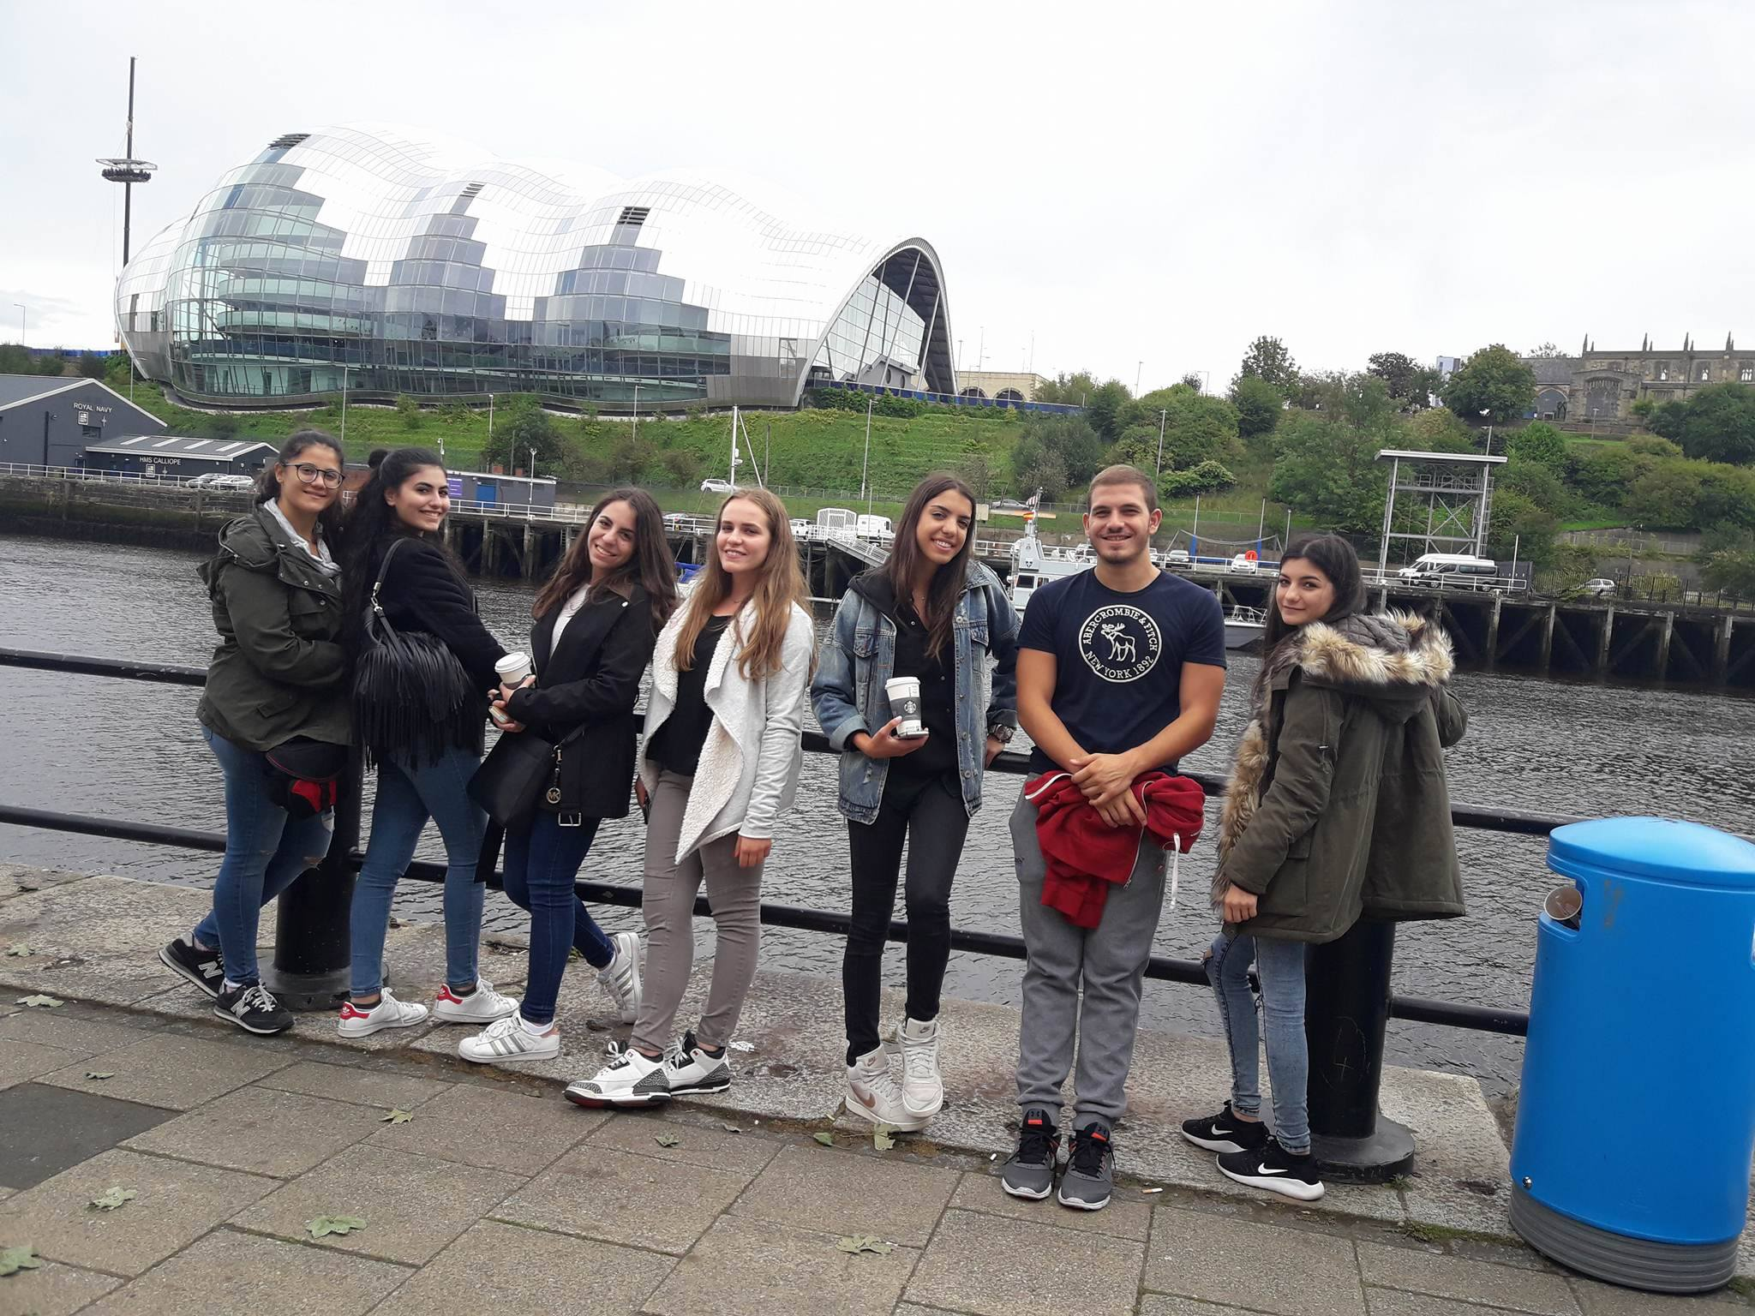

Slide 4
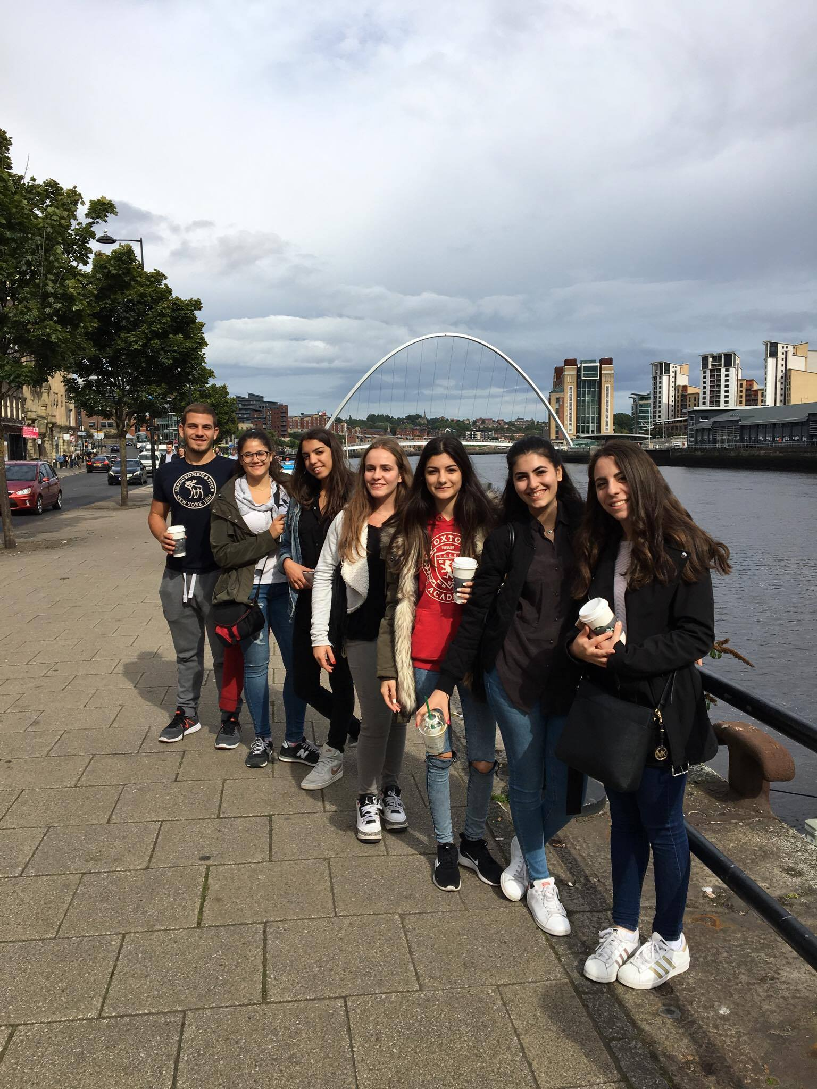
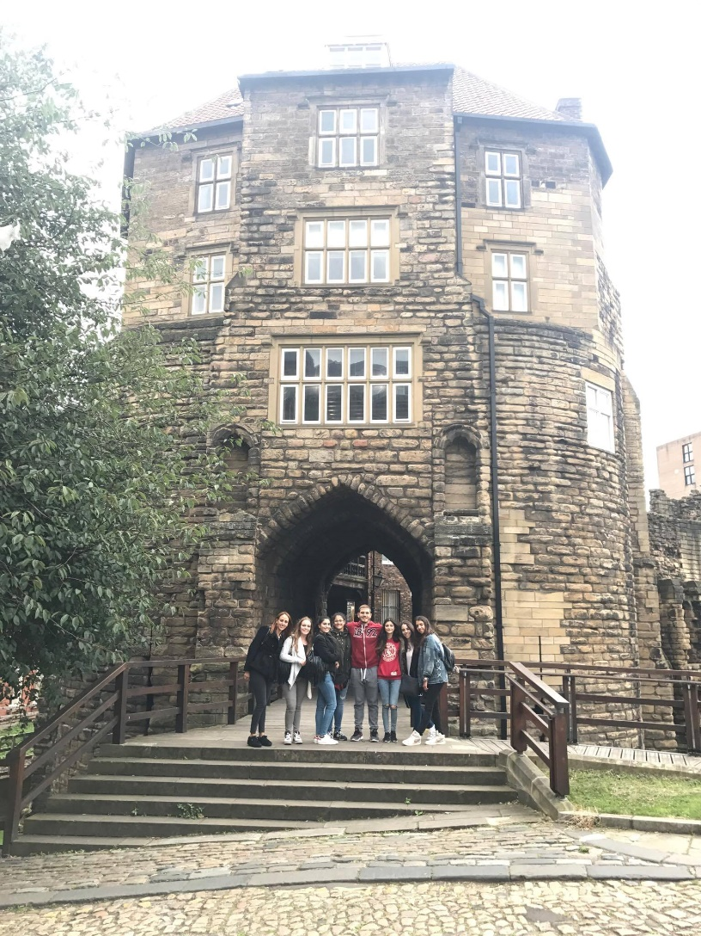

Slide 5
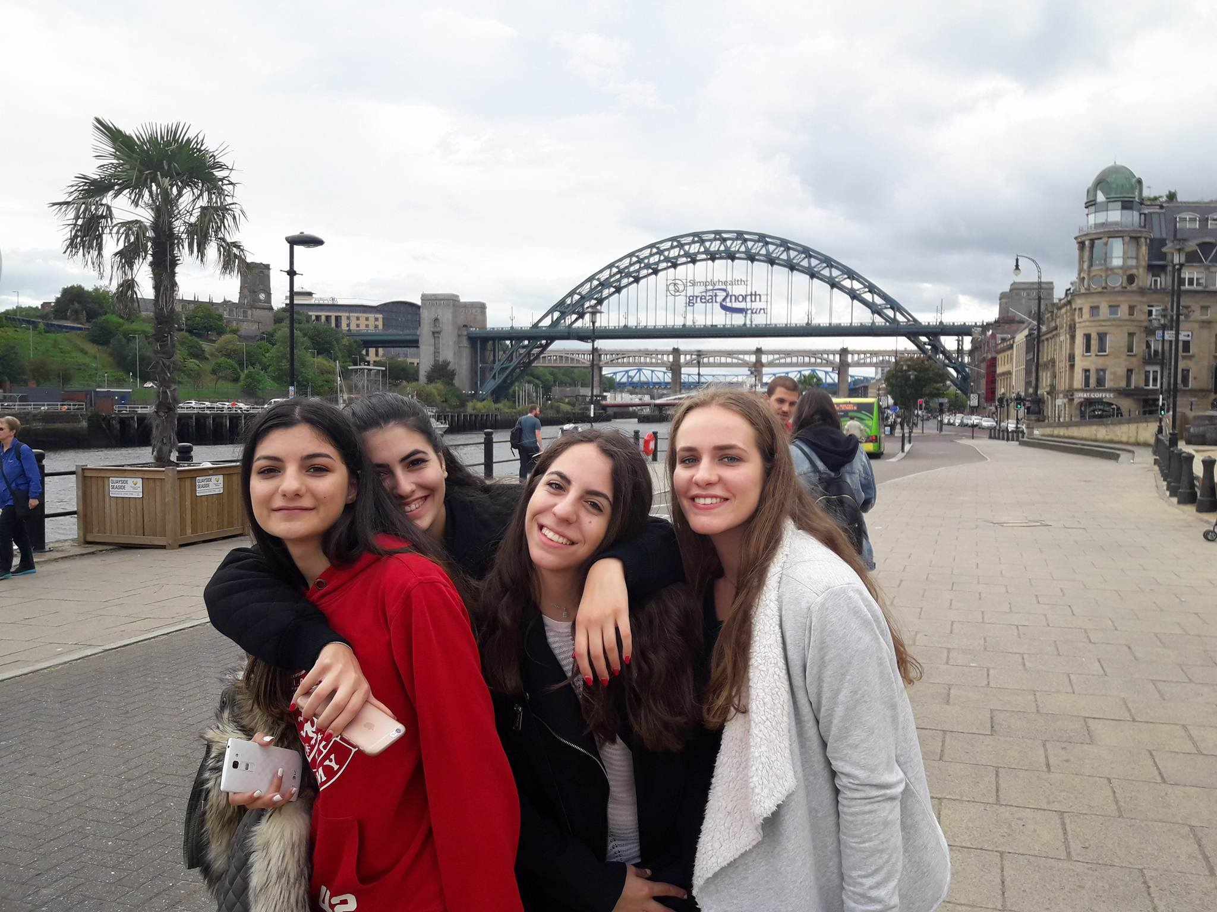

Slide 6


Slide 7
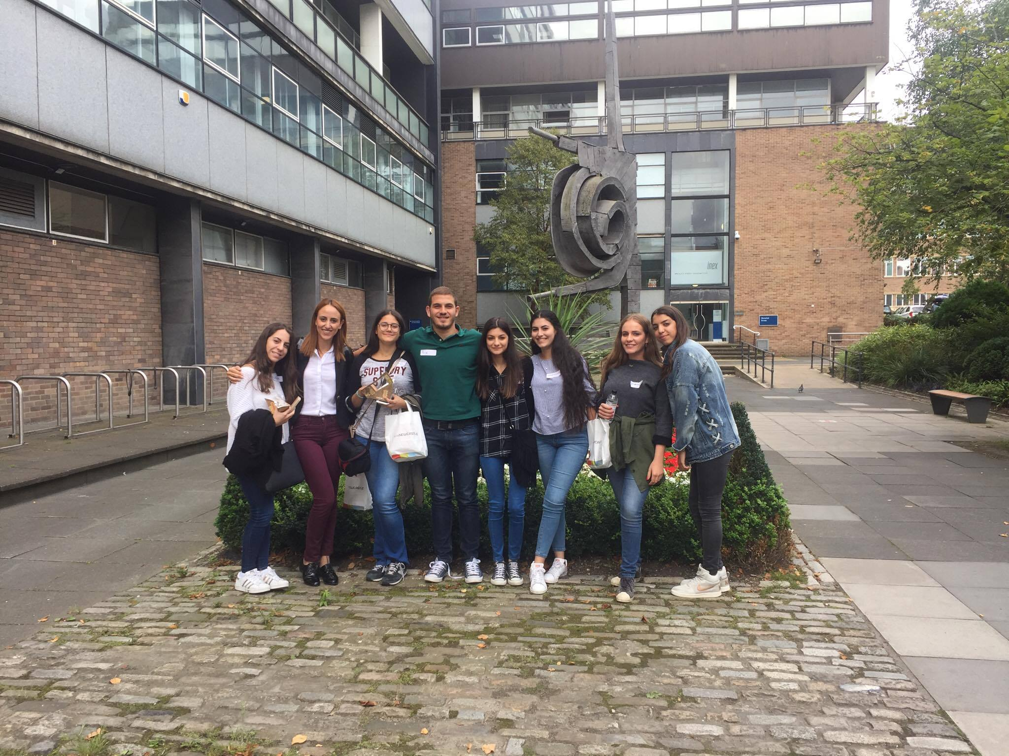
Recent students…

Slide 8
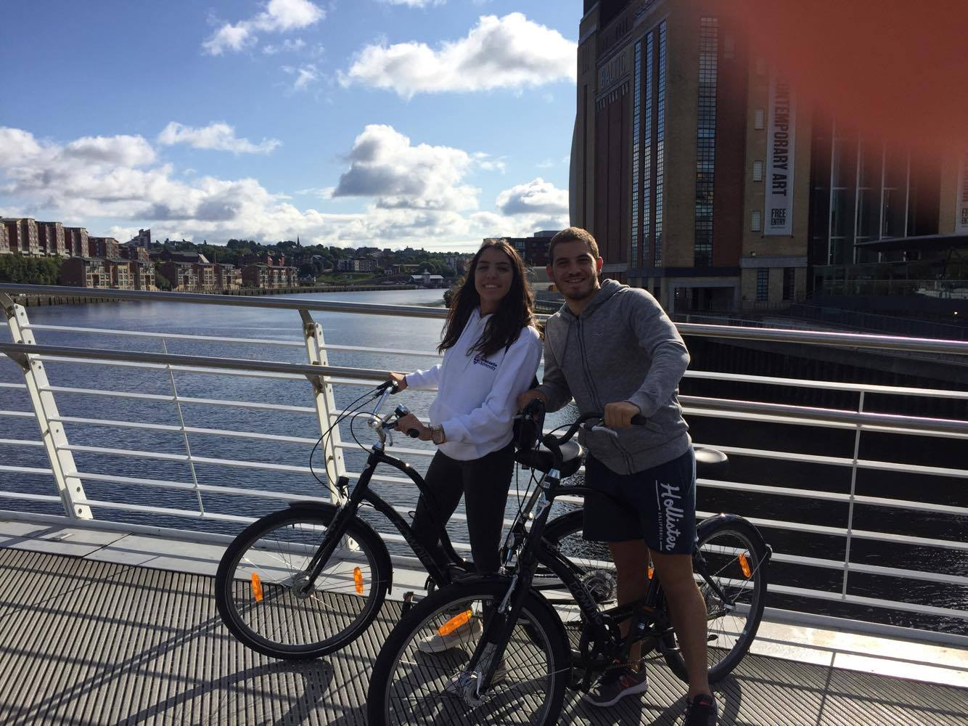

Slide 9
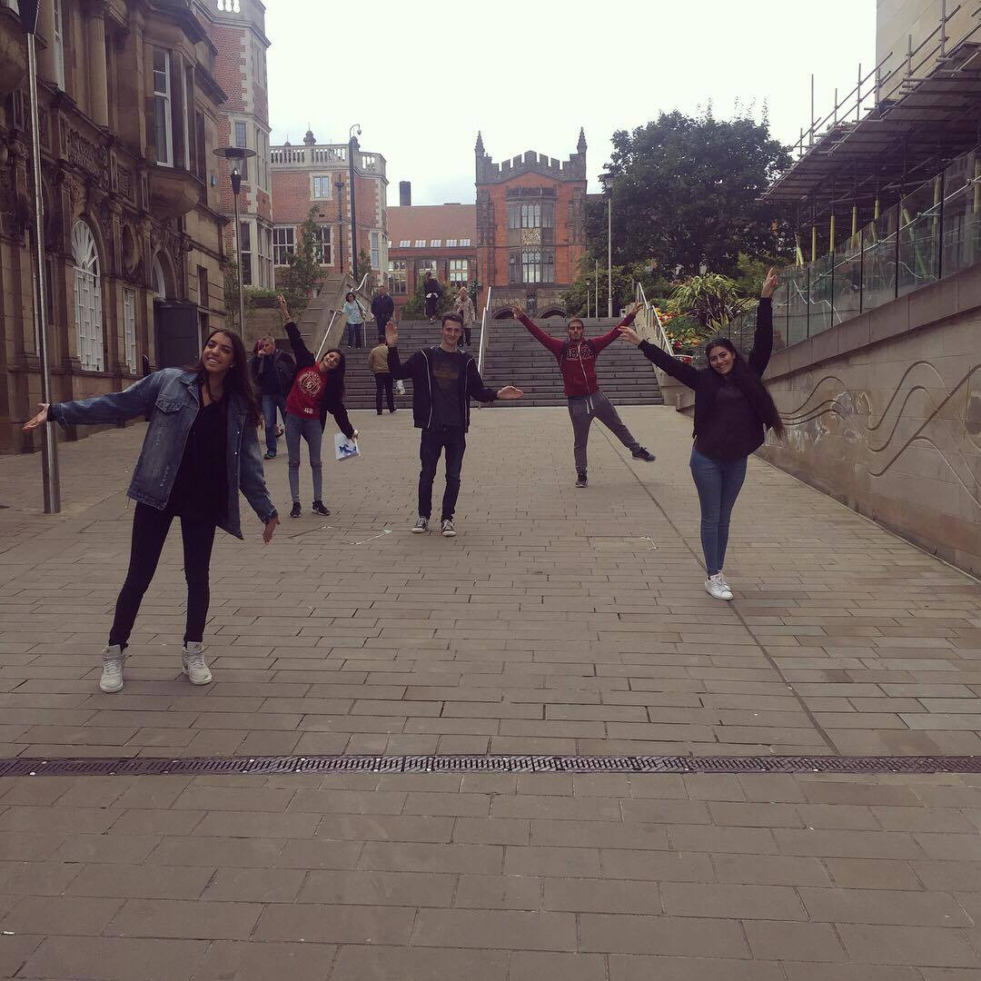

Slide 10
Summer School @ NCL
Boosts your CV
Did you enjoy it?
Boosts your UCAS application – to any University (but especially NCL…)
How could we improve the SS?
What were your impressions of NCL?
Please tell your younger colleagues about your experience!
NCL / Maths @ NCL??

Slide 11
Summer Project @ NCL
Well done!
Now use the experience to your advantage!
You all passed!
Applying to a UK University?
Going to study Mathematics?
Certificates and individual feedback will be given out now…
Want to study Maths at Newcastle ☺ ?

Slide 12
Offers and admissions
Typical Offers
“A level Monday”
Maximise your chances
AAA-ABB, depending on degree / A level subjects
Three piles: 1. Accept 2. Near miss 3. No way!
Make us your “firm choice”
Personal statement: Passion!
Other equivalents: e.g. 17 (overall) in Apolytirion + B
My hardest job: Prioritise students in pile #2!!
Talk about your time with us and your project!

Slide 13
Maths @ NCL this year
Record number of applications
More staff than
ever before
Record intake!!
Highest EU intake than ever before!
We will have 2 Cypriot students this year ☺ ☹
Decision-making process was harder than ever… UCAS personal statements!
We need you!

Slide 14
Maths @ NCL this year
Recent NSS: 97% Satisfaction!
New School: Maths, Stats & Physics
Curriculum review now established
Enhanced careers support
Exciting range of new courses in later years - some related to your SS lectures
New work placements /internships

Slide 15
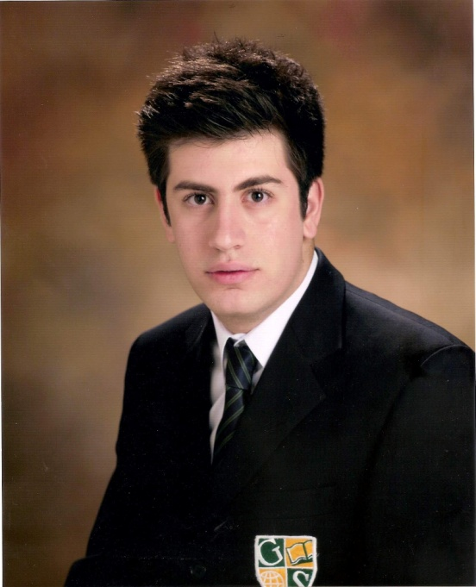
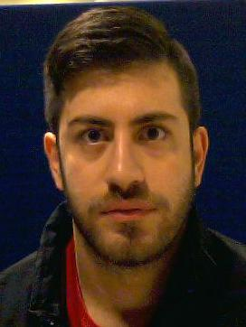
Georgios Melios
“
Top ranking University
City nightlife AMAZING!
Compact city – everything is within walking distance!
University facilities are amazing!
Excellent library services
”

Slide 16
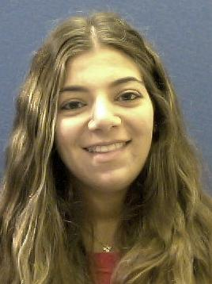
Demetra Demetriou
“
Courses are high-ranking
Very exciting University life
So many events for Freshers, and so easy to meet other people
Everything is within walking distance and the campus is right in the heart of the city
Newcastle University ALWAYS considers the needs of its students
Everyone I know at Newcastle loves it – University and the city!
”

Slide 17

Sarah Koullapi
“
I chose Newcastle University mainly because it provides me the maximum exemptions for the charted and certified accounting diplomas
The city is so compact and you don’t ever have to use transport
Newcastle is a cheap city, especially in comparison to London or Manchester
Most of the people at the university are friendly and helpful.
Accommodation excellent!
”

Slide 18

Student Finance
BREXIT ☹

Slide 19
Tuition Fee Loan
Tuition fee loan
Financial Body
Tuition Fees
Repayment
Funded by the country you apply to study in (e.g. England or Wales)
£9,250
(same for most)
Not until earning > £21,000
Investment in future
Not until after studying
Placement Years only pay £1,000

Slide 20
Loan repayments
Not until you earn above £21,000
Payments stop if income falls below
Repayment
Not until you finish studying
Based on what you earn, not what you owe
Repay 9% of income above £21,000
Written off if not repaid within 30 years
Notes:
If you earned £25,000 a year then you would repay £30 a month, which is approximately the price of a phone contract.

Slide 21

Interest
Interest
During Studies
Rate of Inflation (ROI) plus 3%
After
Studies
Earn less than £21,000: ROI
Earn between £21,000 - £41,000:
ROI plus up to 3%
Earn above £41,000: ROI plus 3%

Slide 22
Subject scholarships
Types:
Excellence Scholarship
Exceed Entry Requirement
Stage 4 Bursary
Year 2 and Year 3 Semester 1 mark above 70%
What you get:
£250 available for each grade above the requirement.
A* in Maths or Further Maths awarded an extra £250
Worth £1,000 per year
of study
Note – You must have achieved your minimum grades, e.g. A*BB will not receive £250
Notes:
So if you got 3xA*, you would get 3x£250 for beating your requirements, plus 2x£250 for A*’s in Maths and Further Maths.

Slide 23
Living costs
Phone bill
Accommodation
Toiletries
TV;
most halls don’t have TV licences
Clothes
Living Costs
Food
Insurance; belongings /
keys!
Study; recommended books
Travel;
To Uni / home / visit friends
Social Life

Slide 24
Money management
Part time Job;
Recommended
15 hours
or less
Use campus facilities; Library, Sports centre, Union etc.
Budget!
If you can’t
afford it,
don’t do it!
Shop around
for
the best
deals
Make it go further
Interest free overdraft! Don’t be drawn in by freebies
Walk
or
get a student
travel pass
Student Discount: Restaurants,
bars etc.
Buy books
second-hand
or
Use the library

Slide 25
Student Accommodation

Slide 26
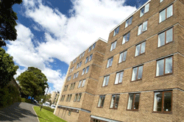
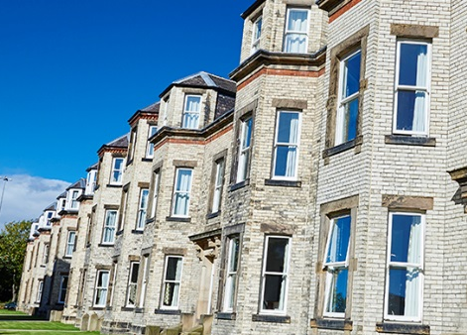
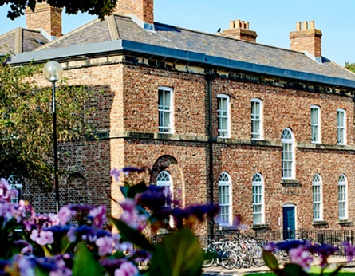
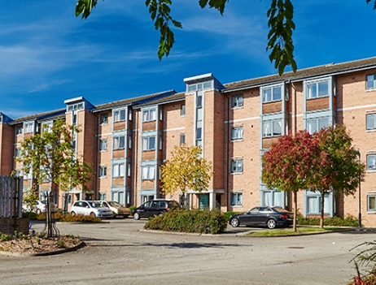
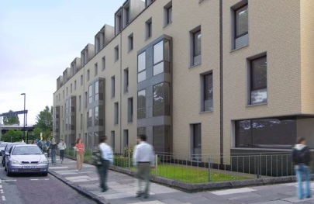
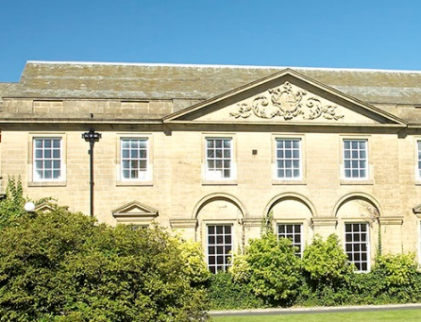
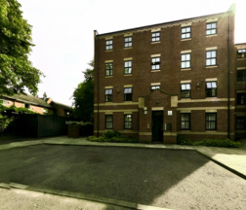
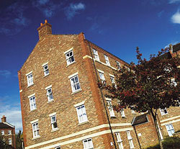
Castle Leazes
Kensington Terrace
Leazes Parade
The Halls
Bowsden Court
The Halls
The Halls
Park Terrace
St Mary’s
Windsor Terrace
Marris House

Slide 27


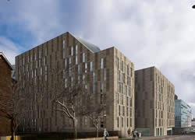
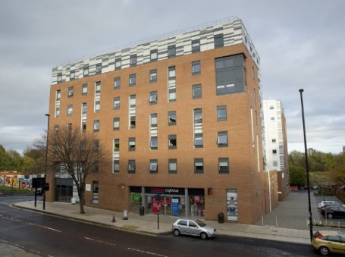
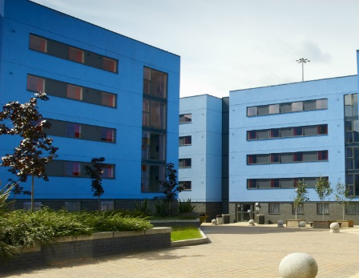
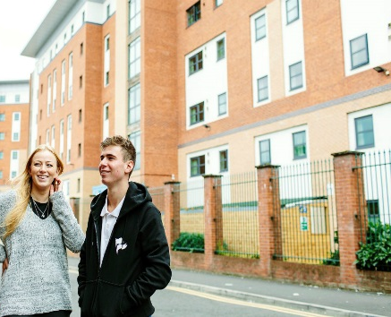
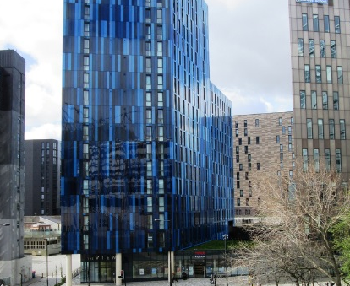
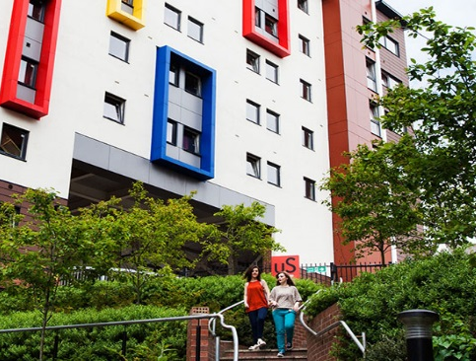
Barker House
Verde
Managed Partnership Accommodation
Liberty Plaza
The Halls
Turner Court
The Halls
Union State
Liberty Quay
The View
Manor Bank

Slide 28
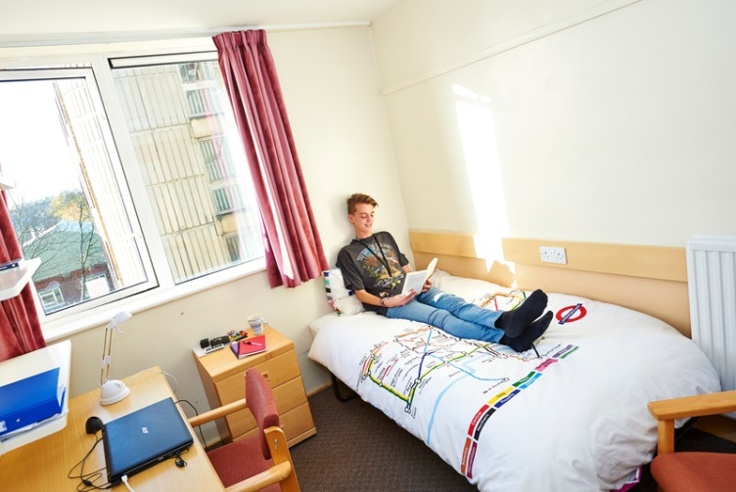
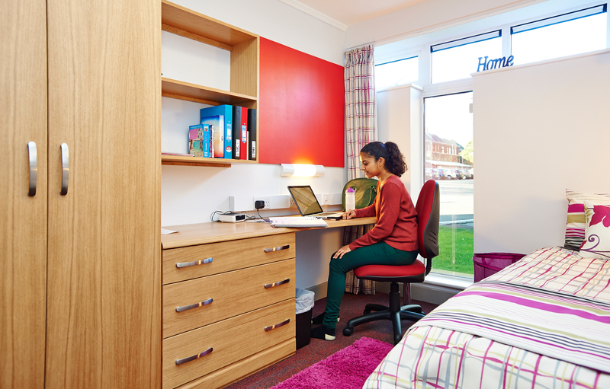
Typical rooms
To find out more detailed information and view our virtual tours for each of our halls of residence visit:
www.ncl.ac.uk/accommodation

Slide 29




What’s included?
Free internet connection
Launderette
Holidays included
Bicycle Storage
24 hour security
Bills

Slide 30
Things to consider
Self Catered/Catered
Affordability
Location
Mixed/Single Gender
Deluxe Room
Flat/Corridor Layout
Standard Washbasin Room
Smaller/Larger Community
Ensuite Room

Slide 31
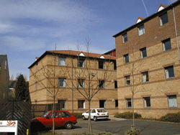


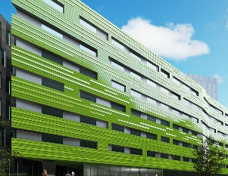
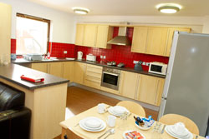
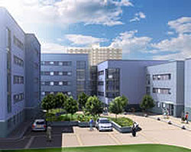
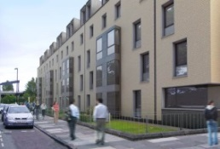
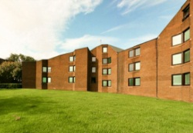
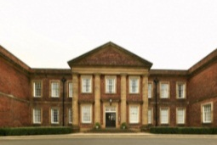

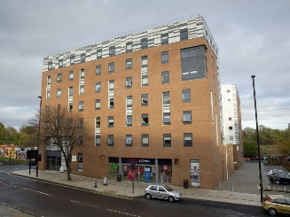



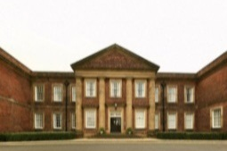

Comparing price
Least Expensive- £83 p/w
Most Expensive- £167p/w
Bowsden Court
Victoria Halls
Park Terrace
Richardson Rd
Bowsden Ct.
Liberty Quay
Park Terrace
Verde
Castle Leazes
Leazes
St Marys College
Marris House
Marris House
Marris House
St Mary’s
Marris House
Turner Court
Union State
Richardson Rd
The View
St Marys College
Windsor Tce.
Leazes Parade
Manor Bank
Liberty Plaza

Slide 32

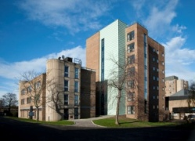
Comparing size
Smallest - 50 rooms
Largest - 1100 rooms
St Marys College
Bowsden Court
Bowsden Court
Marris House
Castle Leazes
Bowsden Court
Leazes Parade
Turner Court
St Marys College
Castle Leazes
Victoria Halls
Windsor Terrace
Park Terrace
Richardson Rd
Liberty Quay
Park Terrace
The View
Liberty Plaza
St Marys College
Park Terrace
Castle Court
Marris House
Marris House
Richardson Rd
Castle Court
Marris House
Manor Bank
Union State
Verde

Slide 33
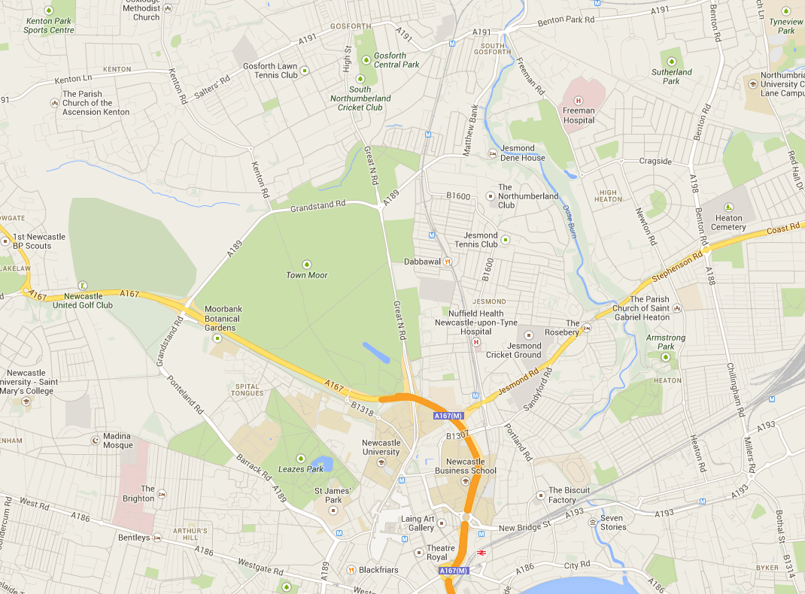

Routes from further away.
Bowsden Court
St Mary’s College
Park, Windsor & Kensington Terrace
Marris House
Castle Leazes, Castle Court & Leazes Parade
Newcastle University
Union State
Turner Court
Liberty Plaza, Verde & The View
Manor Bank & Liberty Quay

Slide 34









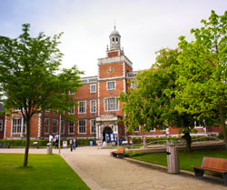
After halls
Lots of student properties
Remember extra costs
Support available
Typically 12 month contracts

Slide 35
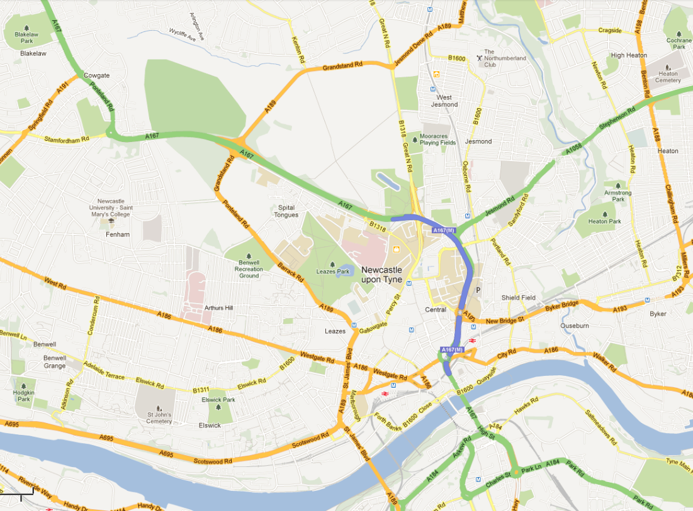
Jesmond
Spital Tongues
Heaton
Newcastle University
Fenham
Sandyford

Slide 36
Final words...

Slide 37
Facts & figures
Part of the UK’s prestigious “Russell Group”
Top 1% of Universities in the world
16th in the UK for global research power
International students put Newcastle in the world’s top 12
12th in the UK for student satisfaction
School of Maths & Stats in the UK top 10
Financial incentives available for good students

Slide 38



Keep in touch
Follow
‘@NCLMathsStats’
Email
‘mathsandstats@ncl.ac.uk’
Visit
‘www.ncl.ac.uk/maths’

Slide 39
Any questions?
@NCLMathsStats

