Slide 1
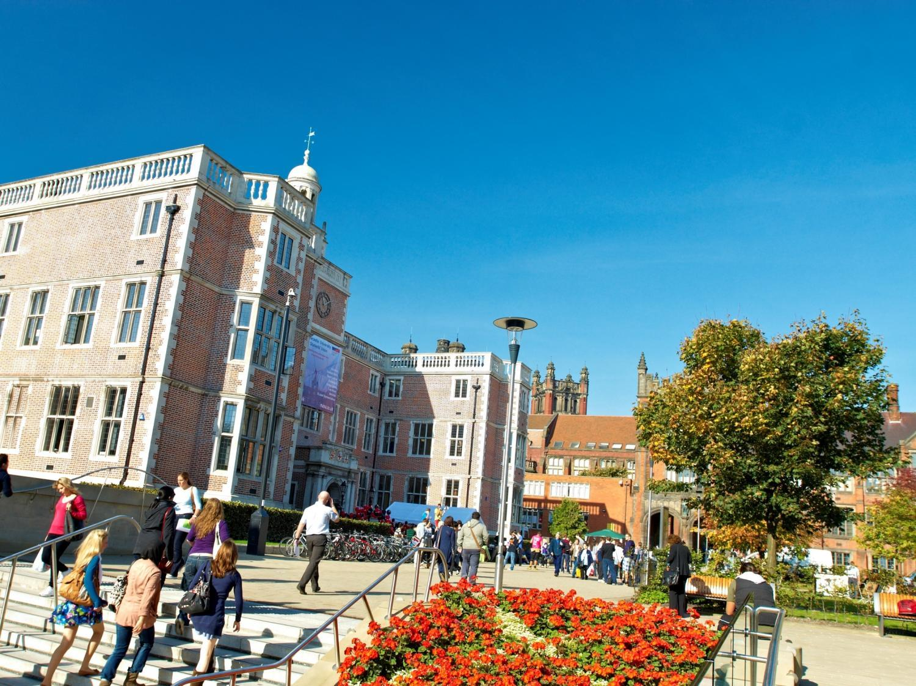


Dr. Lee Fawcett
School of Maths, Statistics & Physics
Newcastle University, UK
A Future in Mathematics
@NCLMathsStats
www.ncl.ac.uk/maths

Slide 2
Who am I?
Lee Fawcett
Lecturer in Statistics at Newcastle University, UK
  Teaching: 1st year, 2nd year and 4th year undergraduate Mathematicians, and students from many other subjects!
  Research: Statistical modelling of environmental extremes
  Outreach: Tell people what we do, and how good Mathematics & Statistics is!

Slide 3
What am I doing here?
Outreach
  Further study in Mathematics
  Careers after studying Mathematics
  Real world applications of Mathematics, including cool research areas
Cypriot students at Newcastle University: Hard-working, motivated and aspirational

Slide 4
A Future in Mathematics
Real world applications
Careers
Mathematics at Newcastle
Newcastle: City and Social
Opportunities @ NCL

Slide 5

Real world applications

Slide 6


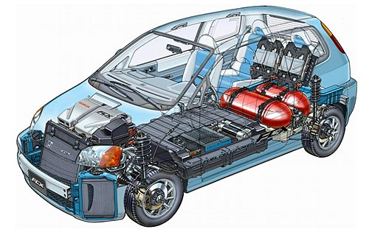

What is STEM?
STEM
CIENCE
ECHNOLOGY
NGINEERING
ATHS
Notes:
STEM acronym brings together the words science, technology, engineering and mathematics - words which are associated with some of the most important and exciting areas of human endeavour

Slide 7
Maths is everywhere…
Decisions...
Digital music
Phones and internet
Satellite Navigation
Cryptography
Crowd control
Rockets and Satellites
Crime prediction
Game theory
Volcano monitoring
Carbon dating
Cosmology
Computer games
Movie Graphics
Search Engines
Epidemic Analysis
Military and Defence
Skate park design
CDs and DVDs
Speech recognition
Climate extremes
Fraud detection
Data compression
Wildfire modelling
Financial Modelling

Slide 8
Maths is everywhere…
Decisions...
Digital music
Phones and internet
Satellite Navigation
Cryptography
Crowd control
Rockets and Satellites
Crime prediction
Game theory
Volcano monitoring
Carbon dating
Cosmology
Computer games
Movie Graphics
Search Engines
Epidemic Analysis
Military and Defence
Skate park design
CDs and DVDs
Speech recognition
Climate extremes
Fraud detection
Data compression
Wildfire modelling
Financial Modelling

Slide 9
Decisions...
Notes:
Big businesses use Maths/Stats to make important decisions – e.g. optimal investment strategies, staffing levels, product quality control, consumer trends, marketing decisions… the list goes on and on…

Slide 10
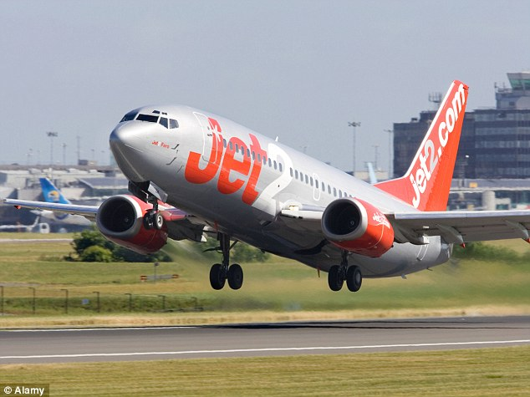

Slide 11
Maths is everywhere…
Decisions...
Digital music
Phones and internet
Satellite Navigation
Cryptography
Crowd control
Rockets and Satellites
Crime prediction
Game theory
Volcano monitoring
Carbon dating
Cosmology
Computer games
Movie Graphics
Search Engines
Epidemic Analysis
Military and Defence
Skate park design
CDs and DVDs
Speech recognition
Climate extremes
Fraud detection
Data compression
Wildfire modelling
Financial Modelling

Slide 12
Maths is everywhere…
Decisions...
Digital music
Phones and internet
Satellite Navigation
Cryptography
Crowd control
Rockets and Satellites
Crime prediction
Game theory
Volcano monitoring
Carbon dating
Cosmology
Computer games
Movie Graphics
Search Engines
Epidemic Analysis
Military and Defence
Skate park design
CDs and DVDs
Speech recognition
Climate extremes
Fraud detection
Data compression
Wildfire modelling
Financial Modelling

Slide 13
Cryptography

Slide 14

Notes:
Public Key Cryptography – to keep your details safe whilst your shopping online…

Slide 15

Notes:
Alan Turing – was the key force behind cracking the codes produced by the German “Enigma” machine… intercepted and decoded messages allowing the Allied Forces to avoid or properly prepare against German air and naval strikes… historians estimate work of Turing and his team of mathematicians helped to bring an early end to WW2 – possibly by as much as two years!

Slide 16
Maths is everywhere…
Decisions...
Digital music
Phones and internet
Satellite Navigation
Cryptography
Crowd control
Rockets and Satellites
Crime prediction
Game theory
Volcano monitoring
Carbon dating
Cosmology
Computer games
Movie Graphics
Search Engines
Epidemic Analysis
Military and Defence
Skate park design
CDs and DVDs
Speech recognition
Climate extremes
Fraud detection
Data compression
Wildfire modelling
Financial Modelling

Slide 17
Maths is everywhere…
Decisions...
Digital music
Phones and internet
Satellite Navigation
Cryptography
Crowd control
Rockets and Satellites
Crime prediction
Game theory
Volcano monitoring
Carbon dating
Cosmology
Computer games
Movie Graphics
Search Engines
Epidemic Analysis
Military and Defence
Skate park design
CDs and DVDs
Speech recognition
Climate extremes
Fraud detection
Data compression
Wildfire modelling
Financial Modelling

Slide 18
Climate extremes

Slide 19
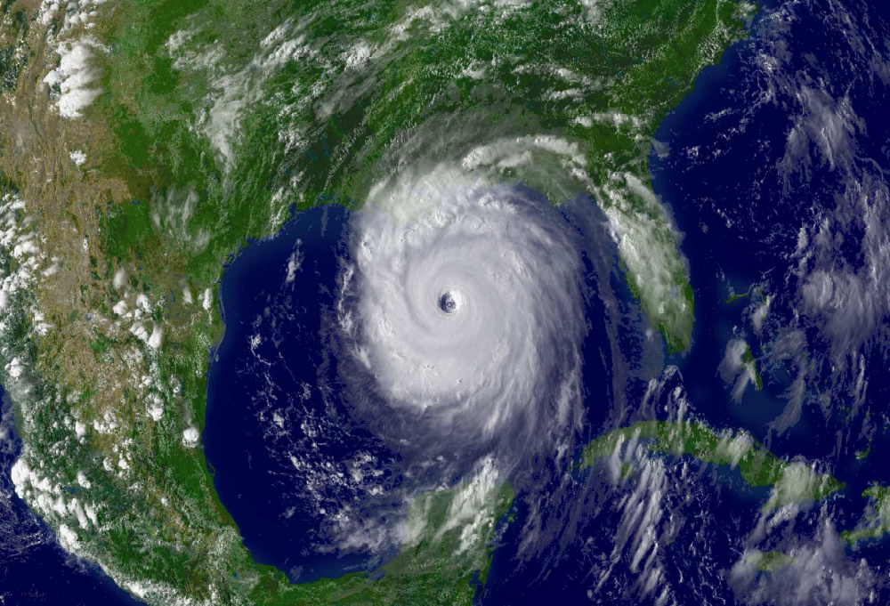

Slide 20
Hurricane Katrina
Category 3 hurricane when it made landfall
Killed 1833 people
Caused over $100 billion worth of damage
Most damage/loss of life caused by storm surge
Storm surge reached 14.4 feet
Classed as the “Storm of the Century”

Slide 21
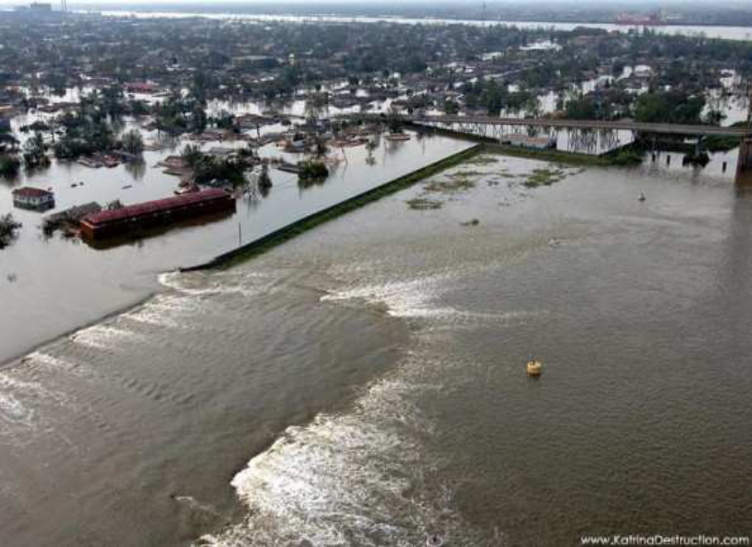

Slide 22
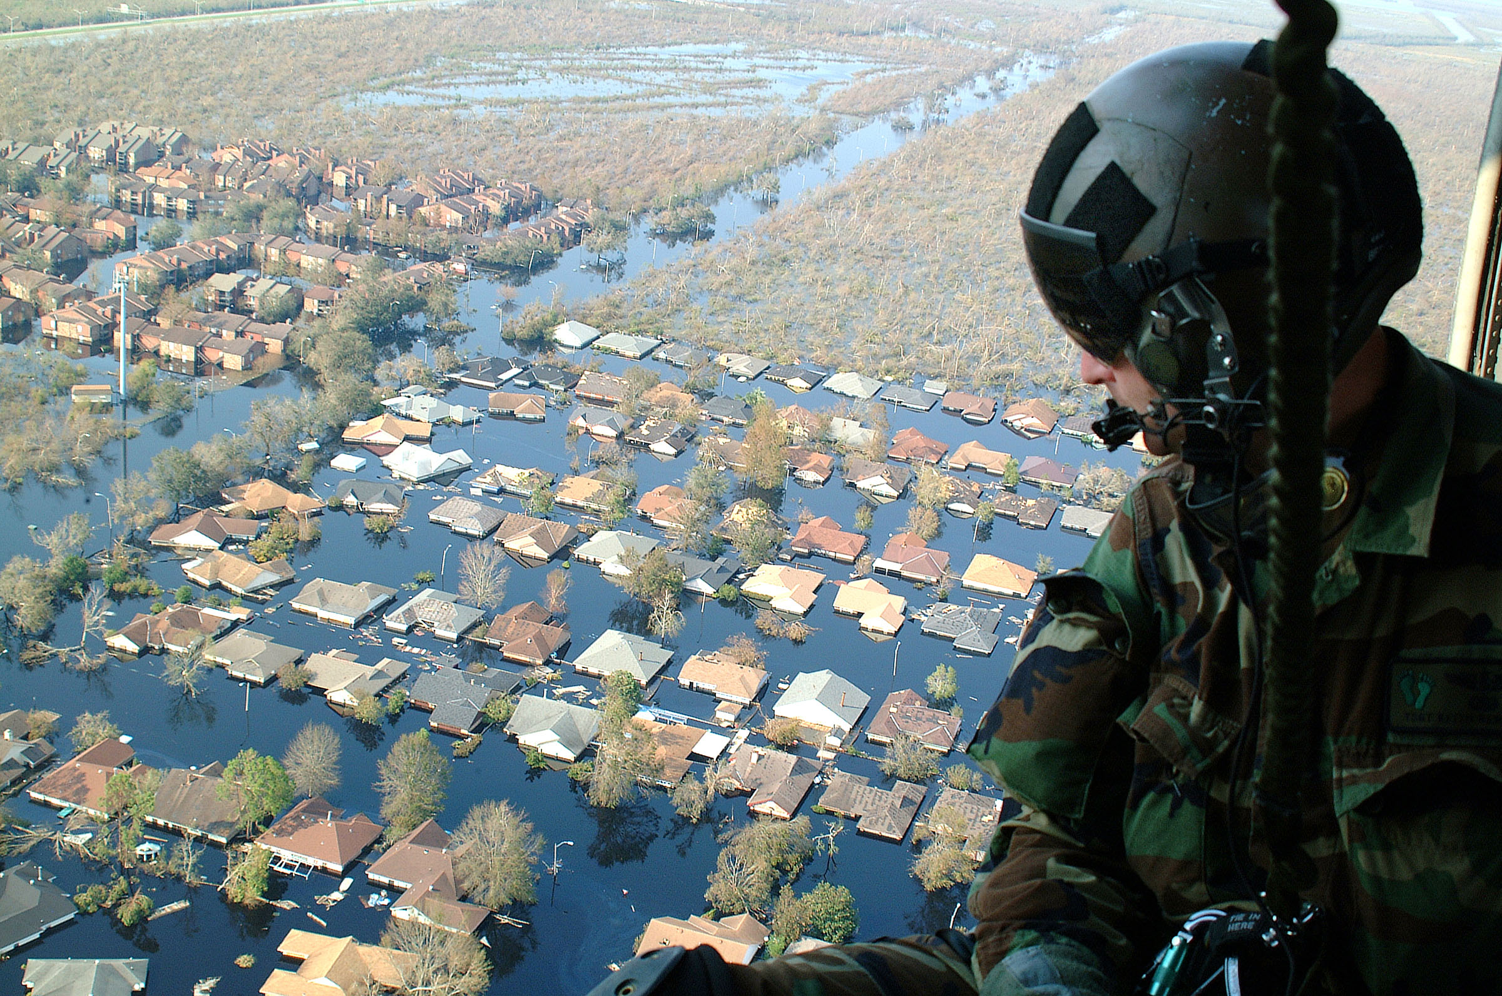

Slide 23

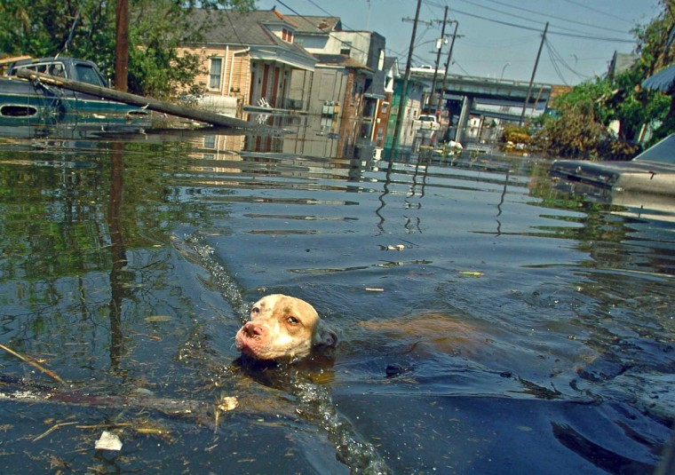

Slide 24
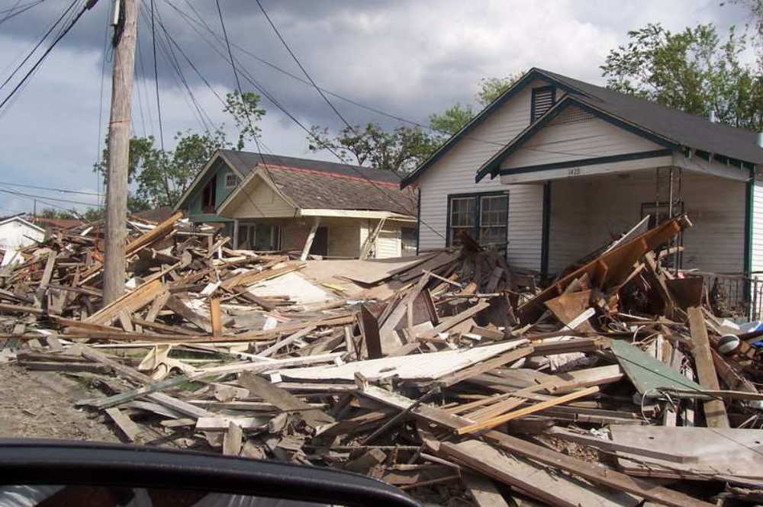

Slide 25
Hurricane Katrina
8.5 | 8.9 | 9.1 | 8.9 | 8.4 | 9.7 | 9.1 | 9.6 | 8.7 | 9.3
9.6 | 9.3 | 8.7 | 9.0 | 8.8 | 8.9 | 12.2 | 7.8 | 7.7 | 8.9
8.3 | 8.1 | 7.3 | 6.8 | 6.7 | 7.3 | 7.6 | 8.2 | 8.6 | 9.8
9.5 | 7.4 | 7.3 | 10.2 | 10.3 | 10.4 | 8.8 | 9.7 | 10.0 | 10.8
11.1 | 12.7 | 11.5 | 11.8 | 12.6 | 13.0 | 10.5 | 10.5 | 10.0 | 9.4
P(sea-surge > 8.75 feet) = ?
P(sea-surge > 11.25 feet) = ?
P(sea-surge > 14 feet) = ?

Slide 26
Hurricane Katrina
6.7 | 6.8 | 7.3 | 7.3 | 7.3 | 7.4 | 7.6 | 7.7 | 7.8 | 8.1
8.2 | 8.3 | 8.4 | 8.5 | 8.6 | 8.7 | 8.7 | 8.8 | 8.8 | 8.9
8.9 | 8.9 | 8.9 | 9.0 | 9.1 | 9.1 | 9.3 | 9.3 | 9.4 | 9.5
9.6 | 9.6 | 9.7 | 9.7 | 9.8 | 10.0 | 10.0 | 10.2 | 10.3 | 10.4
10.5 | 10.5 | 10.8 | 11.1 | 11.5 | 11.8 | 12.2 | 12.6 | 12.7 | 13.0
P(sea-surge > 8.75 feet) = ?
P(sea-surge > 11.25 feet) = ?
P(sea-surge > 14 feet) = ?

Slide 27
Hurricane Katrina
6.7 | 6.8 | 7.3 | 7.3 | 7.3 | 7.4 | 7.6 | 7.7 | 7.8 | 8.1
8.2 | 8.3 | 8.4 | 8.5 | 8.6 | 8.7 | 8.7 | 8.8 | 8.8 | 8.9
8.9 | 8.9 | 8.9 | 9.0 | 9.1 | 9.1 | 9.3 | 9.3 | 9.4 | 9.5
9.6 | 9.6 | 9.7 | 9.7 | 9.8 | 10.0 | 10.0 | 10.2 | 10.3 | 10.4
10.5 | 10.5 | 10.8 | 11.1 | 11.5 | 11.8 | 12.2 | 12.6 | 12.7 | 13.0
P(sea-surge > 8.75 feet) = ?
P(sea-surge > 11.25 feet) = ?
P(sea-surge > 14 feet) = ?

Slide 28
Hurricane Katrina
6.7 | 6.8 | 7.3 | 7.3 | 7.3 | 7.4 | 7.6 | 7.7 | 7.8 | 8.1
8.2 | 8.3 | 8.4 | 8.5 | 8.6 | 8.7 | 8.7 | 8.8 | 8.8 | 8.9
8.9 | 8.9 | 8.9 | 9.0 | 9.1 | 9.1 | 9.3 | 9.3 | 9.4 | 9.5
9.6 | 9.6 | 9.7 | 9.7 | 9.8 | 10.0 | 10.0 | 10.2 | 10.3 | 10.4
10.5 | 10.5 | 10.8 | 11.1 | 11.5 | 11.8 | 12.2 | 12.6 | 12.7 | 13.0
P(sea-surge > 8.75 feet) = 33/50 = 0.66 ?
P(sea-surge > 11.25 feet) = ?
P(sea-surge > 14 feet) = ?

Slide 29
Hurricane Katrina
6.7 | 6.8 | 7.3 | 7.3 | 7.3 | 7.4 | 7.6 | 7.7 | 7.8 | 8.1
8.2 | 8.3 | 8.4 | 8.5 | 8.6 | 8.7 | 8.7 | 8.8 | 8.8 | 8.9
8.9 | 8.9 | 8.9 | 9.0 | 9.1 | 9.1 | 9.3 | 9.3 | 9.4 | 9.5
9.6 | 9.6 | 9.7 | 9.7 | 9.8 | 10.0 | 10.0 | 10.2 | 10.3 | 10.4
10.5 | 10.5 | 10.8 | 11.1 | 11.5 | 11.8 | 12.2 | 12.6 | 12.7 | 13.0
P(sea-surge > 8.75 feet) = 33/50 = 0.66 ?
P(sea-surge > 11.25 feet) = 6/50 = 0.12 ?
P(sea-surge > 14 feet) = ?

Slide 30
Hurricane Katrina
6.7 | 6.8 | 7.3 | 7.3 | 7.3 | 7.4 | 7.6 | 7.7 | 7.8 | 8.1
8.2 | 8.3 | 8.4 | 8.5 | 8.6 | 8.7 | 8.7 | 8.8 | 8.8 | 8.9
8.9 | 8.9 | 8.9 | 9.0 | 9.1 | 9.1 | 9.3 | 9.3 | 9.4 | 9.5
9.6 | 9.6 | 9.7 | 9.7 | 9.8 | 10.0 | 10.0 | 10.2 | 10.3 | 10.4
10.5 | 10.5 | 10.8 | 11.1 | 11.5 | 11.8 | 12.2 | 12.6 | 12.7 | 13.0
P(sea-surge > 8.75 feet) = 33/50 = 0.66 ?
P(sea-surge > 11.25 feet) = 6/50 = 0.12 ?
P(sea-surge > 14 feet) = 0/50 = 0 ?

Slide 31
Hurricane Katrina
6.7 | 6.8 | 7.3 | 7.3 | 7.3 | 7.4 | 7.6 | 7.7 | 7.8 | 8.1
8.2 | 8.3 | 8.4 | 8.5 | 8.6 | 8.7 | 8.7 | 8.8 | 8.8 | 8.9
8.9 | 8.9 | 8.9 | 9.0 | 9.1 | 9.1 | 9.3 | 9.3 | 9.4 | 9.5
9.6 | 9.6 | 9.7 | 9.7 | 9.8 | 10.0 | 10.0 | 10.2 | 10.3 | 10.4
10.5 | 10.5 | 10.8 | 11.1 | 11.5 | 11.8 | 12.2 | 12.6 | 12.7 | 13.0
P(sea-surge > 8.75 feet) = 33/50 = 0.66 ?
P(sea-surge > 11.25 feet) = 6/50 = 0.12 ?
P(sea-surge > 14 feet) = 0/50 = 0 ?!

Slide 32
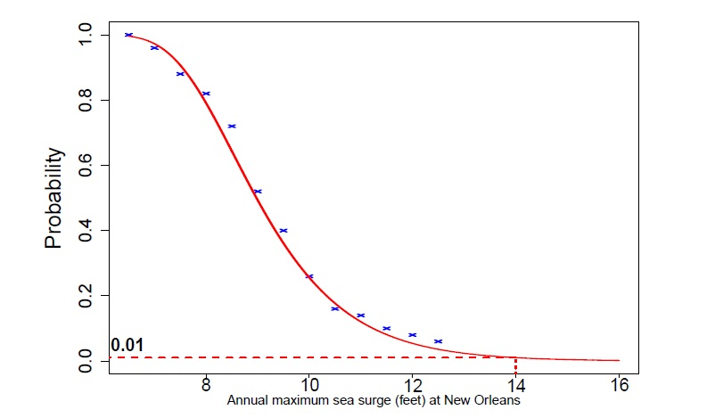

Slide 33
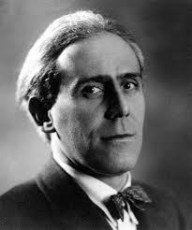


Slide 34
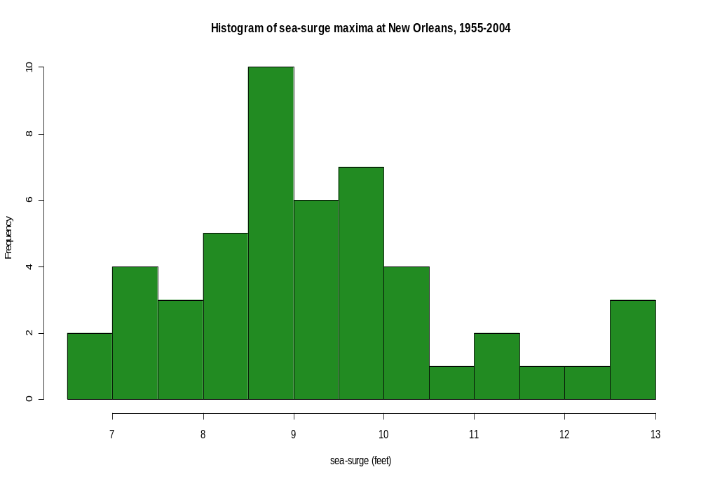

Slide 35

Careers

Slide 36
What careers can Maths lead to?
Meteorologist
Stockbroker
Logistics Manager
Accountant
Teacher
Mathematical Modelling
Economist
Engineer
Researcher
Business Analyst
Statistician
Actuary
Cryptanalyst
Notes:
As a mathematician you can acquire problem-solving and analytical skills that can be put to use in the real world.
*open to audience*
“What jobs could you walk into with a strong background in maths?”
Meteorologist
Meteorologists study the atmosphere and the weather with a focus on climate. They forecast weather, analyse climate change and air pollution and develop new techniques for the measurement and analysis of meteorological occurrences.
Stockbroker
Stockbrokers invest money for individuals and organisations by buying and selling on the stock market.
Mathematical Modelling
A mathematical modeller employs mathematical language to describe a system. An example of this is Computational Fluid Dynamics, which uses maths to describe particularly complex situations involving fluid flow. An application of this is in film visual effects. Think of the waves in a computer-generated sea. The challenge is to reach a middle-ground between processing time and accurately approximating the system, otherwise films would take too long to make!
Logistics Manager
Logistics managers handle processes involved in a supply chain, liaising with a variety of parties including suppliers of raw materials, manufacturers, retailers and consumers.
Statistician
Statisticians collect, analyze, and interpret numerical data; working in both the public and private sector.
Accountant
Chartered accountants are responsible for financial reporting, taxation, auditing, forensic accountancy, corporate finance and insolvency. They play a strategic role by providing professional advice; aiming to maximize profitability on behalf of their client or employer. They work in many different settings, including private practice firms, industry, commerce and the public sector.
Actuary
An actuary is a business professional who analyzes the financial consequences of risk. Actuaries use mathematics, statistics and financial theory to study adverse future events, especially those of concern to insurance and pension programs. They evaluate the likelihood of those events and mitigate the impact of events as they occur.

Slide 37
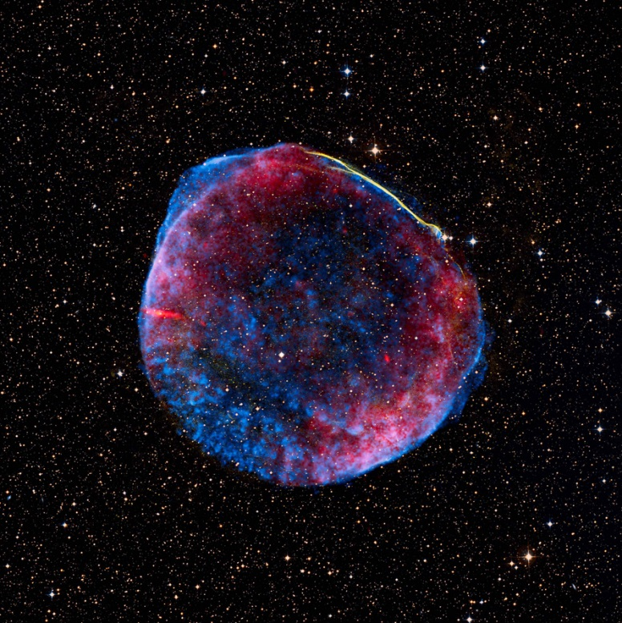
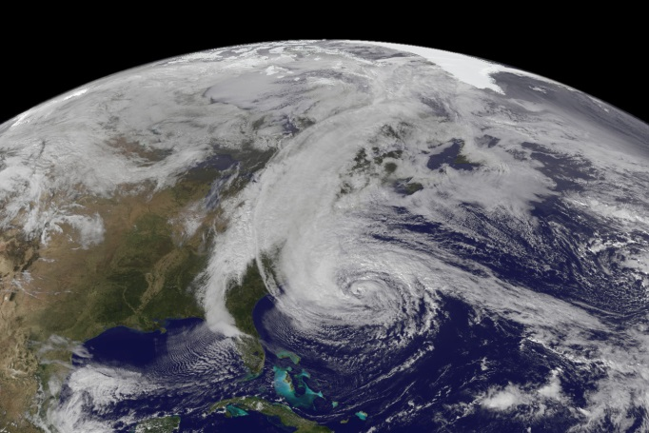
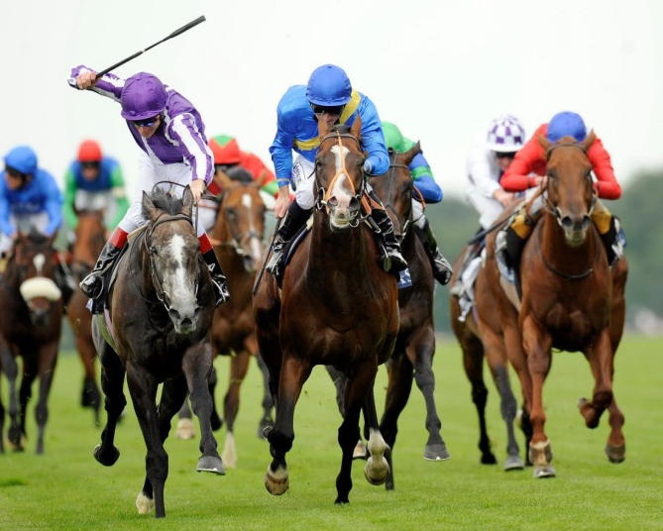

With Maths you could…
Predict the occurrence of hurricanes
Explore the Universe!
Figure out
the odds
Be part of MI5
Notes:
Whenever you send an email or use your credit card online, secret information has to be exchanged between your computer and a web server. Mathematics can be used to encypher this information, so that third party can't read and misuse it.

Slide 38
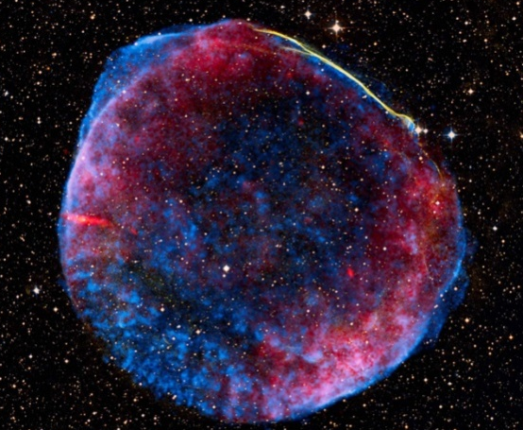
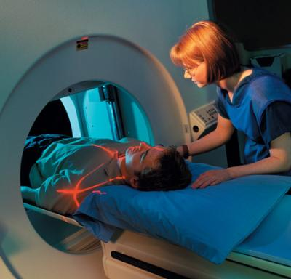

With Maths you could…
“Maths has the ability to discover, create and even predict the future. It has the power solve or crack modern issues such as online security”

Slide 39
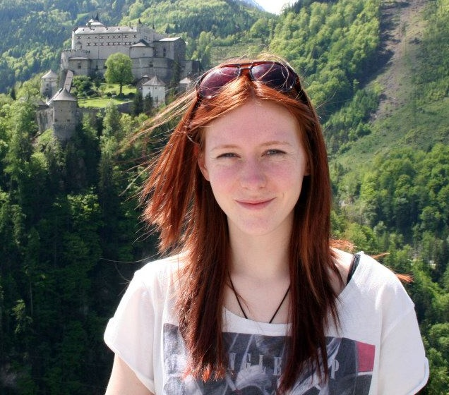
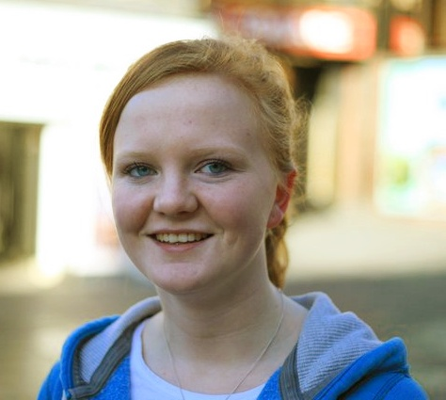
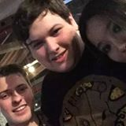
Graduate profiles
Jess
Kathryn
Kieren
Graduated in 2013, BSc
Technology Graduate at BBC
Graduated in 2014, MMathStat
Atomic Weapons Establishment
Graduated in 2015, MMathStat
Computer games engineer at Jagex Games

Slide 40












Employers

Slide 41
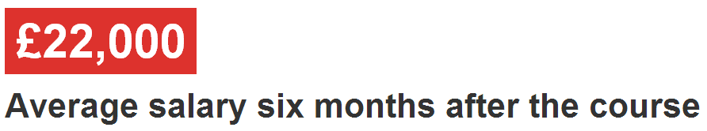
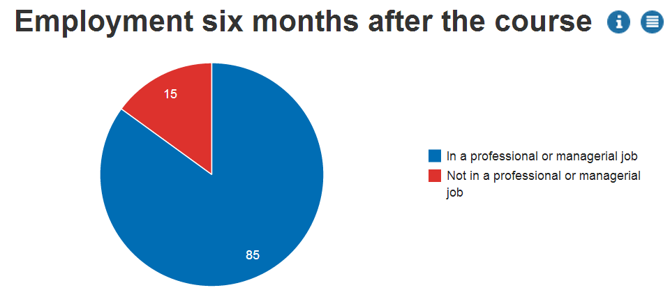
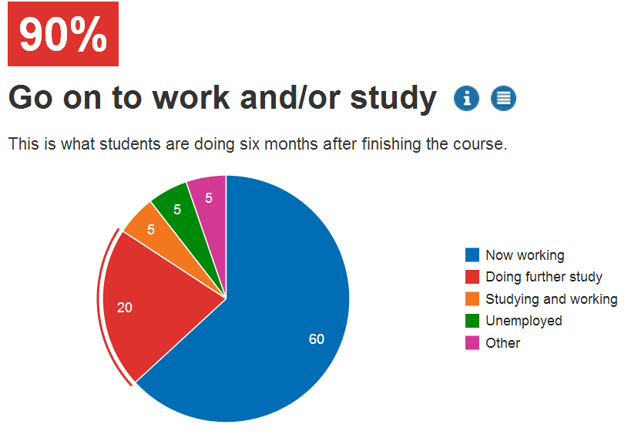
Maths Graduates
Notes:
A Mathematics and Statistics degree opens up many career paths. Whilst you may think it leads only towards becoming an accountant or a teacher, this really isn’t the case. Our graduates in this field go on to many different career and study paths. Some which, yes, are associated commonly with Maths and Statistics, others which couldn’t be further away.

Slide 42
Maths at Newcastle

Slide 43
Newcastle University
Russell Group University
Top 1% of world universities
One of the best UK Universities for student satisfaction (NSS: 93% / 97% are satisfied!)
TEF gold!
Top 20 ‘most targeted’ universities by UK’s leading employers
95% of Newcastle students go into graduate employment/future study within six months
1st in the UK for quality of social life!

Slide 44
Single Honours Degrees
Single Honours
3 Year Degree
4 Year Degree
BSc Maths & Stats (Hons)
BSc Maths (Hons)
MMathStat (Hons)
BSc Statistics (Hons)
MMath (Hons)

Slide 45
Other Types of Degrees
Major/Minor
Maths with Finance
Physics
Psychology and Maths
Maths with Management
Maths and Economics
Maths and Accounting
Joint Honours

Slide 46
1st Year Structure
Semester 1
Semester 2
Multivariable Calculus and Differential Equations
Introduction to Calculus
Linear Algebra: Vectors and Matrices
Probability and Statistics
Sets and Counting
Problem Solving and Computing I
Optimisation with Constraints
Number Systems
Problem Solving and Computing II
Dynamics
Key:
Inner
Outer
Optional
Notes:
Inner core: MAS16**, Sets and counting: MAS17**, Problem solving modules: MAS18**, Optional: MAS19**

Slide 47
2nd Year Structure
Semester 1
Pure Mathematics
Pure Mathematics
Applied Mathematics
Applied Mathematics
Statistics
Statistics
Group Project
Computing
Careers Management
Semester 2

Slide 48
3rd Year Modules
Stochastic Calculus & Applications
Foundations of Group Theory
Coding Theory
Linear Analysis
Topology
Geometries & Designs
Groups, Graphs & Symmetry
Number Theory & Cryptography
Survival Analysis
Statistical Modelling
Markov Processes
Bayesian Inference
Randomised Clinical Trials
Discrete Stochastic Modelling
Applied Probability
Multivariate Data Analysis
Stochastic Financial Modelling
Time Series & Forecasting
Partial Differential Equations with Applications
Instabilities, Turbulence & Scaling
Electromagnetism
Variational Methods
Numerical & Computational Modelling
Quantum Mechanics
Introduction to Fluids
Differential Equations and Fields

Slide 49



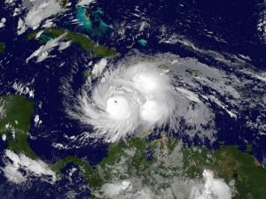
4th Year Project
Quantum Ferrofluid Hedgehogs
C*-algebras
Football Gambling
Particle Orbits around Black Holes
Convexity
Statistical Modelling of Environmental Extremes

Slide 50
Learning & Assessment
Inner Core
Learning
Assessment
Lectures
Seminars
Assignments
CBAs
(Numbas)
Office Hours
Problems Classes
Projects
Presentations
Computing Practicals
Drop Ins
Exams
Mid Semester Tests

Slide 51
Learning & Assessment
Numerical & Computational Modelling
Learning
Assessment
Lectures
Seminars
Assignments
CBAs
(Numbas)
Office Hours
Problems Classes
Projects
Presentations
Computing Practicals
Drop Ins
Exams
Mid Semester Tests

Slide 52
Grades & Weighting

Slide 53
Support
Current Maths Student
Regular contact through emails
Buddy
Module Selection & Registration
Academic & Personal issues
Personal Tutor
Run by Postgraduates
Drop-in:
10am – 4pm
Maths Aid
Undergraduate Secretary
Personal Issues
Exams & Assignments
Student Wellbeing
Financial Matters
Counselling

Slide 54
Transition to University
More support: Dedicated Transition Officer
  Sole remit: Support students in their transition to University
  Holds weekly drop-in sessions (with tea / biscuits)
  Will keep a close eye on you…
Buddy system
1st year seminar groups
  Past A level papers
Academic transition
  Worse from GCSE–A level than from A level to Undergrad

Slide 55
Typical Week
 | 9-10 | 10-11 | 11-12 | 12-1 | 1-2 | 2-3 | 3-4 | 4-5 | 5-6
Mon
Tues
Wed
Thurs
Fri
L
L
L
L
PC
L
L
PC
L
PC
S
L
Sports and Societies
L
L
PC
L
L
PC

Slide 56
Opportunities Abroad
Opportunities Abroad
Work placement
Study abroad
Year Out
All degrees
4 year degree only
Not Graded
Graded

Slide 57




“More than just a degree...”
Freshers’ week: the week before classes start
Clubs and societies
Sport: Athletic Union, Intra-mural, “Go play”
Internships, paid work and voluntary work

Slide 58
Newcastle: City and Social

Slide 59
Clubs and societies
Clubs & Societies
Sports
Societies
Athletic Union
Give It A Go!
Go Play
Joining
Societies
Intra-Mural

Slide 60
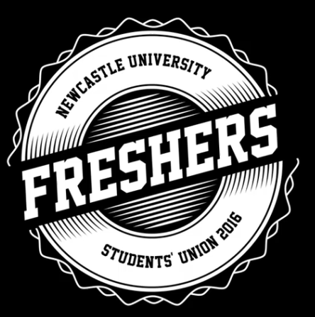
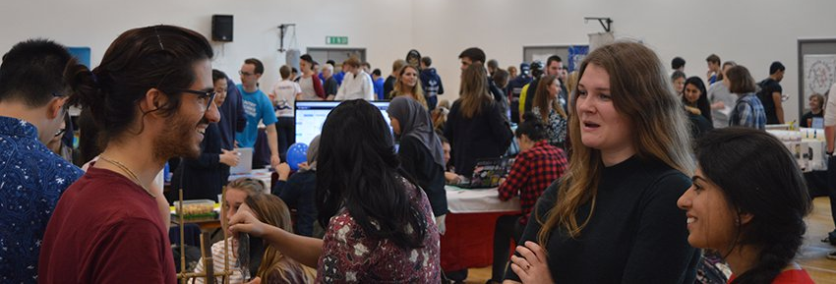
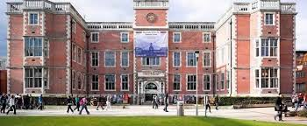

Joining
Freshers’ Fair
NUSU Website

Slide 61



Societies
Nearly 200 registered clubs and societies at Newcastle
Or you can create your own!
Twenty Minute Society
Greek/Hellenic
Dance

Slide 62
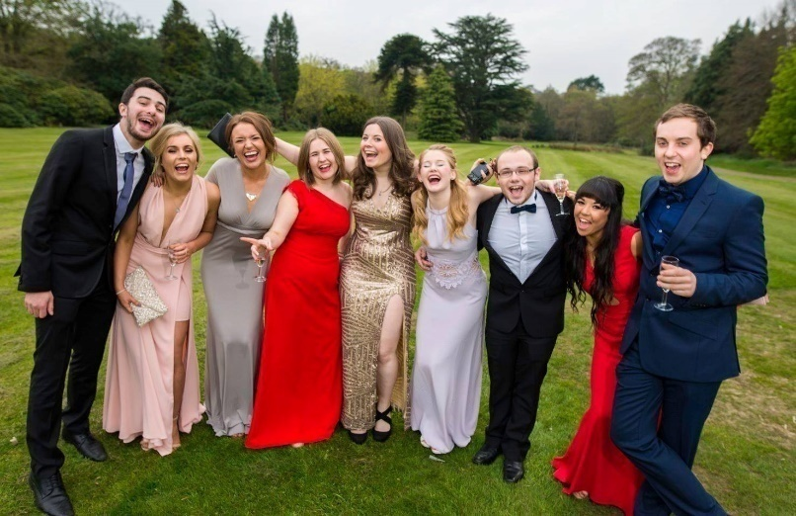
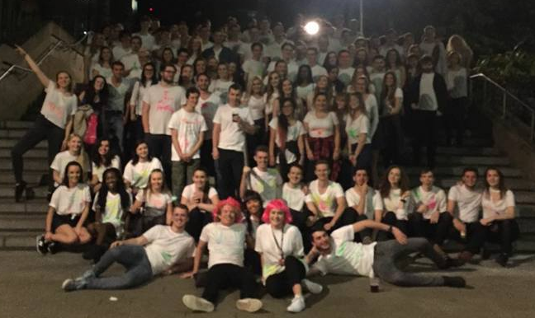
Subject societies
Summer Ball
Public Talks
Sports teams
Holidays Abroad
Ice Skating
Bar Crawls
Bowling
Charity Fundraising
Pub Quizzes

Slide 63
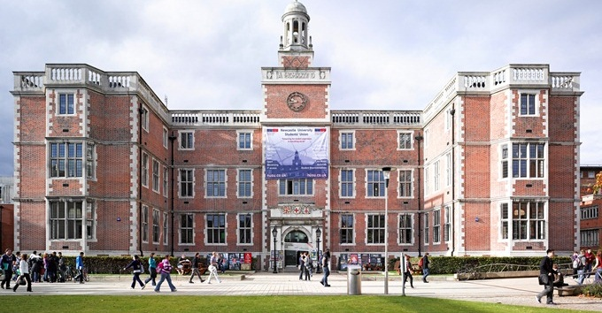
Students’ Union
£8 million refurbishment and was re-opened in 2011
Services
Student Radio
Advice Centre
Courier
Food & Drink
Starbucks
Mensbar
Domino’s
Subway
Organic Food Stall
Facilities
Computer Cluster
Union Shop
Bank
Venue

Slide 64
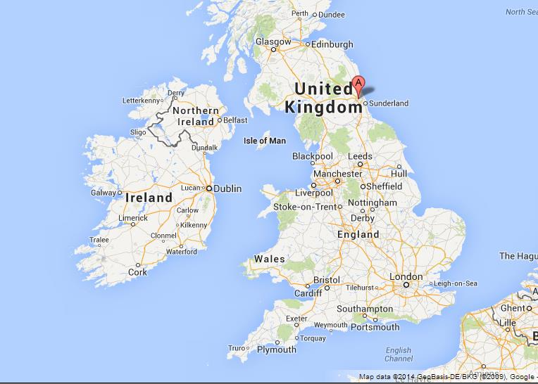
So where is Newcastle?

Slide 65
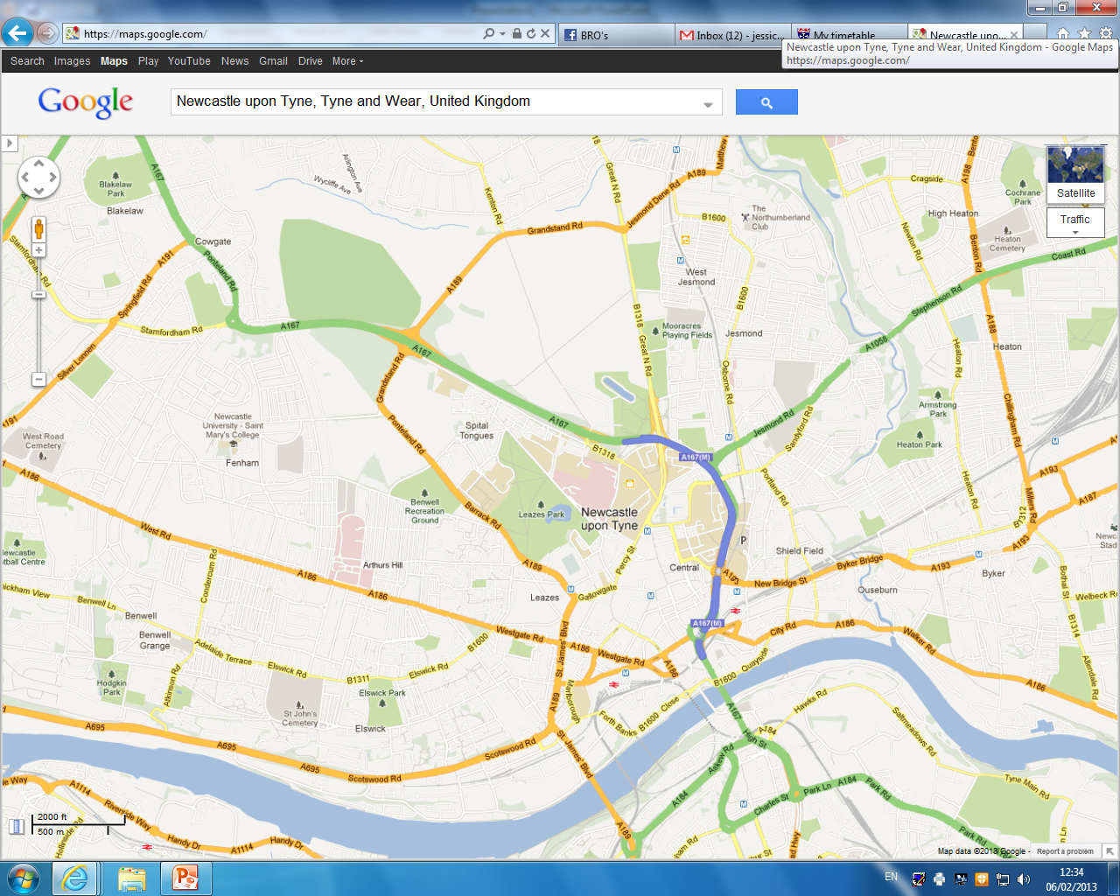

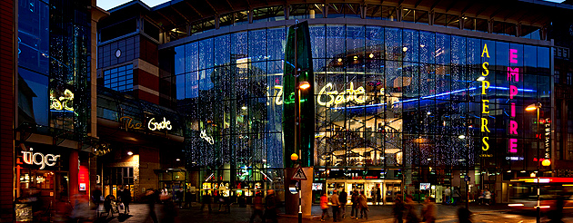
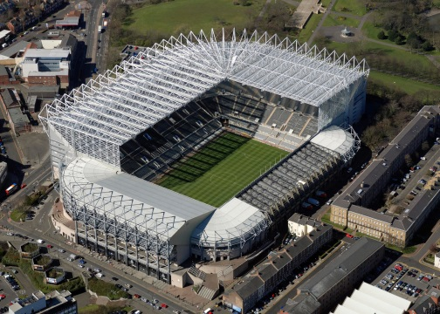
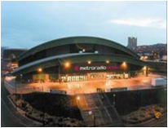
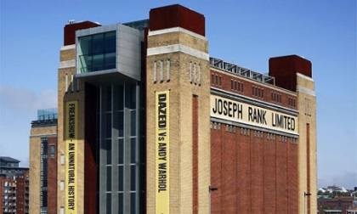
In and around Newcastle
Newcastle University
The Gate
St James’ Park
Metro Radio Arena
The Baltic

Slide 66
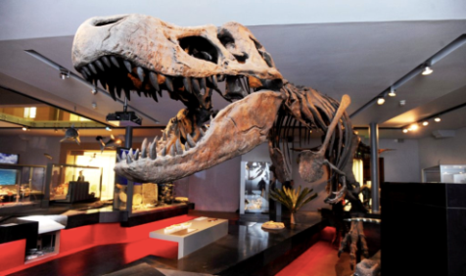
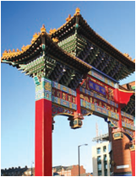
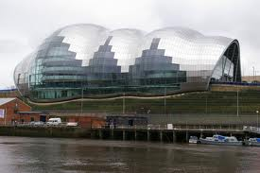
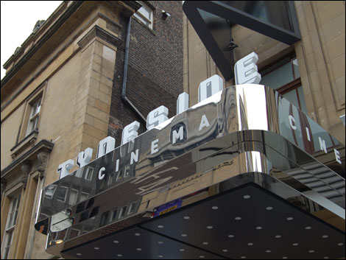
In and around Newcastle
Newcastle University
Hancock Museum
China Town
Tyneside Cinema
Theatre Royal
The Sage

Slide 67
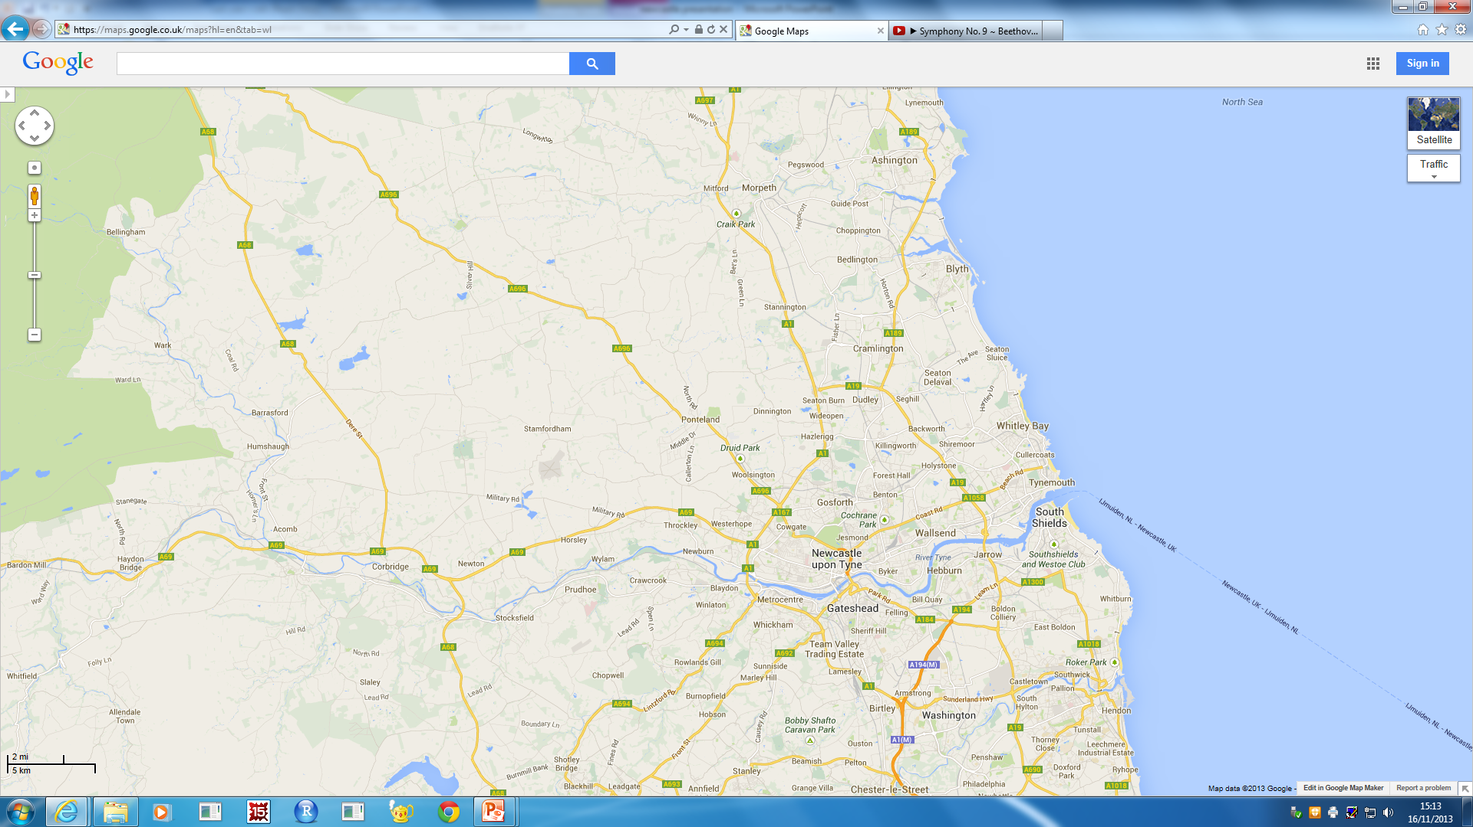
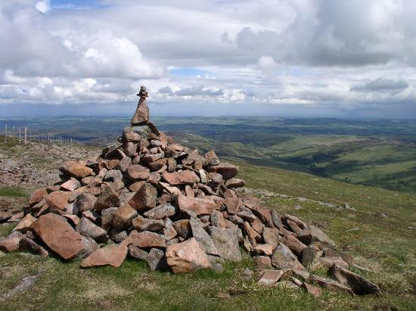
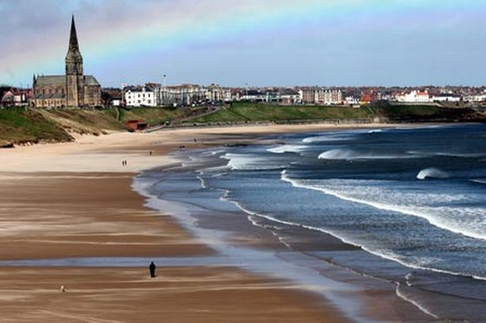

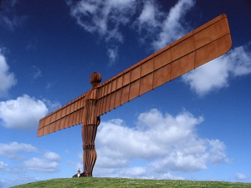
In and around Newcastle
To Northumberland National Park
Tynemouth Beach
Newcastle
South Shields
Metrocentre
Angel Of The North

Slide 68
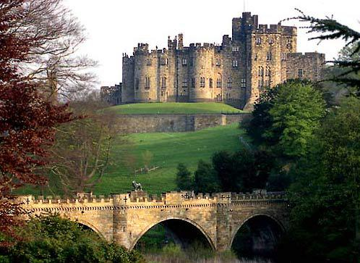
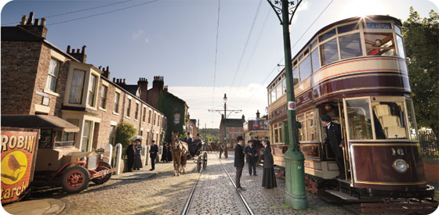
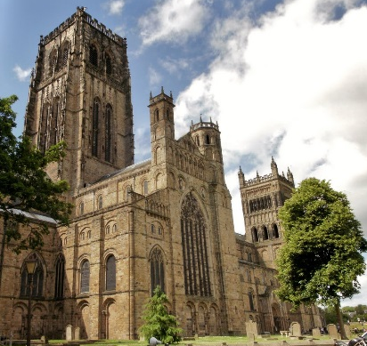
In and around Newcastle
To Alnwick Castle & Gardens
Segedunum Roman Baths
Newcastle
To Durham Cathedral
Beamish Museum

Slide 69
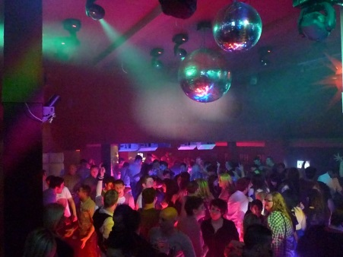
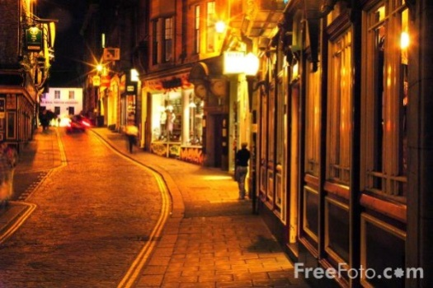


In and around Newcastle
SU
Pink Triangle
Newcastle
Bigg Market
Diamond Strip
Digital

Slide 70

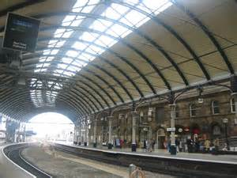
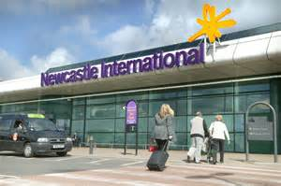

Local transport
3 metro stations in Newcastle city centre, 1 directly opposite campus
Central rail station providing local and national rail services
Newcastle International Airport flying to worldwide destinations
Ferry terminal going to Amsterdam and continental Europe

Slide 71
Opportunities @ NCL

Slide 72
Summer Project
Boost your CV
Written exercises, written “investigation”, web-based test
Boost your UCAS application – to any University (but especially NCL…)
Material: Some A-level standard, some “new” or “advanced”
Workbook – reading material & questions
July – September, although should only take around 5 days to complete
Certificate of completion

Slide 73
Summer School @ NCL
Boost your CV
Come and visit us! Student life, city life
Boost your UCAS application – to any University (but especially NCL…)
Full day of Maths activities – leading Professors
Full day of Campus/City activites
Mid-late August: accommodation and subsistence paid for
Try before you buy!

Slide 74

Recent students…

Slide 75


Slide 76



Slide 77


Slide 78


Slide 79


Slide 80



Slide 81


Slide 82
Final words...

Slide 83
Offers and admissions
Typical Offers
“A level Monday”
Maximise your chances
AAA-AAB, depending on degree / A level subjects
Three piles: 1. Accept 2. Near miss 3. No way!
Make us your “firm choice”
Personal statement: Passion!
Other equivalents: e.g. 17 (overall) in Apolytirion + B
My hardest job: Prioritise students in pile #2!!
Take one of our summer projects on offer!

Slide 84
Facts & figures
Part of the UK’s prestigious “Russell Group”
Top 1% of Universities in the world
16th in the UK for global research power
International students put Newcastle in the world’s top 12
12th in the UK for student satisfaction
School of Maths & Stats in the UK top 10
Financial incentives available for good students

Slide 85


Georgios Melios
“
Top ranking University
City nightlife AMAZING!
Compact city – everything is within walking distance!
University facilities are amazing!
Excellent library services
”

Slide 86

Demetra Demetriou
“
Courses are high-ranking
Very exciting University life
So many events for Freshers, and so easy to meet other people
Everything is within walking distance and the campus is right in the heart of the city
Newcastle University ALWAYS considers the needs of its students
Everyone I know at Newcastle loves it – University and the city!
”

Slide 87

Sarah Koullapi
“
I chose Newcastle University mainly because it provides me the maximum exemptions for the charted and certified accounting diplomas
The city is so compact and you don’t ever have to use transport
Newcastle is a cheap city, especially in comparison to London or Manchester
Most of the people at the university are friendly and helpful.
Accommodation excellent!
”

Slide 88



Keep in touch
Follow
‘@NCLMathsStats’
Email
‘maths.physics@ncl.ac.uk’
Visit
‘www.ncl.ac.uk/maths’

Slide 89
Any questions?
@NCLMathsStats

Slide 90
Student Finance

Slide 91
Tuition Fee Loan
Tuition fee loan
Financial Body
Tuition Fees
Repayment
Funded by the country you apply to study in (e.g. England or Wales)
£9,250
(same for most)
Not until earning > £25,000
Investment in future
Not until after studying
Placement Years only pay £1,000

Slide 92
Loan repayments
Not until you earn above £25,000
Payments stop if income falls below
Repayment
Not until you finish studying
Based on what you earn, not what you owe
Repay 9% of income above £25,000
Written off if not repaid within 30 years
Notes:
If you earned £25,000 a year then you would repay £30 a month, which is approximately the price of a phone contract.

Slide 93

Interest
Interest
During Studies
Rate of Inflation (ROI) plus 3%
After
Studies
Earn less than £25,000: ROI
Earn between £25,000 - £45,000:
ROI plus up to 3%
Earn above £45,000: ROI plus 3%

Slide 94
Excellence scholarship
Get at least A*AA…
… and we will give you £1000 at the start of first year!
(Provided you make us your first choice)
Notes:
So if you got 3xA*, you would get 3x£250 for beating your requirements, plus 2x£250 for A*’s in Maths and Further Maths.

Slide 95
Living costs
Phone bill
Accommodation
Toiletries
TV;
most halls don’t have TV licences
Clothes
Living Costs
Food
Insurance; belongings /
keys!
Study; recommended books
Travel;
To Uni / home / visit friends
Social Life

Slide 96
Money management
Part time Job;
Recommended
15 hours
or less
Use campus facilities; Library, Sports centre, Union etc.
Budget!
If you can’t
afford it,
don’t do it!
Shop around
for
the best
deals
Make it go further
Interest free overdraft! Don’t be drawn in by freebies
Walk
or
get a student
travel pass
Student Discount: Restaurants,
bars etc.
Buy books
second-hand
or
Use the library

Slide 97
Student Accommodation

Slide 98








Castle Leazes
Kensington Terrace
Leazes Parade
The Halls
Bowsden Court
The Halls
The Halls
Park Terrace
St Mary’s
Windsor Terrace
Marris House

Slide 99








Barker House
Verde
Managed Partnership Accommodation
Liberty Plaza
The Halls
Turner Court
The Halls
Union State
Liberty Quay
The View
Manor Bank

Slide 100


Typical rooms
To find out more detailed information and view our virtual tours for each of our halls of residence visit:
www.ncl.ac.uk/accommodation

Slide 101




What’s included?
Free internet connection
Launderette
Holidays included
Bicycle Storage
24 hour security
Bills

Slide 102
Things to consider
Self Catered/Catered
Affordability
Location
Mixed/Single Gender
Deluxe Room
Flat/Corridor Layout
Standard Washbasin Room
Smaller/Larger Community
Ensuite Room

Slide 103
















Comparing price
Least Expensive- £83 p/w
Most Expensive- £167p/w
Bowsden Court
Victoria Halls
Park Terrace
Richardson Rd
Bowsden Ct.
Liberty Quay
Park Terrace
Verde
Castle Leazes
Leazes
St Marys College
Marris House
Marris House
Marris House
St Mary’s
Marris House
Turner Court
Union State
Richardson Rd
The View
St Marys College
Windsor Tce.
Leazes Parade
Manor Bank
Liberty Plaza

Slide 104


Comparing size
Smallest - 50 rooms
Largest - 1100 rooms
St Marys College
Bowsden Court
Bowsden Court
Marris House
Castle Leazes
Bowsden Court
Leazes Parade
Turner Court
St Marys College
Castle Leazes
Victoria Halls
Windsor Terrace
Park Terrace
Richardson Rd
Liberty Quay
Park Terrace
The View
Liberty Plaza
St Marys College
Park Terrace
Castle Court
Marris House
Marris House
Richardson Rd
Castle Court
Marris House
Manor Bank
Union State
Verde

Slide 105

Routes from further away.
Bowsden Court
St Mary’s College
Park, Windsor & Kensington Terrace
Marris House
Castle Leazes, Castle Court & Leazes Parade
Newcastle University
Union State
Turner Court
Liberty Plaza, Verde & The View
Manor Bank & Liberty Quay

Slide 106










After halls
Lots of student properties
Remember extra costs
Support available
Typically 12 month contracts

Slide 107
Jesmond
Spital Tongues
Heaton
Newcastle University
Fenham
Sandyford

