Slide 1


Maths & Stats

Slide 2
2
Main degrees
MMath(Hons)
BSc(Hons)
Four years
Specialise in years 3/4
Research project in final year
Can study abroad in year 3
Three years
Broad programme, but can specialise in year 3
Group project in year 2
Can do a work placement

Slide 3
3
Pure Maths
Applied Maths
Statistics
Core
Areas

Slide 4
Applied Probability
Theory of Flight
Fluid Mechanics
Turbulence
Cryptography
Extremes
Survival Analysis
Big choice of optional modules
All linked to research interests of staff

Slide 5

Joint Honours
Major/
Minor

Slide 6





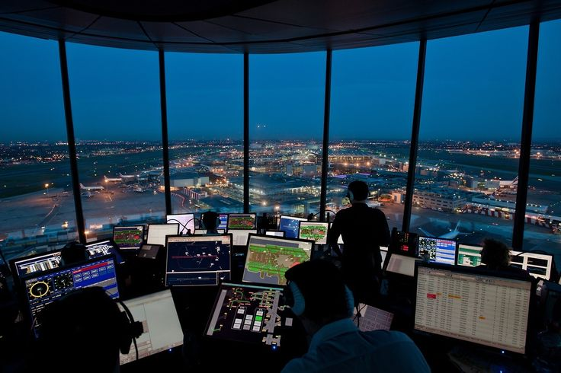


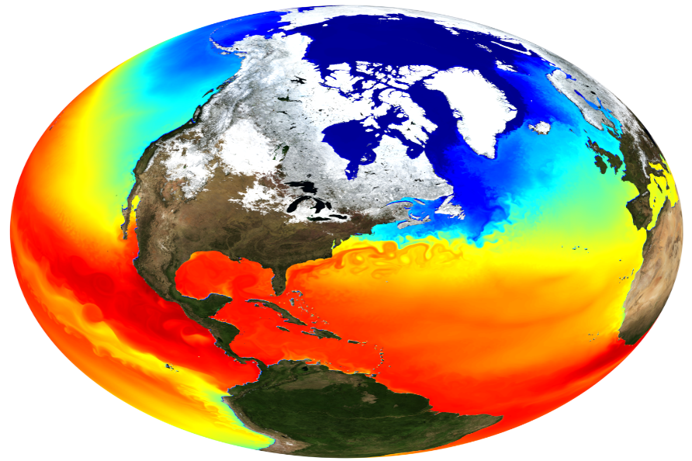
CAREERS IN MATHS

Slide 7
How it’s taught…
Lecture theatres –
delivery of material
Lectures
Tutorials
Problems classes
Computing classes
Staff offices – group work
Classrooms – turning
theory into practice
Computer cluster -
Software / analysis skills

Slide 8
How it’s assessed…
Exams
Projects
Assignments
You all know what these
are! 60%-90%
Team work, presentations, reports… 10%-20%
Written or computer-
based… around 10%

Slide 9
Final words…
Research-informed curriculum
Committed to high teaching standards – e.g. NSS 93%, innovative resources
Great student-staff rapport
Accreditation – e.g. IMA, RSS
Projects
Assignments

Slide 10
Final words…
Good luck!
www.ncl.ac.uk/maths-physics
maths.physics@ncl.ac.uk
@NCLMathsStats

