Slide 1
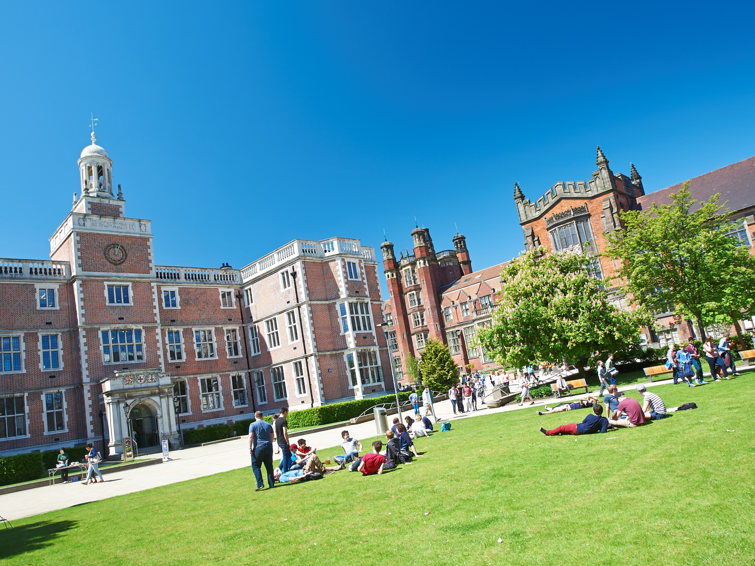


Newcastle Maths and Stats Open Days 2017
School of Mathematics and Statistics
UCAS Open Day:
Spring 2017
Dr. Lee Fawcett, Mrs. Carol Andrew
Student speakers:
Andrew Dixon and Tom Lowe (Work)
Sam Everall (Finance)
Emma Bradley and Amy Green (Accommodation)
Bethany Gibson (City/Social)
Rachel Binks and Martha King (Careers)

Slide 2


The School
Three ‘Sections’
Staff Profile
Applied Mathematics
14 Professors
Pure Mathematics
4 Readers
Statistics
15 Senior Lecturers
18 Lecturers
Committed to excellence in Teaching and Research: e.g. innovations, REF2014

Slide 3
Research Projects
Magnetic Fields in galaxies
(Applied)
Galaxies are giant magnets
How are the magnetic fields generated?
What effect do they have in a galaxy?
Quantum Computing (Pure Mathematics)
Theory of multidimensional computing
Leading to extremely fast calculations!
Climate Extremes (Statistics)
Can we predict how severe the next big storm will be?
Can we use statistics to better prepare for climate extremes?
Inter-disciplinary work between statisticians and engineers

Slide 4
Offers and Admissions
Offer:
AAA-AAB (A in Maths) – Single honours and Major/Minor
AAB-ABB (A in Maths) – Joint Honours
Just Missing Out:
ABB (with an A in Maths) – Still likely, especially if you made us your firm choice
Nature of other subjects may help
Quota:
About 170 each academic year in total across all of our degree programmes
Meet/exceed your offer, you’re guaranteed a place
Notes:
No longer any grant… All loan, however you get more money in total.

Slide 5
Studying At Newcastle
Tom Lowe
Rima Price

Slide 6
This Talk
Degree Types
Single Honours
Major / Minor
Joint Honours
Structure
1st Year
2nd Year
Important Projects
Learning & Assessment
Teaching Methods
Assessment Methods
Grades & Weighting
Resources
The Herschel Building
Internet Resources
Support
Timetabling
Typical Week
Semester Calendars
Important Dates
Notes:
Tom – whole slide

Slide 7
Single Honours Degrees
Single Honours
3 Year Degree
4 Year Degree
BSc Maths & Stats Hons
BSc Maths Hons
MMathStat Hons
BSc Statistics Hons
MMath Hons
Notes:
Rima – whole slide

Slide 8
Other Types of Degree
Major/Minor
Maths with Finance
Maths with Management
Maths and Psychology
Economics and Maths
Accounting and Maths
Joint Honours
Notes:
Tom – whole slide

Slide 9
This Talk
Degree Types
Single Honours
Major / Minor
Joint Honours
Structure
1st Year
2nd Year
Important Projects
Learning & Assessment
Teaching Methods
Assessment Methods
Grades & Weighting
Resources
The Herschel Building
Internet Resources
Support
Timetabling
Typical Week
Semester Calendars
Important Dates
Notes:
Rima – whole slide

Slide 10
University Credits
120 Credits in Each Year
100 Hours per 10 Credits
Lectures
Revision and Exam
Term-time Assessments
Notes:
Rima – whole slide

Slide 11
Single Honours Structure
1st Year
2nd Year
3rd Year
4th Year
MAS
1601
MAS
1602
MAS
2701
MAS
2702
MAS
2703
MAS 8091
MAS
1701
MAS
1801
MAS
1901
MAS
2801
MAS
2802
MAS
2803
MAS
1603
MAS
1604
MAS
2901
MAS
2902
MAS
2903
MAS
1702
MAS
1802
MAS
1902
MAS
2601
MAS
2603
MAS
2602
Key:
Inner
Outer
Optional
Key:
Computing
Pure
Applied
Statistics
Optional
Notes:
Tom – Whole slide

Slide 12
1st Year Structure
Semester 2
Semester 1
Multivariable Calculus and Differential Equations
Introduction to Calculus
Linear Algebra: Vectors and Matrices
Probability and Statistics
Logic, Sets and Counting
Problem Solving and Computing I
Dynamics
Number Systems
Problem Solving and Computing II
Optimisation with Constraints
Key:
Inner
Outer
Optional
Notes:
Rima – whole slide

Slide 13
2nd Year Structure
Semester 1
Linear Algebra
Complex Variable
Algebra
Vector Calculus
Differential Equations
Transforms, Waves and Fluid Dynamics
Introduction to Statistical Inference
Stochastic Modelling
An Introduction to Bayesian Methods
Semester 2
Notes:
Rima – Whole slide

Slide 14
2nd Year Structure
Semester 1
Linear Algebra
Complex Variable
Algebra
Vector Calculus
Differential Equations
Transforms, Waves and Fluid Dynamics
Introduction to Statistical Inference
Stochastic Modelling
An Introduction to Bayesian Methods
Group Project
Careers Management and Mathematical Skills
Computing
Semester 2
Notes:
Rima – Whole slide

Slide 15
3rd Year Modules
Stochastic Calculus & Applications
Foundations of Group Theory
Coding Theory
Linear Analysis
Topology
Geometries & Designs
Groups, Graphs & Symmetry
Number Theory & Cryptography
Survival Analysis
Statistical Modelling
Markov Processes
Bayesian Inference
Randomised Clinical Trials
Discrete Stochastic Modelling
Applied Probability
Multivariate Data Analysis
Stochastic Financial Modelling
Time Series & Forecasting
Partial Differential Equations with Applications
Instabilities, Turbulence & Scaling
Electromagnetism
Variational Methods
Introduction to Numerical & Computational Modelling
Quantum Mechanics
Introduction to Fluids
Differential Equations, Transform Methods & Fields
Notes:
Tom – Whole slide

Slide 16
4th Year Project
Before 4th year
Introductory presentation
Given topic choices
Meetings with potential supervisors
Give list of choices
Summer
Given topic of study
Meeting with confirmed supervisor
Begin research/collect data
1st Semester
Regular meetings with supervisor
Project gets going
Give presentation on topic
2nd Semester
Finalise report and hand in
Report starting to take shape
Produce a poster summarising work
Notes:
Tom – Whole slide

Slide 17




4th Year Project
Quantum Computing
Quantum Ferrofluid Hedgehogs
Analysis of Sport Data
Galactic Winds
Ext Functors
Comparative Gene Location Analysis
Notes:
Tom – whole slide

Slide 18
This Talk
Degree Types
Single Honours
Major / Minor
Joint Honours
Structure
1st Year
2nd Year
Important Projects
Learning & Assessment
Teaching Methods
Assessment Methods
Grades & Weighting
Resources
The Herschel Building
Internet Resources
Support
Timetabling
Typical Week
Semester Calendars
Important Dates
Notes:
Tom – Whole slide

Slide 19
Learning and Assessment
Inner Core
Learning
Assessment
Lectures
Problems Classes
Assignments
CBAs
(Numbas)
Seminars
Computing Practicals
Projects
Presentations
Office Hours
Drop Ins
Mid Semester Tests
Exams
Notes:
Tom – Learning methods
Rima – Assessment methods (and mention of how some modules contain all of these types of learning and assessment)

Slide 20
Learning and Assessment
Mathematical Skills and Career Management
Learning
Assessment
Lectures
Problems Classes
Assignments
CBAs
(Numbas)
Seminars
Computing Practicals
Projects
Presentations
Office Hours
Drop Ins
Mid Semester Tests
Exams
Notes:
Rima – Whole slide (change the module to something relevant)

Slide 21
Grades and Weighting
Notes:
Tom – whole slide

Slide 22
This Talk
Degree Types
Single Honours
Major / Minor
Joint Honours
Structure
1st Year
2nd Year
Important Projects
Learning & Assessment
Teaching Methods
Assessment Methods
Grades & Weighting
Resources
The Herschel Building
Internet Resources
Support
Timetabling
Typical Week
Semester Calendars
Important Dates
Notes:
Rima – Whole slide

Slide 23
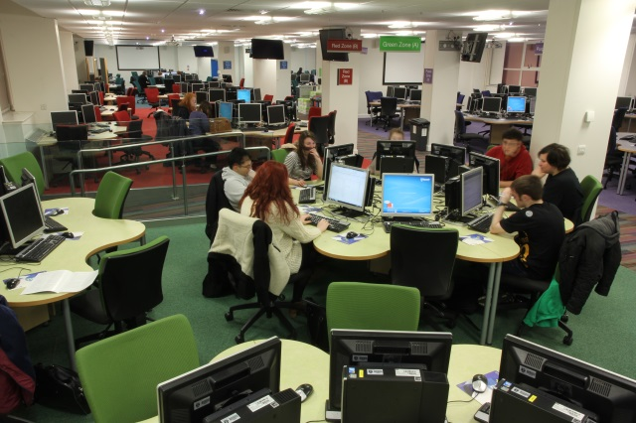
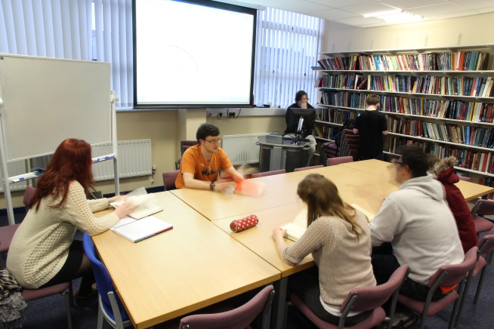
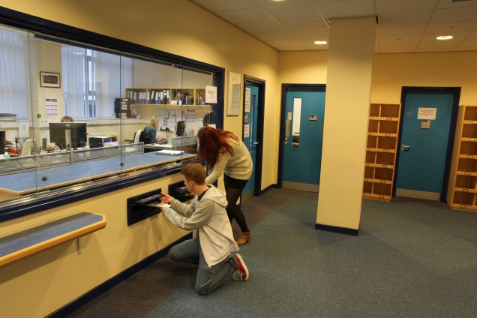
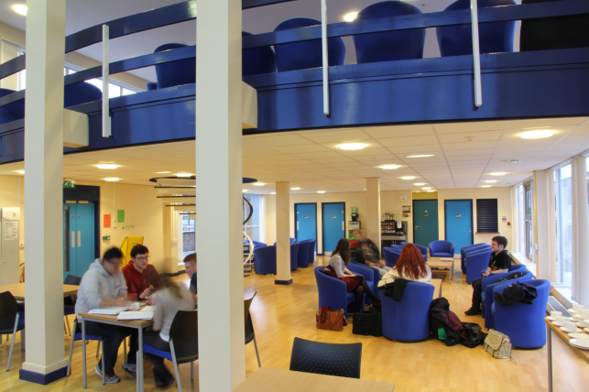
The Herschel Building
Herschel Library
Computer Cluster
School Office
Penthouse
Notes:
Rima – Whole slide

Slide 24
Internet Resources
Blackboard
ReCap
RAS
Lecture Notes
Lecture Recordings
Remote Application Service
Assignments
Open Day ReCap
University Documents
Announcements
University Software
Smartphone App
Notes:
Tom – Blackboard
Rima – ReCap
Tom – RAS
Rima – blackboard demonstration
Tom – CBA demonstration

Slide 25
Support
Current Maths & Stats Student
Regular contact through emails
Buddy
Module Selection & Registration
Academic & Personal issues
Personal Tutor
Support Staff
Undergraduate Secretary
Transition Officer
Student Wellbeing
Financial Matters
Counselling
Notes:
Tom – Buddy
Rima – Personal Tutor
Tom – Undergraduate Secretary
Rima – Student Wellbeing

Slide 26
This Talk
Degree Types
Single Honours
Major / Minor
Joint Honours
Structure
1st Year
2nd Year
Important Projects
Learning & Assessment
Teaching Methods
Assessment Methods
Grades & Weighting
Resources
The Herschel Building
Internet Resources
Support
Timetabling
Typical Week
Semester Calendars
Important Dates
Notes:
Tom – Whole slide

Slide 27
Typical Week
 | 9-10 | 10-11 | 11-12 | 12-1 | 1-2 | 2-3 | 3-4 | 4-5 | 5-6
Mon
Tues
Wed
Thurs
Fri
L
L
PC
Notes:
Tom – Whole slide

Slide 28
Typical Week
 | 9-10 | 10-11 | 11-12 | 12-1 | 1-2 | 2-3 | 3-4 | 4-5 | 5-6
Mon
Tues
Wed
Thurs
Fri
L
L
DI
Notes:
Tom – Whole slide

Slide 29
Typical Week
 | 9-10 | 10-11 | 11-12 | 12-1 | 1-2 | 2-3 | 3-4 | 4-5 | 5-6
Mon
Tues
Wed
Thurs
Fri
L
L
L
PC
L
L
PC
L
PC
Notes:
Tom – Whole slide

Slide 30
Typical Week
 | 9-10 | 10-11 | 11-12 | 12-1 | 1-2 | 2-3 | 3-4 | 4-5 | 5-6
Mon
Tues
Wed
Thurs
Fri
L
L
L
DI
L
L
DI
L
DI
Notes:
Tom – Whole slide

Slide 31
Typical Week
 | 9-10 | 10-11 | 11-12 | 12-1 | 1-2 | 2-3 | 3-4 | 4-5 | 5-6
Mon
Tues
Wed
Thurs
Fri
L
L
L
L
PC
L
L
PC
L
PC
S
L
Sports and Societies
L
L
PC
L
L
PC
Notes:
Tom – Whole slide

Slide 32
Semester One
September 2017
October 2017
November 2017
Important Date:
Freshers’ Week 24th
December 2017
January 2018
Important Date:
Christmas Hols 15th
Important Date:
Exam Period 15th
Key: Teaching Weeks
Holidays
Exam Period
FRESHERS’ WEEK!
Notes:
Rima – whole slide

Slide 33
Semester Two
January 2018
February 2018
March 2018
Important Date:
Semester 2: 29th
Important Date:
Easter Hols 16th
April 2018
May 2018
June 2018
Important Date:
Back to Uni 16th
Important Date:
Exam Period 21st
Important Date:
Summer 15th
Key: Teaching Weeks
Holidays
Exam Period
Resit Period:
20th-31st August
Notes:
Rima – whole slide

Slide 34
Opportunities Abroad
Opportunities Abroad
Intercalating Module
Semester 1 Abroad
Year Out
4 year degree only
Not Graded
Graded
Notes:
Tom – Whole slide

Slide 35
Thanks For Listening
If you have any questions feel free to come and talk to us at any point throughout the day and we will be happy to help.
Thank You for Listening
Notes:
Whoever feels like saying goodbye

Slide 36
Student Finance
Saffron Mabbutt
Sam Everall

Slide 37
Applying In England
How To
Apply
1. Set up an account
5. Sign and return the declaration form
2. Complete the application
4. Provide proof if needed
3. Include details of your household income

Slide 38



For Non-English Students
Finance Information
Scottish Students
Welsh Students
Northern Irish Students

Slide 39
Student Loan
Financial Body
Loan Payments
Tuition Fees
Repayment
Apply in the country you live in
Three payments
£9,250
Not until earning > £21,000
September, January & April
Investment in future
Not until after studying
Placement Years only pay £1,000

Slide 40
Maintenance Loan
£8,430
£7,097
£3,928
£3,124
Notes:
No longer any grant… All loan, however you get more money in total.

Slide 41
Loan Repayments
Not until you earn above £21,000
Payments stop if income falls below
Repayment
Not until you finish studying
Based on what you earn, not what you owe
Repay 9% of income above £21,000
All loans added together – one easy payment!
Written off if not repaid within 30 years
Notes:
If you earned £25,000 a year then you would repay £30 a month, which is approximately the price of a phone contract.

Slide 42

Interest
Interest During Studies
Rate of Inflation (ROI) plus 3%
Interest After
Studies
Earn less than £21,000: ROI
Earn between £21,000 - £41,000:
ROI plus up to 3%
Earn above £41,000: ROI plus 3%

Slide 43

Non-Repayable Finance
From Governments and Universities:
Access to Learning Fund
Disabled Students Allowance
Scholarships & Bursaries:
University Scholarships & Bursaries
Course Specific Scholarships
Part time
work

Slide 44

Opportunity Scholarships
Requirements:
Household Income:
Up to £25,000
Household Income: £25,001 - £35,000
£2000 cash bursary
each year
£1,000 cash bursary each year
What you get:
Don’t need to apply separately to Student Finance!
For more information go to: http://www.ncl.ac.uk/undergraduate/finance/scholarships/opportunity/

Slide 45
Sports Scholarship
Regional/National/International standard within the last 12 months
Requirements:
Up to £10,000 funding
What you get:
Apply online. Applications now OPEN and deadline is 4th Oct 2017
Applying:
Note – For further details please visit performance.sport@newcastle.ac.uk
Notes:
Regional/National/International standard within the last 12 months. Students should be part of a National Governing Body Performance Squad or equivalent.

Slide 46
Maths & Stats Scholarships
Types:
Excellence Scholarship
Exceed Entry Requirement
Stage 4 Bursary
Year 2 and Year 3 Semester 1 mark above 70%
What you get:
£250 available for each grade above the requirement.
A* in Maths or Further Maths awarded an extra £250
Worth £1,000 per year of study
Note – You must have achieved your minimum grades, e.g. A*BB will not receive £250
Notes:
So if you got 3xA*, you would get 3x£250 for beating your requirements, plus 2x£250 for A*’s in Maths and Further Maths.

Slide 47
Living Costs
Phone bill
Accommodation
Toiletries
TV;
most halls don’t have TV licences
Clothes
Living Costs
Food
Insurance; belongings /
keys!
Study; recommended books
Travel;
To Uni / home / visit friends
Social Life

Slide 48
Money Management
Part time Job;
Recommended
15 hours
or less
Use campus facilities; Library, Sports centre, Union etc.
Budget!
If you can’t
afford it,
don’t do it!
Shop around
for
the best
deals
Make it go further
Interest free overdraft! Don’t be drawn in by freebies
Walk
or
get a student
travel pass
Student Discount: Restaurants,
Bars, Cinema
etc.
Buy books
second-hand
or
Use the library

Slide 49

Finance Resources
DirectGov Resources
Student Wellbeing
Independent task force on student finance information: Martin Lewis

Slide 50
Example: Max
Max has a household income of £15,500. He achieved AAA in Maths, P.E. and Drama. He has also made it onto the University Squash Team having played for the County. He will be living away from home and also qualified for the Opportunity Scholarship.
 |  | Repayment
Maintenance Loan | £8,430 | £8,430
Tuition Fee | £9,250 | £9,250
Opportunity Scholarship | £2,000
Sports Scholarship | £1,000
Total: | £20,680 | £17,680
 | -£9,250
Max will receive: | £11,430
Notes:
Household Income < £25,000 so £2000 each year from Opportunity Scholarship. Also £1,000 Sports Scholarship as he is on an elite sports team. Hasn’t yet paid his accommodation though.

Slide 51
Example: Katie
Katie has a household income of £42,800. She achieved A*A*B in Maths, Further Maths and Physics. She will be living away from home.
 |  | Repayment
Maintenance Loan | £5,844 | £5,844
Tuition Fee | £9,250 | £9,250
Maths & Stats Scholarship | £1,000
Total: | £16,094 | £15,094
 | -£9,250
Katie will receive: | £6,844
Notes:
Much less Maintenance Loan than Max since her parents earn £42,800>£20,000. Full tuition fees. 1x£250 for 1 grade beating the requirements, 2x£250 for A*’s in Maths and Further Maths, so £750 from the Maths & Stats Scholarship.

Slide 52
Key Facts
Student loans ARE available to you; no repayments until after you’re
earning over £21,000
You don’t
need money
up front
so don’t worry!
It may seem like a lot of money but it’s worth it as an investment in your future!
There are lots of grants and scholarships available to help with money; see if you’re entitled
If you have any further questions, feel free to contact us on Twitter: @NCLMathsStats

Slide 53

Thank You for Listening ☺

Slide 54
Accommodation
Emma Bradley
Amy Green

Slide 55
Accommodation Guarantee
Choose Newcastle as your first choice before 30th June 2017
You complete the online application form before 30th June 2017
Guaranteed a place in a halls, regardless of where you currently live

Slide 56
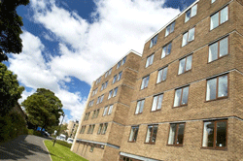
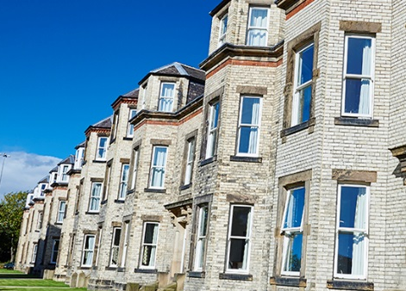

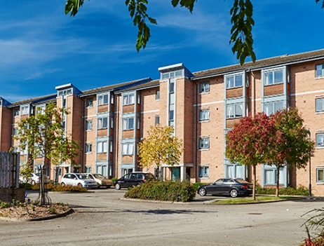
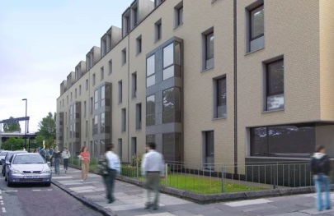
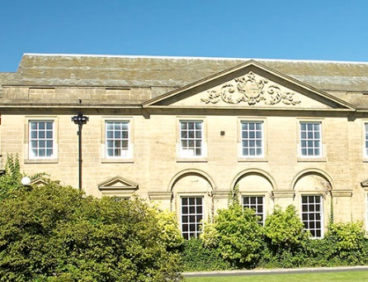
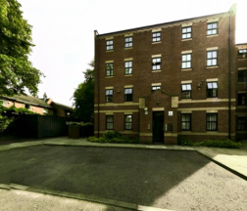
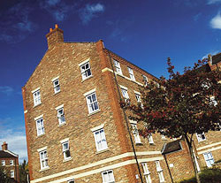
Castle Leazes
Kensington Terrace
Leazes Parade
The Halls
Bowsden Court
The Halls
The Halls
Park Terrace
St Mary’s
Windsor Terrace
Marris House

Slide 57

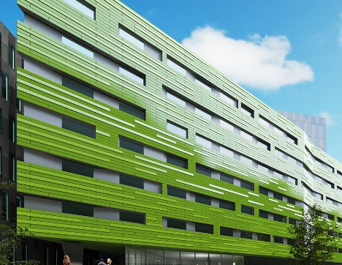
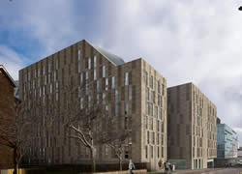
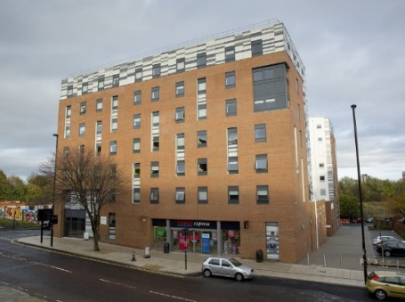
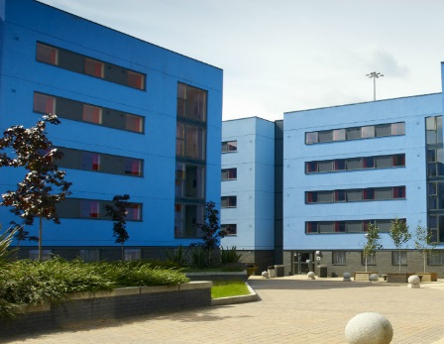
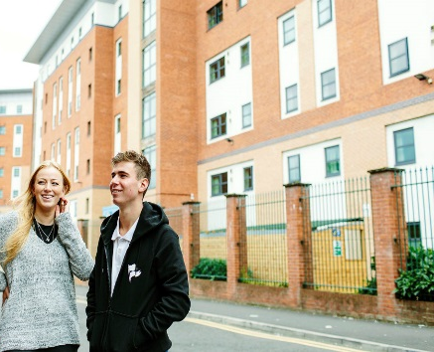
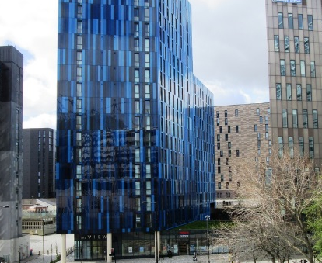
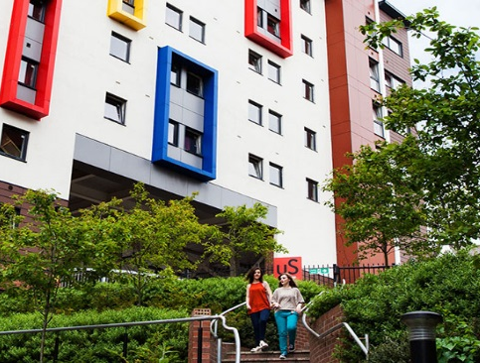
Barker House
Verde
Managed Partnership Accommodation
Liberty Plaza
The Halls
Turner Court
The Halls
Union State
Liberty Quay
The View
Manor Bank

Slide 58
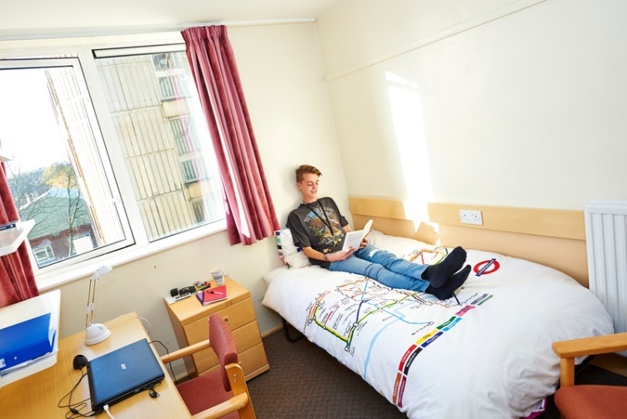
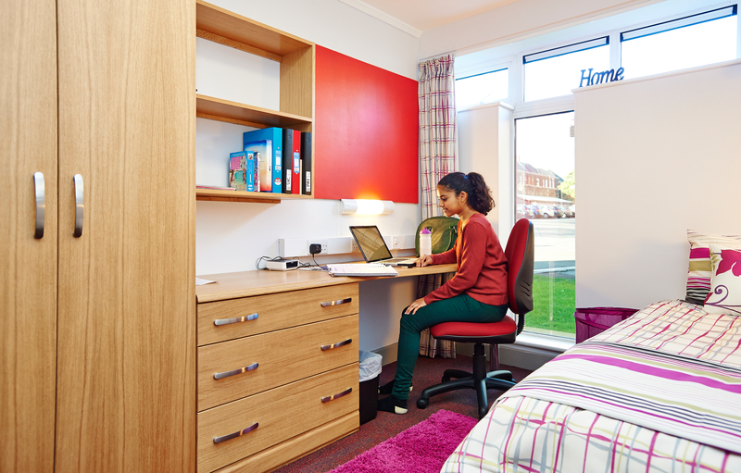
Typical Rooms
To find out more detailed information and view our virtual tours for each of our halls of residence visit:
www.ncl.ac.uk/accommodation

Slide 59



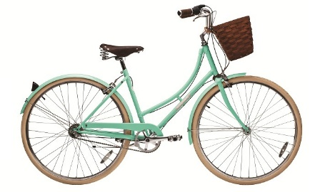
Included In All Halls
Free internet connection
Launderette
Holidays included
Bicycle Storage
24 hour security
Bills

Slide 60
Things To Consider
Self Catered/Catered
Affordability
Location
Mixed/Single Gender
Flat/Corridor Layout
Deluxe Room
Standard Washbasin Room
Smaller/Larger Community
Ensuite Room

Slide 61

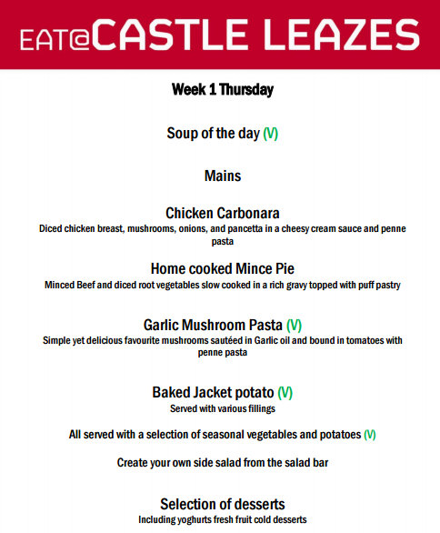


Why Catered Is Best
Get your meals cooked
Cleaner for kitchen & bedroom
Small kitchen provided
Saves time and effort

Slide 62
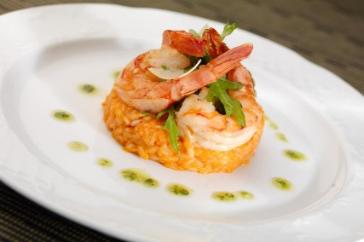
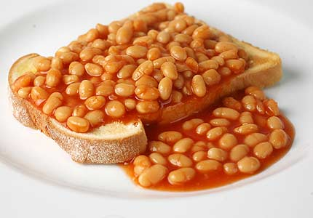
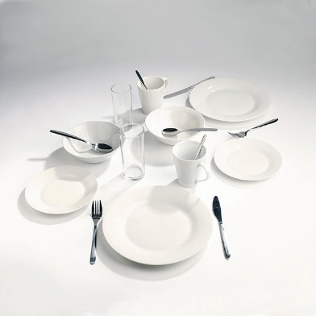
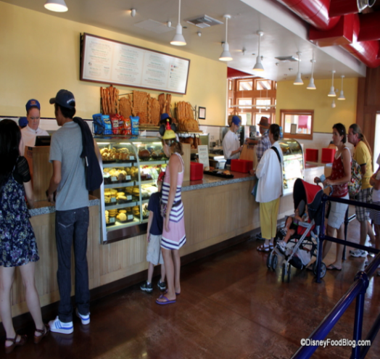
Why Self-Catered Is Best
More freedom to choose what/when you eat
Can still buy catered meals
Larger kitchen & free crockery pack

Slide 63
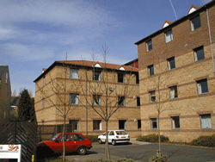


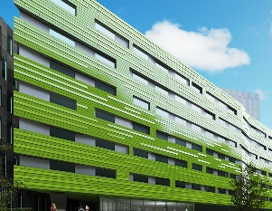
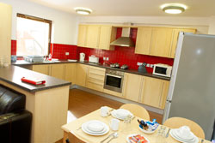
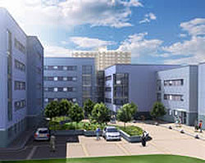
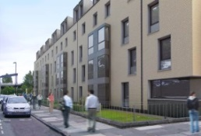
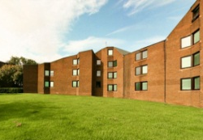
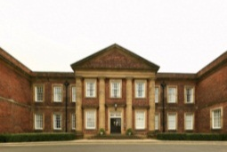

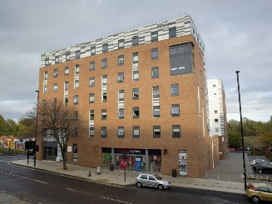



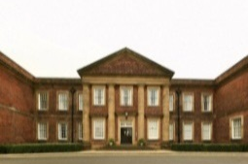

Comparing Price
Least Expensive- £83 p/w
Most Expensive- £167p/w
Bowsden Court
Victoria Halls
Park Terrace
Richardson Rd
Bowsden Court
Liberty Quay
Park Terrace
Verde
Castle Leazes
Castle Leazes
St Marys College
Marris House
Marris House
Marris House
St Marys College
Marris House
Turner Court
Union State
Richardson Rd
The View
St Marys College
Windsor Terrace
Leazes Parade
Manor Bank
Liberty Plaza

Slide 64

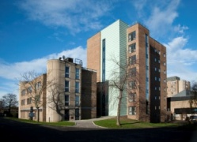
Comparing Size
Smallest - 50 rooms
Largest - 1100 rooms
St Marys College
Bowsden Court
Bowsden Court
Marris House
Castle Leazes
Bowsden Court
Leazes Parade
Turner Court
St Marys College
Castle Leazes
Victoria Halls
Windsor Terrace
Park Terrace
Richardson Rd
Liberty Quay
Park Terrace
The View
Liberty Plaza
St Marys College
Park Terrace
Castle Court
Marris House
Marris House
Richardson Rd
Castle Court
Marris House
Manor Bank
Union State
Verde

Slide 65
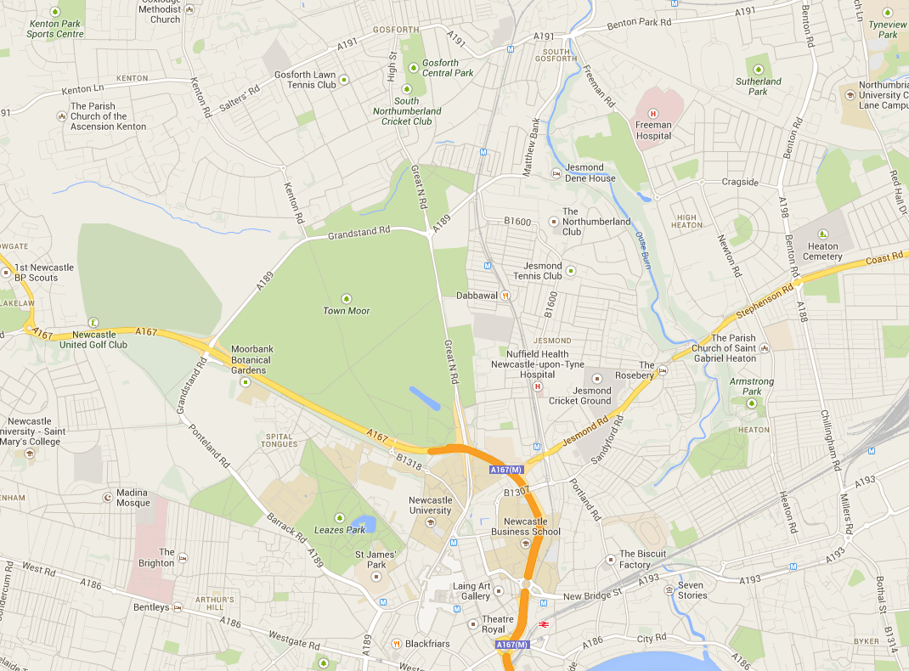

Routes from further away.
Bowsden Court
St Mary’s College
Park, Windsor & Kensington Terrace
Marris House
Castle Leazes, Castle Court & Leazes Parade
Newcastle University
Union State
Turner Court
Liberty Plaza, Verde & The View
Manor Bank & Liberty Quay

Slide 66









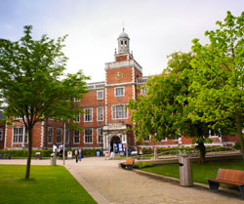
After Halls
Lots of student properties
Remember extra costs
Support available
Typically 12 month contracts

Slide 67
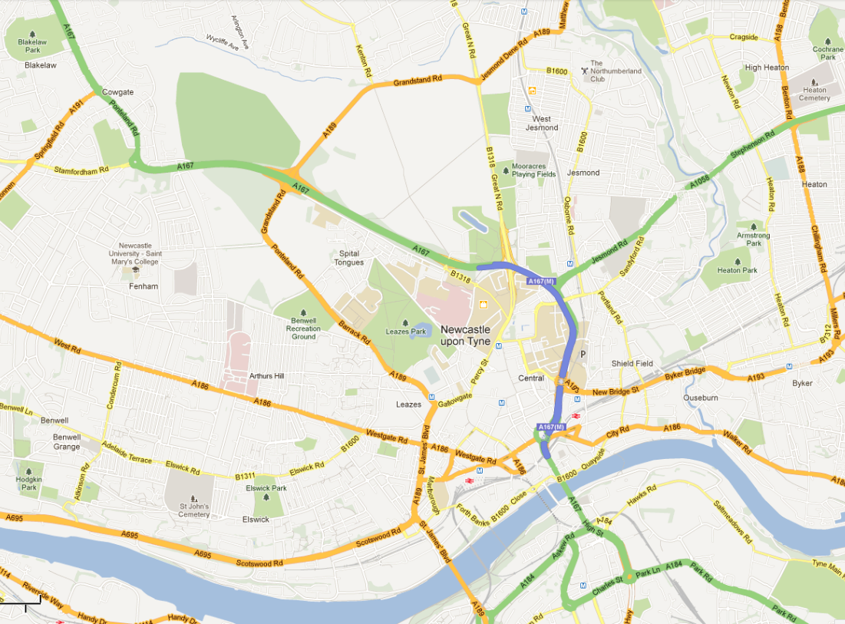
Jesmond
Spital Tongues
Heaton
Newcastle University
Fenham
Sandyford

Slide 68
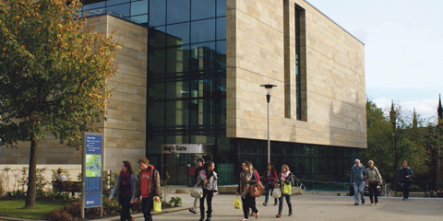

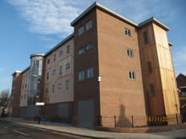
University Properties
Accommodation service - Level 1, Kings Gate
NUStudentHomes
University owned/managed accommodation
Barker House and Albion House; available to all students (Stage 2+)

Slide 69
Overview
Find brief facts and figures for each accommodation on:
http://www.ncl.ac.uk/accommodation/assets/documents/AccommodationOverview.pdf

Slide 70
Overview
“We had a lovely new flat with a great atmosphere and the staff were so helpful. It was nice to be in hall that were shared with Northumbria as I bumped into a lot of friends from school who were studying there.”
Holly, Manor Bank
““The facilities were really nice and my room was huge, there was a really big common room with a pool table and tv’s. It was a bit quiet but I enjoyed that.”
Jenny, St Mary’s College
“Great atmosphere, lovely mix. Great location for going to town and only a 15 minute walk to uni.”
Anna, Liberty Plaza
“Being catered was good, even though it would probably have worked out cheaper cooking for myself, I enjoyed the social aspect of going to the dining hall.”
Georgia, Castle Leazes
“It was a nice local area and good to have an en-suite without breaking the bank.”
Theo, Bowsden Court
If you have any further questions, feel free to contact us on Twitter: @NCLMathsStats

Slide 71
City and Social
Bethany Gibson
Emma Cox

Slide 72

Freshers’ Week
Freshers’ Wristband
Price
Ordering
What’s the point?
Activities

Slide 73
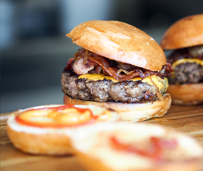


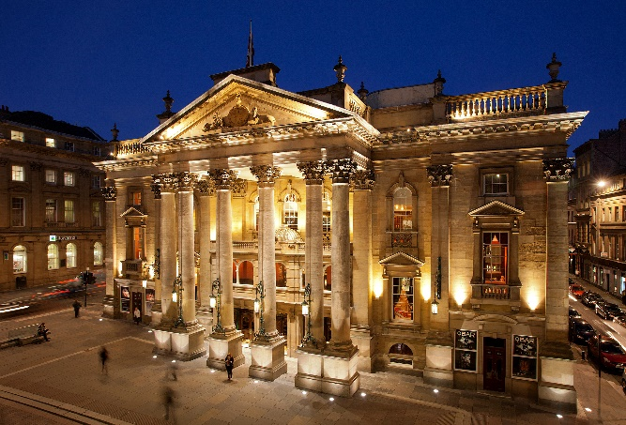
Night Time Activities
Clash of the Halls
Grub Crawl
Theatre trips
Pandamonium

Slide 74
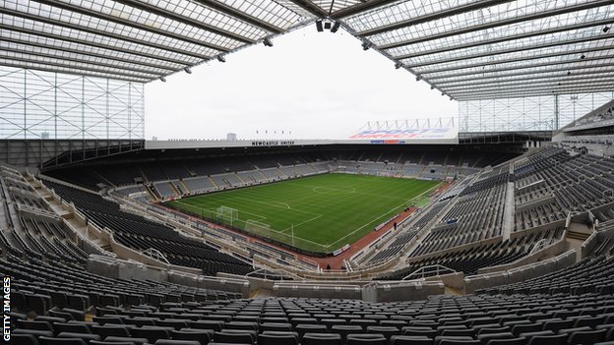


Daytime Activities
St James’ Tour
£25
£30
Cocktail Training
£106.50
Ice Skating
£8.50
Paintball
£10
£33
Go Ape

Slide 75
Clubs And Societies
Clubs & Societies
Sports
Societies
Athletic Union
Go Play
Give It A Go
Joining
Societies
Intra-Mural

Slide 76
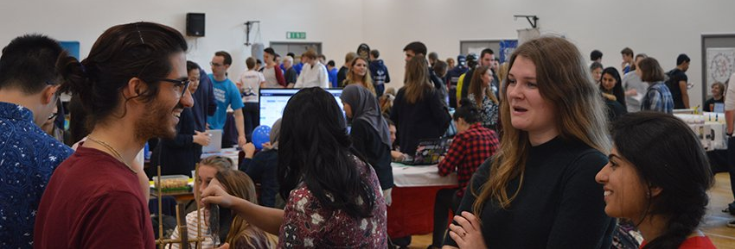
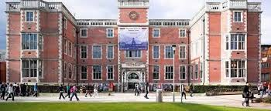

Joining
Freshers’ Fair
NUSU Website

Slide 77



Societies
Nearly 200 registered clubs and societies at Newcastle
Or you can create your own!
Dance
Twenty Minute Society
Cheese & Wine

Slide 78
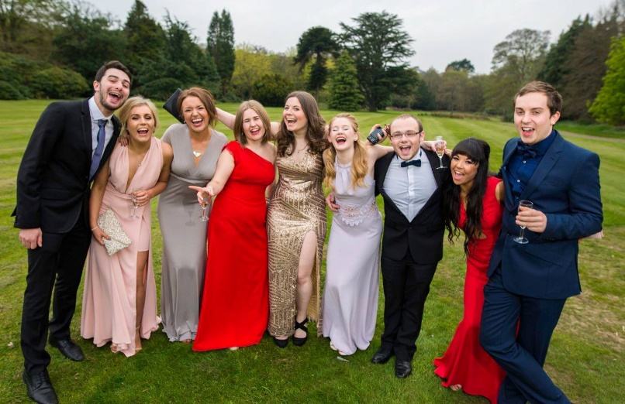
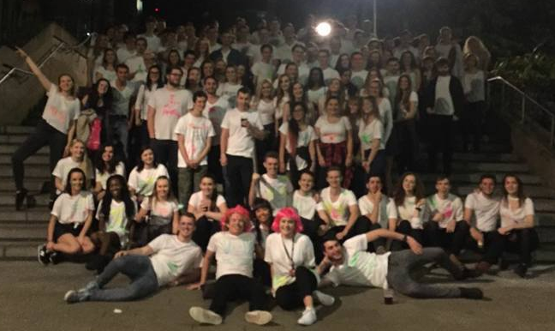
MATHSOC
Summer Ball
Public Talks
Sports teams
Holidays Abroad
Ice Skating
Bar Crawls
Bowling
Charity Fundraising
Pub Quizzes

Slide 79
Give It A Go
No need to join societies
Run by the union
Activities
Give it a Go
Tours
Trips
Signing up

Slide 80
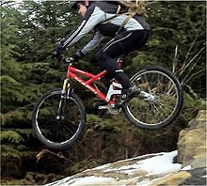


Sports
Sport
Go Play
Athletic Union
Intra-Mural

Slide 81


Go Play
Go Play
Easy to try new things
No long term commitment
Sport just for fun
Archery
Basketball
Fencing

Slide 82

Students’ Union
£8 million refurbishment and was re-opened in 2011
Services
Student Radio
Advice Centre
Courier
Food & Drink
Starbucks
Mensbar
Domino’s
Subway
Organic Food Stall
Facilities
Computer Cluster
Union Shop
Bank
Venue

Slide 83



Safety in the City
In Freshers’ week the crew collect students from their accommodation and walk them back after the events
Free mobile app allows for emergency alerts, first aid and help calls to a Response Team
Emergency taxi service if stranded with no money, can pay with smartcard
Cross- campus CCTV and security staff on duty at all times

Slide 84




In And Around Newcastle
Newcastle University
The Gate
St James’ Park
Metro Radio Arena
The Baltic

Slide 85




In And Around Newcastle
Newcastle University
Hancock Museum
China Town
Tyneside Cinema
Theatre Royal
The Sage

Slide 86





In And Around Newcastle
To Northumberland National Park
Tynemouth Beach
Newcastle
South Shields
Metrocentre
Angel Of The North

Slide 87



In And Around Newcastle
To Alnwick Castle & Gardens
Segedunum Roman Baths
Newcastle
To Durham Cathedral
Beamish Museum

Slide 88




In And Around Newcastle
SU
Pink Triangle
Newcastle
Bigg Market
Diamond Strip
Digital

Slide 89




Local Transport
3 metro stations in Newcastle city centre, 1 directly opposite campus. Travel to the coast in 20 minutes
Central rail station providing local and national rail services
Newcastle International Airport flying to worldwide destinations
Ferry terminal going to Amsterdam and continental Europe

Slide 90
Summary
Freshers’ Week: order wristband to attend all the activities, meet lots of new people and make friends
Join clubs and societies at the fair or on the student union website
Voted the most sociable place to study in the UK (Times Higher Education Student Experience Survey 2016)
Finished 9th overall in 15/16 British Universities and Colleges Sports League

Slide 91
y
Careers
Rachel Binks
Martha King

Slide 92

Facts and Figures
We are one of the
Top 20 ‘Most
Targeted’
universities by the UK’s
leading employers
(The Graduate Market Report 2012–13)
3rd in the UK for quality of staff and lecturers
Times Higher Education Student Experience Survey
6th in the UK for Student Satisfaction
Lloyds Bank Survey 2014
1st in the UK for Quality of Social Life
Lloyds Bank Survey 2014
4th in the UK for Quality of Student Life
Lloyds Bank Survey 2014
Top 1% of world universities
QS World University Rankings 2014/2015
95% of NCL students go into graduate employment or future study within first six months
13th in the world for our careers advice
out of 163 institutions
(International Student Barometer 2012)

Slide 93
Careers Service
Career Advice
Drop in CV checks
Mock Assessments
Recruitment Fairs
Support after Graduation
Careers Workshop
Multi-Award Winning Careers Service
Rise-up
Vacancies Online
Further Advice
Time Out Advice
Great Employer Links
Newcastle Work Experience

Slide 94
NCL+ Award
Represent the University
Clubs, Societies and Events
Earn and Learn
World and Media
Volunteering
Course Rep
Societies Officer
CV Advisor
Careering Ahead Blogger
Go Play Coach
Hall Rep
Events Crew
Jobs OC
Language Learning
Passport to Work
Student Mentor
Rise up
Part-time Jobs
Journalism
Sports Volunteer
Student Ambassador
Student Society
Holiday Work
Broadcaster
Student Advice Centre
Union Officer
Student Ambassador
Student Exchange
Sustainability Volunteer
Sports Centre Jobs

Slide 95


Maths & Stats Specific Advice
Maths & Stats Related Skills
Group work Experience
Presentation Skills
Report Writing Experience
Mathematical Skills and Career Development module
Maths & Stats Careers Help
Careers Fairs

Slide 96
What Next?
Further Study
Crime Analyst
Software Developer
Investment Banker
Time Out
Statistician
Computer Game Designer
Actuary
Teacher
Sports Betting
Engineer
Accountant
Cryptographer
Air Traffic Controller
Data Analyst
Consultant

Slide 97


Further Study
MSc or PhD
Expertise in Interesting Subject
4 Year PhD Programme – Systems Neuroscience
4 Year Doctoral Training in Carbon Capture and Storage, and Cleaner Fossil Energy
Funding
Boost Career Prospects

Slide 98
Employment Routes
Summer Internship
Graduate Scheme or Job
4-10 week summer vacation work placement
Full-time work beginning September after graduation
May lead to conditional offer of employment subject to graduation
Employment

Slide 99
Our Advice
Start looking in good time
Consider preferred sector of employment
Start applying
Take your time and make each one count!
Practice and prepare for next stages
Careers service – mock interviews and psychometric tests

Slide 100
Societies
Lots of Jobs and opportunities advertised through MathSoc
Talks
Graduate Jobs
Voluntary
IMA Careers Presentation
Public Sectors Audit
Study Support Group
KPMG Careers Insight Night
Software Developers

Slide 101


Graduate Profiles
Hannah
Kathryn
Graduated in 2014, BSc
Search Engine Advertising
Graduated in 2012, MMath
Atomic Weapons Establishment

Slide 102

Graduate Profiles
Will
Kieren
Graduated in 2015, BSc
Statistical Analyst, Servelec
Graduated in 2015, MMath
Jagex Games, Computer Games Designer

Slide 103
Summary
Maths & Stats opens many doors!
NCL ensures the best chance for future employment
Thank you for listening

