Slide 1
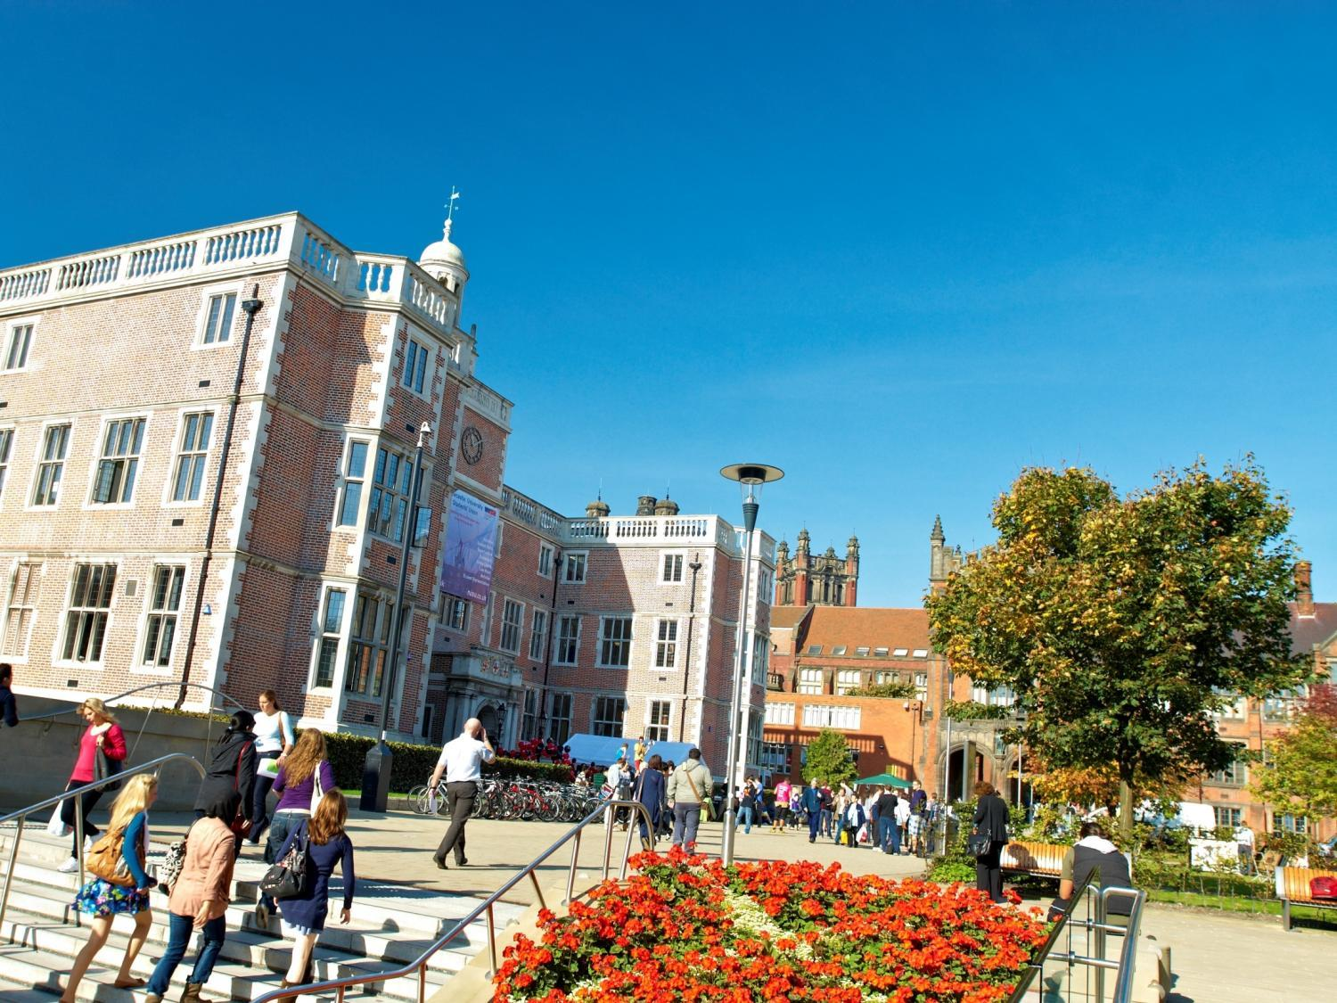


Dr. Lee Fawcett
School of Mathematics & Statistics
Newcastle University, UK
A Future in Mathematics
@NCLMathsStats
www.ncl.ac.uk/maths

Slide 2
Who am I?
Lee Fawcett
Lecturer in Statistics at Newcastle University, UK
  Teaching: 1st year, 2nd year and 4th year undergraduate Mathematicians, and students from many other subjects!
  Research: Statistical modelling of environmental extremes
  Outreach: Tell people what we do, and how good Mathematics & Statistics is!

Slide 3
What am I doing here?
Outreach
  Further study in Mathematics
  Careers after studying Mathematics
  Real world applications of Mathematics, including cool research areas
Cypriot students at Newcastle University: Hard-working, motivated and aspirational

Slide 4
A Future in Mathematics
Real world applications
Careers
Mathematics at University
Newcastle University

Slide 5

Real world applications

Slide 6


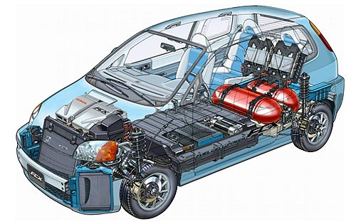

What is STEM?
STEM
CIENCE
ECHNOLOGY
NGINEERING
ATHS
Notes:
STEM acronym brings together the words science, technology, engineering and mathematics - words which are associated with some of the most important and exciting areas of human endeavour

Slide 7
Maths is everywhere…
Decisions...
Digital music
Phones and internet
Satellite Navigation
Cryptography
Crowd control
Rockets and Satellites
Crime prediction
Game theory
Volcano monitoring
Carbon dating
Cosmology
Computer games
Movie Graphics
Search Engines
Epidemic Analysis
Military and Defence
Skate park design
CDs and DVDs
Speech recognition
Climate extremes
Fraud detection
Data compression
Wildfire modelling
Financial Modelling

Slide 8
Maths is everywhere…
Decisions...
Digital music
Phones and internet
Satellite Navigation
Cryptography
Crowd control
Rockets and Satellites
Crime prediction
Game theory
Volcano monitoring
Carbon dating
Cosmology
Computer games
Movie Graphics
Search Engines
Epidemic Analysis
Military and Defence
Skate park design
CDs and DVDs
Speech recognition
Climate extremes
Fraud detection
Data compression
Wildfire modelling
Financial Modelling

Slide 9
Decisions...

Slide 10
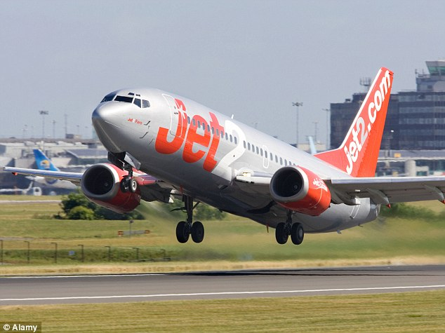

Slide 11
Maths is everywhere…
Decisions...
Digital music
Phones and internet
Satellite Navigation
Cryptography
Crowd control
Rockets and Satellites
Crime prediction
Game theory
Volcano monitoring
Carbon dating
Cosmology
Computer games
Movie Graphics
Search Engines
Epidemic Analysis
Military and Defence
Skate park design
CDs and DVDs
Speech recognition
Climate extremes
Fraud detection
Data compression
Wildfire modelling
Financial Modelling

Slide 12
Maths is everywhere…
Decisions...
Digital music
Phones and internet
Satellite Navigation
Cryptography
Crowd control
Rockets and Satellites
Crime prediction
Game theory
Volcano monitoring
Carbon dating
Cosmology
Computer games
Movie Graphics
Search Engines
Epidemic Analysis
Military and Defence
Skate park design
CDs and DVDs
Speech recognition
Climate extremes
Fraud detection
Data compression
Wildfire modelling
Financial Modelling

Slide 13
Cryptography

Slide 14


Slide 15


Slide 16
Maths is everywhere…
Decisions...
Digital music
Phones and internet
Satellite Navigation
Cryptography
Crowd control
Rockets and Satellites
Crime prediction
Game theory
Volcano monitoring
Carbon dating
Cosmology
Computer games
Movie Graphics
Search Engines
Epidemic Analysis
Military and Defence
Skate park design
CDs and DVDs
Speech recognition
Climate extremes
Fraud detection
Data compression
Wildfire modelling
Financial Modelling

Slide 17
Maths is everywhere…
Decisions...
Digital music
Phones and internet
Satellite Navigation
Cryptography
Crowd control
Rockets and Satellites
Crime prediction
Game theory
Volcano monitoring
Carbon dating
Cosmology
Computer games
Movie Graphics
Search Engines
Epidemic Analysis
Military and Defence
Skate park design
CDs and DVDs
Speech recognition
Climate extremes
Fraud detection
Data compression
Wildfire modelling
Financial Modelling

Slide 18
Climate extremes

Slide 19
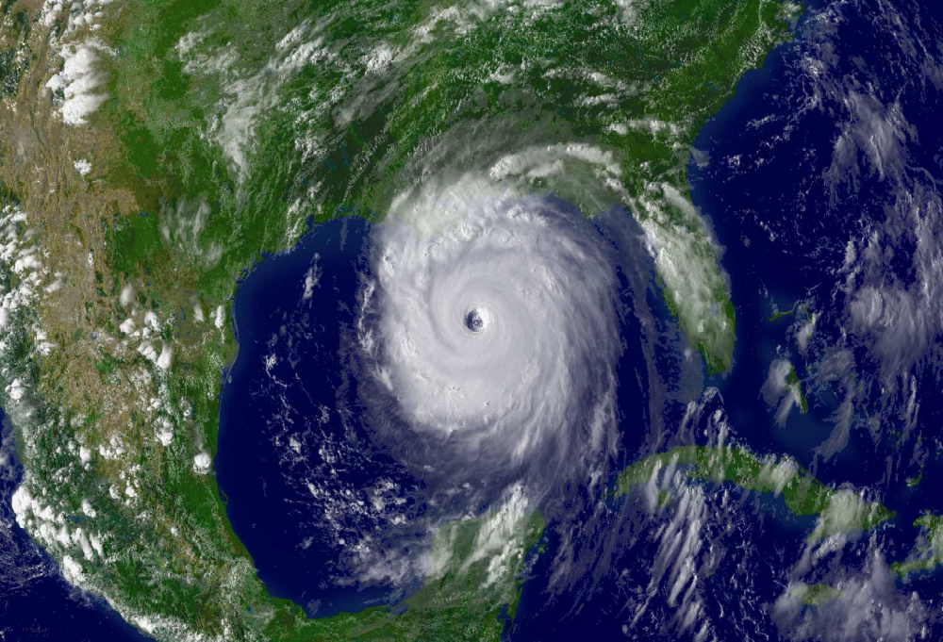

Slide 20
Hurricane Katrina
Category 3 hurricane when it made landfall
Killed 1833 people
Caused over $100 billion worth of damage
Most damage/loss of life caused by storm surge
Storm surge reached 14.4 feet
Classed as the “Storm of the Century”

Slide 21
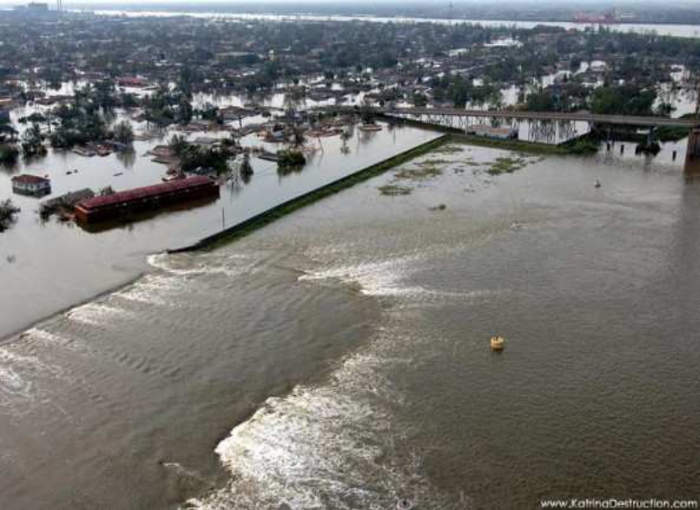

Slide 22
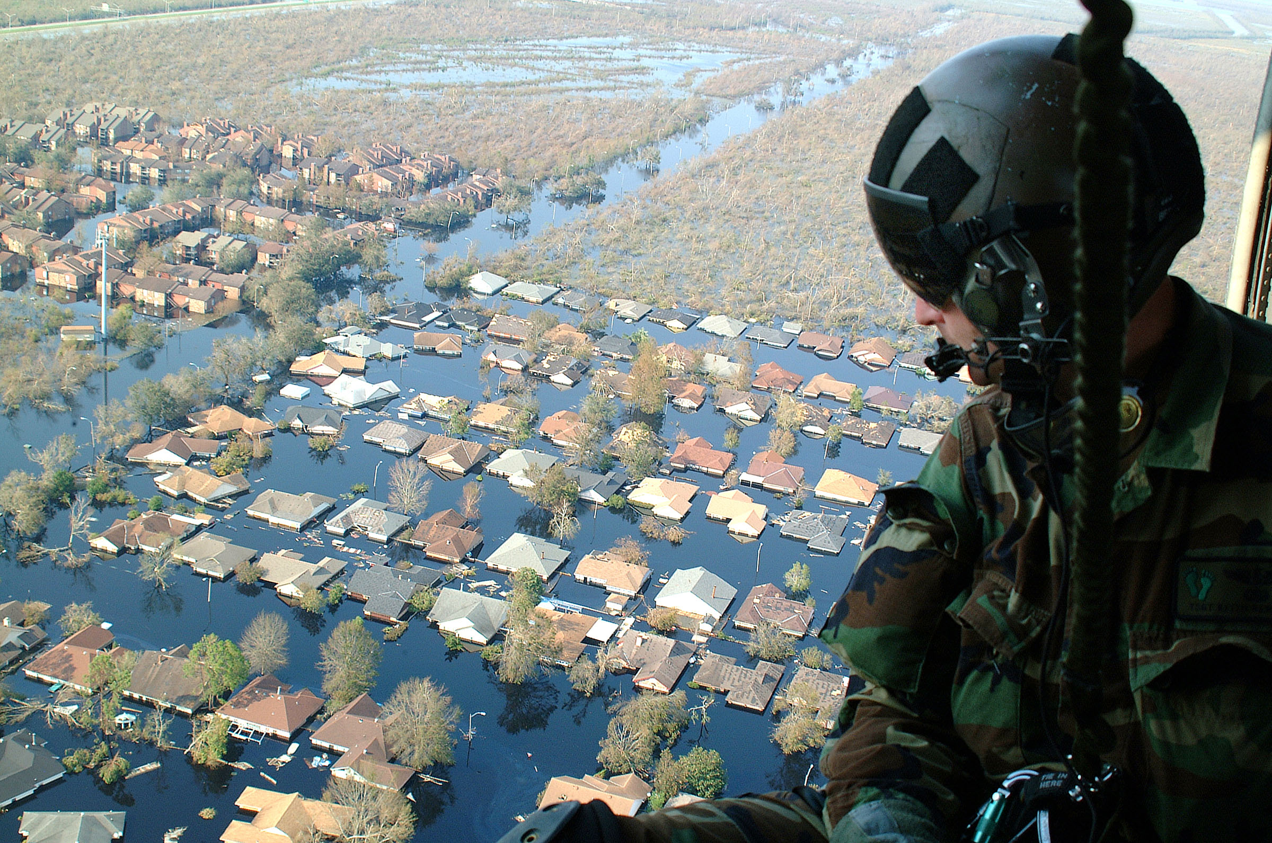

Slide 23

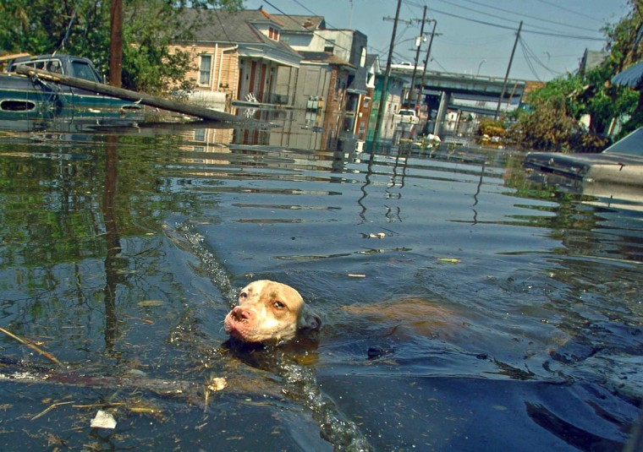

Slide 24
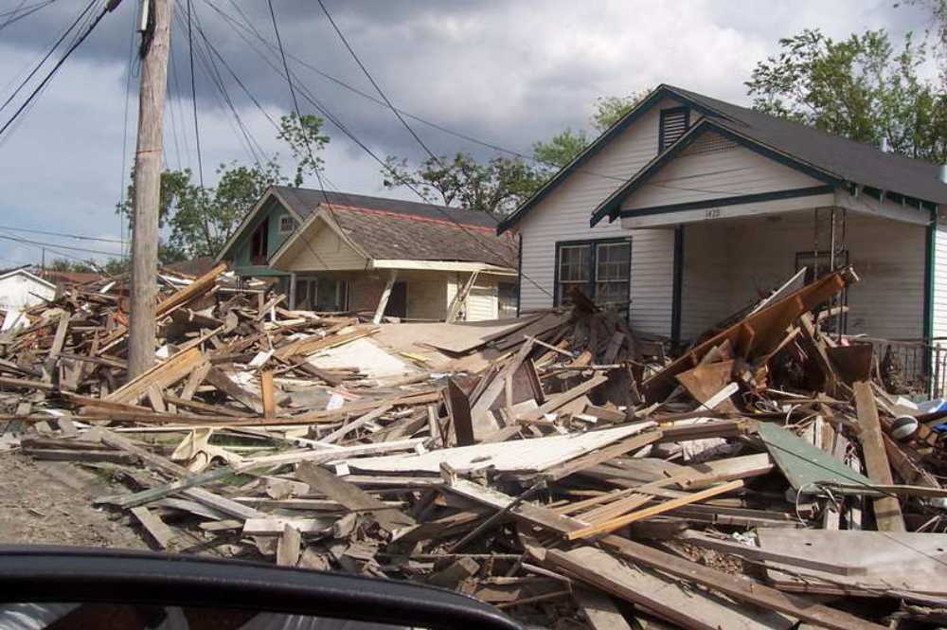

Slide 25
Hurricane Katrina
8.5 | 8.9 | 9.1 | 8.9 | 8.4 | 9.7 | 9.1 | 9.6 | 8.7 | 9.3
9.6 | 9.3 | 8.7 | 9.0 | 8.8 | 8.9 | 12.2 | 7.8 | 7.7 | 8.9
8.3 | 8.1 | 7.3 | 6.8 | 6.7 | 7.3 | 7.6 | 8.2 | 8.6 | 9.8
9.5 | 7.4 | 7.3 | 10.2 | 10.3 | 10.4 | 8.8 | 9.7 | 10.0 | 10.8
11.1 | 12.7 | 11.5 | 11.8 | 12.6 | 13.0 | 10.5 | 10.5 | 10.0 | 9.4
P(sea-surge > 8.75 feet) = ?
P(sea-surge > 11.25 feet) = ?
P(sea-surge > 14 feet) = ?

Slide 26
Hurricane Katrina
6.7 | 6.8 | 7.3 | 7.3 | 7.3 | 7.4 | 7.6 | 7.7 | 7.8 | 8.1
8.2 | 8.3 | 8.4 | 8.5 | 8.6 | 8.7 | 8.7 | 8.8 | 8.8 | 8.9
8.9 | 8.9 | 8.9 | 9.0 | 9.1 | 9.1 | 9.3 | 9.3 | 9.4 | 9.5
9.6 | 9.6 | 9.7 | 9.7 | 9.8 | 10.0 | 10.0 | 10.2 | 10.3 | 10.4
10.5 | 10.5 | 10.8 | 11.1 | 11.5 | 11.8 | 12.2 | 12.6 | 12.7 | 13.0
P(sea-surge > 8.75 feet) = ?
P(sea-surge > 11.25 feet) = ?
P(sea-surge > 14 feet) = ?

Slide 27
Hurricane Katrina
6.7 | 6.8 | 7.3 | 7.3 | 7.3 | 7.4 | 7.6 | 7.7 | 7.8 | 8.1
8.2 | 8.3 | 8.4 | 8.5 | 8.6 | 8.7 | 8.7 | 8.8 | 8.8 | 8.9
8.9 | 8.9 | 8.9 | 9.0 | 9.1 | 9.1 | 9.3 | 9.3 | 9.4 | 9.5
9.6 | 9.6 | 9.7 | 9.7 | 9.8 | 10.0 | 10.0 | 10.2 | 10.3 | 10.4
10.5 | 10.5 | 10.8 | 11.1 | 11.5 | 11.8 | 12.2 | 12.6 | 12.7 | 13.0
P(sea-surge > 8.75 feet) = ?
P(sea-surge > 11.25 feet) = ?
P(sea-surge > 14 feet) = ?

Slide 28
Hurricane Katrina
6.7 | 6.8 | 7.3 | 7.3 | 7.3 | 7.4 | 7.6 | 7.7 | 7.8 | 8.1
8.2 | 8.3 | 8.4 | 8.5 | 8.6 | 8.7 | 8.7 | 8.8 | 8.8 | 8.9
8.9 | 8.9 | 8.9 | 9.0 | 9.1 | 9.1 | 9.3 | 9.3 | 9.4 | 9.5
9.6 | 9.6 | 9.7 | 9.7 | 9.8 | 10.0 | 10.0 | 10.2 | 10.3 | 10.4
10.5 | 10.5 | 10.8 | 11.1 | 11.5 | 11.8 | 12.2 | 12.6 | 12.7 | 13.0
P(sea-surge > 8.75 feet) = 33/50 = 0.66 ?
P(sea-surge > 11.25 feet) = ?
P(sea-surge > 14 feet) = ?

Slide 29
Hurricane Katrina
6.7 | 6.8 | 7.3 | 7.3 | 7.3 | 7.4 | 7.6 | 7.7 | 7.8 | 8.1
8.2 | 8.3 | 8.4 | 8.5 | 8.6 | 8.7 | 8.7 | 8.8 | 8.8 | 8.9
8.9 | 8.9 | 8.9 | 9.0 | 9.1 | 9.1 | 9.3 | 9.3 | 9.4 | 9.5
9.6 | 9.6 | 9.7 | 9.7 | 9.8 | 10.0 | 10.0 | 10.2 | 10.3 | 10.4
10.5 | 10.5 | 10.8 | 11.1 | 11.5 | 11.8 | 12.2 | 12.6 | 12.7 | 13.0
P(sea-surge > 8.75 feet) = 33/50 = 0.66 ?
P(sea-surge > 11.25 feet) = 6/50 = 0.12 ?
P(sea-surge > 14 feet) = ?

Slide 30
Hurricane Katrina
6.7 | 6.8 | 7.3 | 7.3 | 7.3 | 7.4 | 7.6 | 7.7 | 7.8 | 8.1
8.2 | 8.3 | 8.4 | 8.5 | 8.6 | 8.7 | 8.7 | 8.8 | 8.8 | 8.9
8.9 | 8.9 | 8.9 | 9.0 | 9.1 | 9.1 | 9.3 | 9.3 | 9.4 | 9.5
9.6 | 9.6 | 9.7 | 9.7 | 9.8 | 10.0 | 10.0 | 10.2 | 10.3 | 10.4
10.5 | 10.5 | 10.8 | 11.1 | 11.5 | 11.8 | 12.2 | 12.6 | 12.7 | 13.0
P(sea-surge > 8.75 feet) = 33/50 = 0.66 ?
P(sea-surge > 11.25 feet) = 6/50 = 0.12 ?
P(sea-surge > 14 feet) = 0/50 = 0 ?

Slide 31
Hurricane Katrina
6.7 | 6.8 | 7.3 | 7.3 | 7.3 | 7.4 | 7.6 | 7.7 | 7.8 | 8.1
8.2 | 8.3 | 8.4 | 8.5 | 8.6 | 8.7 | 8.7 | 8.8 | 8.8 | 8.9
8.9 | 8.9 | 8.9 | 9.0 | 9.1 | 9.1 | 9.3 | 9.3 | 9.4 | 9.5
9.6 | 9.6 | 9.7 | 9.7 | 9.8 | 10.0 | 10.0 | 10.2 | 10.3 | 10.4
10.5 | 10.5 | 10.8 | 11.1 | 11.5 | 11.8 | 12.2 | 12.6 | 12.7 | 13.0
P(sea-surge > 8.75 feet) = 33/50 = 0.66 ?
P(sea-surge > 11.25 feet) = 6/50 = 0.12 ?
P(sea-surge > 14 feet) = 0/50 = 0 ?!

Slide 32
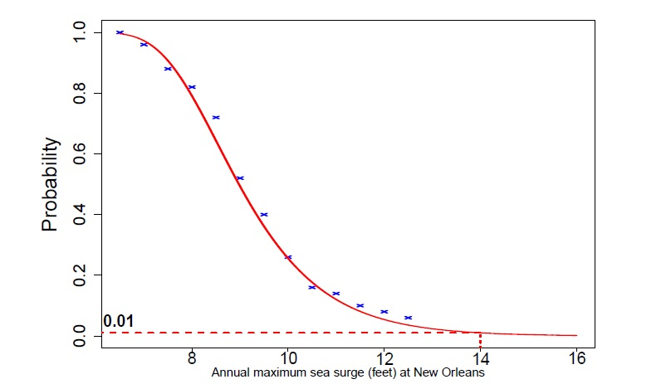

Slide 33
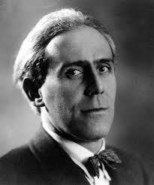


Slide 34
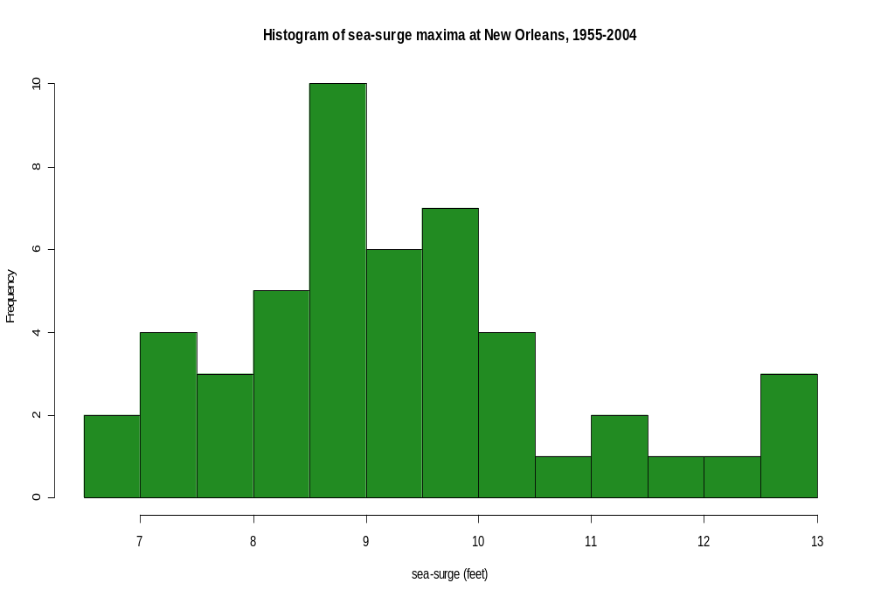

Slide 35
Maths is everywhere…
Decisions...
Digital music
Phones and internet
Satellite Navigation
Cryptography
Crowd control
Rockets and Satellites
Crime prediction
Game theory
Volcano monitoring
Carbon dating
Cosmology
Computer games
Movie Graphics
Search Engines
Epidemic Analysis
Military and Defence
Skate park design
CDs and DVDs
Speech recognition
Climate extremes
Fraud detection
Data compression
Wildfire modelling
Financial Modelling

Slide 36
Maths is everywhere…
Decisions...
Digital music
Phones and internet
Satellite Navigation
Cryptography
Crowd control
Rockets and Satellites
Crime prediction
Game theory
Volcano monitoring
Carbon dating
Cosmology
Computer games
Movie Graphics
Search Engines
Epidemic Analysis
Military and Defence
Skate park design
CDs and DVDs
Speech recognition
Climate extremes
Fraud detection
Data compression
Wildfire modelling
Financial Modelling

Slide 37
Financial
modelling

Slide 38


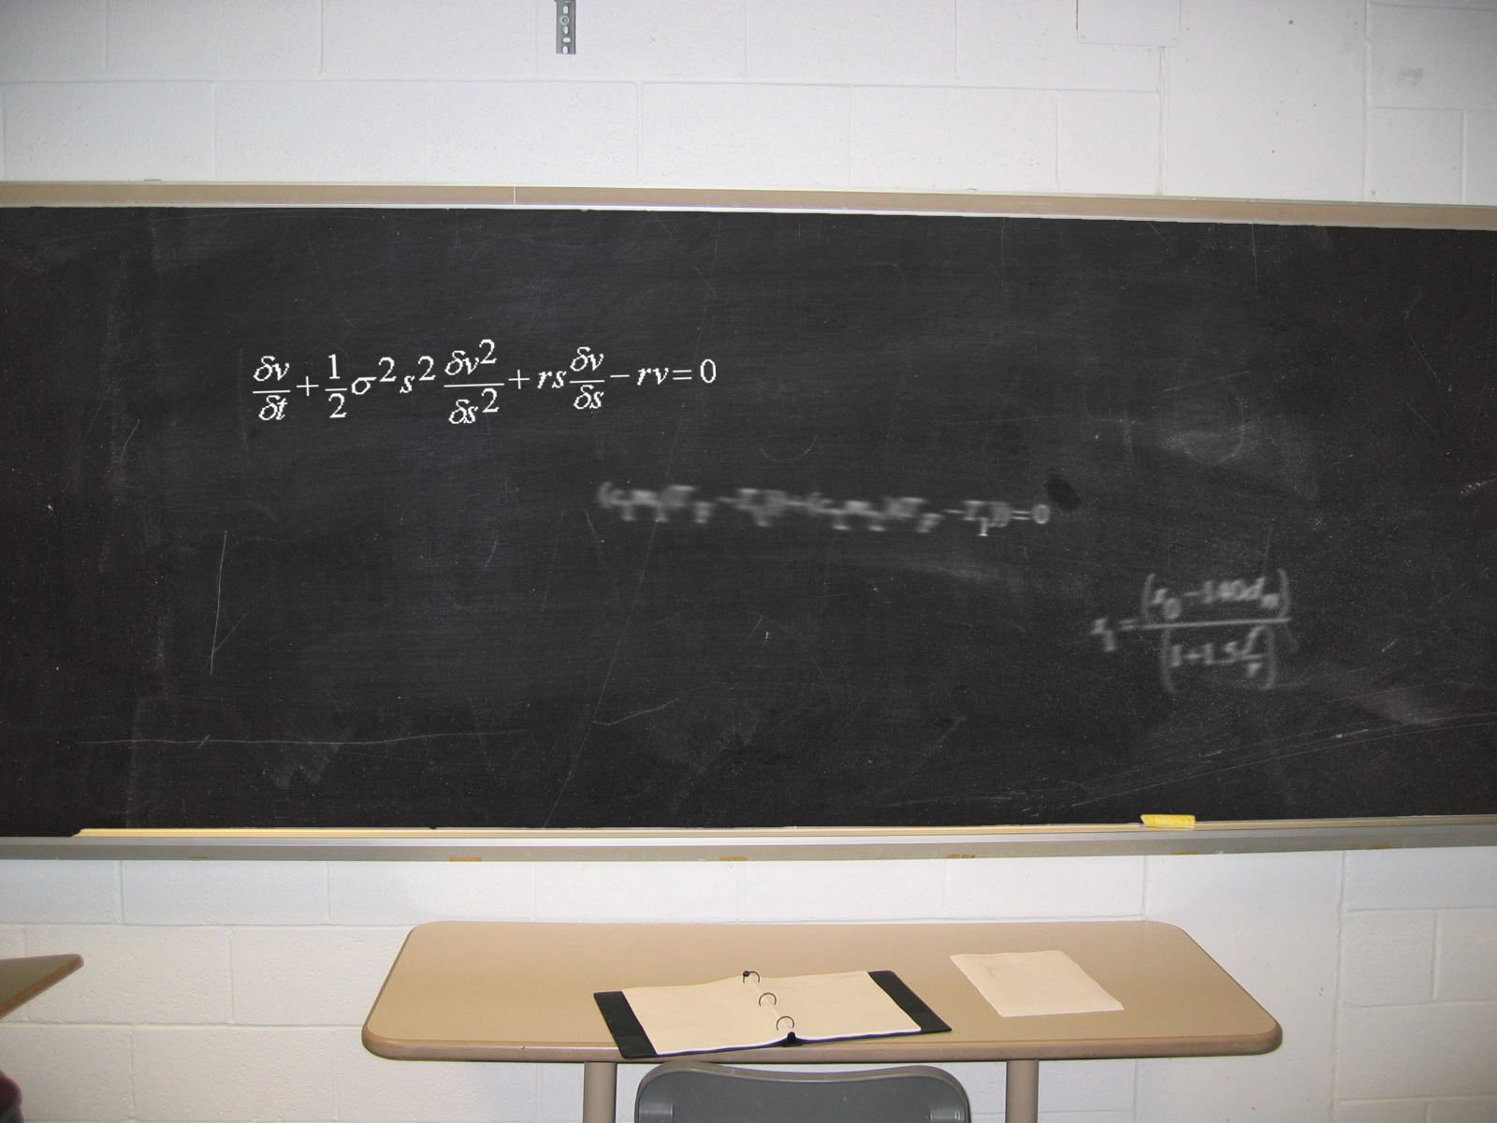
Notes:
Ask them to have a guess what this slide is used for?

Slide 39
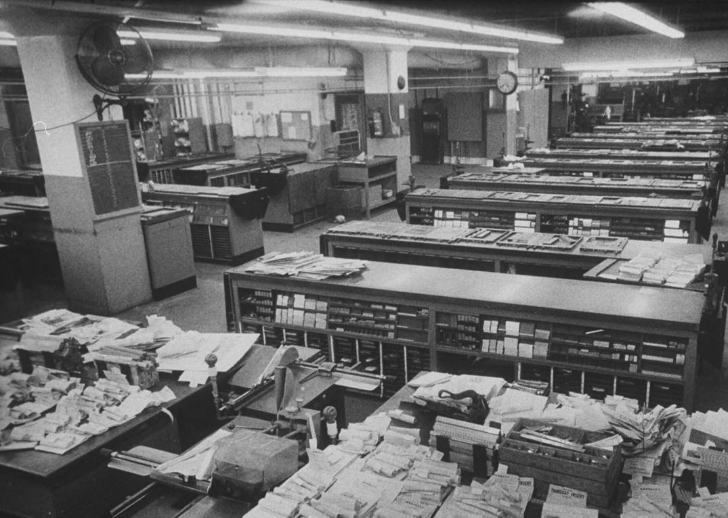
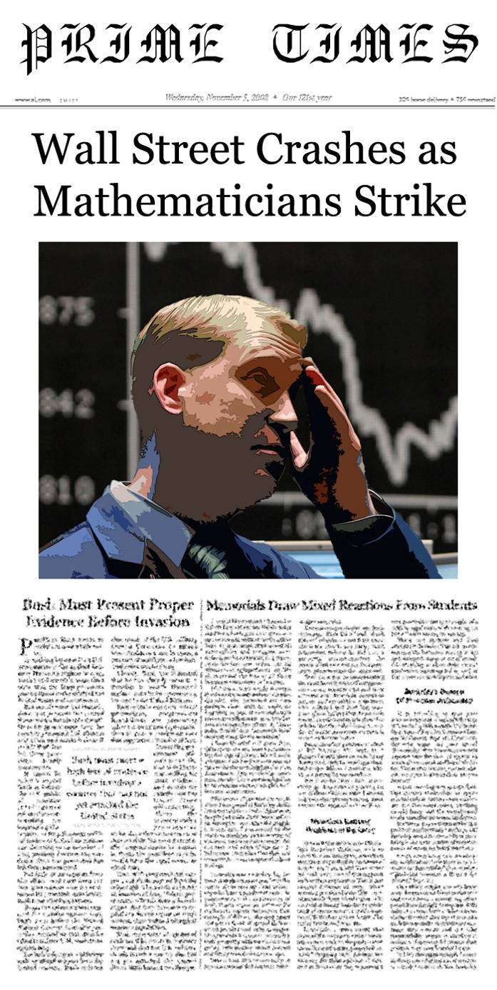
Without Maths, stock markets would crash…
Notes:
The equation is known as the “black Scholes equation” and is one of the equations used on the stock markets around the world.
Without maths, there would be no stock markets, which would result in business and investments around the world failing over night.
In financial mathematics, traders can buy or sell stocks in a company, commodities like oil and gold, or derivatives, which are “virtual” goods whose prices are derived from the change of other things. For example, you can buy options which could allow you to buy or sell a stock at a particular price at some point in the future – if you still want to at that time.
Financial analyst have many different mathematical tools to help them make better decisions, for example statistical models to analyse historic economic data, or probability and Stochastic calculus to predict the behaviour of financial markets. Particularly famous is the Black-Scholes equation, a partial differential eqaution used to find the correct value of derivatives.
Unfortunately, mathematics is often used unwisely in finance…

Slide 40

Careers

Slide 41
What careers can Maths lead to?
Meteorologist
Stockbroker
Logistics Manager
Accountant
Teacher
Mathematical Modelling
Economist
Engineer
Researcher
Business Analyst
Statistician
Actuary
Cryptanalyst
Notes:
As a mathematician you can acquire problem-solving and analytical skills that can be put to use in the real world.
*open to audience*
“What jobs could you walk into with a strong background in maths?”
Meteorologist
Meteorologists study the atmosphere and the weather with a focus on climate. They forecast weather, analyse climate change and air pollution and develop new techniques for the measurement and analysis of meteorological occurrences.
Stockbroker
Stockbrokers invest money for individuals and organisations by buying and selling on the stock market.
Mathematical Modelling
A mathematical modeller employs mathematical language to describe a system. An example of this is Computational Fluid Dynamics, which uses maths to describe particularly complex situations involving fluid flow. An application of this is in film visual effects. Think of the waves in a computer-generated sea. The challenge is to reach a middle-ground between processing time and accurately approximating the system, otherwise films would take too long to make!
Logistics Manager
Logistics managers handle processes involved in a supply chain, liaising with a variety of parties including suppliers of raw materials, manufacturers, retailers and consumers.
Statistician
Statisticians collect, analyze, and interpret numerical data; working in both the public and private sector.
Accountant
Chartered accountants are responsible for financial reporting, taxation, auditing, forensic accountancy, corporate finance and insolvency. They play a strategic role by providing professional advice; aiming to maximize profitability on behalf of their client or employer. They work in many different settings, including private practice firms, industry, commerce and the public sector.
Actuary
An actuary is a business professional who analyzes the financial consequences of risk. Actuaries use mathematics, statistics and financial theory to study adverse future events, especially those of concern to insurance and pension programs. They evaluate the likelihood of those events and mitigate the impact of events as they occur.

Slide 42
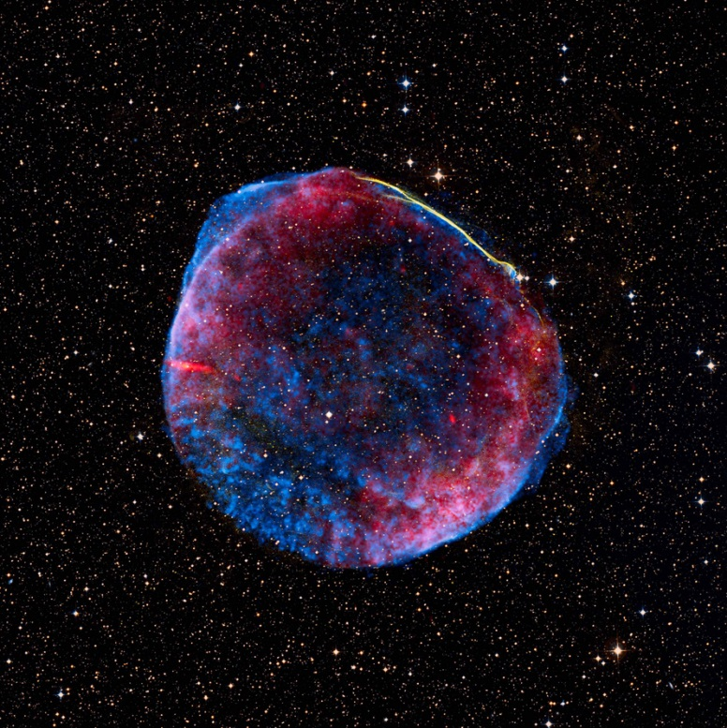
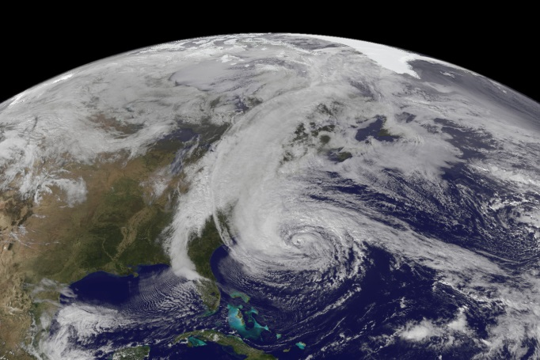
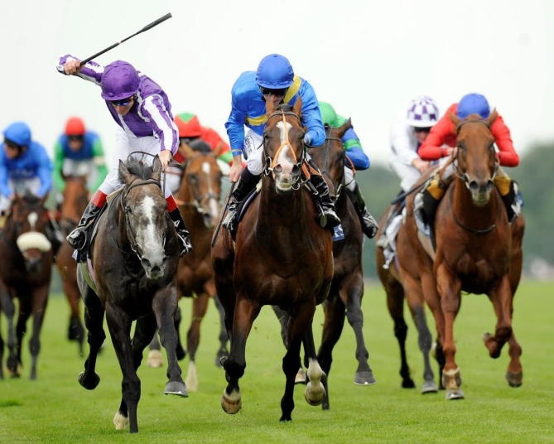

With Maths you could…
Predict the occurrence of hurricanes
Explore the Universe!
Figure out
the odds
Be part of MI5
Notes:
Whenever you send an email or use your credit card online, secret information has to be exchanged between your computer and a web server. Mathematics can be used to encypher this information, so that third party can't read and misuse it.

Slide 43
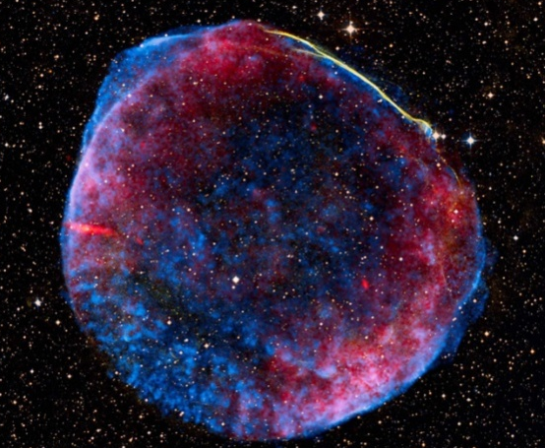
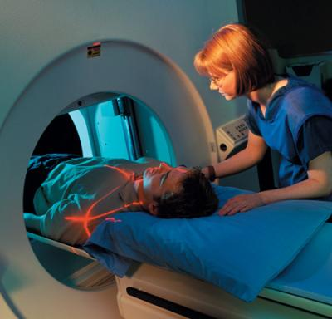

With Maths you could…
“Maths has the ability to discover, create and even predict the future. It has the power solve or crack modern issues such as online security”

Slide 44
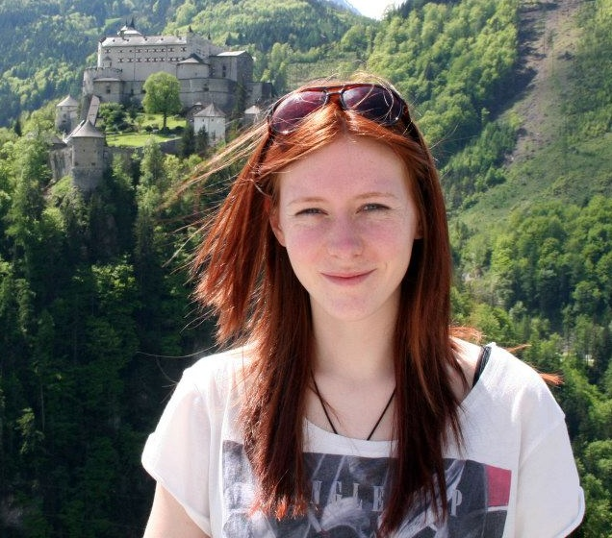
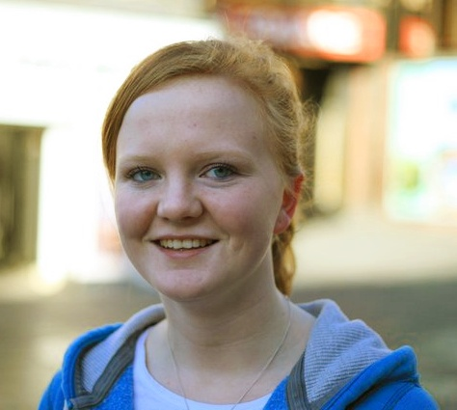
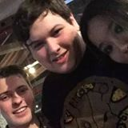
Graduate profiles
Jess
Kathryn
Kieren
Graduated in 2013, BSc
Technology Graduate at BBC
Graduated in 2014, MMathStat
Atomic Weapons Establishment
Graduated in 2015, MMathStat
Computer games engineer at Jagex Games

Slide 45












Employers

Slide 46
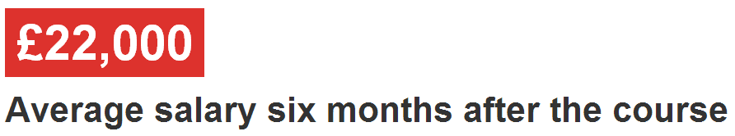
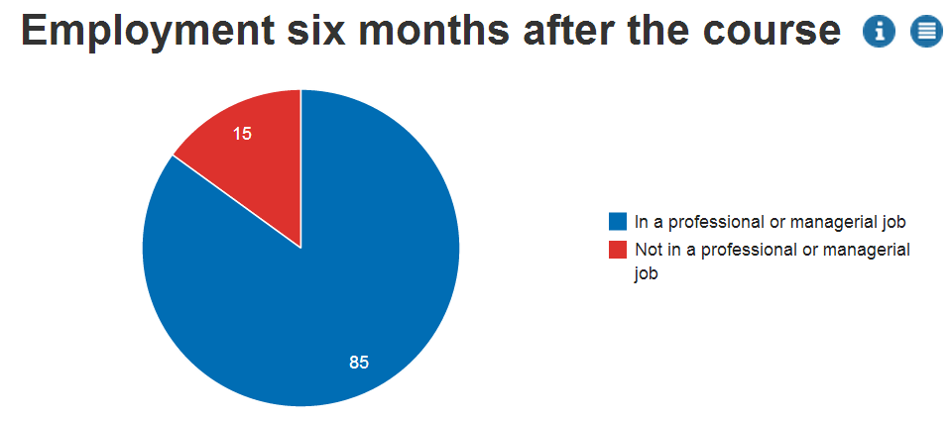
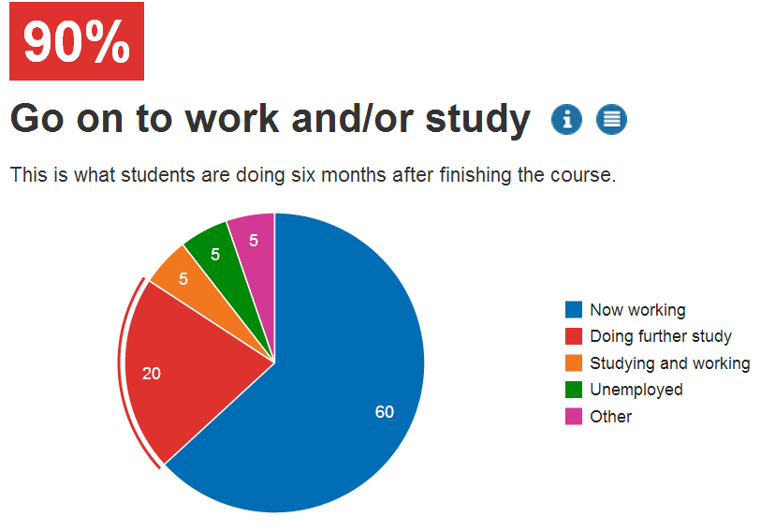
Maths Graduates
Notes:
A Mathematics and Statistics degree opens up many career paths. Whilst you may think it leads only towards becoming an accountant or a teacher, this really isn’t the case. Our graduates in this field go on to many different career and study paths. Some which, yes, are associated commonly with Maths and Statistics, others which couldn’t be further away.

Slide 47
Maths at University

Slide 48
Single Honours Degrees
Single Honours
3 Year Degree
4 Year Degree
BSc Maths & Stats Hons
BSc Maths Hons
MMathStat Hons
BSc Statistics Hons
MMath Hons

Slide 49
Other Types of Degrees
Major/Minor
Financial Maths
Financial Maths with Management
Physics
Maths and Psychology
Maths with Management
Economics and Maths
Accounting and Maths
Joint Honours

Slide 50
1st Year Structure
Semester 1
Semester 2
Multivariable Calculus and Differential Equations
Introduction to Calculus
Linear Algebra: Vectors and Matrices
Probability and Statistics
Sets and Counting
Problem Solving and Computing I
Optimisation with Constraints
Number Systems
Problem Solving and Computing II
Dynamics
Key:
Inner
Outer
Optional
Notes:
Inner core: MAS16**, Sets and counting: MAS17**, Problem solving modules: MAS18**, Optional: MAS19**

Slide 51
2nd Year Structure
Semester 1
Pure Mathematics
Pure Mathematics
Applied Mathematics
Applied Mathematics
Statistics
Statistics
Group Project
Computing
Careers Management
Semester 2

Slide 52
3rd Year Modules
Stochastic Calculus & Applications
Foundations of Group Theory
Coding Theory
Linear Analysis
Topology
Geometries & Designs
Groups, Graphs & Symmetry
Number Theory & Cryptography
Survival Analysis
Statistical Modelling
Markov Processes
Bayesian Inference
Randomised Clinical Trials
Discrete Stochastic Modelling
Applied Probability
Multivariate Data Analysis
Stochastic Financial Modelling
Time Series & Forecasting
Partial Differential Equations with Applications
Instabilities, Turbulence & Scaling
Electromagnetism
Variational Methods
Numerical & Computational Modelling
Quantum Mechanics
Introduction to Fluids
Differential Equations and Fields

Slide 53
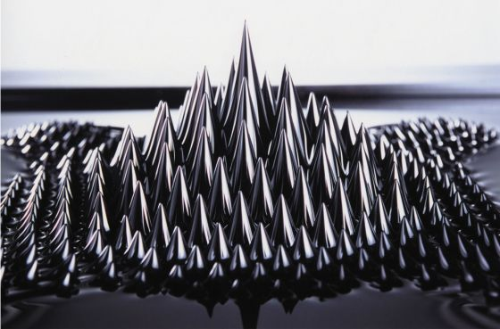


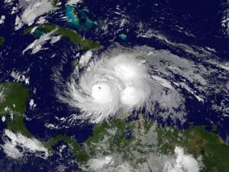
4th Year Project
Quantum Ferrofluid Hedgehogs
C*-algebras
Football Gambling
Particle Orbits around Black Holes
Convexity
Statistical Modelling of Environmental Extremes

Slide 54
Learning & Assessment
Inner Core
Learning
Assessment
Lectures
Seminars
Assignments
CBAs
(Numbas)
Office Hours
Problems Classes
Projects
Presentations
Computing Practicals
Drop Ins
Exams
Mid Semester Tests

Slide 55
Learning & Assessment
Numerical & Computational Modelling
Learning
Assessment
Lectures
Seminars
Assignments
CBAs
(Numbas)
Office Hours
Problems Classes
Projects
Presentations
Computing Practicals
Drop Ins
Exams
Mid Semester Tests

Slide 56
Grades & Weighting

Slide 57
Support
Current Maths Student
Regular contact through emails
Buddy
Module Selection & Registration
Academic & Personal issues
Personal Tutor
Run by Postgraduates
Drop-in:
10 am – 4 pm
Maths Aid
Undergraduate Secretary
Personal Issues
Exams & Assignments
Student Wellbeing
Financial Matters
Counselling

Slide 58
Typical Week
 | 9-10 | 10-11 | 11-12 | 12-1 | 1-2 | 2-3 | 3-4 | 4-5 | 5-6
Mon
Tues
Wed
Thurs
Fri
L
L
L
L
PC
L
L
PC
L
PC
S
L
Sports and Societies
L
L
PC
L
L
PC

Slide 59
Opportunities Abroad
Opportunities Abroad
Intercalating Module
Semester 1 Abroad
Year Out
3 year degree only
4 year degree only
Not Graded
Graded

Slide 60




“More than just a degree...”
Fresher's week: the week before classes start
Clubs and societies
Sport: Athletic Union, Intra-mural, “Go play”
Internships, paid work and voluntary work

Slide 61
Student Finance

Slide 62
Tuition Fee Loan
Tuition fee loan
Financial Body
Tuition Fees
Repayment
Funded by the country you apply to study in (e.g. England or Wales)
£9,250
(same for most)
Not until earning > £21,000
Investment in future
Not until after studying
Placement Years only pay £1,000

Slide 63
Loan repayments
Not until you earn above £21,000
Payments stop if income falls below
Repayment
Not until you finish studying
Based on what you earn, not what you owe
Repay 9% of income above £21,000
Written off if not repaid within 30 years
Notes:
If you earned £25,000 a year then you would repay £30 a month, which is approximately the price of a phone contract.

Slide 64

Interest
Interest
During Studies
Rate of Inflation (ROI) plus 3%
After
Studies
Earn less than £21,000: ROI
Earn between £21,000 - £41,000:
ROI plus up to 3%
Earn above £41,000: ROI plus 3%

Slide 65
Subject scholarships
Types:
Excellence Scholarship
Exceed Entry Requirement
Stage 4 Bursary
Year 2 and Year 3 Semester 1 mark above 70%
What you get:
£250 available for each grade above the requirement.
A* in Maths or Further Maths awarded an extra £250
Worth £1,000 per year of study
Note – You must have achieved your minimum grades, e.g. A*BB will not receive £250
Notes:
So if you got 3xA*, you would get 3x£250 for beating your requirements, plus 2x£250 for A*’s in Maths and Further Maths.

Slide 66
Living costs
Phone bill
Accommodation
Toiletries
TV;
most halls don’t have TV licences
Clothes
Living Costs
Food
Insurance; belongings /
keys!
Study; recommended books
Travel;
To Uni / home / visit friends
Social Life

Slide 67
Money management
Part time Job;
Recommended
15 hours
or less
Use campus facilities; Library, Sports centre, Union etc.
Budget!
If you can’t
afford it,
don’t do it!
Shop around
for
the best
deals
Make it go further
Interest free overdraft! Don’t be drawn in by freebies
Walk
or
get a student
travel pass
Student Discount: Restaurants,
Bars, Cinema
etc.
Buy books
second-hand
or
Use the library

Slide 68
Student Accommodation

Slide 69
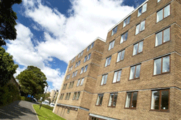
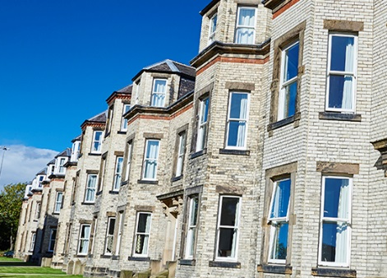
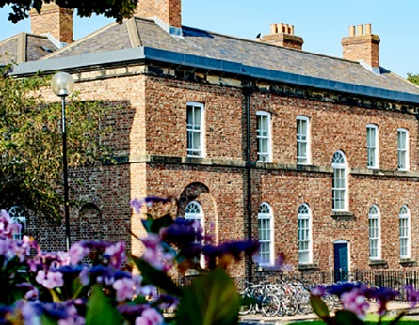
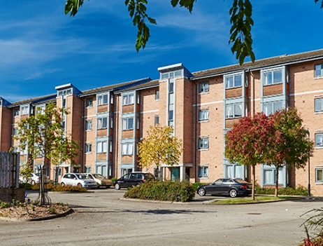
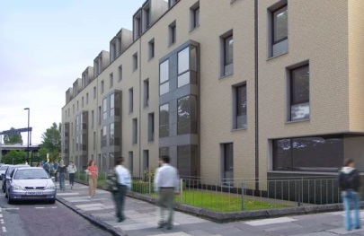
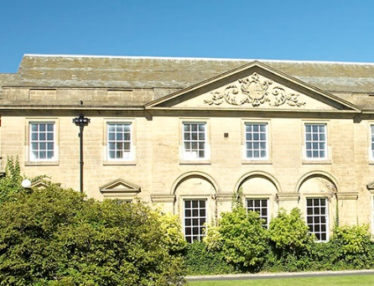
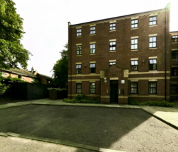
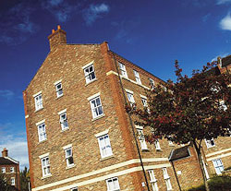
Castle Leazes
Kensington Terrace
Leazes Parade
The Halls
Bowsden Court
The Halls
The Halls
Park Terrace
St Mary’s
Windsor Terrace
Marris House

Slide 70
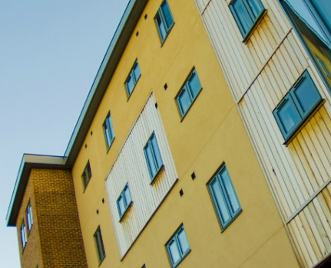
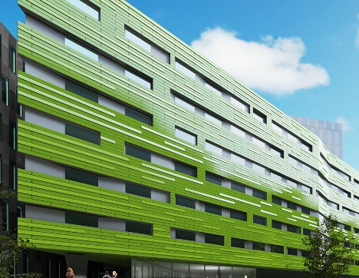
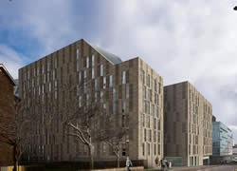
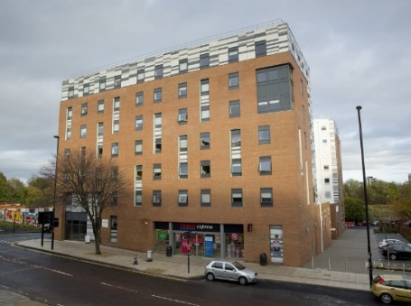
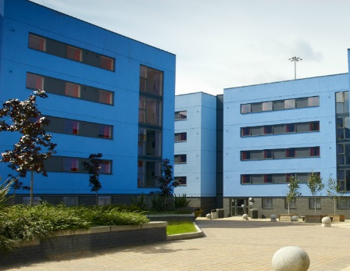
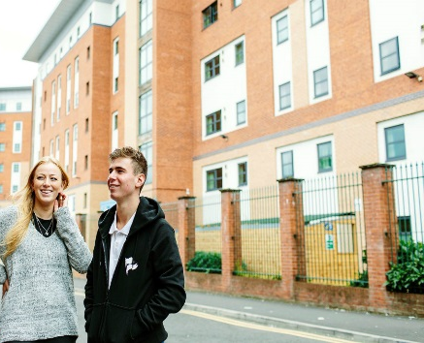
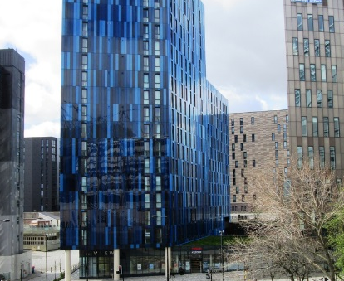
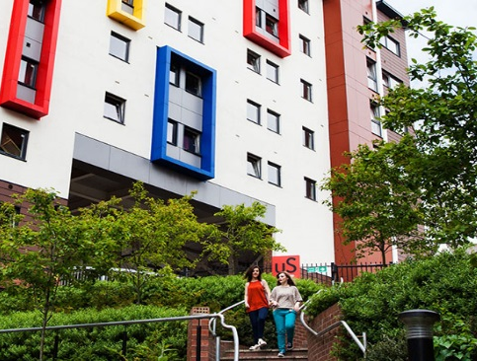
Barker House
Verde
Managed Partnership Accommodation
Liberty Plaza
The Halls
Turner Court
The Halls
Union State
Liberty Quay
The View
Manor Bank

Slide 71
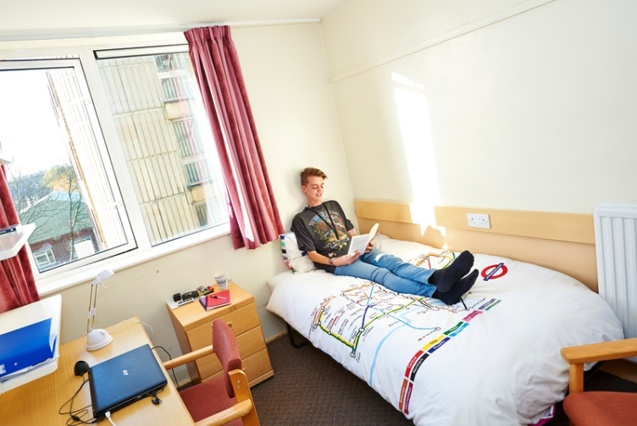
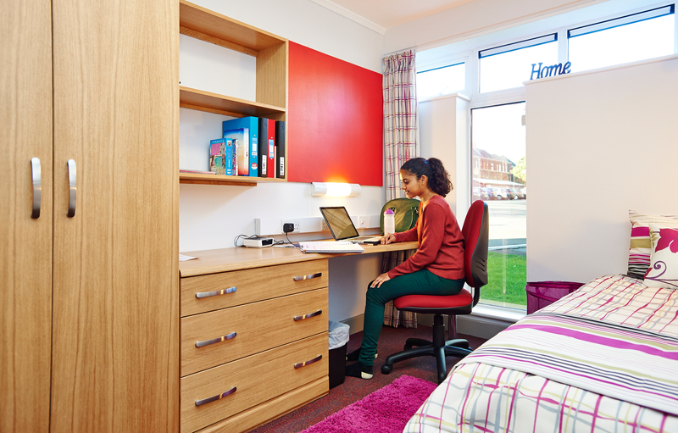
Typical rooms
To find out more detailed information and view our virtual tours for each of our halls of residence visit:
www.ncl.ac.uk/accommodation

Slide 72



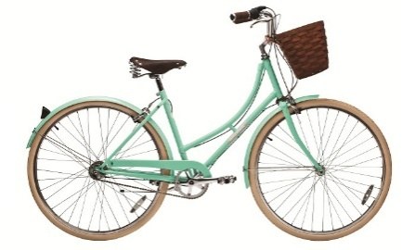
What’s included?
Free internet connection
Launderette
Holidays included
Bicycle Storage
24 hour security
Bills

Slide 73
Things to consider
Self Catered/Catered
Affordability
Location
Mixed/Single Gender
Flat/Corridor Layout
Deluxe Room
Standard Washbasin Room
Smaller/Larger Community
Ensuite Room

Slide 74
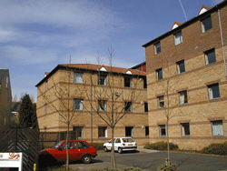


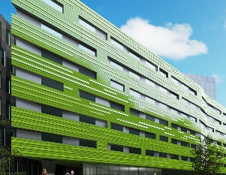
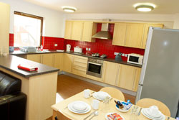
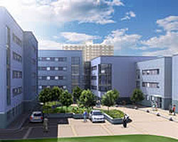










Comparing price
Least Expensive- £83 p/w
Most Expensive- £167p/w
Bowsden Court
Victoria Halls
Park Terrace
Richardson Rd
Bowsden Court
Liberty Quay
Park Terrace
Verde
Castle Leazes
Castle Leazes
St Marys College
Marris House
Marris House
Marris House
St Marys College
Marris House
Turner Court
Union State
Richardson Rd
The View
St Marys College
Windsor Terrace
Leazes Parade
Manor Bank
Liberty Plaza

Slide 75


Comparing size
Smallest - 50 rooms
Largest - 1100 rooms
St Marys College
Bowsden Court
Bowsden Court
Marris House
Castle Leazes
Bowsden Court
Leazes Parade
Turner Court
St Marys College
Castle Leazes
Victoria Halls
Windsor Terrace
Park Terrace
Richardson Rd
Liberty Quay
Park Terrace
The View
Liberty Plaza
St Marys College
Park Terrace
Castle Court
Marris House
Marris House
Richardson Rd
Castle Court
Marris House
Manor Bank
Union State
Verde

Slide 76


Routes from further away.
Bowsden Court
St Mary’s College
Park, Windsor & Kensington Terrace
Marris House
Castle Leazes, Castle Court & Leazes Parade
Newcastle University
Union State
Turner Court
Liberty Plaza, Verde & The View
Manor Bank & Liberty Quay

Slide 77










After halls
Lots of student properties
Remember extra costs
Support available
Typically 12 month contracts

Slide 78

Jesmond
Spital Tongues
Heaton
Newcastle University
Fenham
Sandyford

Slide 79
Newcastle: City & Social

Slide 80
Clubs and societies
Clubs & Societies
Sports
Societies
Athletic Union
Go Play
Give It A Go
Joining
Societies
Intra-Mural

Slide 81




Joining
Freshers’ Fair
NUSU Website

Slide 82



Societies
Nearly 200 registered clubs and societies at Newcastle
Or you can create your own!
Dance
Twenty Minute Society
Greek/Hellenic

Slide 83


Subject societies
Summer Ball
Public Talks
Sports teams
Holidays Abroad
Ice Skating
Bar Crawls
Bowling
Charity Fundraising
Pub Quizzes

Slide 84

Students’ Union
£8 million refurbishment and was re-opened in 2011
Services
Student Radio
Advice Centre
Courier
Food & Drink
Starbucks
Mensbar
Domino’s
Subway
Organic Food Stall
Facilities
Computer Cluster
Union Shop
Bank
Venue

Slide 85

So where is Newcastle?

Slide 86




In and around Newcastle
Newcastle University
The Gate
St James’ Park
Metro Radio Arena
The Baltic

Slide 87




In and around Newcastle
Newcastle University
Hancock Museum
China Town
Tyneside Cinema
Theatre Royal
The Sage

Slide 88





In and around Newcastle
To Northumberland National Park
Tynemouth Beach
Newcastle
South Shields
Metrocentre
Angel Of The North

Slide 89



In and around Newcastle
To Alnwick Castle & Gardens
Segedunum Roman Baths
Newcastle
To Durham Cathedral
Beamish Museum

Slide 90




In and around Newcastle
SU
Pink Triangle
Newcastle
Bigg Market
Diamond Strip
Digital

Slide 91




Local transport
3 metro stations in Newcastle city centre, 1 directly opposite campus
Central rail station providing local and national rail services
Newcastle International Airport flying to worldwide destinations
Ferry terminal going to Amsterdam and continental Europe

Slide 92
Final words...

Slide 93
Offers and admissions
Typical Offers
“A level Monday”
Maximise your chances
AAA-ABB, depending on degree / A level subjects
Three piles: 1. Accept 2. Near miss 3. No way!
Make us your “firm choice”
Personal statement: Passion!
Other equivalents: e.g. 17 (overall) in Apolytirion + B
My hardest job: Prioritise students in pile #2!!
Take one of our summer projects on offer!

Slide 94
Facts & figures
Part of the UK’s prestigious “Russell Group”
Top 1% of Universities in the world
16th in the UK for global research power
International students put Newcastle in the world’s top 12
12th in the UK for student satisfaction
School of Maths & Stats in the UK top 10
Financial incentives available for good students

Slide 95


Georgios Melios
“
Top ranking University
City nightlife AMAZING!
Compact city – everything is within walking distance!
University facilities are amazing!
Excellent library services
”

Slide 96

Demetra Demetriou
“
Courses are high-ranking
Very exciting University life
So many events for Freshers, and so easy to meet other people
Everything is within walking distance and the campus is right in the heart of the city
Newcastle University ALWAYS considers the needs of its students
Everyone I know at Newcastle loves it – University and the city!
”

Slide 97

Sarah Koullapi
“
I chose Newcastle University mainly because it provides me the maximum exemptions for the charted and certified accounting diplomas
The city is so compact and you don’t ever have to use transport
Newcastle is a cheap city, especially in comparison to London or Manchester
Most of the people at the university are friendly and helpful.
Accommodation excellent!
”

Slide 98



Keep in touch
Follow
‘@NCLMathsStats’
Email
‘mathsandstats@ncl.ac.uk’
Visit
‘www.ncl.ac.uk/maths’

Slide 99
Any questions?
@NCLMathsStats

