Slide 1
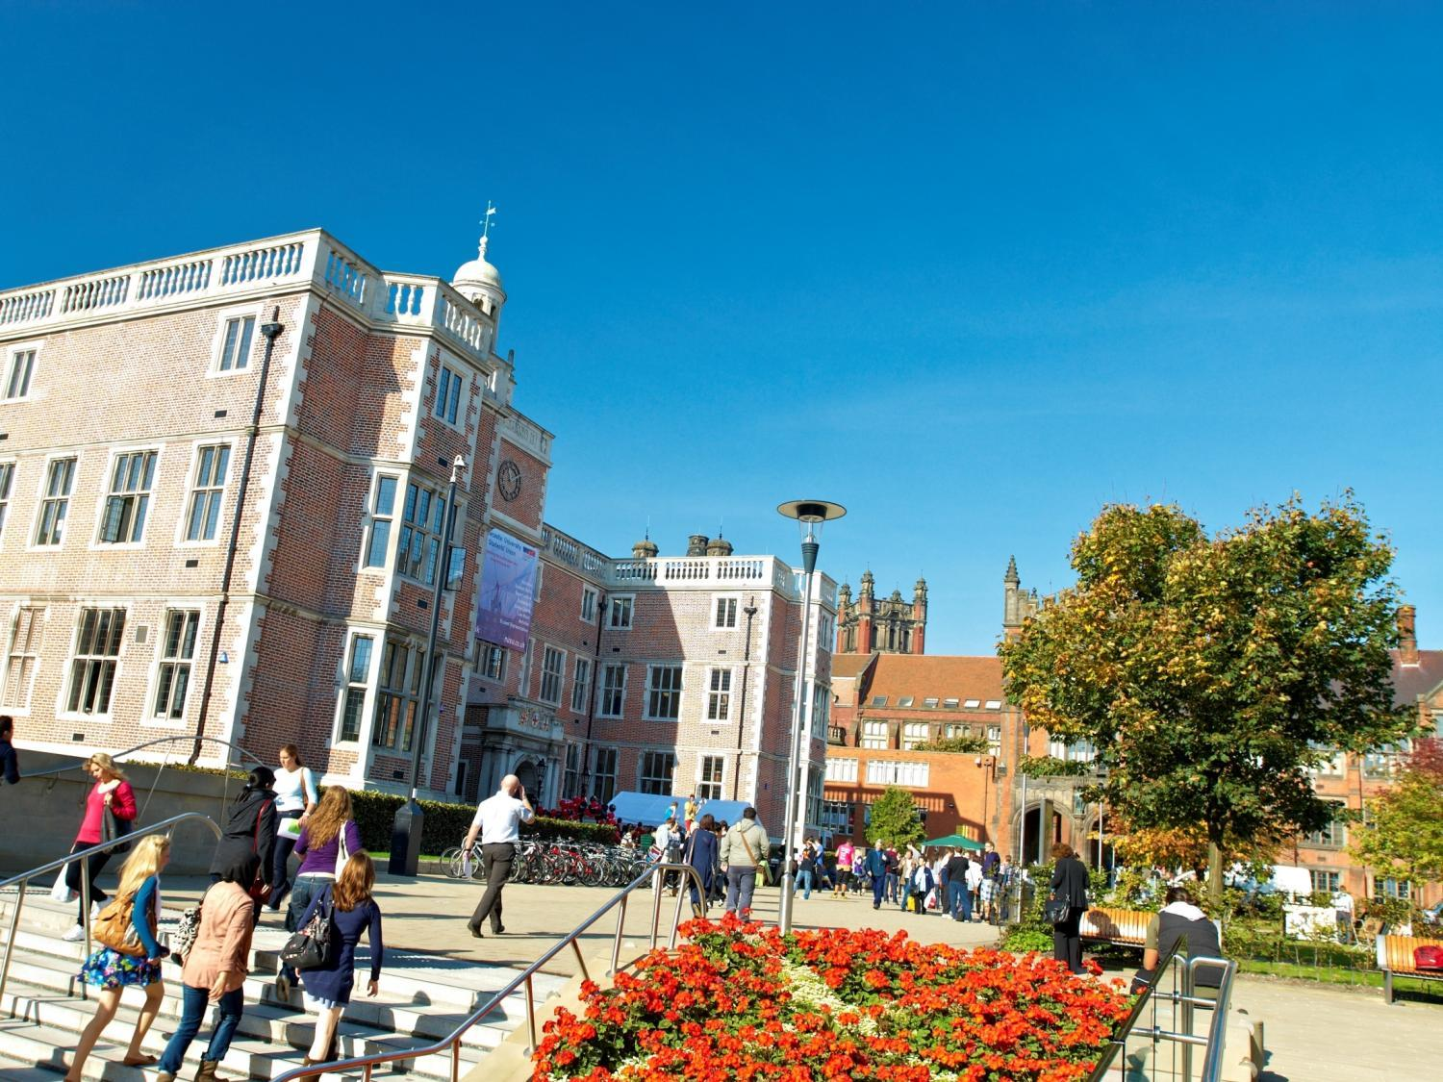


Dr. Lee Fawcett
School of Maths, Statistics & Physics
Newcastle University, UK
A Future in Mathematics
@NCLMathsStats
www.ncl.ac.uk/maths

Slide 2
Who am I?
Lee Fawcett
Senior Lecturer in Statistics: Newcastle University
Teaching: 1st year, 2nd year and 4th year undergraduate Mathematicians, and students from many other subjects!
Research: Statistical modelling of environmental extremes
Outreach: Tell people what we do, and how good Mathematics & Statistics is!

Slide 3
What am I doing here?
Outreach
Further study in Mathematics
Careers after studying Mathematics
Real world applications of Mathematics, including cool research areas
Cypriot students at Newcastle University: Hard-working, motivated and aspirational

Slide 4
Newcastle University
Russell Group University
Top 1% of world universities
One of the best UK Universities for student satisfaction (NSS: 93% / 97% are satisfied!)
TEF gold!
Top 20 ‘most targeted’ universities by UK’s leading employers
95% of Newcastle students go into graduate employment/future study within six months
1st in the UK for quality of social life!

Slide 5
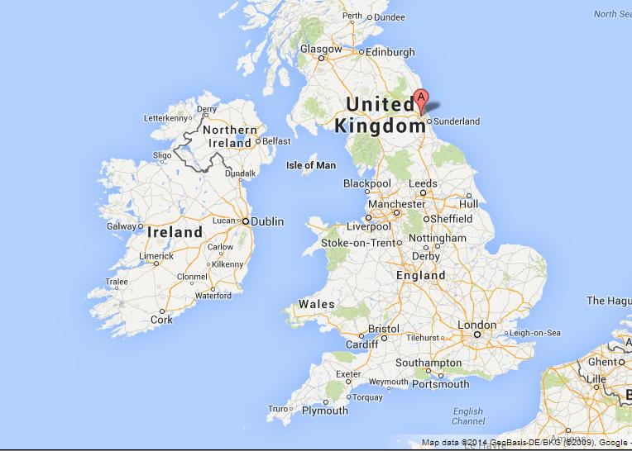
So where is Newcastle?

Slide 6
A Future in Mathematics
Opportunities @ NCL
Real world applications
Careers
Mathematics @ NCL
Newcastle: City and Social

Slide 7

Opportunities @ NCL

Slide 8
Summer Project
Boost your CV
Written exercises, written “investigation”, web-based test
Boost your UCAS application – to any University (but especially NCL…)
Material: Some A-level standard, some “new” or “advanced”
Workbook – reading material & questions
July – September, although should only take around 5 days to complete
Certificate of completion

Slide 9
Summer School @ NCL
Boost your CV
Come and visit us! Student life, city life
Boost your UCAS application – to any University (but especially NCL…)
Full day of Maths activities – leading Professors
Full day of Campus/City activites
Mid-late August: accommodation and subsistence paid for
Try before you buy!

Slide 10
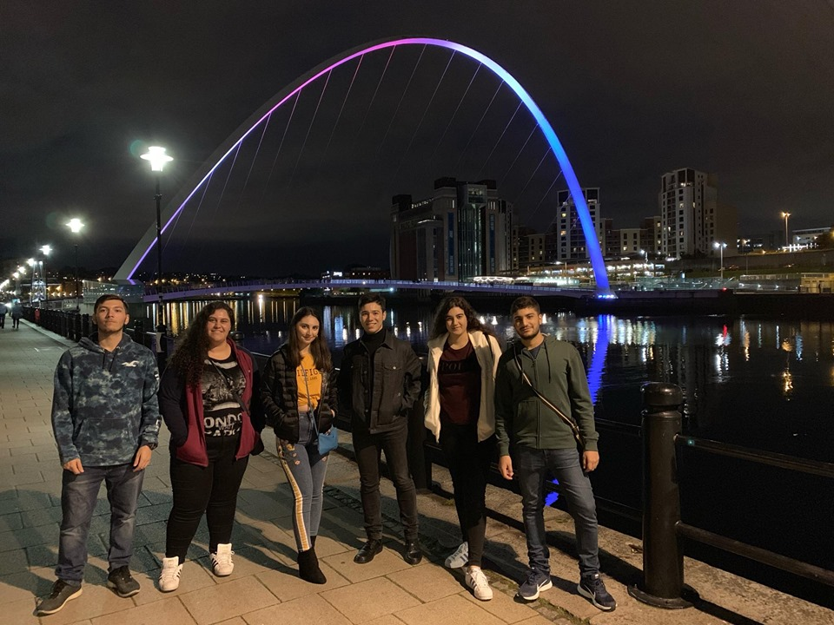

Slide 11
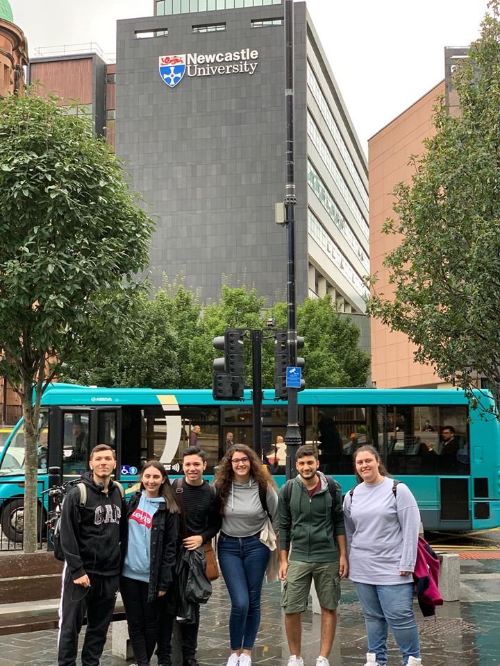
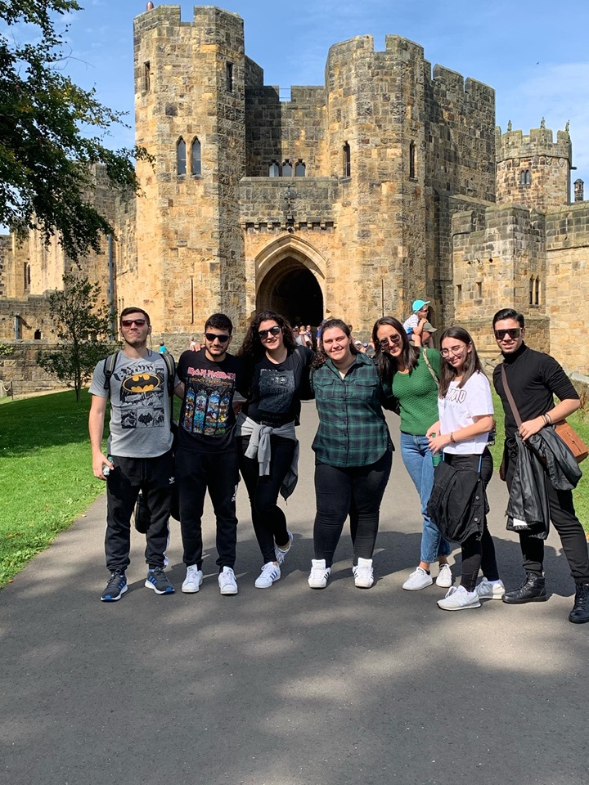

Slide 12


Slide 13
This year’s SP graduates!
Kyprianos Iakovou
Paraskevi Papakyriakou
Evanthis Vacanas
Sotiris Vacanas
Marianna Vassiliou
Eirini Zarka

Slide 14
Real world applications

Slide 15
Maths is everywhere…
Decisions...
Digital music
Phones and internet
Satellite Navigation
Cryptography
Crowd control
Rockets and Satellites
Crime prediction
Game theory
Volcano monitoring
Carbon dating
Cosmology
Computer games
Movie Graphics
Search Engines
Epidemic Analysis
Military and Defence
Skate park design
CDs and DVDs
Speech recognition
Climate extremes
Fraud detection
Data compression
Wildfire modelling
Financial Modelling

Slide 16
Maths is everywhere…
Decisions...
Digital music
Phones and internet
Satellite Navigation
Cryptography
Crowd control
Rockets and Satellites
Crime prediction
Game theory
Volcano monitoring
Carbon dating
Cosmology
Computer games
Movie Graphics
Search Engines
Epidemic Analysis
Military and Defence
Skate park design
CDs and DVDs
Speech recognition
Climate extremes
Fraud detection
Data compression
Wildfire modelling
Financial Modelling

Slide 17
Decisions...
Notes:
Big businesses use Maths/Stats to make important decisions – e.g. optimal investment strategies, staffing levels, product quality control, consumer trends, marketing decisions… the list goes on and on…

Slide 18
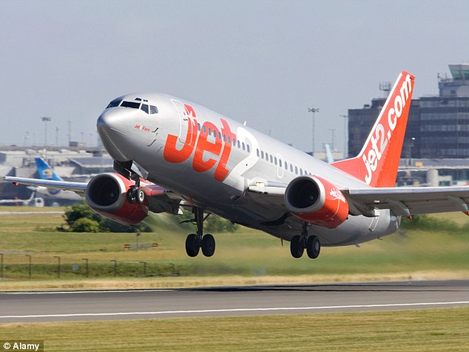

Slide 19
Maths is everywhere…
Decisions...
Digital music
Phones and internet
Satellite Navigation
Cryptography
Crowd control
Rockets and Satellites
Crime prediction
Game theory
Volcano monitoring
Carbon dating
Cosmology
Computer games
Movie Graphics
Search Engines
Epidemic Analysis
Military and Defence
Skate park design
CDs and DVDs
Speech recognition
Climate extremes
Fraud detection
Data compression
Wildfire modelling
Financial Modelling

Slide 20
Maths is everywhere…
Decisions...
Digital music
Phones and internet
Satellite Navigation
Cryptography
Crowd control
Rockets and Satellites
Crime prediction
Game theory
Volcano monitoring
Carbon dating
Cosmology
Computer games
Movie Graphics
Search Engines
Epidemic Analysis
Military and Defence
Skate park design
CDs and DVDs
Speech recognition
Climate extremes
Fraud detection
Data compression
Wildfire modelling
Financial Modelling

Slide 21
Cryptography

Slide 22

Notes:
Public Key Cryptography – to keep your details safe whilst your shopping online…

Slide 23

Notes:
Alan Turing – was the key force behind cracking the codes produced by the German “Enigma” machine… intercepted and decoded messages allowing the Allied Forces to avoid or properly prepare against German air and naval strikes… historians estimate work of Turing and his team of mathematicians helped to bring an early end to WW2 – possibly by as much as two years!

Slide 24
Maths is everywhere…
Decisions...
Digital music
Phones and internet
Satellite Navigation
Cryptography
Crowd control
Rockets and Satellites
Crime prediction
Game theory
Volcano monitoring
Carbon dating
Cosmology
Computer games
Movie Graphics
Search Engines
Epidemic Analysis
Military and Defence
Skate park design
CDs and DVDs
Speech recognition
Climate extremes
Fraud detection
Data compression
Wildfire modelling
Financial Modelling

Slide 25
Maths is everywhere…
Decisions...
Digital music
Phones and internet
Satellite Navigation
Cryptography
Crowd control
Rockets and Satellites
Crime prediction
Game theory
Volcano monitoring
Carbon dating
Cosmology
Computer games
Movie Graphics
Search Engines
Epidemic Analysis
Military and Defence
Skate park design
CDs and DVDs
Speech recognition
Climate extremes
Fraud detection
Data compression
Wildfire modelling
Financial Modelling

Slide 26
Climate extremes

Slide 28
Hurricane Katrina
Category 3 hurricane when it made landfall
Killed 1833 people
Caused over $100 billion worth of damage
Most damage/loss of life caused by storm surge
Storm surge reached 14.4 feet
Classed as the “Storm of the Century”

Slide 30
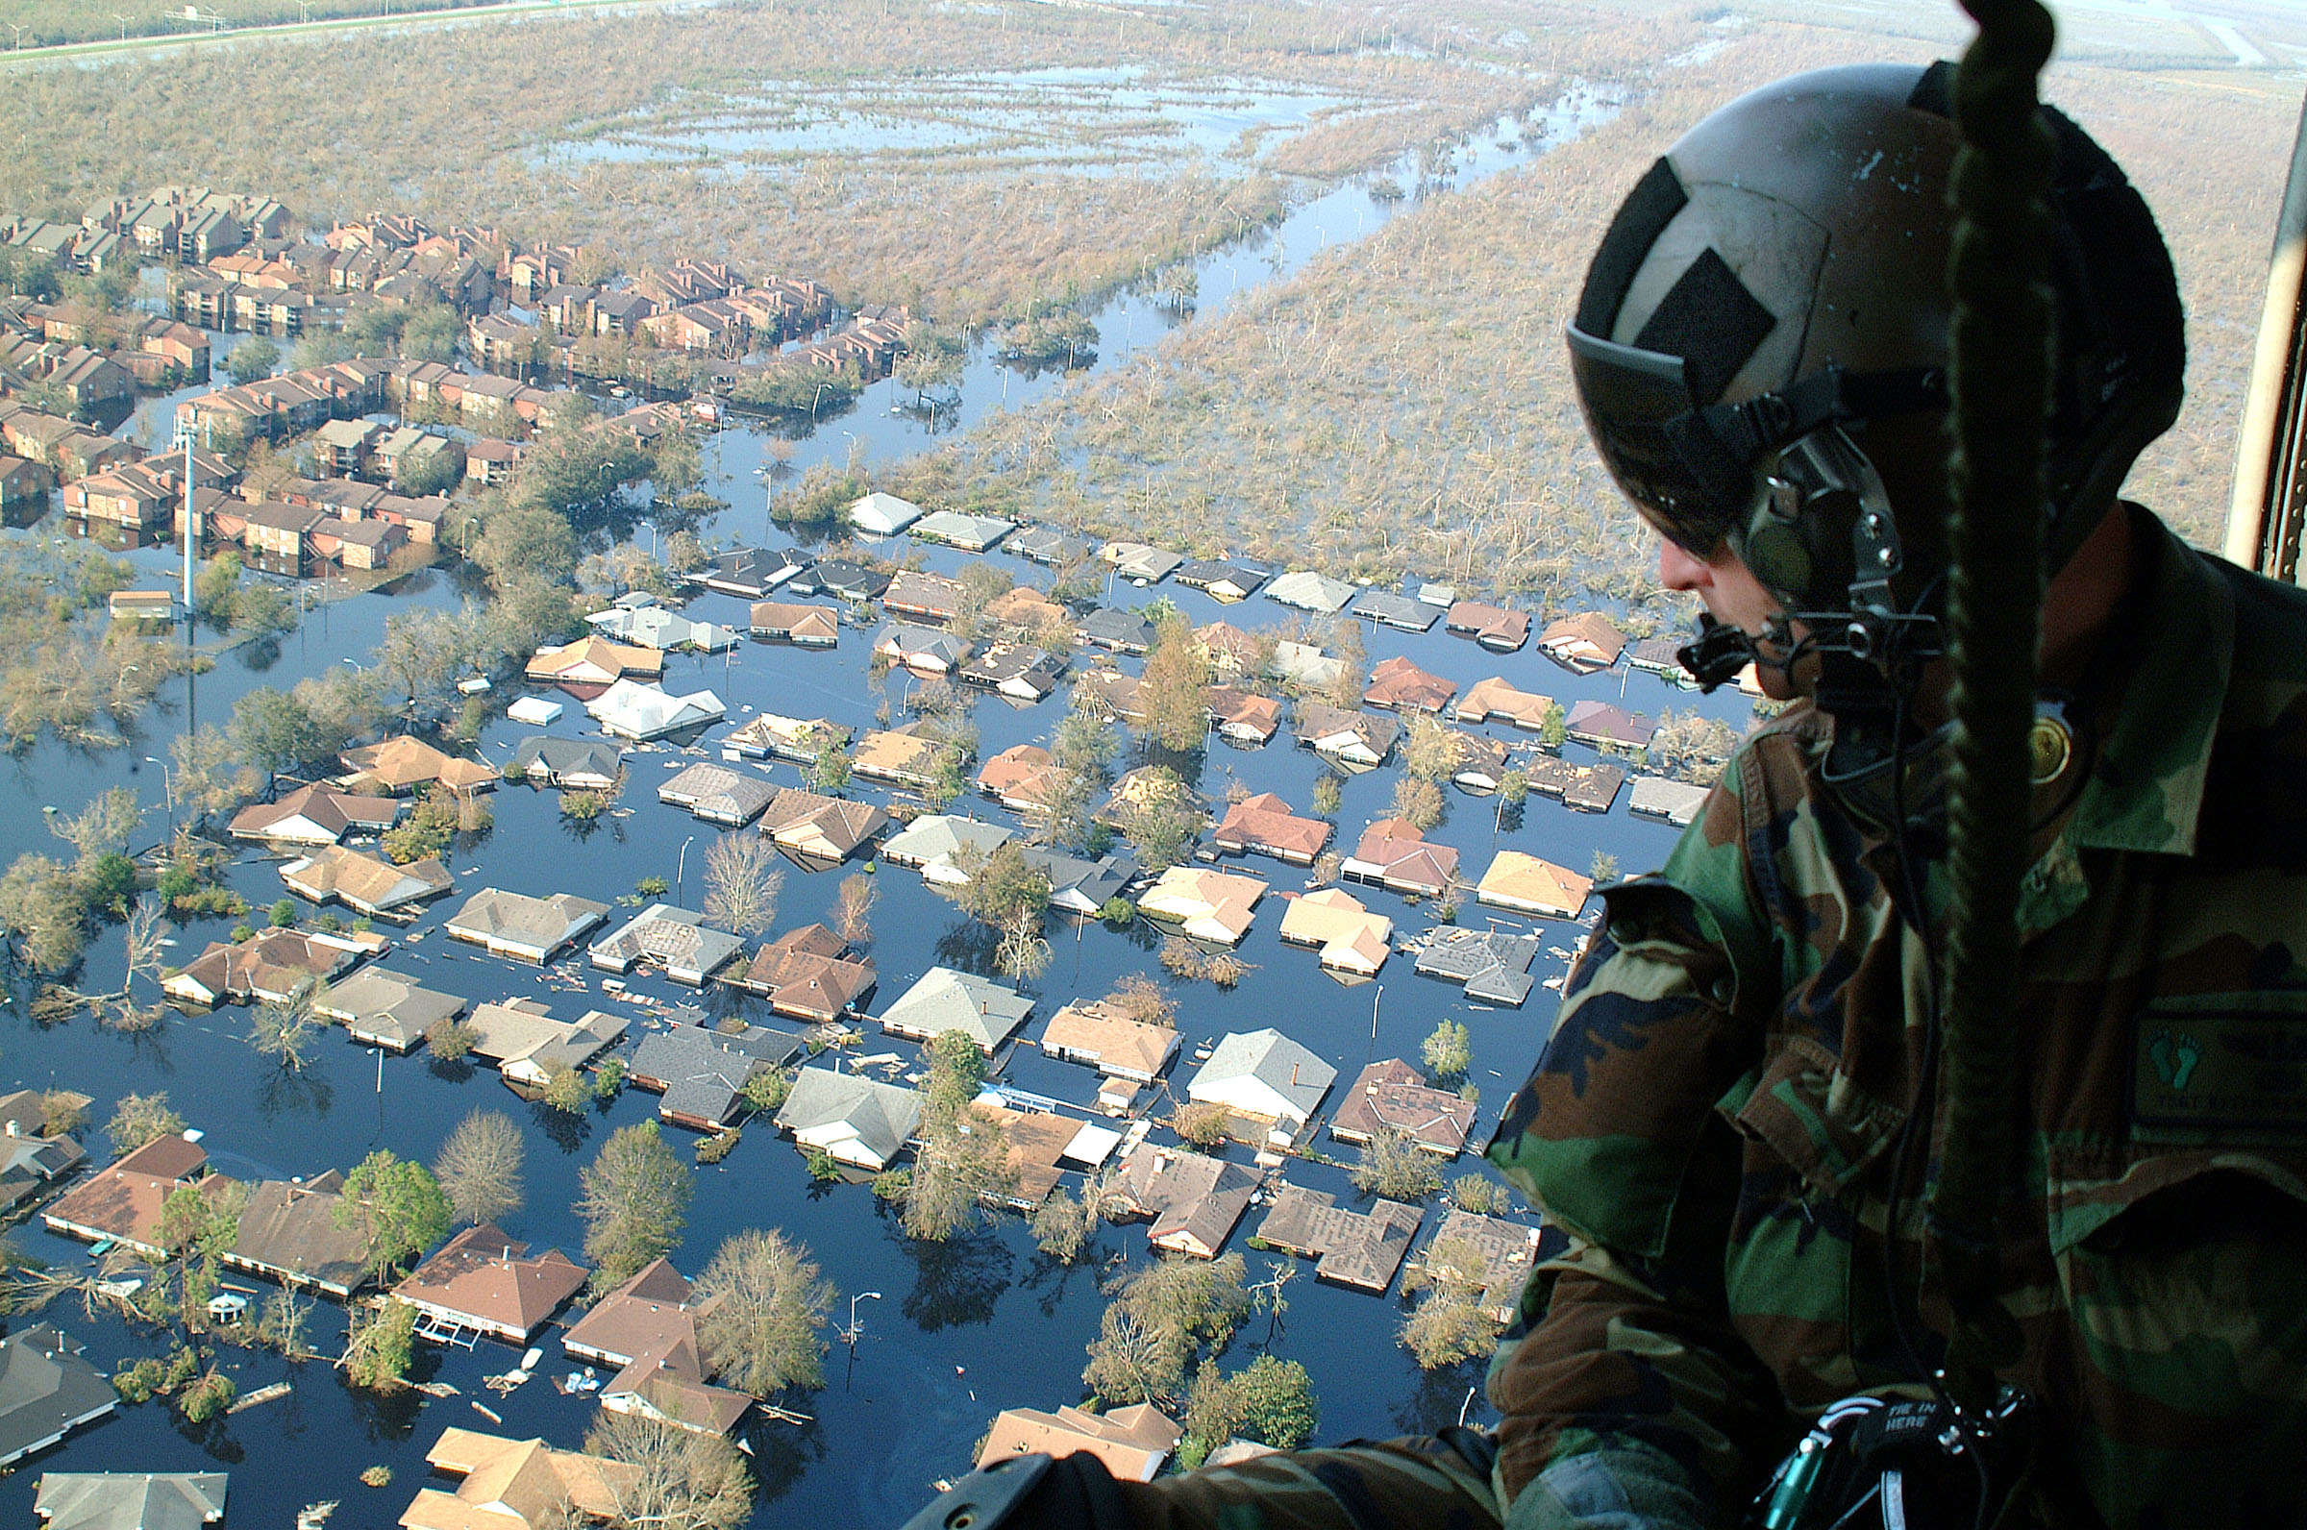

Slide 31

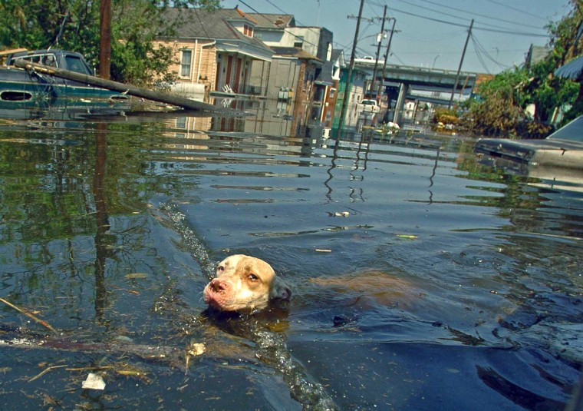

Slide 33
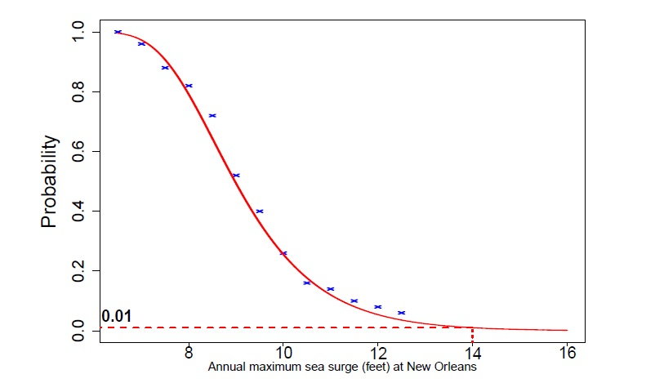
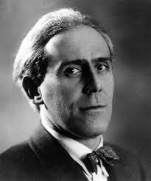


Slide 34

Careers

Slide 35
What careers can Maths lead to?
Meteorologist
Stockbroker
Logistics Manager
Accountant
Teacher
Mathematical Modelling
Economist
Engineer
Researcher
Business Analyst
Statistician
Actuary
Cryptanalyst
Notes:
As a mathematician you can acquire problem-solving and analytical skills that can be put to use in the real world.
*open to audience*
“What jobs could you walk into with a strong background in maths?”
Meteorologist
Meteorologists study the atmosphere and the weather with a focus on climate. They forecast weather, analyse climate change and air pollution and develop new techniques for the measurement and analysis of meteorological occurrences.
Stockbroker
Stockbrokers invest money for individuals and organisations by buying and selling on the stock market.
Mathematical Modelling
A mathematical modeller employs mathematical language to describe a system. An example of this is Computational Fluid Dynamics, which uses maths to describe particularly complex situations involving fluid flow. An application of this is in film visual effects. Think of the waves in a computer-generated sea. The challenge is to reach a middle-ground between processing time and accurately approximating the system, otherwise films would take too long to make!
Logistics Manager
Logistics managers handle processes involved in a supply chain, liaising with a variety of parties including suppliers of raw materials, manufacturers, retailers and consumers.
Statistician
Statisticians collect, analyze, and interpret numerical data; working in both the public and private sector.
Accountant
Chartered accountants are responsible for financial reporting, taxation, auditing, forensic accountancy, corporate finance and insolvency. They play a strategic role by providing professional advice; aiming to maximize profitability on behalf of their client or employer. They work in many different settings, including private practice firms, industry, commerce and the public sector.
Actuary
An actuary is a business professional who analyzes the financial consequences of risk. Actuaries use mathematics, statistics and financial theory to study adverse future events, especially those of concern to insurance and pension programs. They evaluate the likelihood of those events and mitigate the impact of events as they occur.

Slide 36
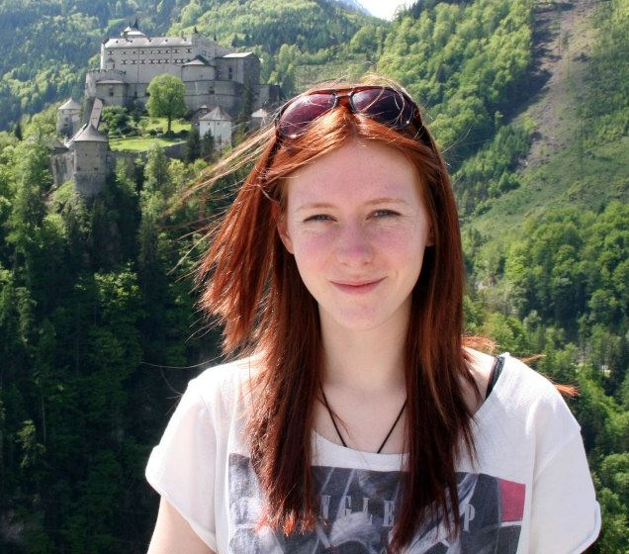
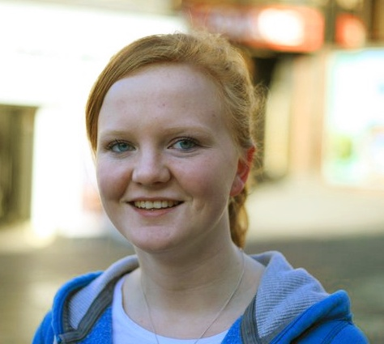
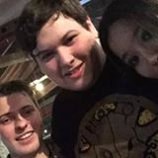
Graduate profiles
Jess
Kathryn
Kieren
Graduated in 2013, BSc
Technology Graduate at BBC
Graduated in 2014, MMathStat
Atomic Weapons Establishment
Graduated in 2015, MMathStat
Computer games engineer at Jagex Games

Slide 37












Employers

Slide 38
Maths @ NCL

Slide 39
Single Honours Degrees
Single Honours
3 Year Degree
4 Year Degree
BSc Maths & Stats (Hons)
BSc Maths (Hons)
MMathStat (Hons)
BSc Statistics (Hons)
MMath (Hons)

Slide 40
1st Year Structure
Semester 1
Semester 2
Multivariable Calculus and Differential Equations
Introduction to Calculus
Linear Algebra: Vectors and Matrices
Probability and Statistics
Sets and Counting
Problem Solving and Computing I
Optimisation with Constraints
Number Systems
Problem Solving and Computing II
Dynamics
Key:
Inner
Outer
Optional
Notes:
Inner core: MAS16**, Sets and counting: MAS17**, Problem solving modules: MAS18**, Optional: MAS19**

Slide 41
2nd Year Structure
Semester 1
Pure Mathematics
Pure Mathematics
Applied Mathematics
Applied Mathematics
Statistics
Statistics
Group Project
Computing
Careers Management
Semester 2

Slide 42
3rd Year Modules
Stochastic Calculus & Applications
Foundations of Group Theory
Coding Theory
Linear Analysis
Topology
Geometries & Designs
Groups, Graphs & Symmetry
Number Theory & Cryptography
Survival Analysis
Statistical Modelling
Markov Processes
Bayesian Inference
Randomised Clinical Trials
Discrete Stochastic Modelling
Applied Probability
Multivariate Data Analysis
Stochastic Financial Modelling
Time Series & Forecasting
Partial Differential Equations with Applications
Instabilities, Turbulence & Scaling
Electromagnetism
Variational Methods
Numerical & Computational Modelling
Quantum Mechanics
Introduction to Fluids
Differential Equations and Fields

Slide 43

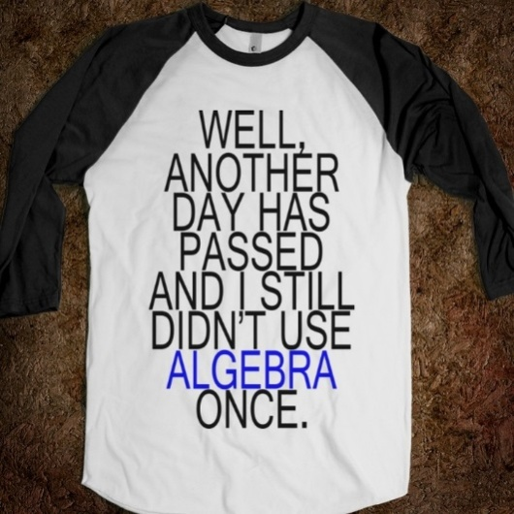

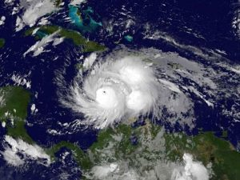
4th Year Project
Quantum Ferrofluid Hedgehogs
C*-algebras
Particle Orbits around Black Holes
Statistical Modelling of Environmental Extremes

Slide 44
Learning & Assessment
Learning
Assessment
Lectures
Seminars
Assignments
CBAs (Numbas)
Office Hours
Problems Classes
Projects
Presentations
Computing Practicals
Drop Ins
Exams
Mid Semester Tests

Slide 45
Support
Current Maths Student
Regular contact through emails
Buddy
Module Selection & Registration
Academic & Personal issues
Personal Tutor
Transition Officer
School teacher
Pastoral care
Undergraduate Secretary
Personal Issues
Exams & Assignments
Student Wellbeing
Financial Matters
Counselling

Slide 46
Typical Week
 | 9-10 | 10-11 | 11-12 | 12-1 | 1-2 | 2-3 | 3-4 | 4-5 | 5-6
Mon
Tues
Wed
Thurs
Fri
L
L
L
L
PC
L
L
PC
L
PC
S
L
Sports and Societies
L
L
PC
L
L
PC

Slide 47
Opportunities Abroad
Opportunities Abroad
Work placement
Study abroad
Year Out
All degrees
All degrees
Not Graded
Graded

Slide 48
Newcastle: City and Social

Slide 49




“More than just a degree...”
Freshers’ week: the week before classes start
Clubs and societies
Sport: Athletic Union, Intra-mural, “Go play”
Internships, paid work and voluntary work

Slide 50
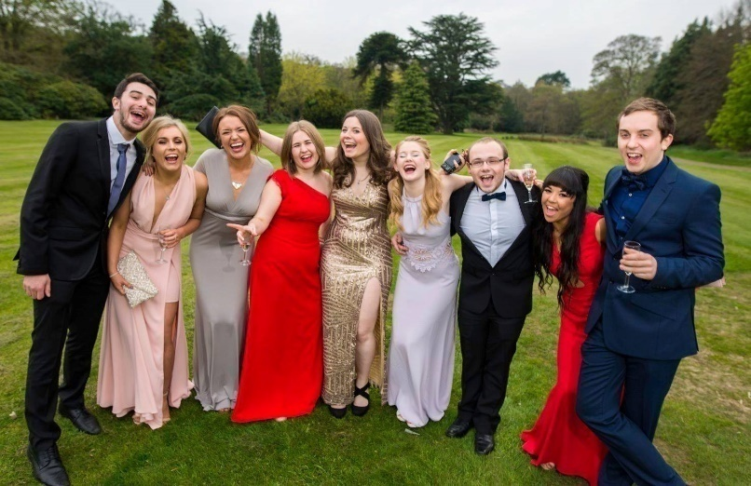
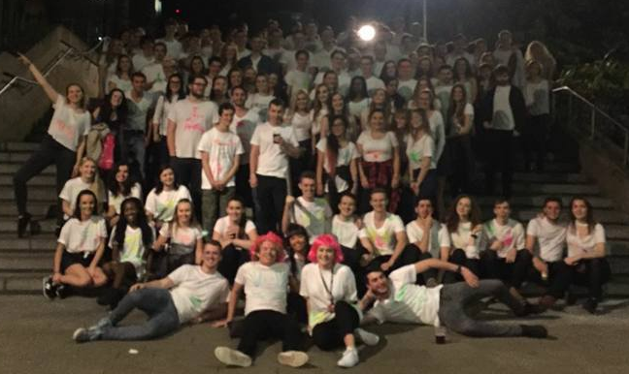
MathSoc
Summer Ball
Public Talks
Sports teams
Holidays Abroad
Ice Skating
Bar Crawls
Bowling
Charity Fundraising
Pub Quizzes

Slide 51
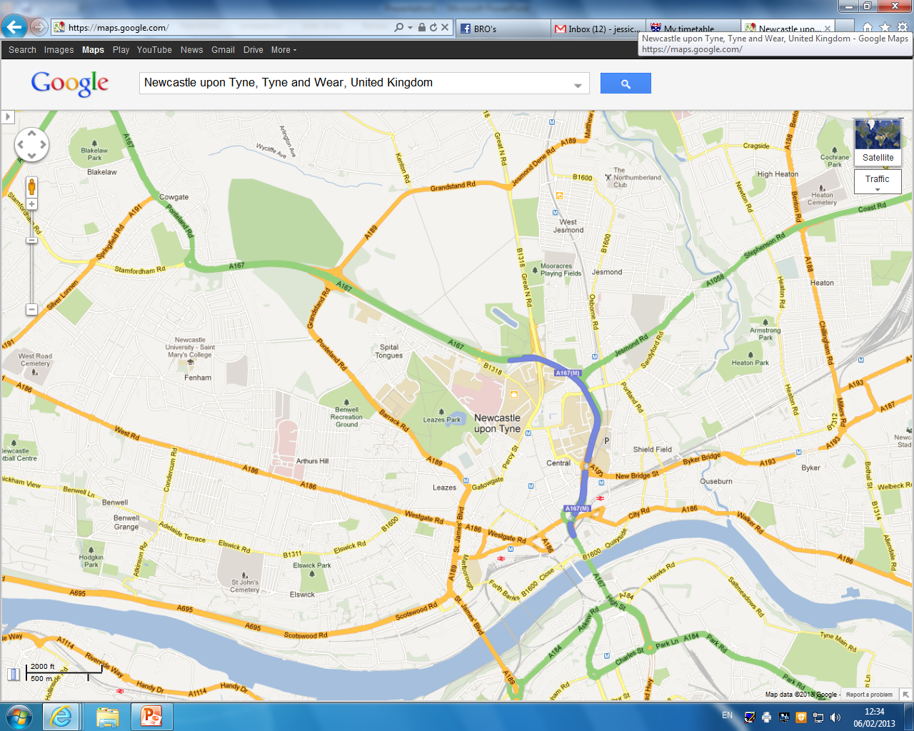

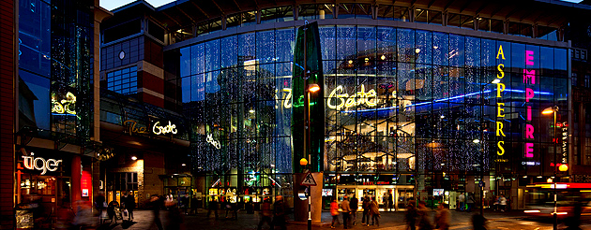
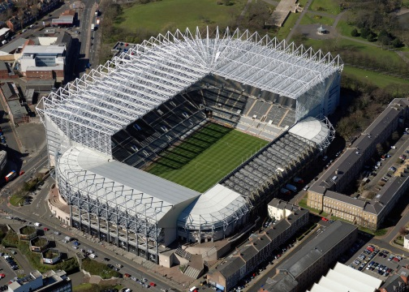

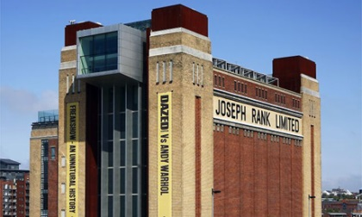
In and around Newcastle
Newcastle University
The Gate
St James’ Park
Metro Radio Arena
The Baltic

Slide 52
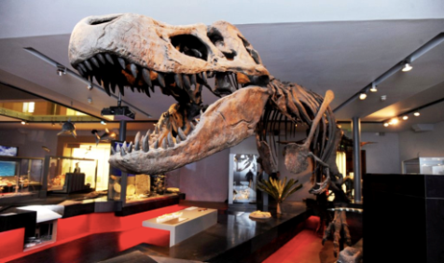
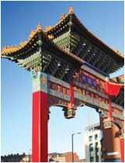
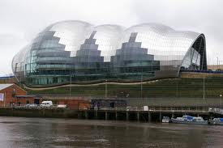

In and around Newcastle
Newcastle University
Hancock Museum
China Town
Tyneside Cinema
Theatre Royal
The Sage

Slide 53
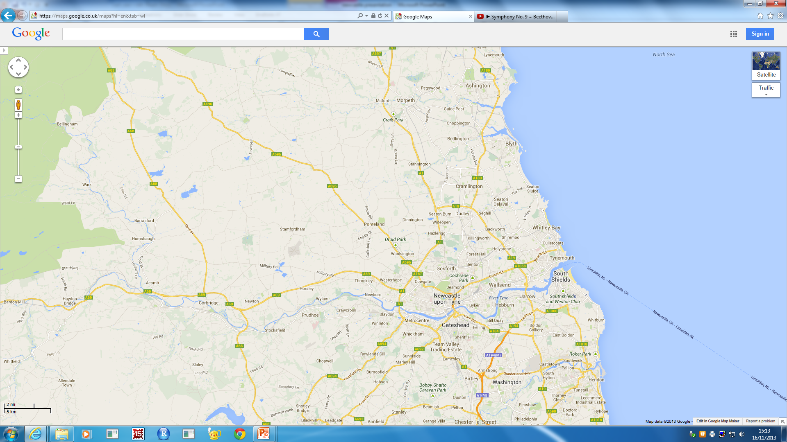
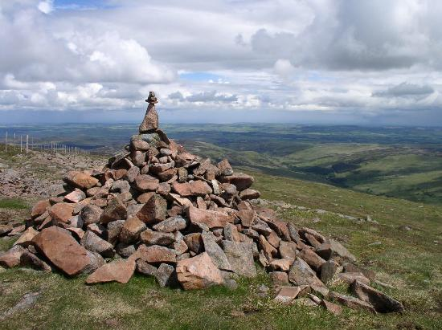
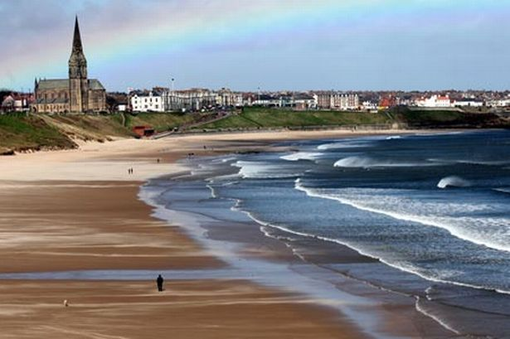

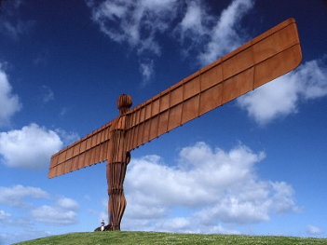
In and around Newcastle
To Northumberland National Park
Tynemouth Beach
Newcastle
South Shields
Metrocentre
Angel Of The North

Slide 54
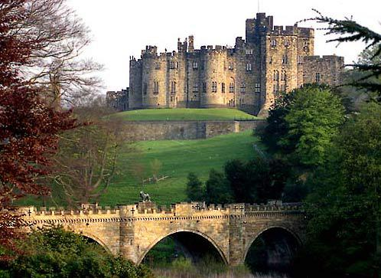
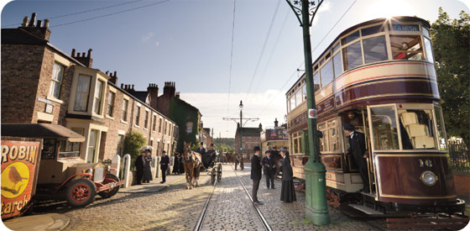
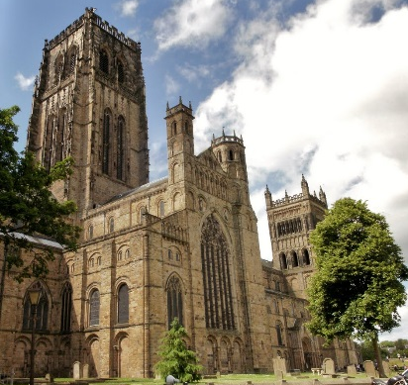
In and around Newcastle
To Alnwick Castle & Gardens
Segedunum Roman Baths
Newcastle
To Durham Cathedral
Beamish Museum

Slide 55
Final words...

Slide 56
Offers and admissions
Typical Offers
“A level Monday”
Maximise your chances
AAA-AAB, depending on course applied for
Three piles: 1. Accept 2. Near miss 3. No way!
Make us your “firm choice”
Personal statement: Passion!
Apolyterion from both public and private schools now considered
My hardest job: Prioritise students in pile #2!!
Take one of our summer projects on offer!

Slide 57
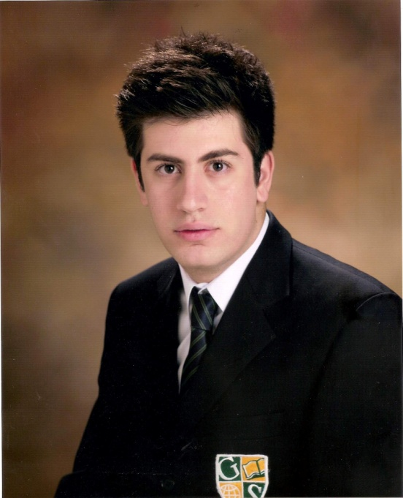
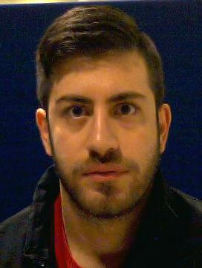
Georgios Melios
“
Top ranking University
City nightlife AMAZING!
Compact city – everything is within walking distance!
University facilities are amazing!
Excellent library services
”

Slide 58
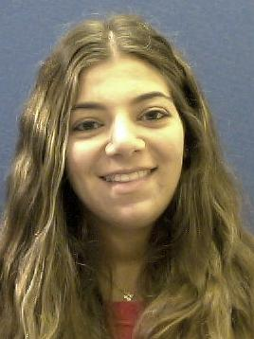
Demetra Demetriou
“
Courses are high-ranking
Very exciting University life
So many events for Freshers, and so easy to meet other people
Everything is within walking distance and the campus is right in the heart of the city
Newcastle University ALWAYS considers the needs of its students
Everyone I know at Newcastle loves it – University and the city!
”

Slide 59
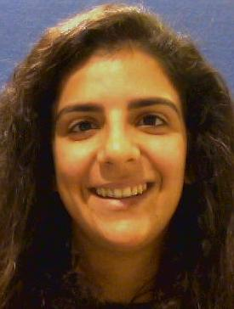
Sarah Koullapi
“
I chose Newcastle University mainly because it provides me the maximum exemptions for the charted and certified accounting diplomas
The city is so compact and you don’t ever have to use transport
Newcastle is a cheap city, especially in comparison to London or Manchester
Most of the people at the university are friendly and helpful.
Accommodation excellent!
”

Slide 60



Keep in touch
Follow
‘@NCLMathsStats’
Email
‘maths.physics@ncl.ac.uk’
Visit
‘www.ncl.ac.uk/maths’

Slide 61
Any questions?
@NCLMathsStats

