Slide 1
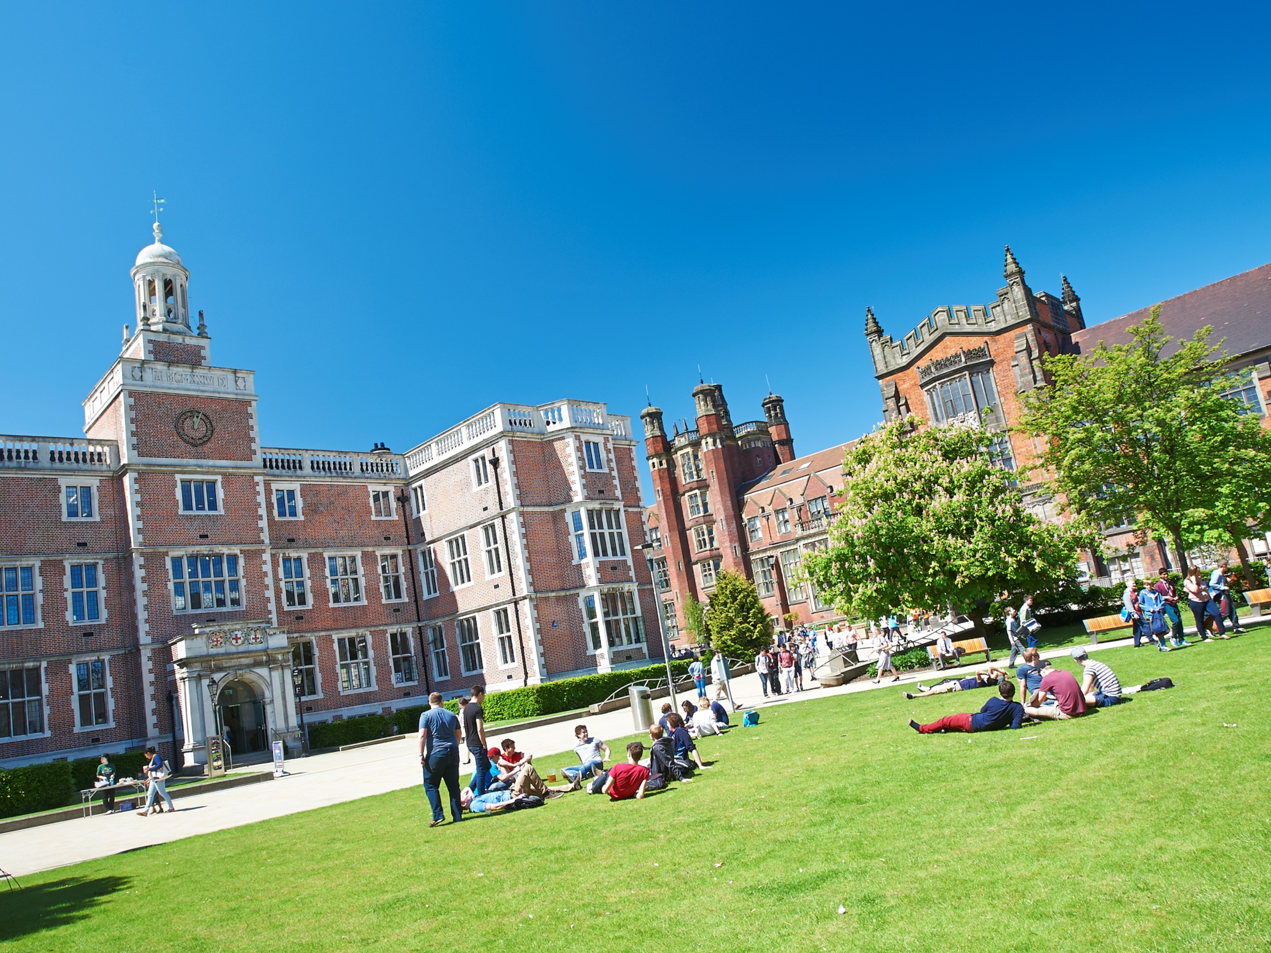

Studying Mathematics @
Newcastle University
Lee Fawcett
)

Slide 2
Introductions
Statistics Lecturer
Why Cyprus?
This talk
Teach: 1st year, 2nd year and 4th year undergraduates
Cypriot students at NCL are hard-working…
Degrees in Mathematics & Statistics
Research: Statistical models for extremes
...highly motivated… aspirational…
Student Finance (a little… Brexit uncertainty!)
Outreach: Tell people how good maths is!
We want more of you at Newcastle!
Newcastle: Accommodation and the City

Slide 3
Degree programmes in
Mathematics & Statistics
)

Slide 4
Single Honours Degrees
Single Honours
3 Year Degree
4 Year Degree
BSc Maths & Stats Hons
BSc Maths Hons
MMathStat Hons
BSc Statistics Hons
MMath Hons
Notes:
Rima – whole slide

Slide 5
Other Types of Degree
Major/Minor
Maths with Finance
Maths with Management
Maths and Psychology
Economics and Maths
Accounting and Maths
Joint Honours
Notes:
Tom – whole slide

Slide 6
University Credits
120 Credits in Each Year
100 Hours per 10 Credits
Lectures
Revision and Exam
Term-time Assessments
Notes:
Rima – whole slide

Slide 7
Single Honours Structure
1st Year
2nd Year
3rd Year
4th Year
MAS
1601
MAS
1602
MAS
2701
MAS
2702
MAS
2703
MAS 8091
MAS
1701
MAS
1801
MAS
1901
MAS
2801
MAS
2802
MAS
2803
MAS
1603
MAS
1604
MAS
2901
MAS
2902
MAS
2903
MAS
1702
MAS
1802
MAS
1902
MAS
2601
MAS
2603
MAS
2602
Key:
Inner
Outer
Optional
Key:
Computing
Pure
Applied
Statistics
Optional
Notes:
Tom – Whole slide

Slide 8
1st Year Structure
Semester 2
Semester 1
Multivariable Calculus and Differential Equations
Introduction to Calculus
Linear Algebra: Vectors and Matrices
Probability and Statistics
Logic, Sets and Counting
Problem Solving and Computing I
Dynamics
Number Systems
Problem Solving and Computing II
Optimisation with Constraints
Key:
Inner
Outer
Optional
Notes:
Rima – whole slide

Slide 9
2nd Year Structure
Semester 1
Linear Algebra
Complex Variable
Algebra
Vector Calculus
Differential Equations
Transforms, Waves and Fluid Dynamics
Introduction to Statistical Inference
Stochastic Modelling
An Introduction to Bayesian Methods
Semester 2
Notes:
Rima – Whole slide

Slide 10
2nd Year Structure
Semester 1
Linear Algebra
Complex Variable
Algebra
Vector Calculus
Differential Equations
Transforms, Waves and Fluid Dynamics
Introduction to Statistical Inference
Stochastic Modelling
An Introduction to Bayesian Methods
Group Project
Careers Management and Mathematical Skills
Computing
Semester 2
Notes:
Rima – Whole slide

Slide 11
3rd Year Modules
Stochastic Calculus & Applications
Foundations of Group Theory
Coding Theory
Linear Analysis
Topology
Geometries & Designs
Groups, Graphs & Symmetry
Number Theory & Cryptography
Survival Analysis
Statistical Modelling
Markov Processes
Bayesian Inference
Randomised Clinical Trials
Discrete Stochastic Modelling
Applied Probability
Multivariate Data Analysis
Stochastic Financial Modelling
Time Series & Forecasting
Partial Differential Equations with Applications
Instabilities, Turbulence & Scaling
Electromagnetism
Variational Methods
Introduction to Numerical & Computational Modelling
Quantum Mechanics
Introduction to Fluids
Differential Equations, Transform Methods & Fields
Notes:
Tom – Whole slide

Slide 12
4th Year Project
Before 4th year
Introductory presentation
Given topic choices
Meetings with potential supervisors
Give list of choices
Summer
Given topic of study
Meeting with confirmed supervisor
Begin research/collect data
1st Semester
Regular meetings with supervisor
Project gets going
Give presentation on topic
2nd Semester
Finalise report and hand in
Report starting to take shape
Produce a poster summarising work
Notes:
Tom – Whole slide

Slide 13




4th Year Project
Quantum Computing
Quantum Ferrofluid Hedgehogs
Analysis of Sport Data
Galactic Winds
Ext Functors
Comparative Gene Location Analysis
Notes:
Tom – whole slide

Slide 14
Learning and Assessment
Inner Core
Learning
Assessment
Lectures
Problems Classes
Assignments
CBAs
(Numbas)
Seminars
Computing Practicals
Projects
Presentations
Office Hours
Drop Ins
Mid Semester Tests
Exams
Notes:
Tom – Learning methods
Rima – Assessment methods (and mention of how some modules contain all of these types of learning and assessment)

Slide 15
Learning and Assessment
Mathematical Skills and Career Management
Learning
Assessment
Lectures
Problems Classes
Assignments
CBAs
(Numbas)
Seminars
Computing Practicals
Projects
Presentations
Office Hours
Drop Ins
Mid Semester Tests
Exams
Notes:
Rima – Whole slide (change the module to something relevant)

Slide 16
Grades and Weighting
Notes:
Tom – whole slide

Slide 17
Support
Current Maths & Stats Student
Regular contact through emails
Buddy
Module Selection & Registration
Academic & Personal issues
Personal Tutor
Support Staff
Undergraduate Secretary
Transition Officer
Student Wellbeing
Financial Matters
Counselling
Notes:
Tom – Buddy
Rima – Personal Tutor
Tom – Undergraduate Secretary
Rima – Student Wellbeing

Slide 18
Typical Week
 | 9-10 | 10-11 | 11-12 | 12-1 | 1-2 | 2-3 | 3-4 | 4-5 | 5-6
Mon
Tues
Wed
Thurs
Fri
L
L
PC
Notes:
Tom – Whole slide

Slide 19
Typical Week
 | 9-10 | 10-11 | 11-12 | 12-1 | 1-2 | 2-3 | 3-4 | 4-5 | 5-6
Mon
Tues
Wed
Thurs
Fri
L
L
DI
Notes:
Tom – Whole slide

Slide 20
Typical Week
 | 9-10 | 10-11 | 11-12 | 12-1 | 1-2 | 2-3 | 3-4 | 4-5 | 5-6
Mon
Tues
Wed
Thurs
Fri
L
L
L
PC
L
L
PC
L
PC
Notes:
Tom – Whole slide

Slide 21
Typical Week
 | 9-10 | 10-11 | 11-12 | 12-1 | 1-2 | 2-3 | 3-4 | 4-5 | 5-6
Mon
Tues
Wed
Thurs
Fri
L
L
L
DI
L
L
DI
L
DI
Notes:
Tom – Whole slide

Slide 22
Typical Week
 | 9-10 | 10-11 | 11-12 | 12-1 | 1-2 | 2-3 | 3-4 | 4-5 | 5-6
Mon
Tues
Wed
Thurs
Fri
L
L
L
L
PC
L
L
PC
L
PC
S
L
Sports and Societies
L
L
PC
L
L
PC
Notes:
Tom – Whole slide

Slide 23
Some words on
Student Finance
)

Slide 24
Tuition Fee Loan
Financial Body
Tuition Fees
Repayment
Funded by the country you apply to study in (e.g. England or Wales)
£9,250
(same for most)
Not until earning > £21,000
Investment in future
Not until after studying
Placement Years only pay £1,000

Slide 25
Loan Repayments
Not until you earn above £21,000
Payments stop if income falls below
Repayment
Not until you finish studying
Based on what you earn, not what you owe
Repay 9% of income above £21,000
Written off if not repaid within 30 years
Notes:
If you earned £25,000 a year then you would repay £30 a month, which is approximately the price of a phone contract.

Slide 26

Interest
Interest During Studies
Rate of Inflation (ROI) plus 3%
Interest After
Studies
Earn less than £21,000: ROI
Earn between £21,000 - £41,000:
ROI plus up to 3%
Earn above £41,000: ROI plus 3%

Slide 27
Maths & Stats Scholarships
Types:
Excellence Scholarship
Exceed Entry Requirement
Stage 4 Bursary
Year 2 and Year 3 Semester 1 mark above 70%
What you get:
£250 available for each grade above the requirement.
A* in Maths or Further Maths awarded an extra £250
Worth £1,000 per year of study
Note – You must have achieved your minimum grades, e.g. A*BB will not receive £250
Notes:
So if you got 3xA*, you would get 3x£250 for beating your requirements, plus 2x£250 for A*’s in Maths and Further Maths.

Slide 28
Living Costs
Phone bill
Accommodation
Toiletries
TV;
most halls don’t have TV licences
Clothes
Living Costs
Food
Insurance; belongings /
keys!
Study; recommended books
Travel;
To Uni / home / visit friends
Social Life

Slide 29
Money Management
Part time Job;
Recommended
15 hours
or less
Use campus facilities; Library, Sports centre, Union etc.
Budget!
If you can’t
afford it,
don’t do it!
Shop around
for
the best
deals
Make it go further
Interest free overdraft! Don’t be drawn in by freebies
Walk
or
get a student
travel pass
Student Discount: Restaurants,
Bars, Cinema
etc.
Buy books
second-hand
or
Use the library

Slide 30
Accommodation
at Newcastle
)

Slide 31
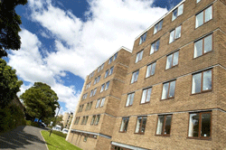
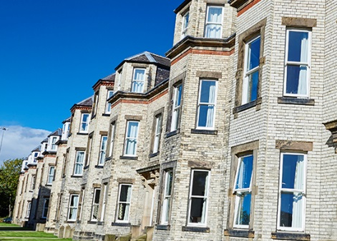
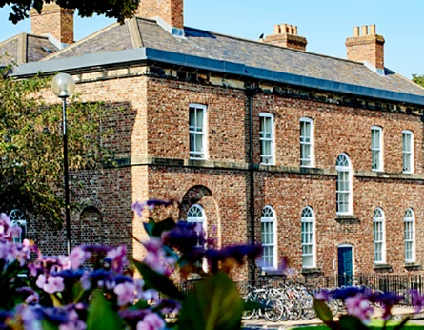
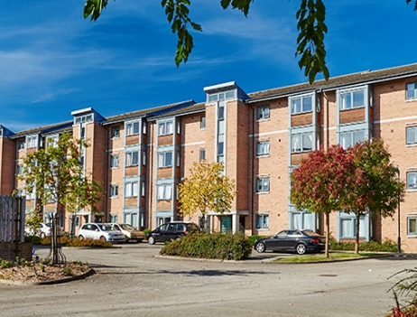
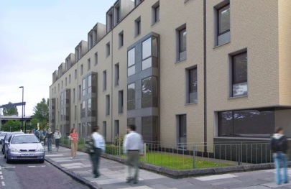
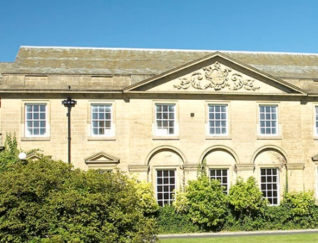
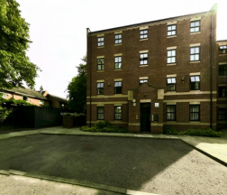
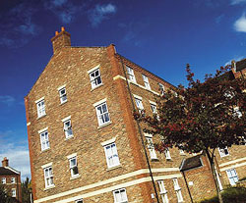
Castle Leazes
Kensington Terrace
Leazes Parade
The Halls
Bowsden Court
The Halls
The Halls
Park Terrace
St Mary’s
Windsor Terrace
Marris House

Slide 32
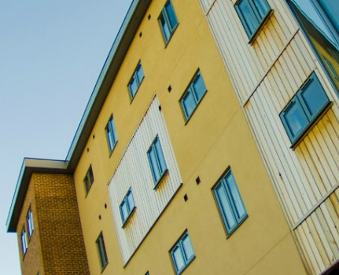
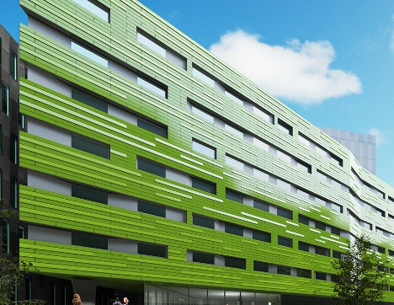
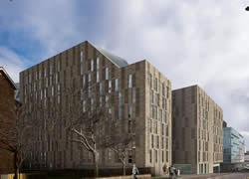
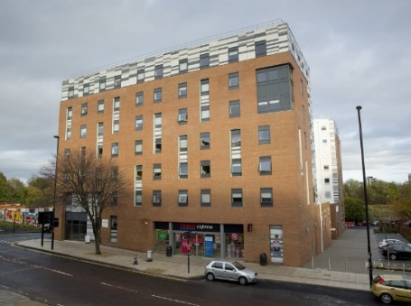
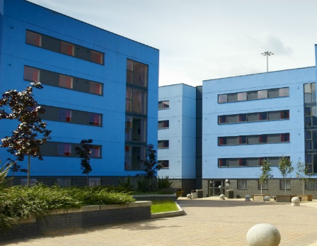
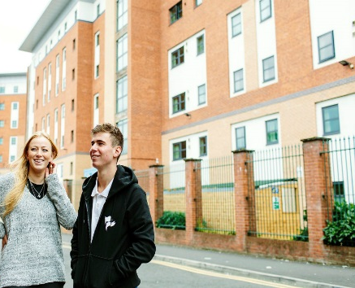
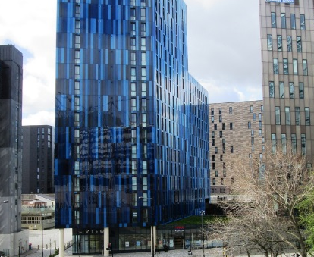
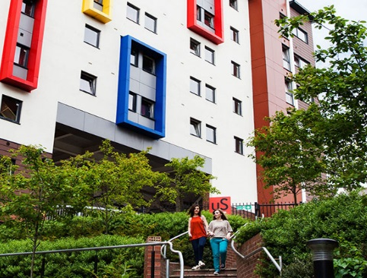
Barker House
Verde
Managed Partnership Accommodation
Liberty Plaza
The Halls
Turner Court
The Halls
Union State
Liberty Quay
The View
Manor Bank

Slide 33
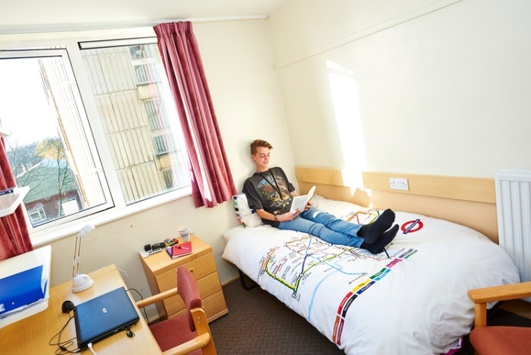
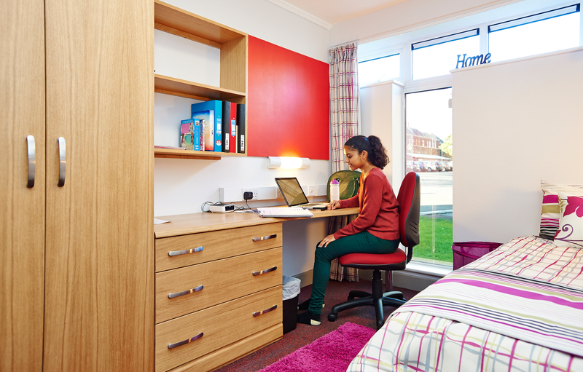
Typical Rooms
To find out more detailed information and view our virtual tours for each of our halls of residence visit:
www.ncl.ac.uk/accommodation

Slide 34



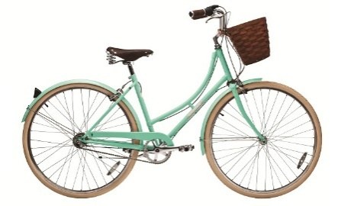
Included In All Halls
Free internet connection
Launderette
Holidays included
Bicycle Storage
24 hour security
Bills

Slide 35
Things To Consider
Self Catered/Catered
Affordability
Location
Mixed/Single Gender
Flat/Corridor Layout
Deluxe Room
Standard Washbasin Room
Smaller/Larger Community
Ensuite Room

Slide 36
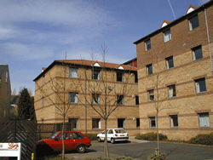


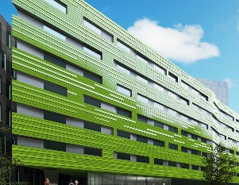
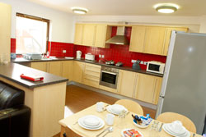
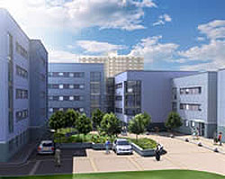
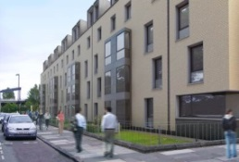
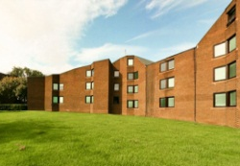
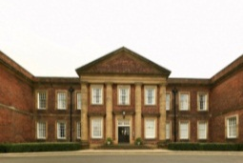

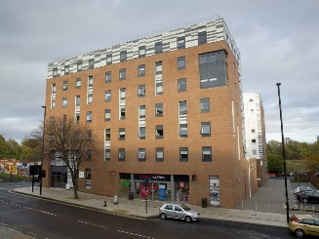



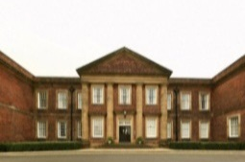

Comparing Price
Least Expensive- £83 p/w
Most Expensive- £167p/w
Bowsden Court
Victoria Halls
Park Terrace
Richardson Rd
Bowsden Court
Liberty Quay
Park Terrace
Verde
Castle Leazes
Castle Leazes
St Marys College
Marris House
Marris House
Marris House
St Marys College
Marris House
Turner Court
Union State
Richardson Rd
The View
St Marys College
Windsor Terrace
Leazes Parade
Manor Bank
Liberty Plaza

Slide 37

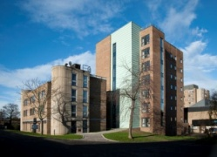
Comparing Size
Smallest - 50 rooms
Largest - 1100 rooms
St Marys College
Bowsden Court
Bowsden Court
Marris House
Castle Leazes
Bowsden Court
Leazes Parade
Turner Court
St Marys College
Castle Leazes
Victoria Halls
Windsor Terrace
Park Terrace
Richardson Rd
Liberty Quay
Park Terrace
The View
Liberty Plaza
St Marys College
Park Terrace
Castle Court
Marris House
Marris House
Richardson Rd
Castle Court
Marris House
Manor Bank
Union State
Verde

Slide 38
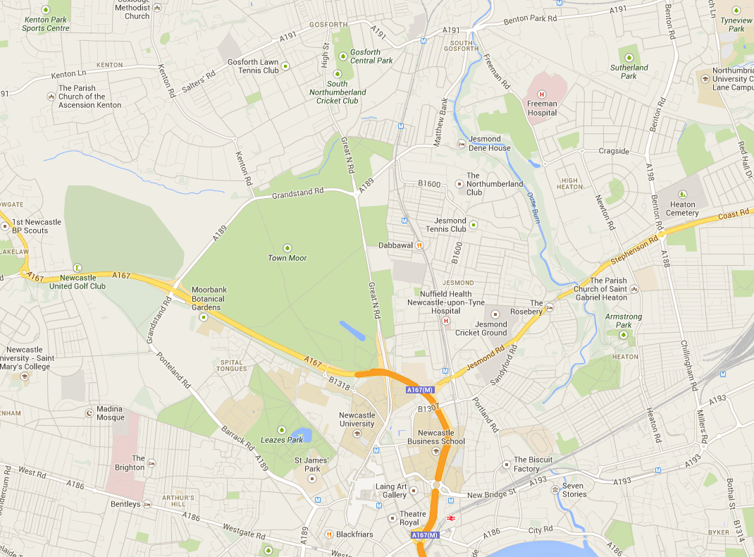

Routes from further away.
Bowsden Court
St Mary’s College
Park, Windsor & Kensington Terrace
Marris House
Castle Leazes, Castle Court & Leazes Parade
Newcastle University
Union State
Turner Court
Liberty Plaza, Verde & The View
Manor Bank & Liberty Quay

Slide 39









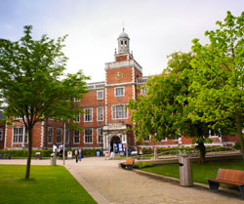
After Halls
Lots of student properties
Remember extra costs
Support available
Typically 12 month contracts

Slide 40
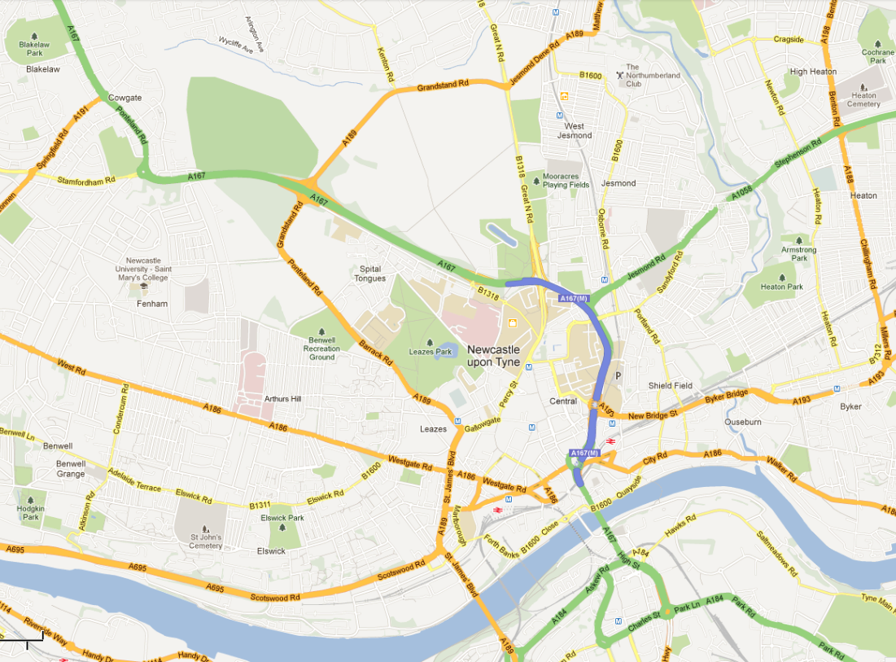
Jesmond
Spital Tongues
Heaton
Newcastle University
Fenham
Sandyford

Slide 41
Newcastle: City/Social
)

Slide 42
Clubs And Societies
Clubs & Societies
Sports
Societies
Athletic Union
Go Play
Give It A Go
Joining
Societies
Intra-Mural

Slide 43

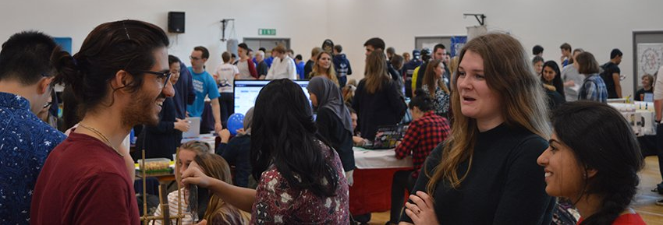
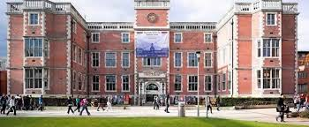

Joining
Freshers’ Fair
NUSU Website

Slide 44



Societies
Nearly 200 registered clubs and societies at Newcastle
Or you can create your own!
Dance
Twenty Minute Society
Greek/Hellenic

Slide 45
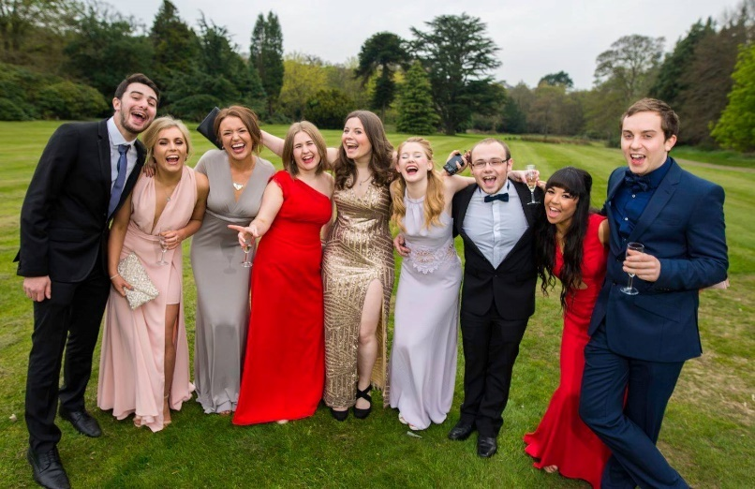
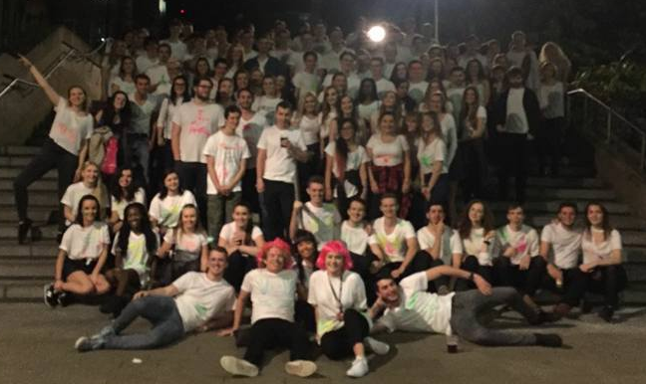
MATHSOC
Summer Ball
Public Talks
Sports teams
Holidays Abroad
Ice Skating
Bar Crawls
Bowling
Charity Fundraising
Pub Quizzes

Slide 46
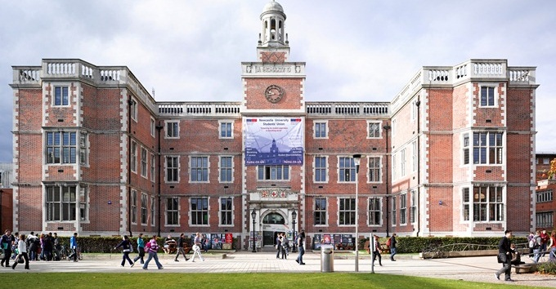
Students’ Union
£8 million refurbishment and was re-opened in 2011
Services
Student Radio
Advice Centre
Courier
Food & Drink
Starbucks
Mensbar
Domino’s
Subway
Organic Food Stall
Facilities
Computer Cluster
Union Shop
Bank
Venue

Slide 47
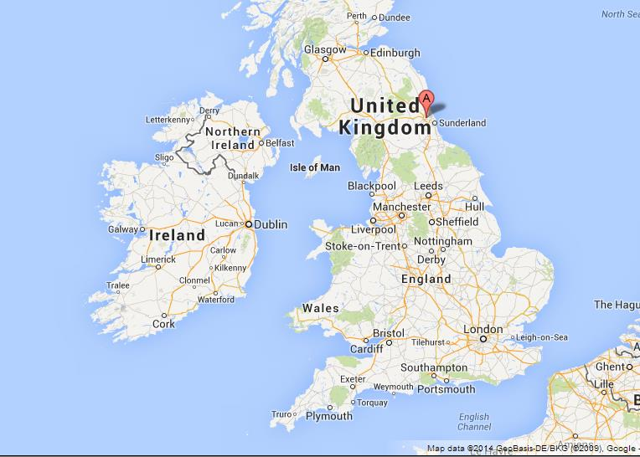
So where is Newcastle?

Slide 48

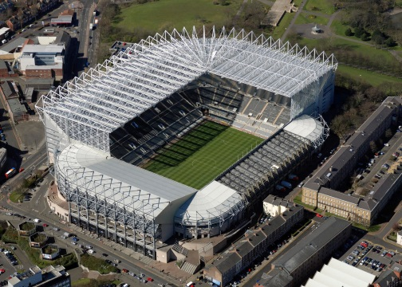

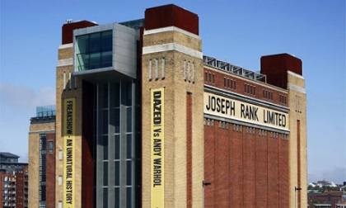
In And Around Newcastle
Newcastle University
The Gate
St James’ Park
Metro Radio Arena
The Baltic

Slide 49
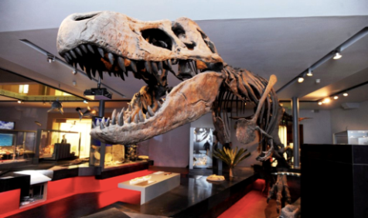

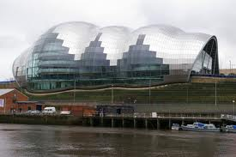
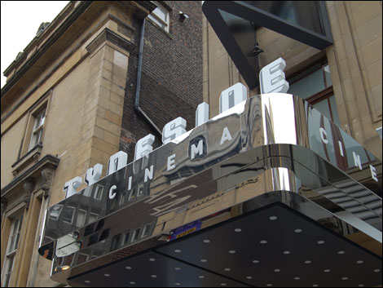
In And Around Newcastle
Newcastle University
Hancock Museum
China Town
Tyneside Cinema
Theatre Royal
The Sage

Slide 50
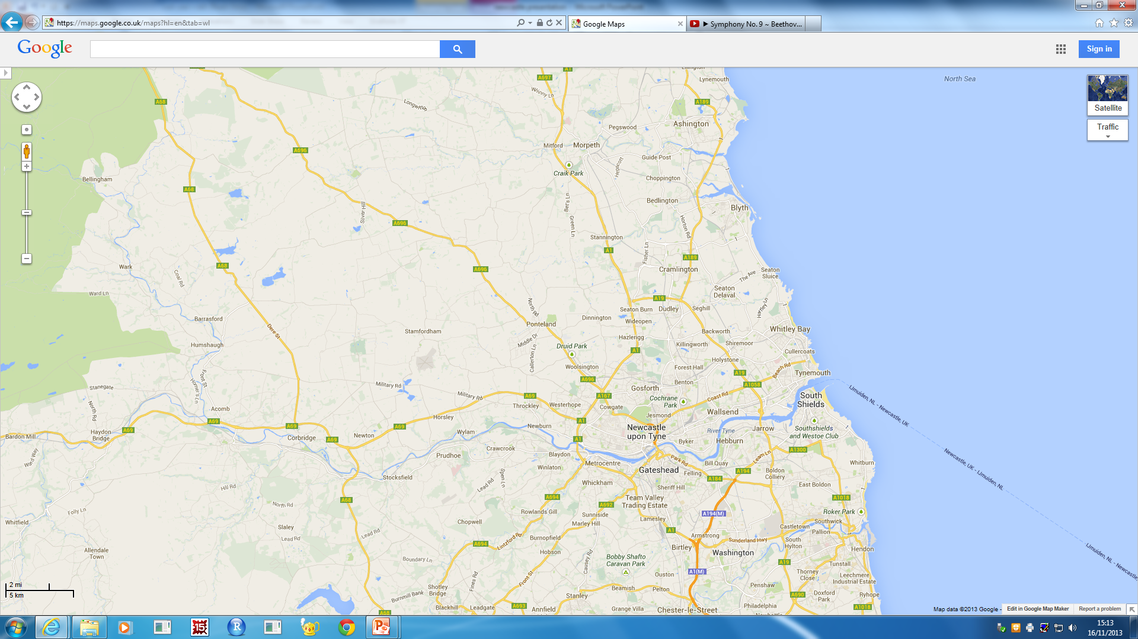
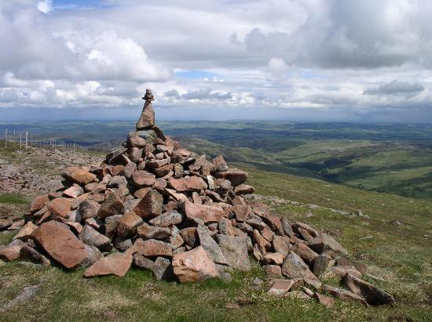
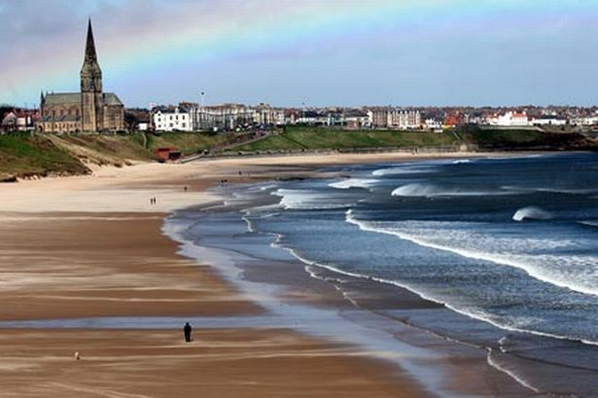


In And Around Newcastle
To Northumberland National Park
Tynemouth Beach
Newcastle
South Shields
Metrocentre
Angel Of The North

Slide 51
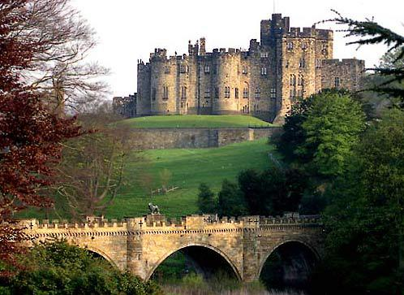

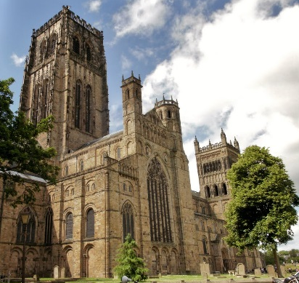
In And Around Newcastle
To Alnwick Castle & Gardens
Segedunum Roman Baths
Newcastle
To Durham Cathedral
Beamish Museum

Slide 52




In And Around Newcastle
SU
Pink Triangle
Newcastle
Bigg Market
Diamond Strip
Digital

Slide 53

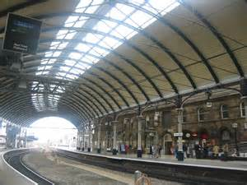


Local Transport
3 metro stations in Newcastle city centre, 1 directly opposite campus. Travel to the coast in 20 minutes
Central rail station providing local and national rail services
Newcastle International Airport flying to worldwide destinations
Ferry terminal going to Amsterdam and continental Europe

Slide 54

Facts and Figures
We are one of the
Top 20 ‘Most
Targeted’
universities by the UK’s
leading employers
(The Graduate Market Report 2012–13)
3rd in the UK for quality of staff and lecturers
Times Higher Education Student Experience Survey
6th in the UK for Student Satisfaction
Lloyds Bank Survey 2014
1st in the UK for Quality of Social Life
Lloyds Bank Survey 2014
4th in the UK for Quality of Student Life
Lloyds Bank Survey 2014
Top 1% of world universities
QS World University Rankings 2014/2015
95% of NCL students go into graduate employment or future study within first six months
13th in the world for our careers advice
out of 163 institutions
(International Student Barometer 2012)

Slide 55
Offers and Admissions
Typical Offers
“A level Monday”
Maximise your chances
AAA-ABB, depending on degree / A level subjects
Three piles: 1. Accept 2. Near miss 3. No way!
Make us your “firm choice”
Personal statement: Passion!
Other equivalents: e.g. 17 (overall) in Apolytirion + B
My hardest job: Prioritise students in pile #2!!
Take one of our summer projects on offer!

